Slide 2
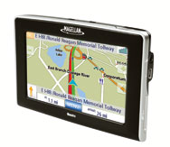
By Stephen Cass Monday, November 26, 2012
Talk to your gadgets
Link: http://discovermagazine.com/2008/nov/17-talk-to-your-gadgets
.

Slide 3

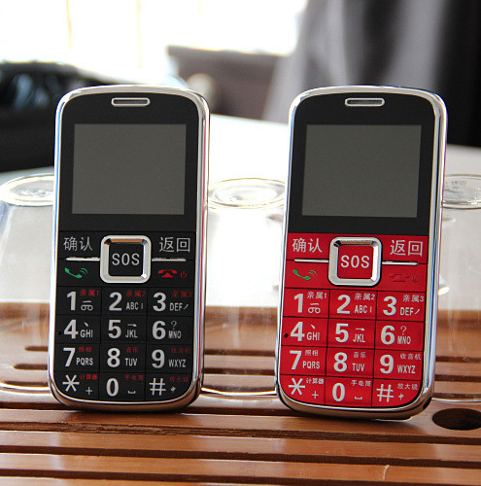

Slide 4
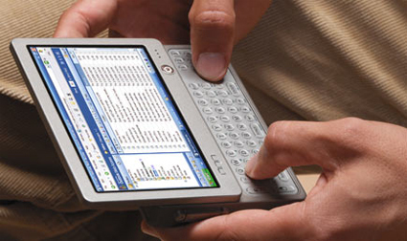

Slide 5
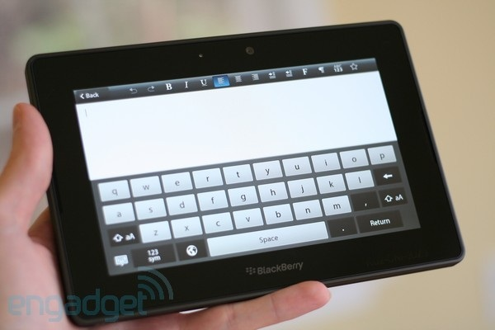

Slide 6
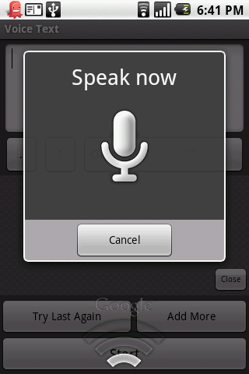


Slide 7


Slide 8


