Slide 1
Presented by:
Khalid MASOUDI
Lionel DEMANOU

Slide 2
Summary
Bionic drone bird
Talk to your Gadgets

Slide 3
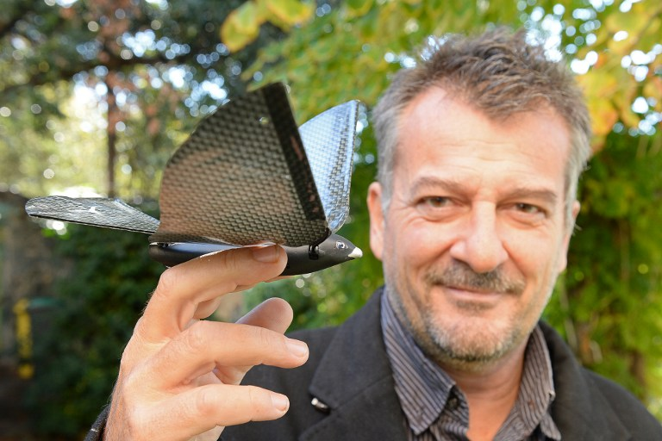
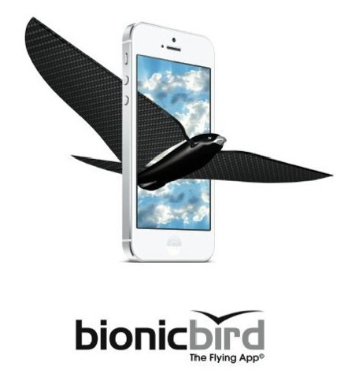
Bionic drone bird

Slide 4
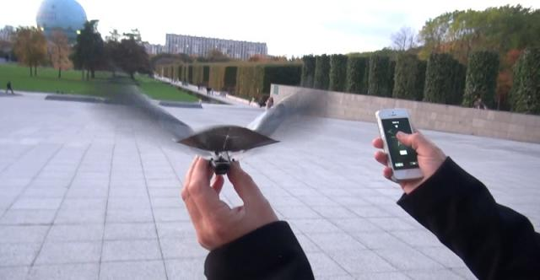
Bionic drone bird
Ready to fly
Available on IPhone
http://www.bbc.com/news/technology-30955444

Slide 5
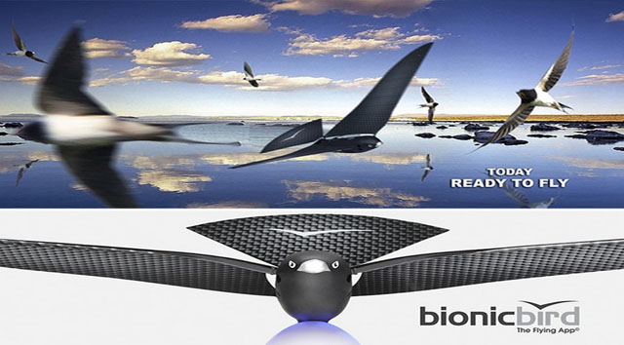
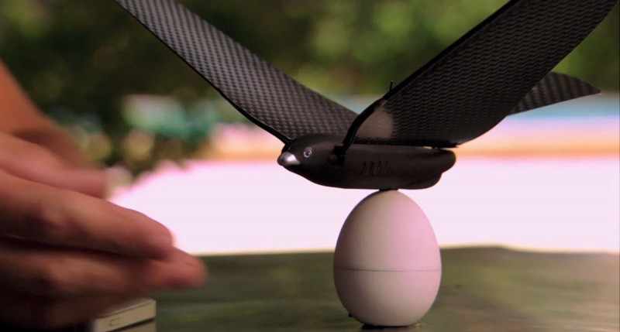
Bionic drone bird
Nature friendly
Smart design

Slide 6
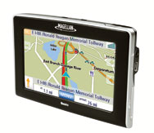
Talk to your gadgets​
​
By Stephen Cass Monday, November 26, 2012

