Slide 1
Presented by:
Khalid MASOUDI
Lionel DEMANOU

Slide 2
Summary
Talk to your Gadgets
Bionic drone bird

Slide 3
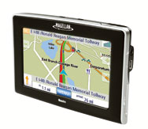
Talk to your gadgets
Link:
http://discovermagazine.com/2008/nov/17-talk-to-your-gadgets
http://gadgets.ndtv.com/videos/lg-lets-you-talk-to-your-home-appliances-332612
By Stephen Cass Monday, November 26, 2012

Slide 4
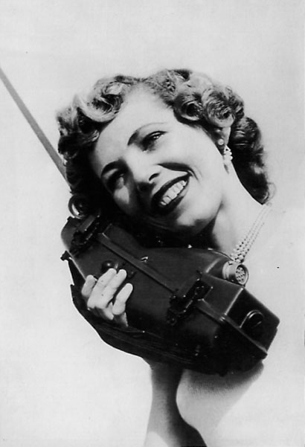
Just for call.
But, it is not to big

Slide 5
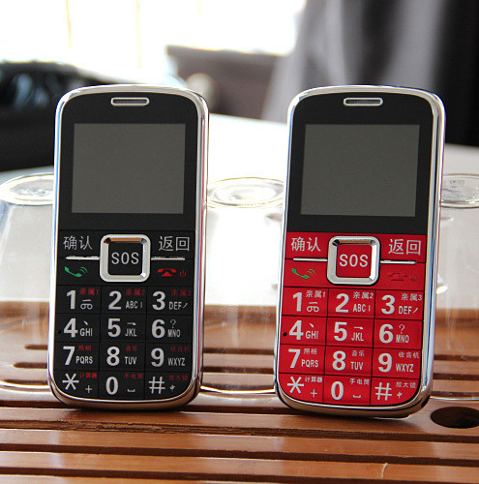
Cooooool,
We can send text.
But, screen is not to small

Slide 6
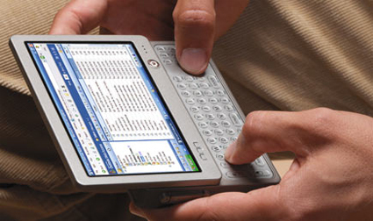
Good.
But, now keyboard is too small.

Slide 7
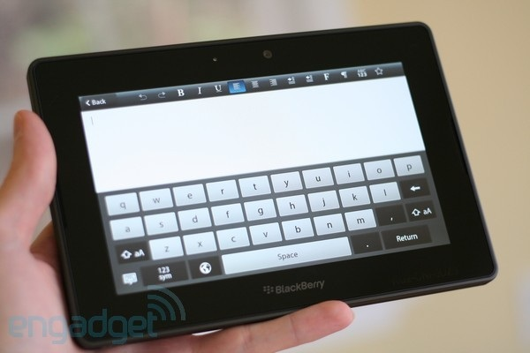
Better.
But, i’m tired to use keyboard.

Slide 8
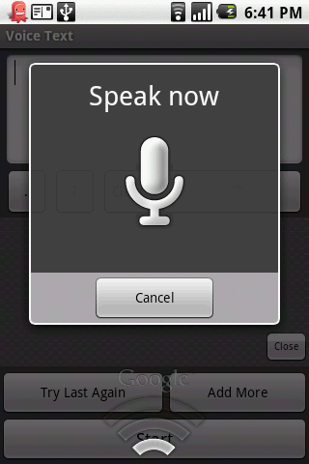

Ok.
But, it is not possible to do more?

Slide 9
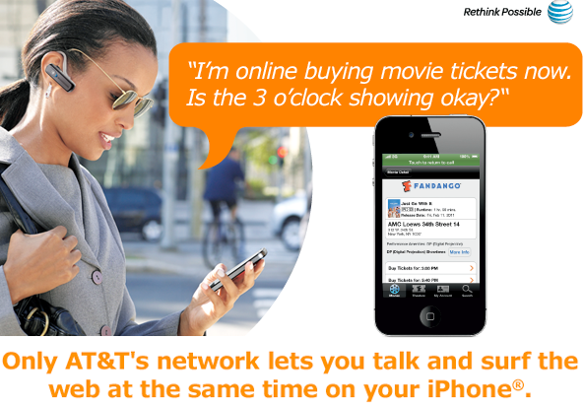
Wouaouuu.
Something next?

Slide 10
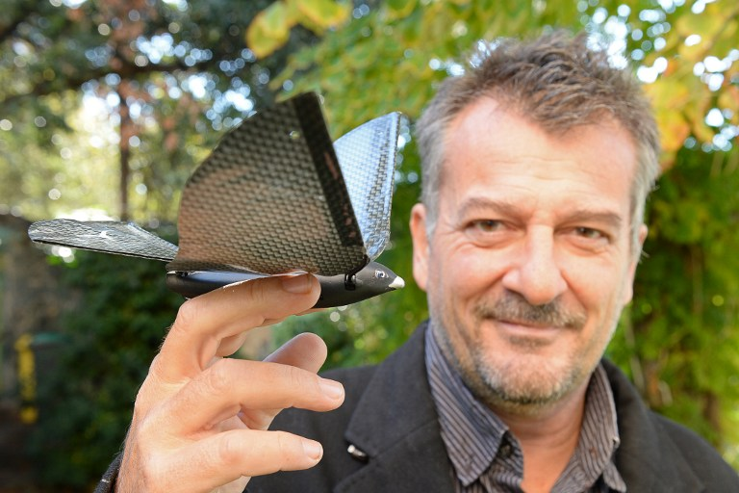
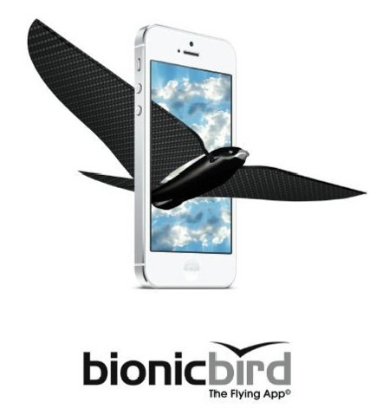
Bionic drone bird

Slide 11
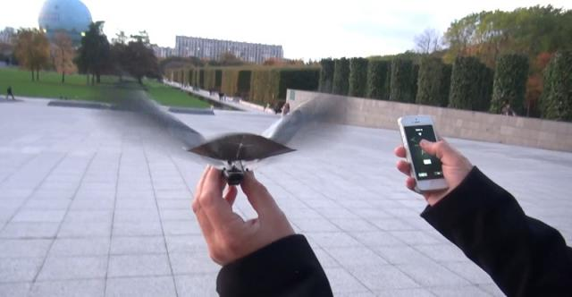
Bionic drone bird
Ready to fly
Available on IPhone
http://www.bbc.com/news/technology-30955444

Slide 12
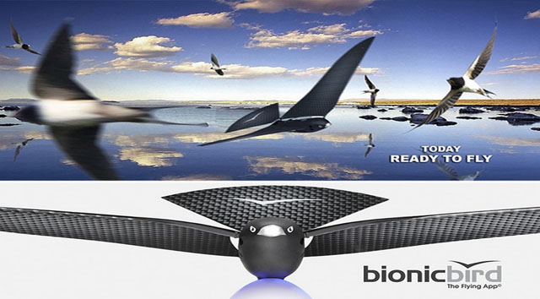
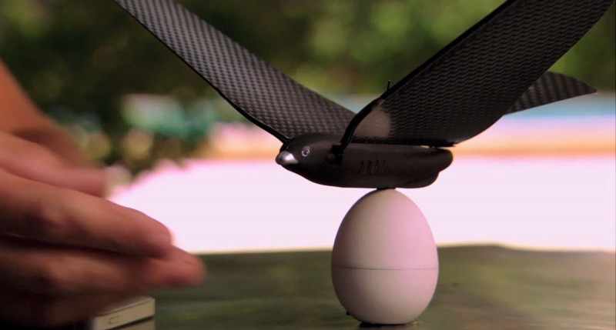
Bionic drone bird
Nature friendly
Smart design

