Slide 1
Introduction to citizen science data
Diana Bowler
Gfoe workshop,
29th August 2021

Slide 2
Outline
diversity of citizen science data
bias associated with each (site selection, reporting bias, detection issues …)
simple trend models

Slide 3
Diversity of citizen science
Structured data
Standardized sampling protocol
Site-selection – sometimes stratified random, often not
Semi-structured data
No standardized sampling protocol
Metadata associated with data informs on survey methods
Unstructured data
No standardized sampling protocol
Site selection – free
Site selection - free
Little metadata

Slide 4
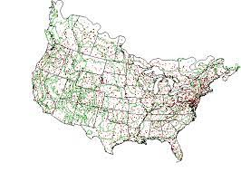


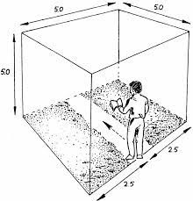
Structured citizen science
Analysis is (relatively) easy!!
Still can be site selection biases and missing data issues (see Bled et al. 2013; Sauer et al. 2020; bbBayes)
The North American Breeding Bird Survey

Slide 5

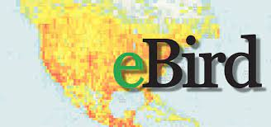





Semi-structured and structured data
Examples:

Slide 6
Semi-structured and structured data
Analysis more difficult!
People are not coordinated in their efforts
Variation among people in how they collect data

Slide 7
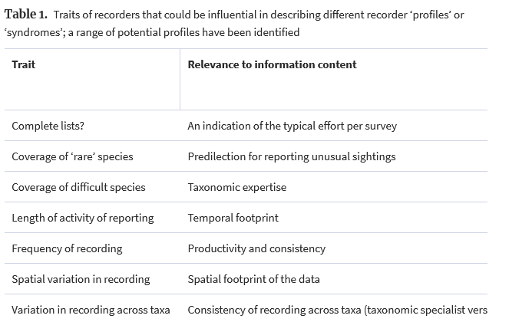
How do people vary in data collection?
Isaac and Pocock, 2015

Slide 8
Semi-structured and structured data
Analysis more difficult!
Need to consider observation/sampling processes:
People are not coordinated in their efforts
Variation among people in how they collect data
Need to model these observation/sampling processes
Estimating detection probability
‘Imperfect detection’

Slide 9
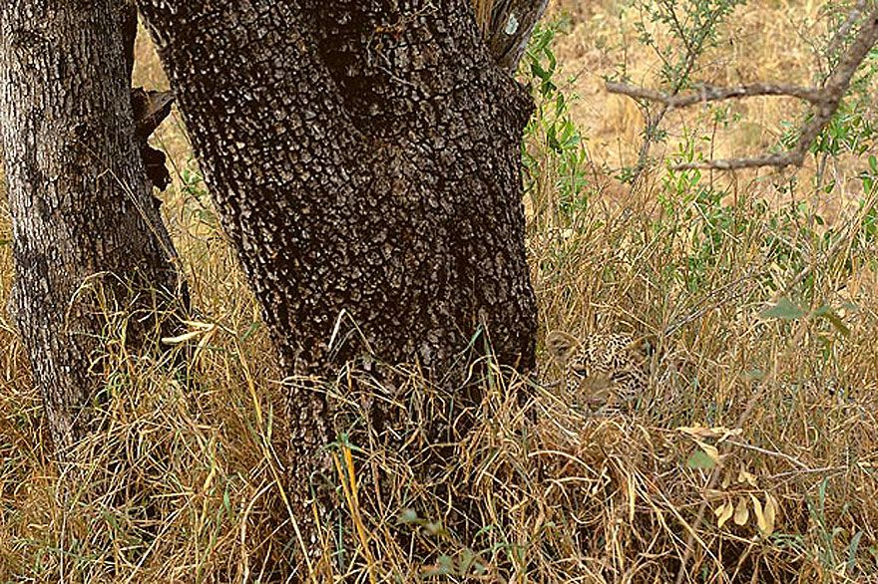
Concept of imperfect detection
When we do a wildlife survey, we (almost) never see all individuals of a species present.

Slide 10
Is imperfect detection always a problem?
No – we don’t need to worry about imperfect detection when:
We can assume detection probability don’t change over time or space
and
we are only interested in species’ relative occurrences/abundances and not absolute values.
We make this assumption most of the time when we analyze structured citizen science data

Slide 11

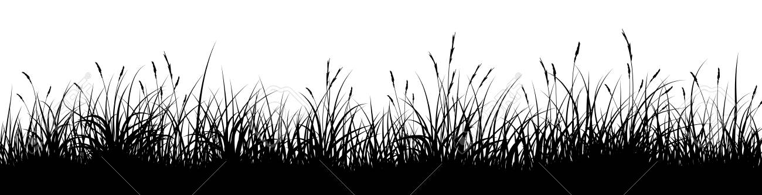
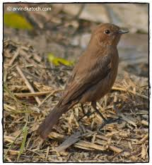
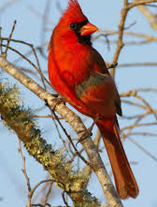


When can imperfect detection be a problem?
We are comparing among habitats
We are comparing among species
We are comparing among surveys collected with different methods or durations

Slide 12

Imperfect reporting too!!
Most unstructured citizen science observations are just of one species … probably more species were seen!!!
Presence-only data
For semi-structured citizen science, we might have metadata on whether an observation comes from a ‘complete checklist’
Presence-absence data
Birds present
Birds observed
Birds recorded

Slide 13

Hierarchical models for citizen science data
Models to ask questions about:
How large is the population or distribution of my species?
What factors explain where my species lives?
Is my species declining or increasing over time?

Slide 14
Different types of related models
Occupancy Models
N-Mixture Models
Distance sampling Models
All these models assume data is generated by:
ecological processes affecting where the species is
observation (or sampling) processes affecting where the species is detected by my survey method
We have separate models for each process

Slide 15
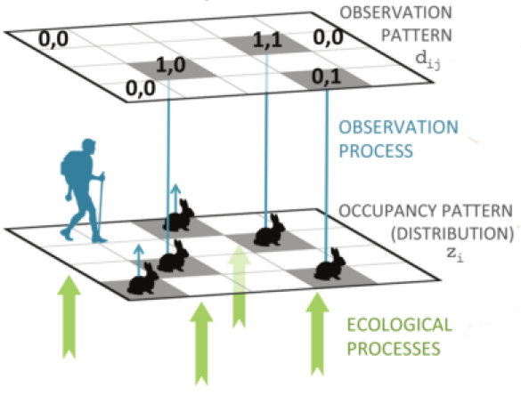
Hierarchical models to account for observation/sampling processes
Usually modelled separately
Image by: Res Altwegg

Slide 16
Imperfect detection in CS includes imperfect reporting
In unstructured citizen science, people might see more species than they report
1
Imperfect reporting
Observation and reporting processes
usually modelled together

Slide 17
Common detection covariates
Type | Direction
Sampling effort | Species are more detectable with longer survey duration
Checklist length | Single list (opportunistic) or longer (complete checklist?)
Date of year | Dependent on species’ phenology (e.g., flight period of butterflies)
Observer | More experienced observers might be able to detect species more often
Forest cover | Species harder to see in forest
Climate | Some species (e.g., many insects) are amore active on warm, sunny, rain-free days
……
Depends on survey method: visual, acoustic, DNA-based etc..

Slide 18
Simple trend analysis
Response: Count (Poisson or negative binomial) or Occurrence (binomial)
Predictors: Site and Year (as fixed or random effects)

Slide 19

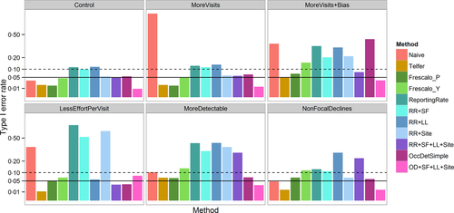
Useful resources

Slide 20
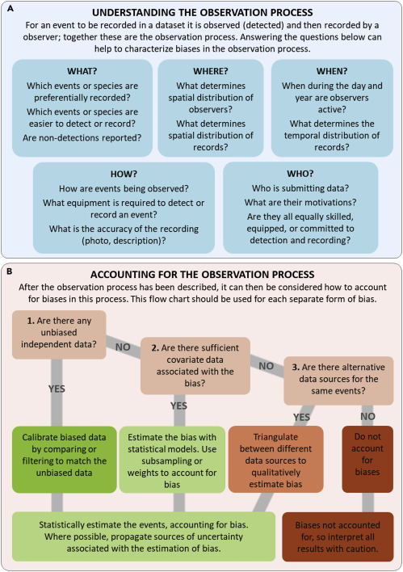
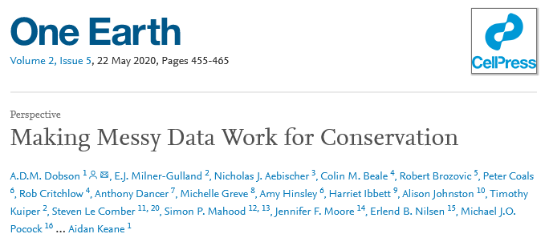
Useful resources

Slide 21

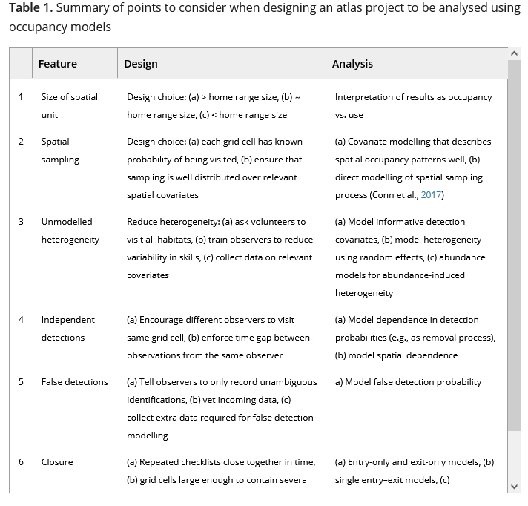
Useful resources

Slide 22

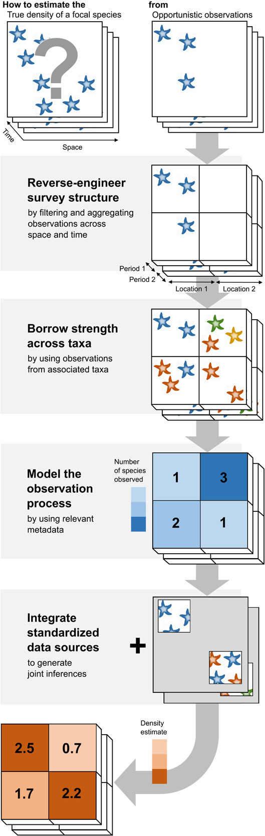
Useful resources

