Slide 1
gdhrgh
gdsfhgd

Slide 2
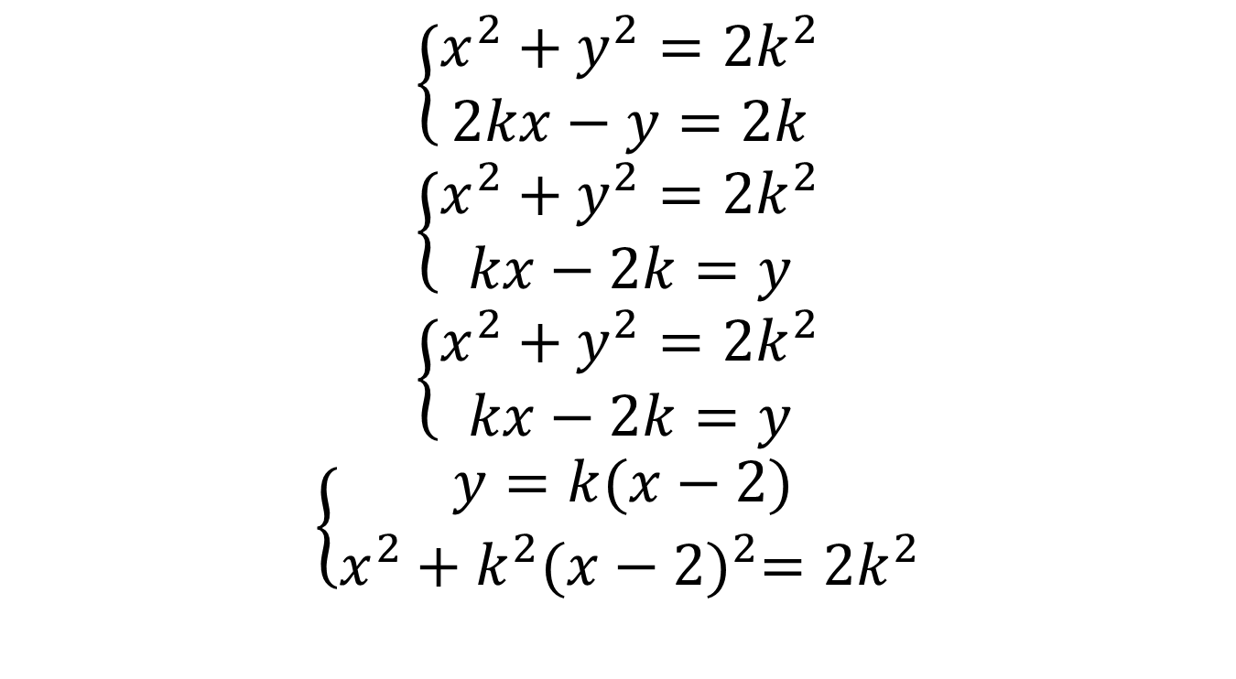
$$\left\{\begin{aligned}x^{2}+y^{2}=2k^{2} \\ 2kx−y=2k\end{aligned}\right.$$
$$\left\{\begin{aligned}x^{2}+y^{2}=2k^{2} \\ kx−2k=y\end{aligned}\right.$$
$$\left\{\begin{aligned}x^{2}+y^{2}=2k^{2} \\ kx−2k=y\end{aligned}\right.$$
$$\left\{\begin{aligned}y=k(x−2) \\ x^{2}+k^{2}{(x−2)}^{2}=2k^{2}\end{aligned}\right.$$

Slide 3
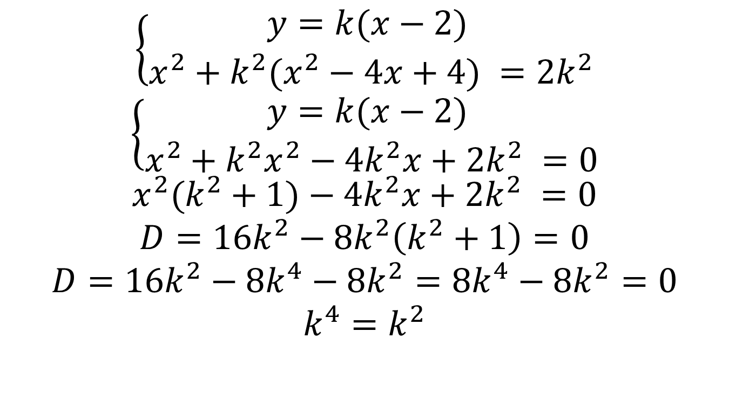
$$\left\{\begin{aligned}y=k(x−2) \\ x^{2}+k^{2}(x^{2}−4x+4) =2k^{2}\end{aligned}\right.$$
$$\left\{\begin{aligned}y=k(x−2) \\ x^{2}+k^{2}x^{2}−4k^{2}x+2k^{2} =0\end{aligned}\right.$$
$$x^{2}(k^{2}+1)−4k^{2}x+2k^{2} =0$$
$$D=16k^{2}−8k^{2}\left(k^{2}+1\right)=0$$
$$D=16k^{2}−8k^{4}−8k^{2}=8k^{4}−8k^{2}=0$$
$$k^{4}=k^{2}$$

Slide 4

Отже корені цього рівняння:
$$\left\{\begin{aligned}k=0 \\ k=1 \\ k=−1\end{aligned}\right.$$

