Slide 1

The D Programming Language
Lionello Lunesu
Presentation for BLUG
April 13th 2010
lio@lunesu.com http://lunesu.com/

Slide 2
“Hello?”
#!/usr/bin/rdmd
import std.stdio;
/// The entry point of the application.
/// Params:
/// args = the command line arguments
void main(string[] args)
{
writefln("世界,你好!");
}

Slide 3
Overview
D is C++ done right
High level versus low level languages
D lets you make fast software, fast
  Improving programmer productivity
  Reducing build time
  Reducing run time
Disclaimer
Cool projects using D

Slide 4
Overview
D is C++ done right
High level versus low level languages
D lets you make fast software, fast
  Improving programmer productivity
  Reducing build time
  Reducing run time
Disclaimer
Cool projects using D

Slide 5
What is D?
Systems programming language inspired by C++
Created by Walter Bright, creator of Zortech C++
Community driven, open-source*
Multi-platform (Linux, FreeBSD, OSX, Windows)
Multi-paradigm (IP, OOP, FP, DBC, TDD)

Slide 6
Alternative to C++
Syntax and grammar similar to C++, java, C#
Link compatible with C libraries (and some C++)
  Vast amount of available SDKs
  htod tool converts C headers to D modules
The D standard library uses libc
  Seemless interaction between C and D code

Slide 7
Overview
D is C++ done right
High level versus low level languages
D lets you make fast software, fast
  Improving programmer productivity
  Reducing build time
  Reducing run time
Disclaimer
Cool projects using D

Slide 8
High level vs. low level
Traditional trade-off: high vs. low level
D has best of both worlds
 | Programmer productivity | Build time | Run time
High level | + | + | -
Low level | - | - | +
D | + | + | +

Slide 9
Overview
D is C++ done right
High level versus low level languages
D lets you make fast software, fast
  Improving programmer productivity
  Reducing build time
  Reducing run time
Disclaimer
Cool projects using D

Slide 10
Programmer productivity

Slide 11
Improving programmer productivity
All types are platform independent
  int is always 32 bit; long is always 64 bit
Built-in arrays and associative arrays
  Arrays know their length and can be resized
  Strings are arrays of Unicode characters
Universal iteration using foreach
Support for unit-tests, contracts, invariants
Meta-programming (code generation)

Slide 12
Overview
D is C++ done right
High level versus low level languages
D lets you make fast software, fast
  Improving programmer productivity
  Reducing build time
  Reducing run time
Disclaimer
Cool projects using D

Slide 13

Reducing build time
http://xkcd.com/303/

Slide 14
Reducing build time
Simple syntax and grammar
Much simpler than C++ (creator ought to know)
No macro preprocessor
  No more header files!
Compiler outputs dependencies for build tools
  No more make files!
Reference compiler is fast

Slide 15
Overview
D is C++ done right
High level versus low level languages
D lets you make fast software, fast
  Improving programmer productivity
  Reducing build time
  Reducing run time
Disclaimer
Cool projects using D

Slide 16
Reducing run time
Systems language
  Direct access to OS, C, C++ APIs
Compiles to native code
Support for inline assembly
Compile-time function evaluation
Built-in profiler and code coverage tool

Slide 17
Overview
D is C++ done right
High level versus low level languages
D lets you make fast software, fast
  Improving programmer productivity
  Reducing build time
  Reducing run time
Disclaimer
Cool projects using D

Slide 18
Disclaimer
Two language versions (confuses new users)
  D 1.0 (stable)
  D 2.0 (will be released June 14th)
Two standard libraries (confuses all users)
  Phobos (based on libc; for 1.0 and 2.0)
  Tango (object oriented; for 1.0 only)
No standard GUI solution
  Bindings available for GTK, QT, Win32, SDL

Slide 19
Overview
D is C++ done right
High level versus low level languages
D lets you make fast software, fast
  Improving programmer productivity
  Reducing build time
  Reducing run time
Disclaimer
Cool projects using D

Slide 20

Cool Projects
Torus Trooper by ABA Games

Slide 21
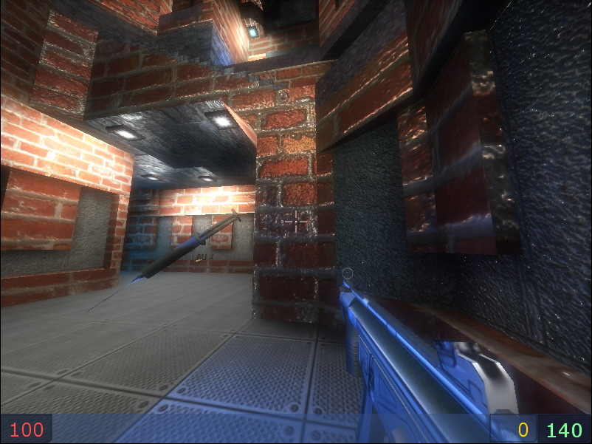
Cool Projects
Deadlock by team0xf

Slide 22
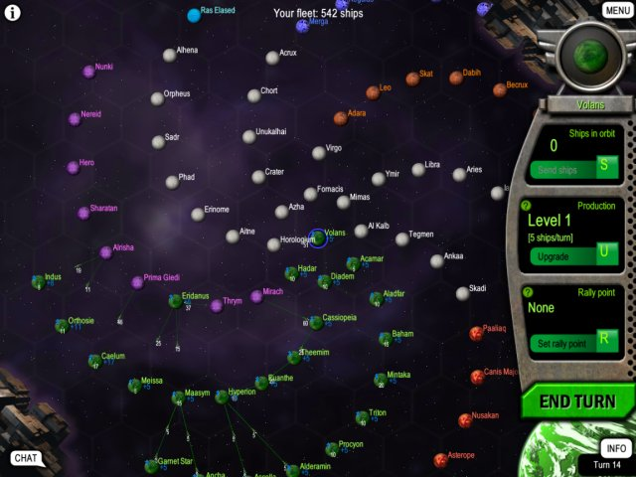
Cool projects
Mayhem Intergalactic by Inventive Dingo

Slide 23
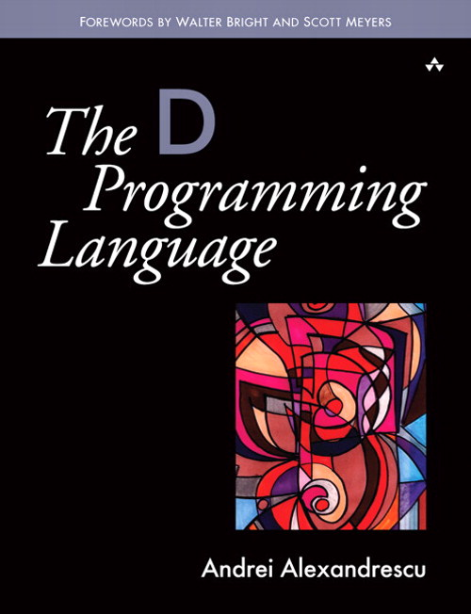
Resources
http://digitalmars.com/d/
http://dsource.org/
nntp://news.digitalmars.com
“Learn to Tango with D”
“Programmieren in D: Einführung in die neue Programmiersprache”
“The D Programming Language” by Andrei Alexandrescu (out June 14th)

Slide 24

The End
http://digitalmars.com/d/

Slide 25
Goodies
Type deduction
  auto ptr = std.c.stdlib.malloc(1000);
Scope guards (RAII)
  scope(exit) std.c.stdlib.free(ptr);
Closures
  auto square = (int i) { return i*i; };
Safe variadic arguments (uses RTTI)
  writefln("%s %s %s", "abc", 2, 5.6);

