Slide 1

CAS Applied Data Science - Module 1 - www | data bases
Data Acquisition and Management
PD Dr. Sigve Haug
Bern, 2019-08-23

Slide 2
Questions from yesterday
...
...

Slide 3
Module 1
Third day
13:30 Discussion session
14:00 Retrieving data from www
Introduction, notebook tutorial
15:00 Break
15:30 Retrieving data from www
Notebook tutorial
Project clarificationsl
17:00 Apero

Slide 4
Retrieving data from www
The World Wide Web (WWW), also called the Web, is an information space where documents and other web resources are identified by Uniform Resource Locators (URLs), interlinked by hypertext links, and accessible via the Internet.

Slide 5
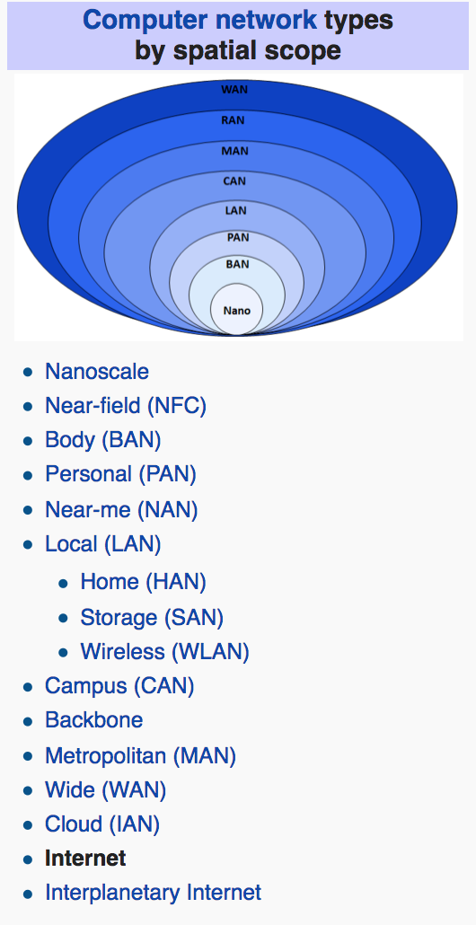
Internet
History
Early developments in 1960s
ARPANET 1969 (Advanced Research Projects Agency)
Packets switching
TCP/IP standardized in 1982
Email, phone, file sharing … www

Slide 6
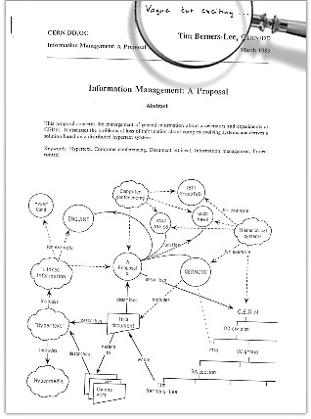
World Wide Web
History
1989 Tim Berners Lee proposal at CERN
HTML, URI/L, HTTP
1990 First www server and browser
Rest is history
https://webfoundation.org/about/vision/history-of-the-web/

Slide 7
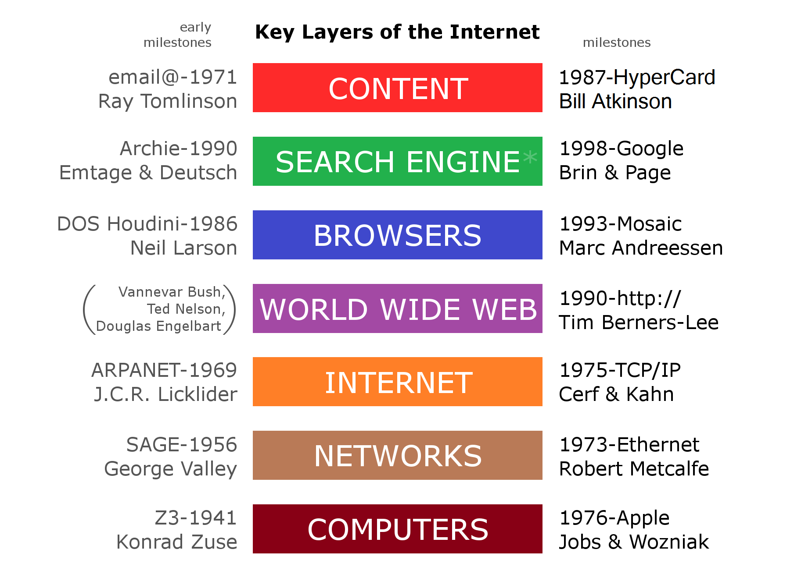
World Wide Web
Usage
https://www.slideshare.net/Micro-Focus/growth-of-internet-data-2017

Slide 8
How to access www data sources?
GUI or from shell, scripts and programs
With application programming interface (API)
Gives you the set of functions/methods (in python modules) to access (remote) services
Can automate the access process
...
Often provided by service provider
Also “unofficial” API by “private” programmers
Let us jump to the examples (notebook of today)

Slide 9
CAS Applied Data Science - Module 1
Data Acquisition and Management
End of www
Bern, 2019-08-23

