Slide 1
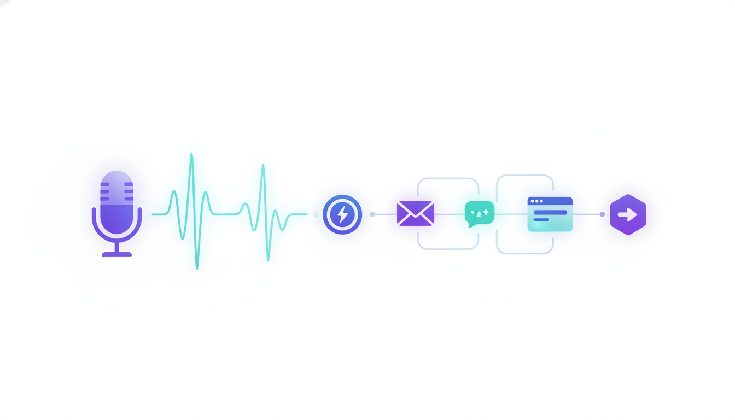
SpeakEasy
Wispr Flow types for you.
SpeakEasy works for you.
The voice tool the marketing group is sleeping on — a head-to-head for people who actually want to get work done.
$99 one-time · not $180/yr forever

Slide 2
WHAT EVERYONE'S HYPED ABOUT
Wispr Flow is, honestly, a great dictation app.
$2B
2.5M+
100+
~184
valuation (May 2026)
downloads
languages
words/min dictation
We're not here to trash it. If your job is multilingual dictation on a Mac or phone, Wispr is the better buy — and we'll say so. The question for marketers is different: do you want voice that types, or voice that runs your stack?
SpeakEasy
Voice that works for you — not just types for you.

Slide 3
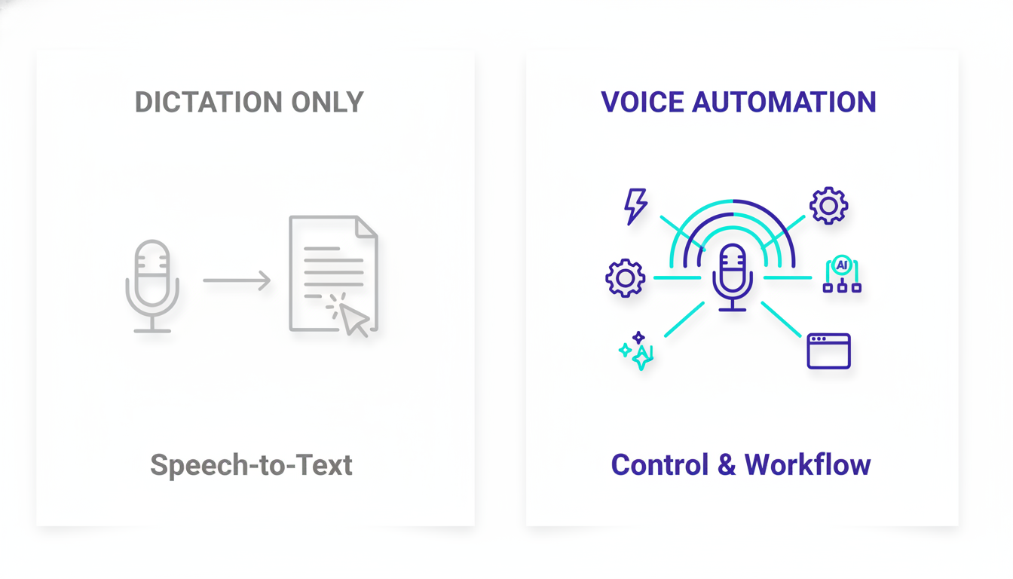
THE CATEGORY GAP
It only types. That's the whole ceiling.
0
voice-triggered actions
No webhooks. No custom workflows. No “say it → it happens.”
No no-code webhooks into Zapier / Make / n8n
No stored AI-prompt actions
No per-action hotkeys or targeted paste
A dev API exists — but you're not coding mid-campaign
SpeakEasy
Voice that works for you — not just types for you.

Slide 4
THE DIFFERENCE
Say the name of an action — it runs.
1
Speak
Press one hotkey, say an action's name. Fuzzy-matching finds it.
PRESS HOTKEY · SPEAK A NAME
"Send to my newsletter Zap"
2
Webhook
Fires into Zapier / Make / n8n or any endpoint, response pasted back.
→ fires a webhook into your stack
"Rewrite this as a hook"
3
AI prompt
Runs a stored prompt on your text — Claude, GPT, or OpenRouter.
→ runs a stored AI prompt
"Open Canva"
4
Open tool
Launches the right app or URL (even the right Chrome profile).
→ launches the right tool
SpeakEasy
Voice that works for you — not just types for you.

Slide 5
WHY MARKETERS SWITCH
Five reasons it wins
1
Voice that DOES things
2
Your keys, your money
3
Multi-LLM, not locked
Trigger webhooks, AI transforms & tools by voice. Wispr can only type.
Bring your own OpenAI key. Dictation runs ~$0.006/min — pennies.
Claude, GPT, or anything on OpenRouter. Wispr is one closed engine.
4
Power-user control
5
Own it, don't rent it
6
No surveillance scandal
Per-action hotkeys, Cursor Lock, Chrome-profile routing on Windows.
One license key, yours to keep. No subscription that dies when you stop.
Clean privacy record. (Wispr was caught sending audio + screenshots in 2025.)
SpeakEasy
Voice that works for you — not just types for you.

Slide 6
HEAD TO HEAD
We concede what Wispr does better.
Capability
SpeakEasy
Wispr Flow
Voice commands (say an action → it runs)
Yes
None
No-code webhooks (Zapier / Make / n8n)
Unlimited
None
Stored AI-prompt actions
Yes
None
Multi-LLM (Claude / GPT / OpenRouter)
Yes
Closed
Per-action hotkeys + Cursor Lock
Yes
No
Pricing model
$99 one-time
$180/yr forever
Languages
~13
100+ (wins)
Mac / iOS / Android
Windows only
All (wins)
Learned dictionary / auto-format
On demand
Refined (wins)
Privacy track record
Clean
2025 incident
SpeakEasy
Voice that works for you — not just types for you.

Slide 7
THE KILL SHOT
Run the numbers. It isn't close.
3-year total cost by usage level — SpeakEasy ($99 once + your usage) vs. Wispr ($180/yr).
Medium user saves
~$300
over 3 years — pays for itself in ~9 months.
The honest part
At extreme volume (5+ hrs of talking/week), Whisper minutes narrow the gap — the live calculator shows that too. That candor is the sell.
SpeakEasy
Voice that works for you — not just types for you.

Slide 8
BIG ≠ ON YOUR SIDE
Scale cuts both ways.
⚠ Wispr Flow — 2025, reported
🛡 SpeakEasy
A developer found the app capturing screenshots of your active window and sending audio to third-party cloud infrastructure. Wispr's first move was to ban the researcher who reported it — the CTO apologized only later.
No public privacy incident. You hold your own license key and bring your own API key — your account and your spend stay in your hands.
Straight talk: transcription is cloud (OpenAI Whisper) — same as Wispr. Neither is offline. We don't pretend otherwise.
Privacy Mode was added after — but users can't independently verify it.
Sources: independent coverage (Medium / ModelPiper, 2025) and 2026 review roundups; criticisms stated as reported, not adjudicated.

Slide 9
WHEN NOT TO BUY
We'll tell you when Wispr is the better choice.
Saying this out loud is exactly why the pitch lands. Buy SpeakEasy for the automation + cost story — not because Wispr is bad.
You work across many languages
Wispr's 100+ vs our ~13. Real edge if you're not English-first.
You need it on a phone or Mac
Wispr ships Mac, iOS & Android. We're a Windows desk tool.
You want zero-setup polish
Wispr's learned dictionary & auto-format are more refined out of the box.
You live across many devices
Wispr syncs everywhere. SpeakEasy is one powerful desktop.
SpeakEasy
Voice that works for you — not just types for you.

Slide 10
THE OFFER
Own your voice tool for $99 — once.
Less than 7 months of Wispr, then it's yours. Bring your own OpenAI key and run dictation for pennies.
FOUNDING PRICE
$99 once
✓
Voice commands — run any action by name
✓
Unlimited webhook + AI-prompt actions
vs Wispr $180/yr, forever
✓
Claude, GPT & OpenRouter support
Get your license →
✓
Per-action hotkeys + Cursor Lock
Try the live calculator with your own Wispr usage — see your exact savings before you buy.
✓
2 devices · free updates · your API key
SpeakEasy
Voice that works for you — not just types for you.

Slide 11
SpeakEasy
Wispr types for you.
SpeakEasy works for you.
$99 once · your API key · voice that runs your marketing stack.
Get your license →

