Slide 1
ConDUIt-app
Mock Project :
1 – Nguyễn thanh tùng
2 – Nguyễn mai phương

Slide 2
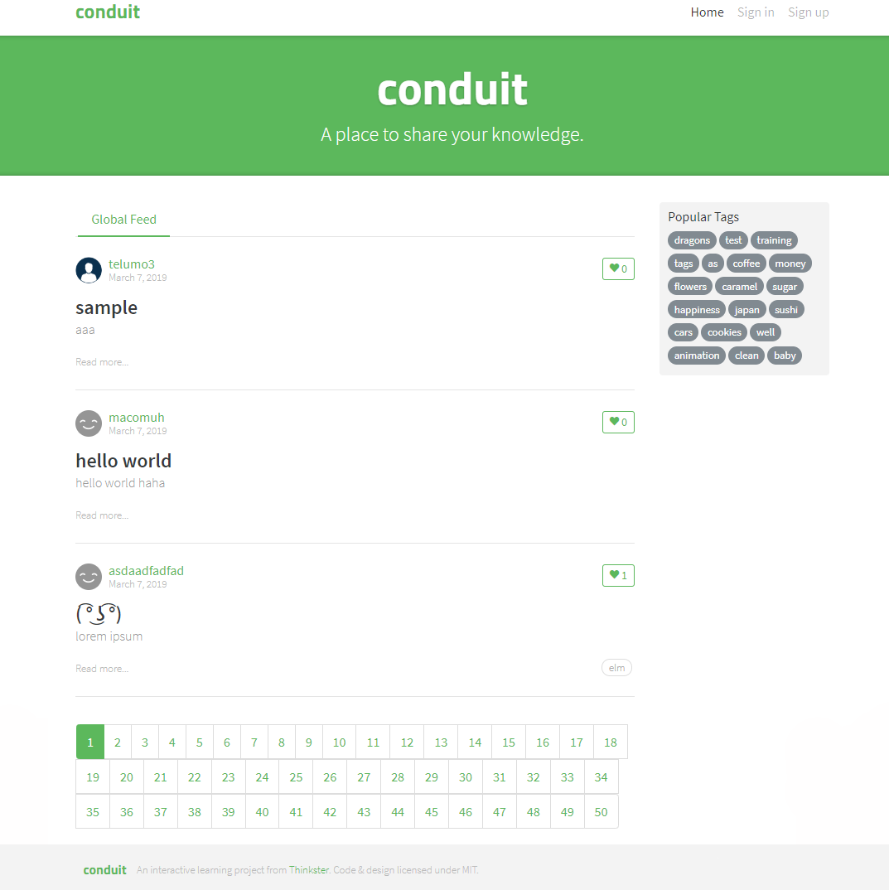
Home before login
Links Routing
Header
Tap to show
Banner
List tags
Content
List Articles
Footer
Pagination

Slide 3
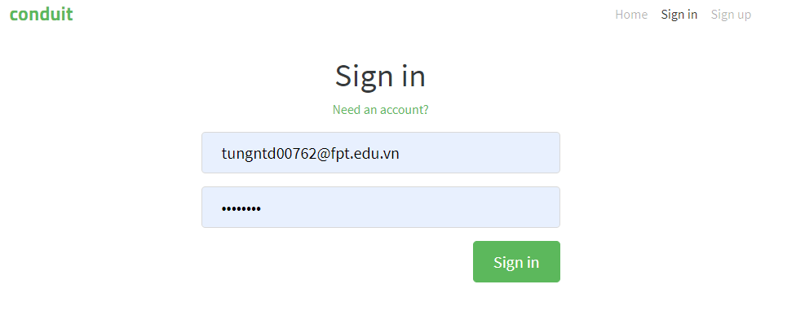
Sign-in component :
Form to Login

Slide 4
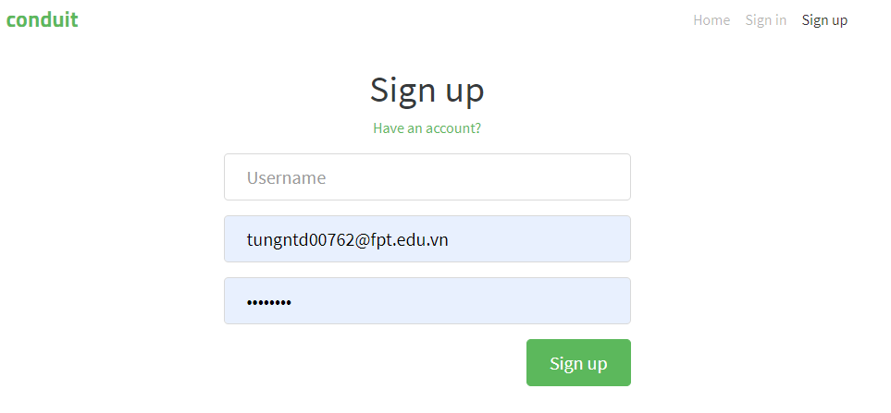
Sign-up component :
Form to Sign up

Slide 5
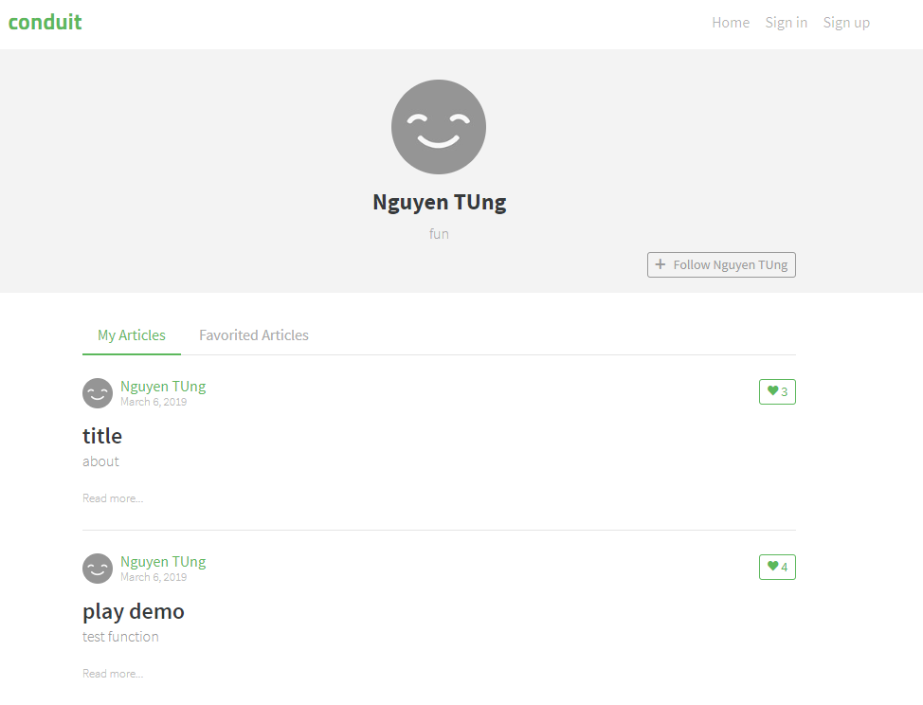
User’s profile before login
Tap to show
List Article

Slide 6
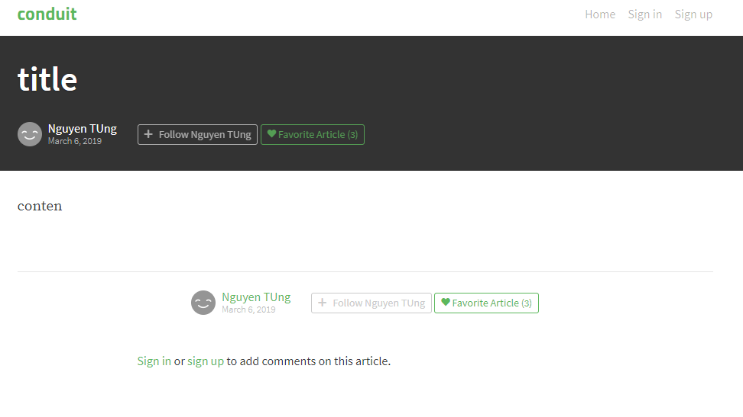
Article before login

