Slide 1

Arbitrary Order Total Variation for Deformable Image Registration By Jinming Duan, Xi Jia, Joseph Bartlett, Wenqi Lu, Zhaowen Qiu
Presented by:
Lior Dvir and Neta Becker
Notes:
The alternating direction method of multipliers (ADMM) is an algorithm that attempts to solve a convex optimization problem by breaking it into smaller pieces, each of which will be easier to handle.

Slide 2
Table of contents
01
02
03
04
Background
Paper
Our Method
Results

Slide 3
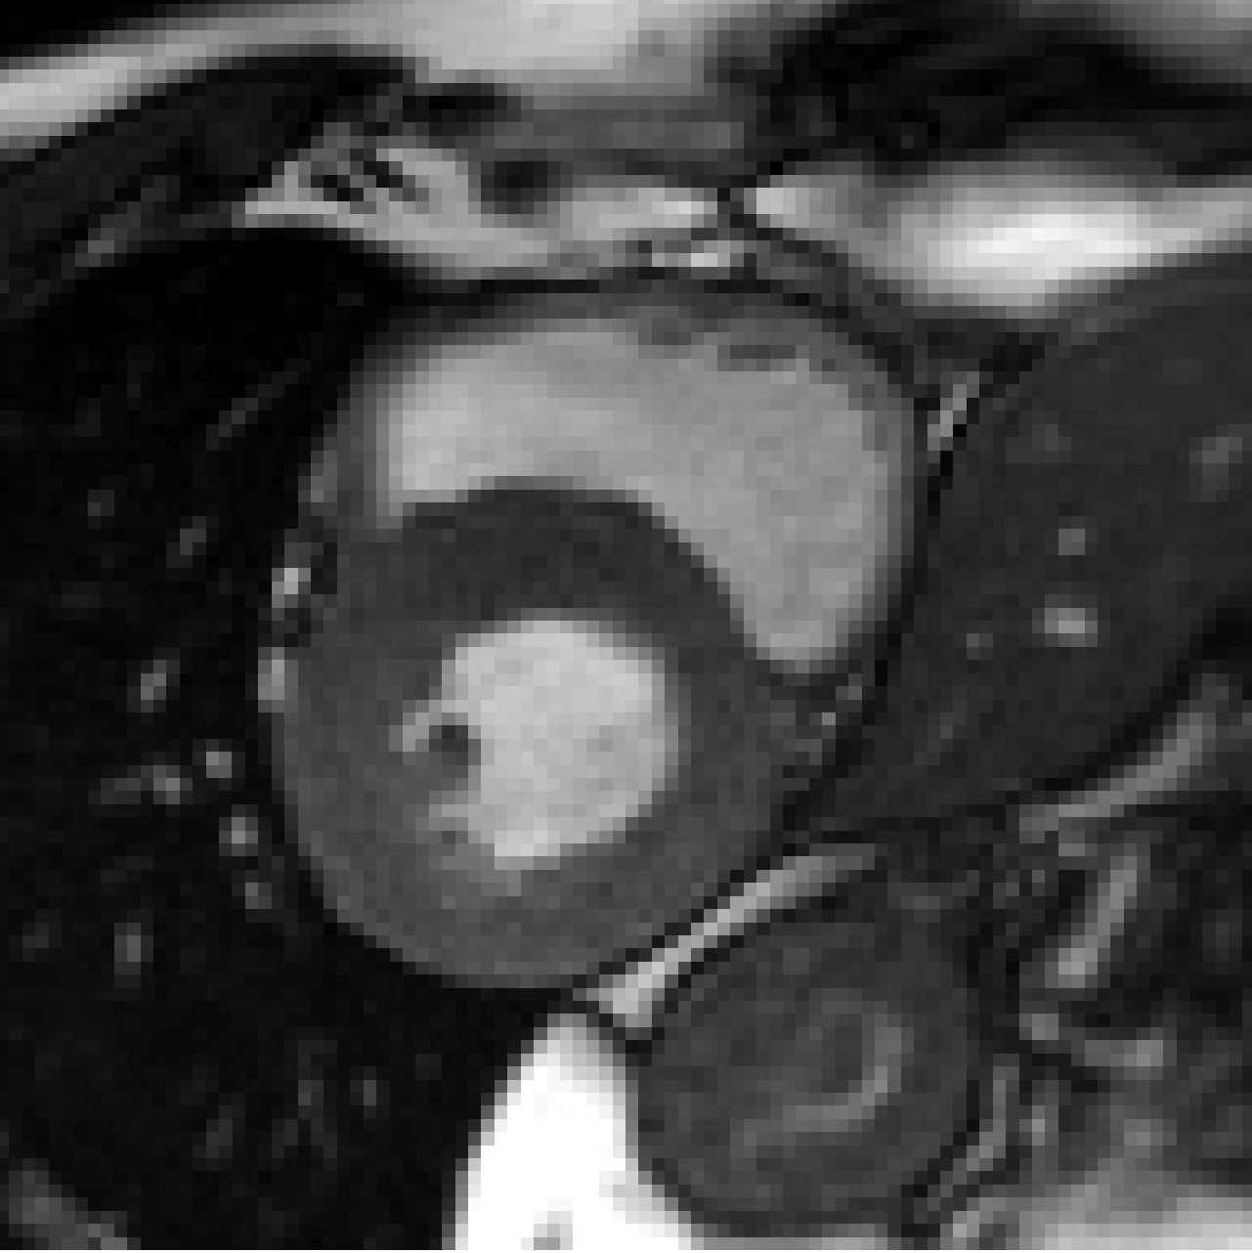
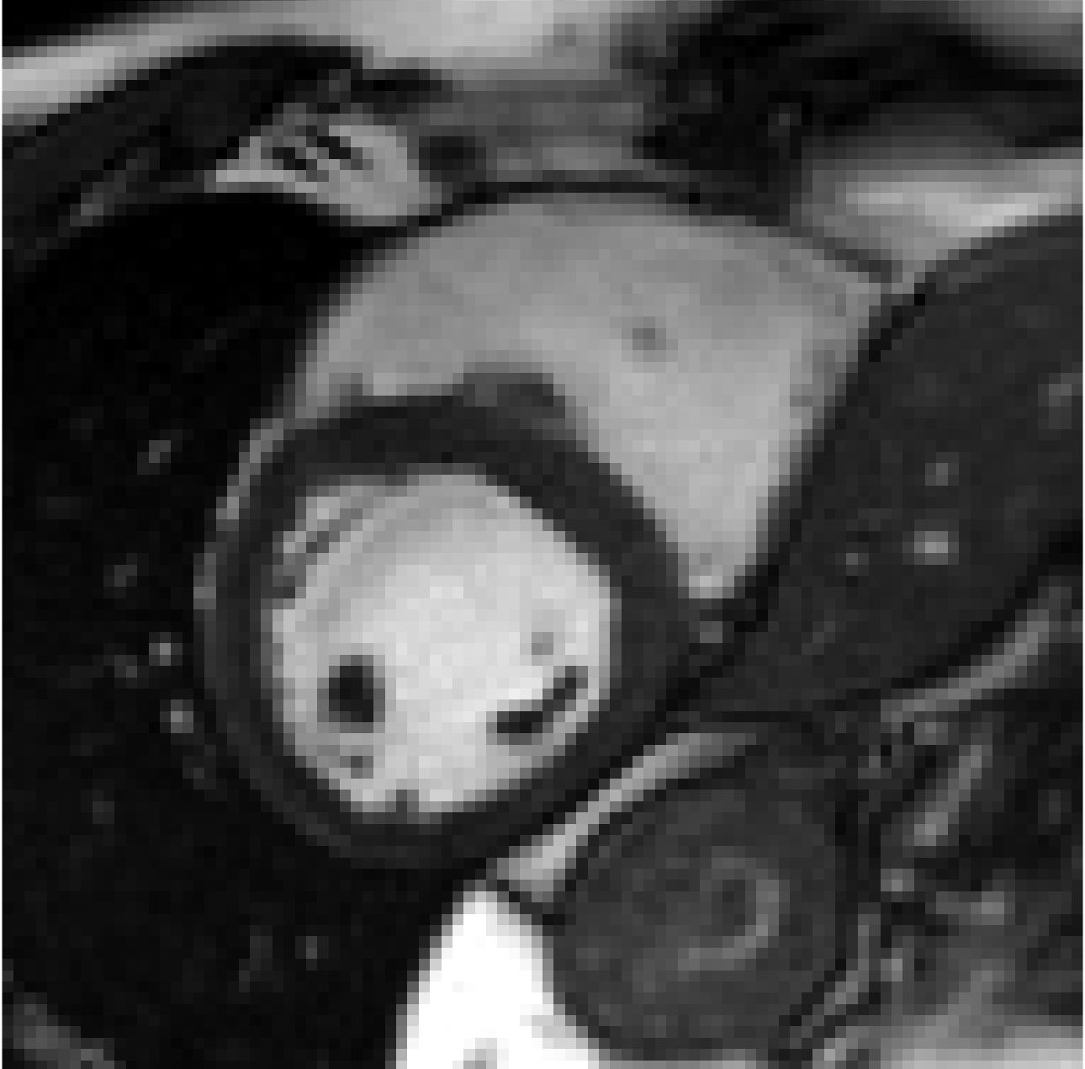
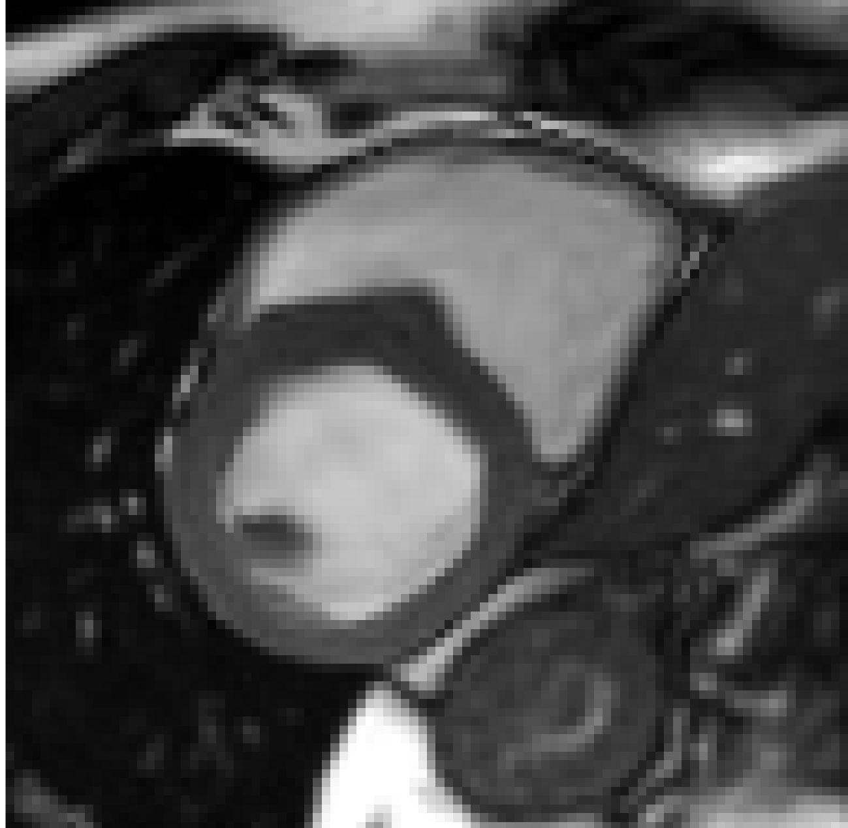

Background
Background
The paper aims to solve non-rigid registration in medical imaging
It utilizes TV of arbitrary order in its regularization which:
Induces smooth solutions
Allows discontinuities in local deformation fields
Is less dependent on initial alignment
$$→$$
=

Slide 4
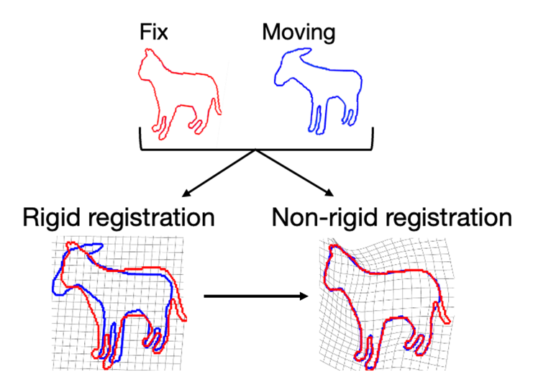
Image registration and object tracking
Background
Image registration: the process of matching two or more images of the same or similar object, viewpoints, or imaging modalities.
Rigid transformation: Objects are rotated and translated with respect to one another
Non-Rigid transformation: correspondence between objects is achieved with localized stretching of the images

Slide 5
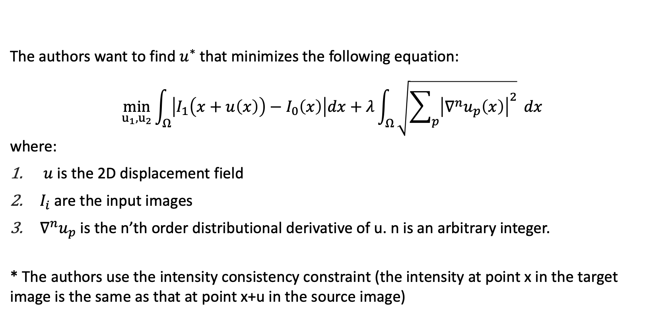
The proposed algorithm
Paper
The authors want to find $u^{∗}$that minimizes the following equation: $$\min_{u_{1},u_{2}}{\int_{Ω}{\left|I_{1}\left(x+u\left(x\right)\right)−I_{0}\left(x\right)\right|dx}+λ\int_{Ω}{\sqrt{\sum_{p}{{\left|∇^{n}u_{p}\left(x\right)\right|}^{2}}} dx}}$$ where:
$u$is the 2D displacement field
$I_{i}$ are the input images
$∇^{n}u_{p}$ is the n’th order distributional derivative of u. n is an arbitrary integer.
* The authors use the intensity consistency constraint (the intensity at point x in the target image is the same as that at point x+u in the source image)
Notes:
In summary, to handle the original non-linear, non- differentiable and non-convex minimization problem (1) , we break it down into a warping problem (2a) and a linearized, convex minimization problem (2b) . We then develop an acceler- ated, ADMM-based iterative algorithm to decompose (2b) into an over-relaxation step and three simple subproblems. Each subprob- lem has a closed-form, point-wise solution and can be efficiently handled using existing numerical methods (i.e. DCT and soft thresholding). As such, the algorithm is very accurate and efficient, which can be confirmed in Section 4.3 .

Slide 6
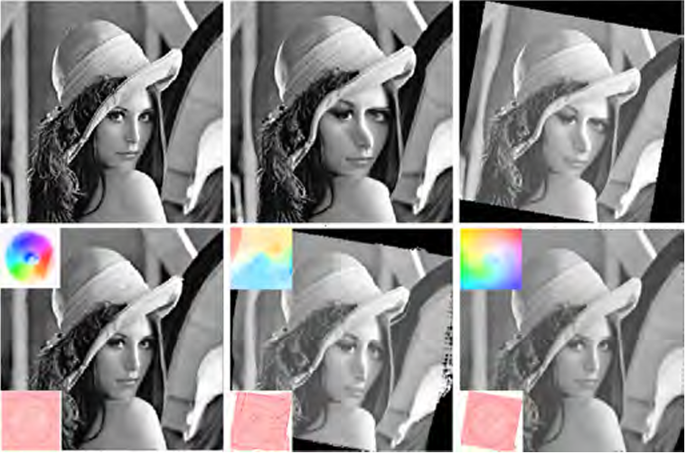
Paper’s results
Paper
Image is deformed
Affine transformation
1a
1b
1c
From left to right:
Using 1st order TV
Using 1st order TV
Using 3rd order TV
2a
2b
2c
Notes:
רצו לבדוק:
השפעת מספר הגזירה על התוצאות
רובאסטיות ביחס לנורמל L1 לעומת L2.
השפעת אלפא (over relaxation parameter)
1st-order methods are more dependant on initial alignments between images so are more suitable when an affine linear pre-registration is avail- able, which is not the case for higher-order methods.

Slide 7
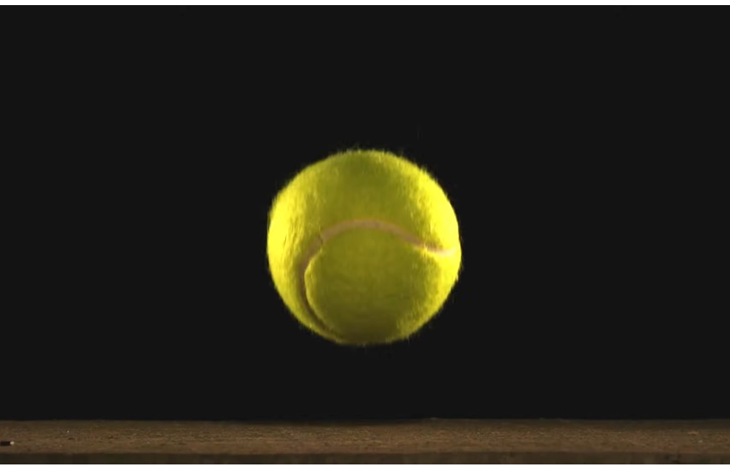
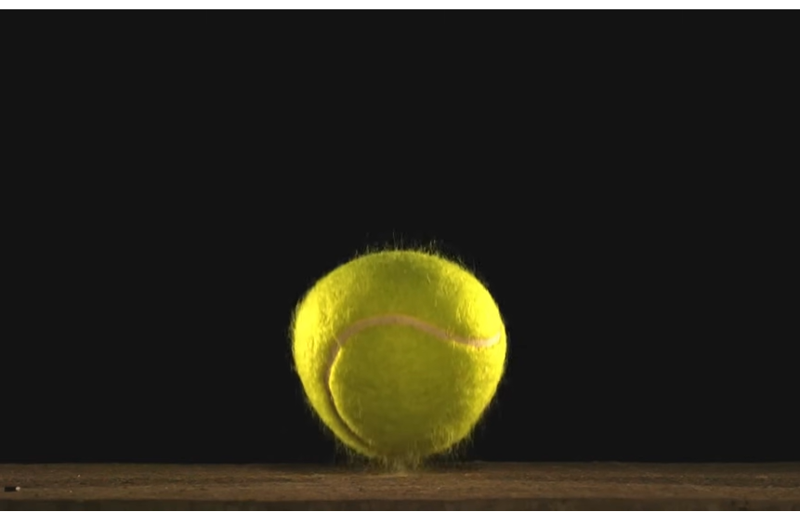
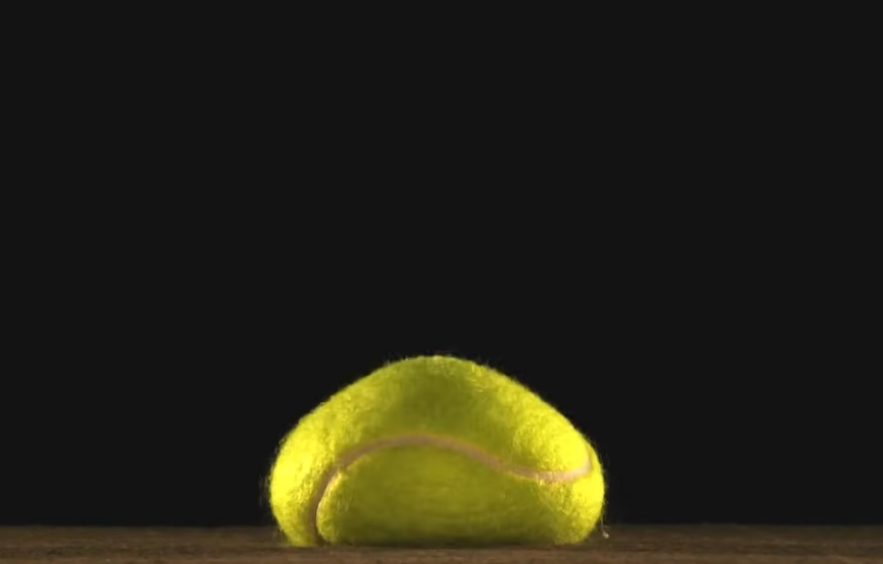
Our goal
Our Method
Video tracking is the process of locating a moving object over time using a camera.
Our goal is to develop an algorithm that performs object tracking of objects that may change their form throughout the video.
Notes:
We are planning to perform object tracking by using the algorithm presented in the paper to predict the changes in the object’s form between frames.

Slide 8
Implementation (algorithm)
Our Method
For the first frame:
Detect the object of interest using object detection algorithm
Create a mask of said object
For any frame that follows:
Use the algorithm from the given article to shape the mask using the current frame and the previous one as input images
Create a mask according to the result of the algorithm

Slide 9
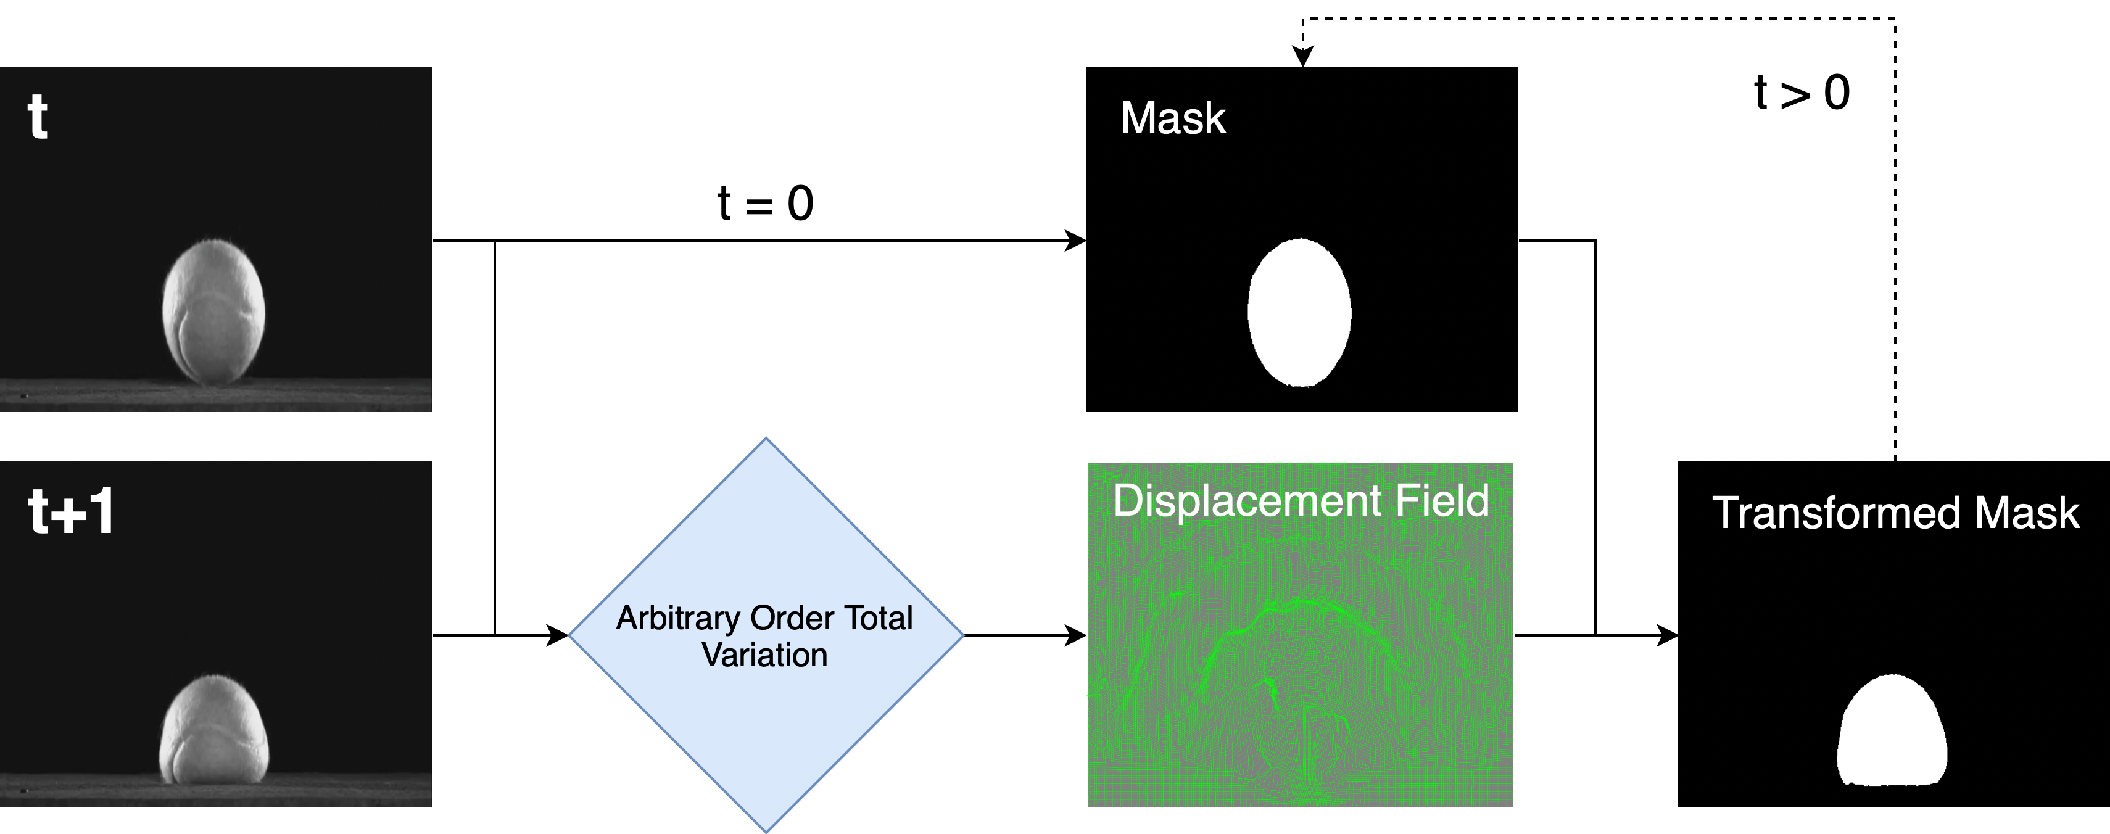
Implementation (algorithm)
Our Method

Slide 10
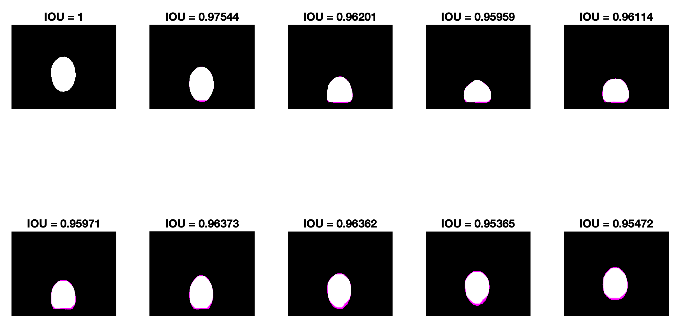
Results
Results

Slide 11
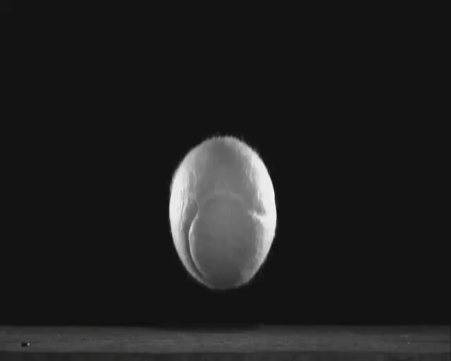
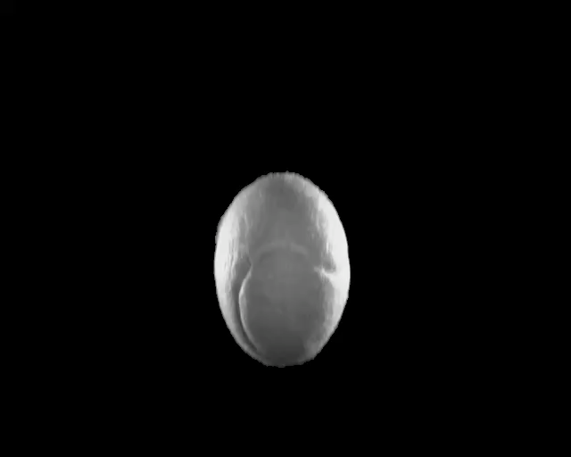
Results
Results
Original Video
Ground Truth
Algorithm Masking

Slide 12
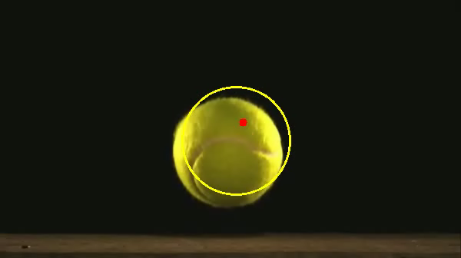
Comparison with another algorithm
Comparisons
Our model
Works on any given object
Robust – doesn’t require specific object characteristics to work
Works slow. Takes a few minutes for the algorithm to run
Compared model
Works with tennis balls only
Requires the shape and color of a tennis ball (works only in RGB)
Works fast. It takes a few seconds for the algorithm to run
The mentioned algorithm was written by Adrian Rosebrock

Slide 13
Thank you!
Questions?

