Slide 1
Sentiment Analysis

Slide 2
Our Story / scikit learn
Dataset
Baseline + new
AUC > best AUC
Evaluate
models + pipeline
update
Parameters
Raw Data
Baseline Parameters
Parse Data
Feature Extraction
Feature Selection
Topic Analysis

Slide 3
Our Story
Parser?
Classifier?
Extraction?
Word selection?
Transformation?
Feature Selection?
Univariate Feature Selection?
Emoticons?
Topic Analysis1
Word 2 Vec Feature Selection?
Topic Analysis2

Slide 4
Parser? Classifier?
Stratified 3 fold (keep label balance)
SGD, SVM,AdaBoost,KNN,Tree,RForest
Dataset
Baseline + new
AUC > best AUC
Evaluate
models + pipeline
update
Parameters
Raw Data
Baseline Parameters
Parse Data
Feature Extraction
Feature Selection
Count VS Tfidf
Topic Analysis

Slide 5
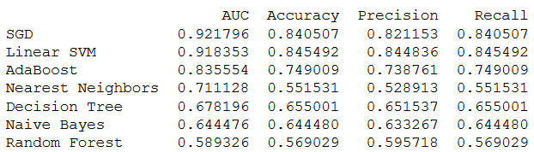
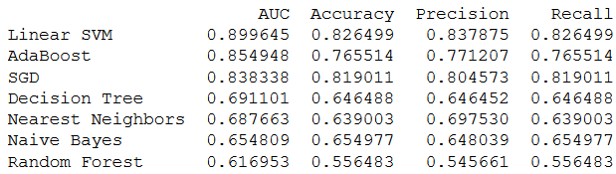
Evaluate tfidf vs count
Tfidf
Count

Slide 6
Evaluate parser
Stratified 3 fold (keep label balance)
SGD
Dataset
Baseline + new
0.921 > 0
Evaluate
models + pipeline
update
Parameters
Raw Data
Baseline Parameters
Parse Data
Feature Extraction
Feature Selection
Tfidf
Count VS Tfidf
Topic Analysis

Slide 7
Extraction?
Stratified 3 fold
SGD
Dataset
Baseline + new
0.921
Evaluate
models + pipeline
update
Parameters
Raw Data
Baseline Parameters
Parse Data
Feature Extraction
Feature Selection
Tfidf
Tokenizer: None / stemmer
Lower: True / False
Stop words: None / English
Ngram: 1, 2, 3
Topic Analysis

Slide 8




Evaluate Extraction
Tokenizer: None / stemmer
Lower: True / False
Stop words: None / English
Ngram: 1, 2, 3

Slide 9
Evaluate Extraction
Stratified 3 fold
SGD
Dataset
Baseline + new
0.923 > 0.921
Evaluate
models + pipeline
update
Parameters
Raw Data
Baseline Parameters
Parse Data
Feature Extraction
Feature Selection
Tfidf
Normal tokenizer
Lower = true
Stop words = none
Ngram = 1
Tokenizer: None / stemmer
Lower: True / False
Stop words: None / English
Ngram: 1, 2, 3
Topic Analysis

Slide 10
Word Selection
Stratified 3 fold
SGD
Dataset
Baseline + new
0.923
Evaluate
models + pipeline
update
Parameters
Raw Data
Baseline Parameters
Parse Data
Feature Extraction
Feature Selection
Tfidf
Normal tokenizer
Lower = true
Stop words = none
Ngram = 1
Max df: 0.5 , 0.7, 1.0
Min df: 0.005, 0.01, 0.5, 1
Max features per doc: 500, 1500, 2000, All
Topic Analysis

Slide 11
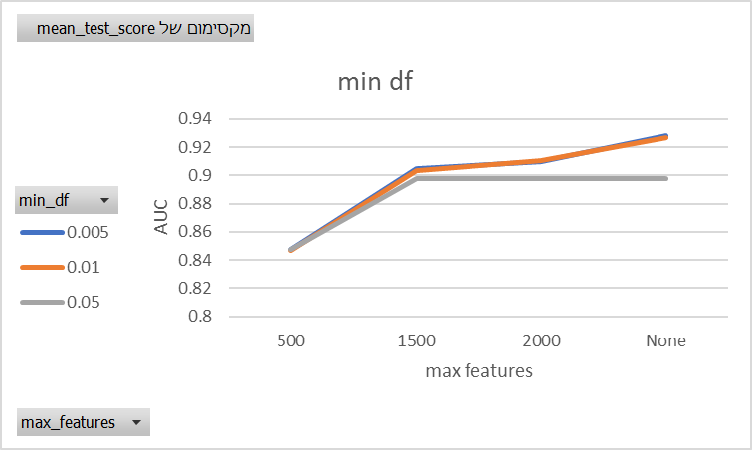
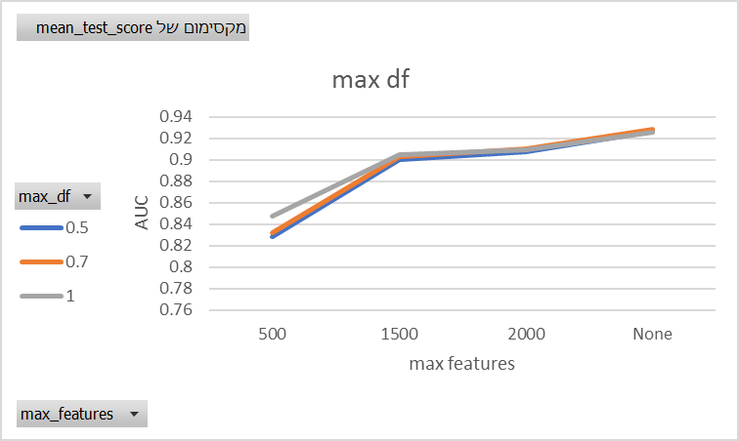
Evaluate word selection

Slide 12
Evaluate word Selection
Stratified 3 fold
SGD
Dataset
Baseline + new
0.928 > 0.923
Evaluate
models + pipeline
update
Parameters
Raw Data
Baseline Parameters
Parse Data
Feature Extraction
Feature Selection
Tfidf
Normal tokenizer
Lower = true
Stop words = none
Ngram = 1
Max df = 0.7
Min df: 0.005
Max features = All
Max df: 0.5 , 0.7, 1.0
Min df: 0.005, 0.01, 0.5, 1
Max features per doc: 500, 1500, 2000, All
Topic Analysis

Slide 13
Transformation
Stratified 3 fold
SGD
Dataset
Baseline + new
0.928
Evaluate
models + pipeline
update
Parameters
Raw Data
Baseline Parameters
Parse Data
Feature Extraction
Feature Selection
Tfidf
Normal tokenizer
Lower = true
Stop words = none
Ngram = 1
Max df = 0.7
Min df: 0.005
Max features = All
Normalize: None / l1
Tf sublinear: True / False
Topic Analysis

Slide 14
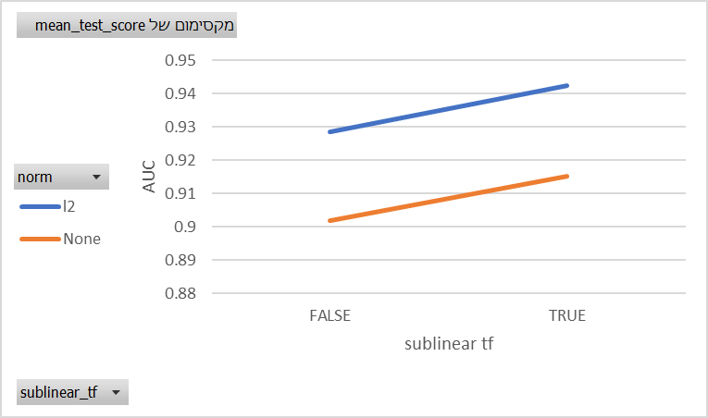

Slide 15
Evaluate Transformation
Stratified 3 fold
SGD
Dataset
Baseline + new
0.94224 > 0.921
Evaluate
models + pipeline
update
Parameters
Raw Data
Baseline Parameters
Parse Data
Feature Extraction
Feature Selection
Tfidf
Normal tokenizer
Lower = true
Stop words = none
Ngram = 1
Max df = 0.7
Min df: 0.005
Max features = All
Normalize: None / l1
Tf sublinear: True / False
Topic Analysis
Normalize= l1
Tf sublinear= True

Slide 16
Univariate Feature Selection
Stratified 3 fold
SGD
Dataset
Baseline + new
0.94224
Evaluate
models + pipeline
update
Parameters
Raw Data
Baseline Parameters
Parse Data
Feature Extraction
Feature Selection
Tfidf
Normal tokenizer
Lower = true
Stop words = none
Ngram = 1
Max df = 0.7
Min df: 0.005
Max features = All
Score function: chi^2, f score, mutual information
Percentile: 10% / 25% / 75% / 100%
Topic Analysis
Normalize= l1
Tf sublinear= True

Slide 17
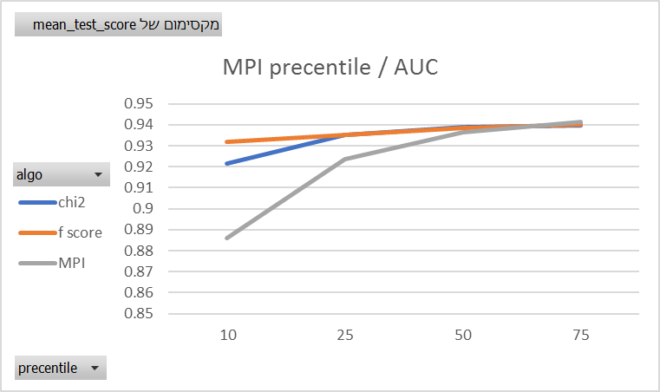
Evaluate Univariate FS

Slide 18
Enrich with emoticons
Stratified 3 fold
SGD
Dataset
Baseline + new
0.94224
Evaluate
models + pipeline
update
Parameters
Raw Data
Baseline Parameters
Parse Data
Feature Extraction
Feature Selection
Tfidf
Normal tokenizer
Lower = true
Stop words = none
Ngram = 1
Max df = 0.7
Min df: 0.005
Max features = All
Enrich with emoticons: True, False
Topic Analysis
Normalize= l1
Tf sublinear= True

Slide 19
Evaluate emoticons
Enrich with smile!
:) :( =\ =)….
0.94224 -> 0.94226

Slide 20
Topic Analysis
Stratified 3 fold
SGD
Dataset
Baseline + new
0.94224
Evaluate
models + pipeline
update
Parameters
Raw Data
Baseline Parameters
Parse Data
Feature Extraction
Feature Selection
Tfidf
Normal tokenizer
Lower = true
Stop words = none
Ngram = 1
Max df = 0.7
Min df: 0.005
Max features = All
Topic Analysis
LDA, LSI
Normalize= l1
Tf sublinear= True

Slide 21
Topic Analysis
20 topics
analysis:
Top 10 words in topic:
Topic sentiment score: ABS(W(“good”|topic) – W(“bad”|topic))
Print sentiment topic

Slide 22
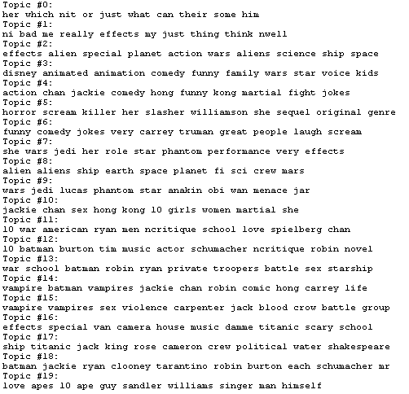
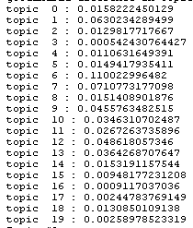
LSI Best estimator
Top 10 words in topic:
Topic sentiment score: ABS(W(“good”|topic) – W(“bad”|topic))

Slide 23
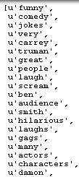
LSI Best estimator
Print topic 6
Funny = Good?

Slide 24
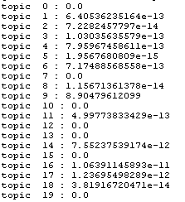
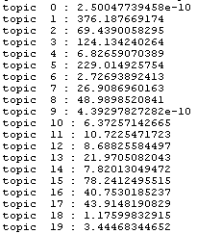
LDA
Topic sentiment score: ABS(W(“good”|topic) – W(“bad”|topic))
Best estimator
count

Slide 25
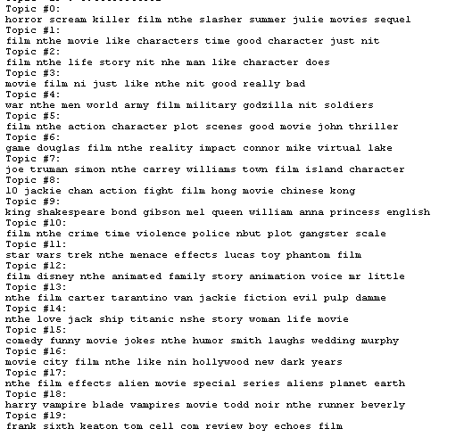
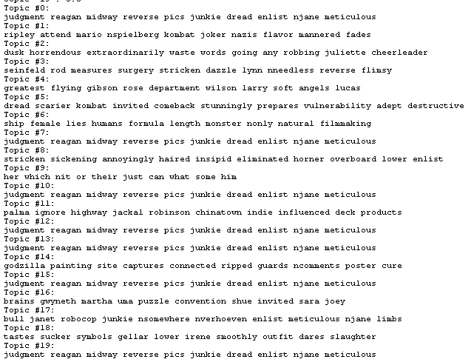
LDA
Top 10 words in topic:
LDA Best estimator
LDA count
horror
positive
army
positive
?
action
royal
crime
fiction

Slide 26
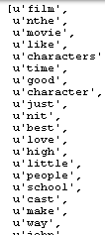
Print sentiment topic 1
LDA count

Slide 27
W2V Selection
Stratified 3 fold
SGD
Dataset
Baseline + new
0.94224
Evaluate
models + pipeline
update
Parameters
Raw Data
Baseline Parameters
Parse Data
Feature Extraction
Feature Selection
Word2Vec
Topic Analysis

Slide 28
Word 2 Vec
Model : sentiment (trained on given data)
Word selection:
Semi unsupervised
Supervised

Slide 29
W2V Algorithm:
Lists =
Read positive and negative word list (http://ptrckprry.com/course/ssd/)
Threshold =
For each list:
for each word in list
Calculate word similarity to “good” and “bad”
average and std similarities
threshold = average + std
Best_words =
For each word list
find most similar to “good” and “bad” and above threshold
Enrich_words =
for each word in Best_words:
if similarity > threshold*1.7
find Best_words(word, threshold*1.7 )
Find most similar(positive(word,senti_word),negative = opposite_word
(best + good – bad = worst)
Supervised_words=
Select top N words (MPI):
For each topNword:
Find K most similar words

Slide 30
W2V all words collected
Pos + neg Lists = 1471 + 3283
+ pos + neg best words = 145 + 329 = 5230
+ pos + neg enrich words = 479 + 534 = 5725
+ supervised = 2365 = 7024

Slide 31
W2V Topic Analysis
Stratified 3 fold
SGD
Dataset
Baseline + new
0.942
Evaluate
models + pipeline
update
Parameters
Raw Data
Baseline Parameters
Parse Data
Feature Extraction
Feature Selection
Tfidf
Word2Vec
Topic Analysis

Slide 32
W2V Topic Analysis
20 topics
analysis:
Top 10 words in topic:
Topic sentiment score: ABS(W(“good”|topic) – W(“bad”|topic))
Print sentiment topic

Slide 33
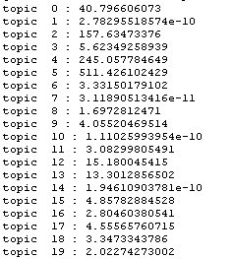
LDA Count
Topic sentiment score: ABS(W(“good”|topic) – W(“bad”|topic))
Previous
W2V

Slide 34
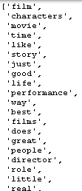
Best Topic words
Previous
W2V

Slide 35
W2V Evaluation
Stratified 3 fold
SGD
Dataset
Baseline + new
0.942
Evaluate
models + pipeline
update
Parameters
Raw Data
Baseline Parameters
Parse Data
Feature Extraction
Feature Selection
Tfidf
Word2Vec
Topic Analysis

Slide 36
W2V Evaluation
Algo 1 : univariate feature selection for different K
Algo 2: W2V word selection

Slide 37
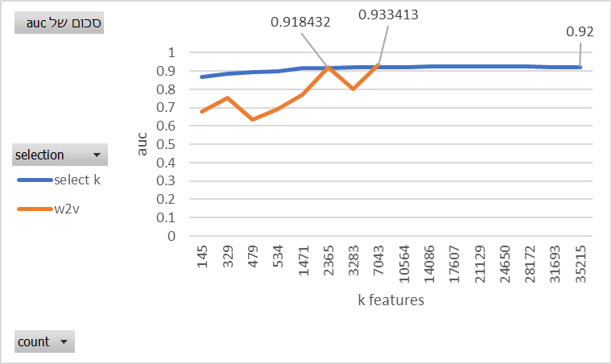
Evaluate w2v VS Feature Selection
W2v feature selection breaks the 0.92 AUC boundary!

