Slide 1
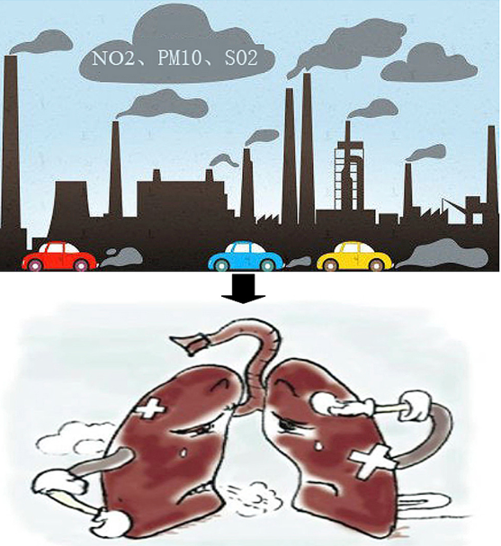
Impact of Air pollution On Hospitalizations from respiratory disease
89789 ..| Augusto Marques
92434 ..| Catarina Rodrigues
92626 ..| Filipa Costa
92643 ..| Patrícia Roxo
101475 | Maximilian Buxadé
Professor: Maria do Rosário De Oliveira Silva

Slide 2
1. Introduction
“Many of the world’s megacities exceed WHO’s guideline levels for air quality by more than 5 times, representing a major risk to people’s health”
Dr. Maria Neira, Director of the Department of Public Health, Social and Environmental Determinants of Health, at WHO.

Slide 3
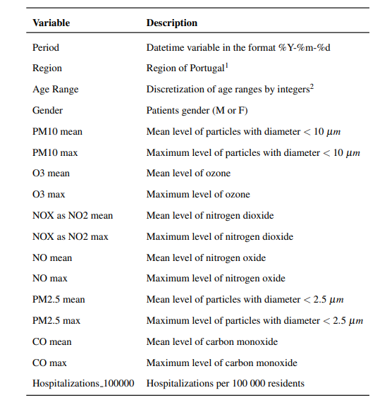
Table 1: Variables belonging to the used dataset, and their description.
2. Materials and Methods
2.1 Data Preparation
¹ Norte, Centro, LVT (Lisboa e Vale do Tejo), Algarve e Madeira. Does not include Açores and Alentejo regions.
² An age range of 1 represents ages between 0 and 25 years old. An age range of 5 represents ages between 25 and 45 years old, 6 between 45 and 65 years old, and 7 between 65 and 120 years old.

Slide 4
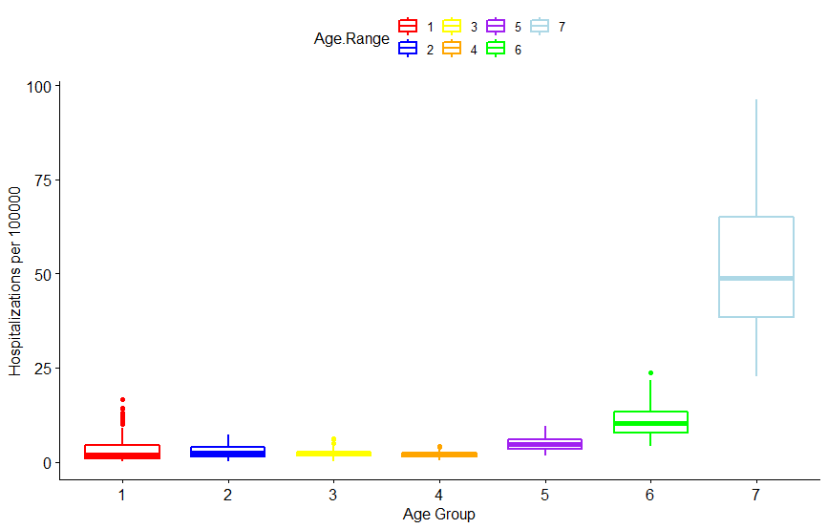
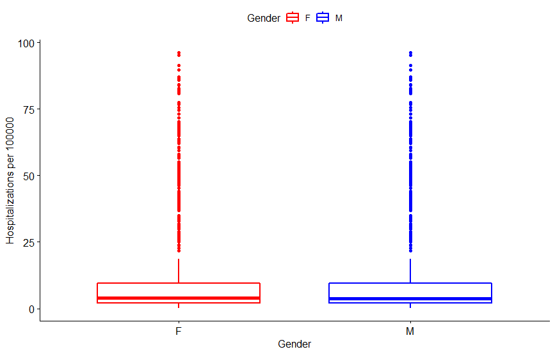
2. Materials and Methods
2.1 Data Preparation
(a)
(b)
Figure 1: Distribution of hospitalizations (a) per age ranges and (b) gender variables, in the original hospitalizations dataset, retrieved from SNS website.

Slide 5
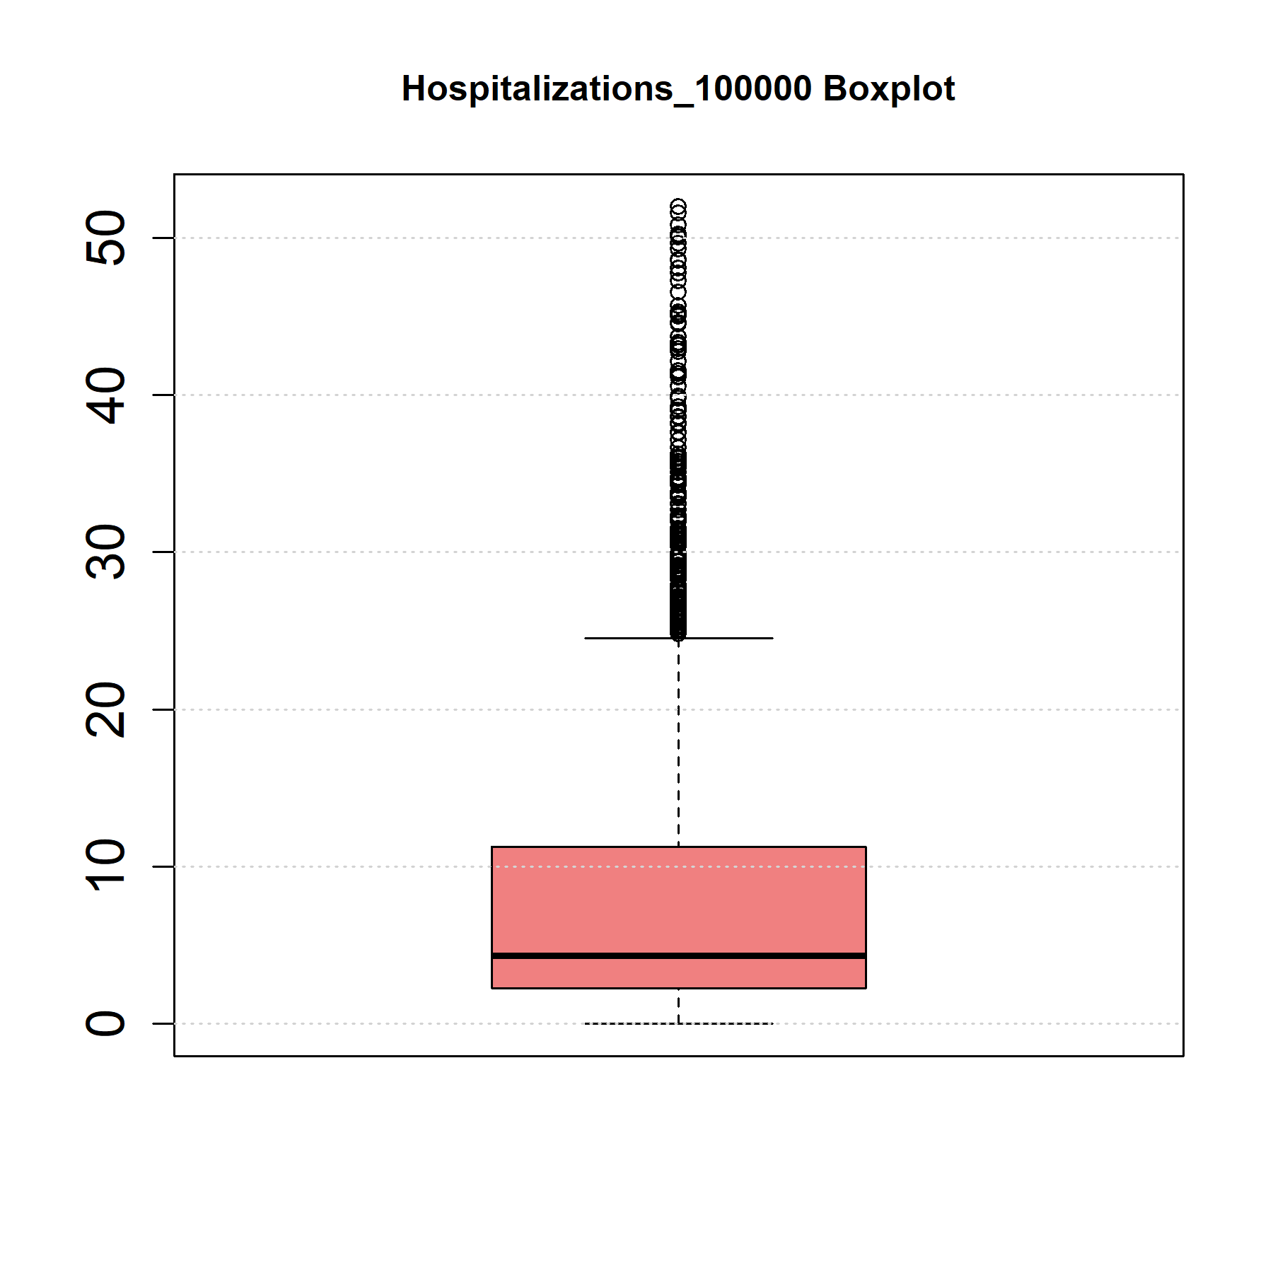
2.2 Outliers and Distributions
Figure 2: Boxplots Hospitalizations per 100 000 habitants.

Slide 6
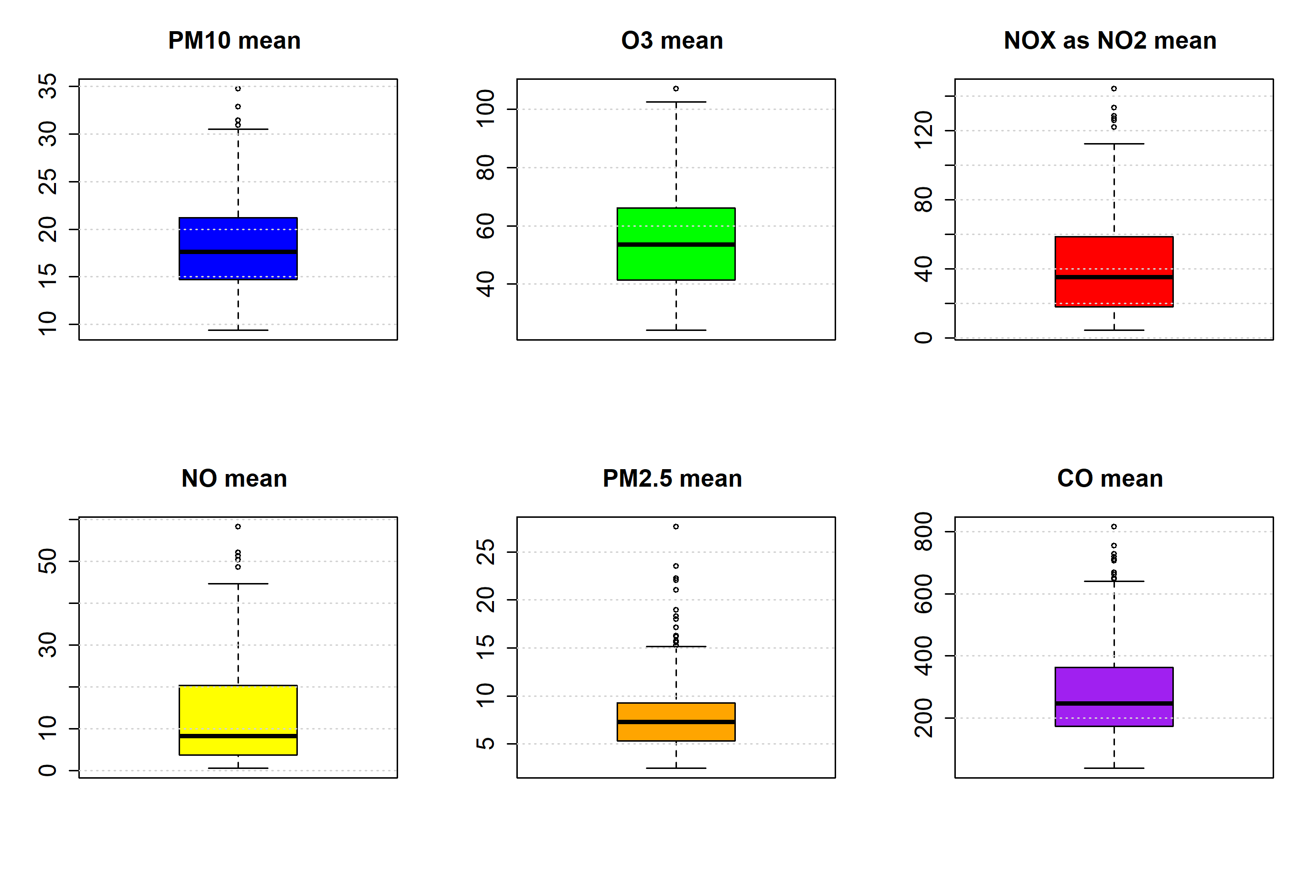
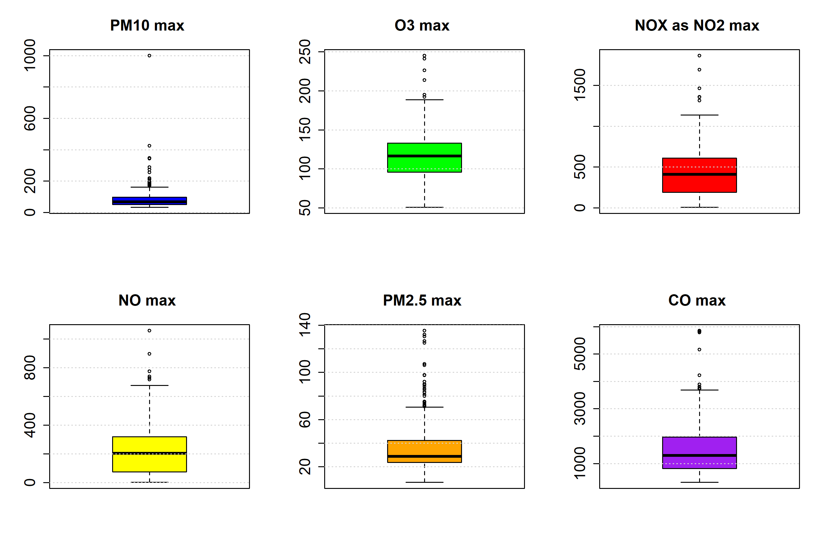
2.2 Outliers and Distributions
(a)
(b)
Figure 3: Boxplots of air pollutants (a) mean and (b) max, respectively.

Slide 7
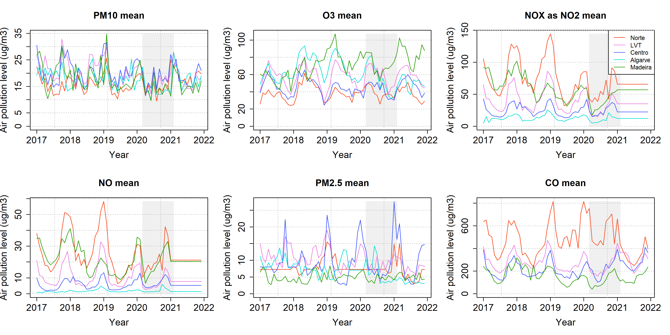
2.3 Temporal Dependency
Figure 4: Mean levels of the different air pollutants over time in each region of Portugal.

Slide 8
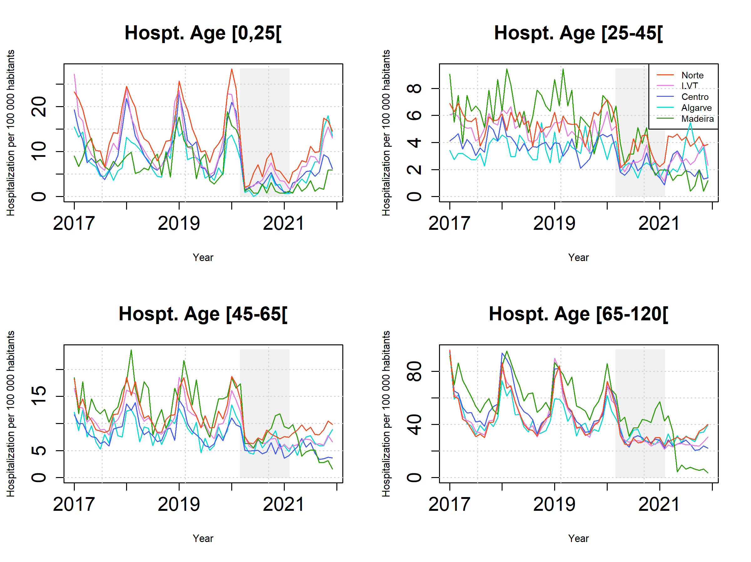
2.3 Temporal Dependency
Figure 5: Hospitalizations per 100 000 residents for different age ranges.

Slide 9
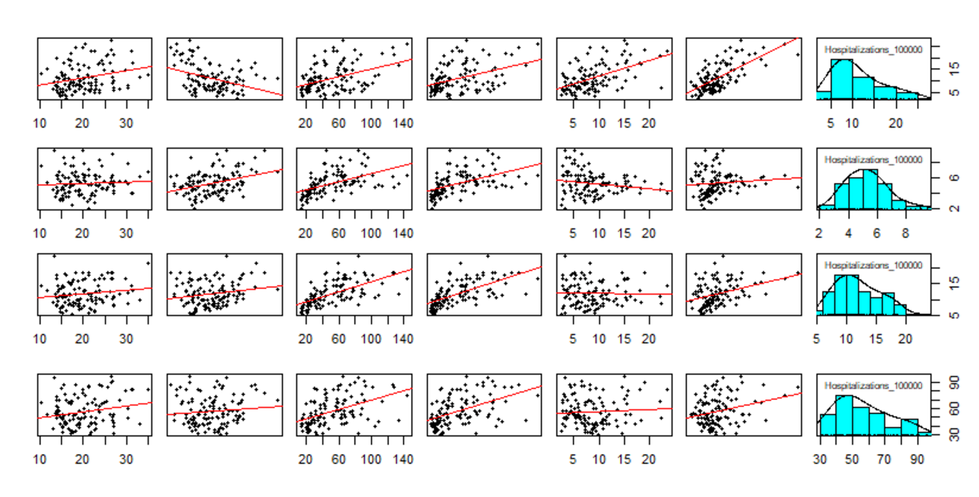
2.4 Correlation Analysis
Figure 6: From left-to-right: correlation between PM10, O3, NOx as NO2 mean, NO, PM2.5, CO and the number of hospitalizations per 100 000 residents per age group. From top-to-bottom: correlations for age group [0,25[ and respective relative hospitalizations density, correlations for age group [25,45[ and respective relative hospitalizations density, correlations for age group [45,65[ and respective relative hospitalizations density and correlations for age group [65,120[ and respective relative hospitalizations density.

Slide 10
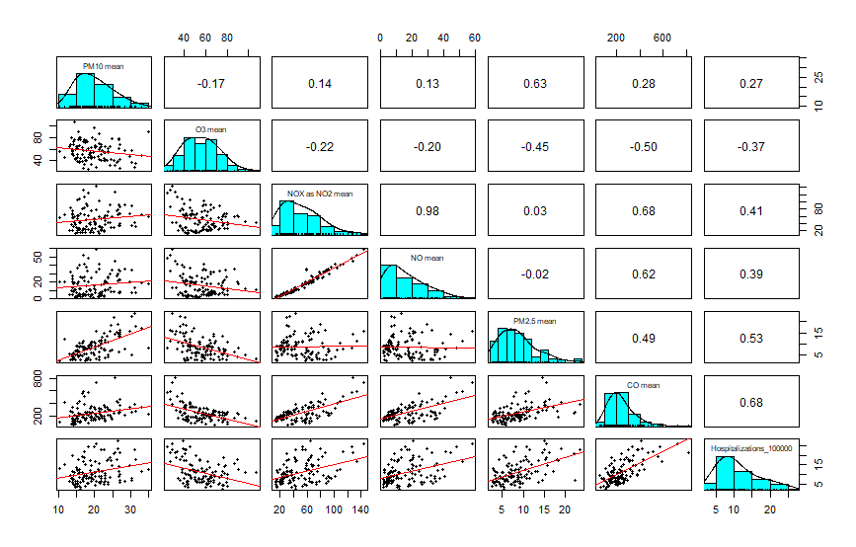
2.4 Correlation Analysis
Figure 7: Correlation between each pollutant and relative number of hospitalizations per 100 000 residents for age group [0,25[.

Slide 11

2.5 Missing Values

Slide 12
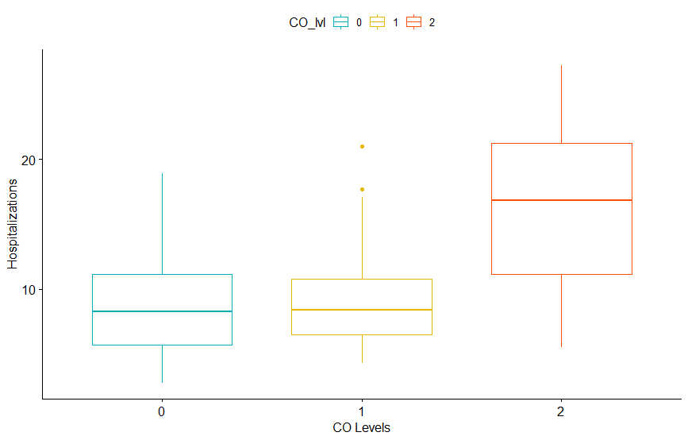
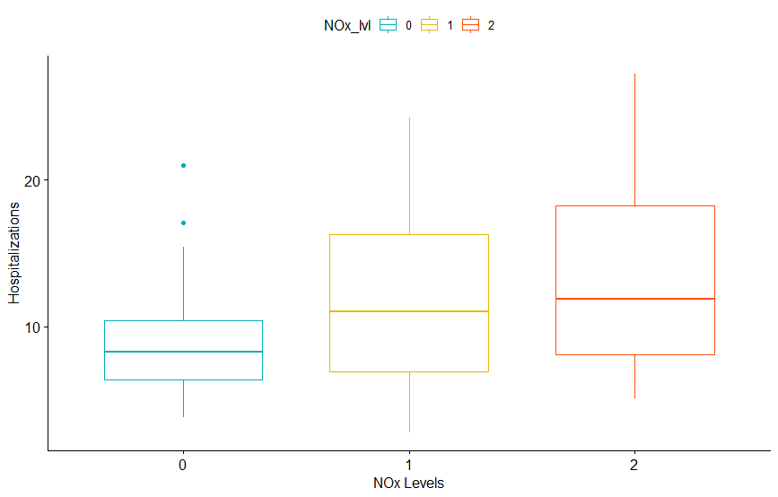
3. Results and Discussion
3.1 Kruskal-Wallis Test
(a)
(b)
Figure 8: Hospitalizations per 100.000 habitants of age group [0,25[ for different levels of (a) CO and (b) NOx.

Slide 13
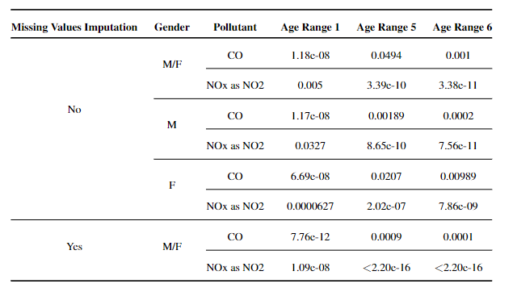
3.2 Model Selection
Table 2: Kruskal Wallis Test p-value results.

Slide 14
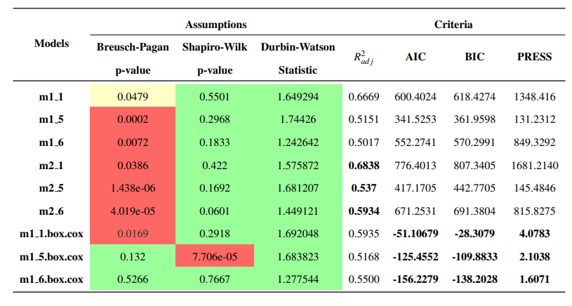
3.3 Prediction
Table 3: Results of Breusch-Pagan Test, Shapiro-wilk Test and Durbin-Watson Test for nine models considered to verify different assumptions; Results of performance measures R2 adj, AICc, BIC and PRESS.
Model 1, Age [0,25[: Hospitalizations = 7,756*** + 0.037.(CO mean)*** + 0.069.(PM2.5 mean)*** - 0.076.(O3 max)*** - 0.059.(NOX as NO2 mean)*** + 0.064.(O3 mean)*
Model 1, Age [25,45[: Hospitalizations = 2.836*** + 0.833.(LVT)* + 1.396.(Madeira)** + 0.451.(Norte) + 0.019.(NOx as NO mean)** + 0.027.(O3 mean)* - 0.006.(O3 max)
Model 1, Age[45,65[: Hospitalizations = 7.659*** + 1.498. (LVT).+ 5.601.(Madeira)*** + 0.139.(Norte) + 0.016.(CO mean)*** + 0.017.(O3 max).

Slide 15
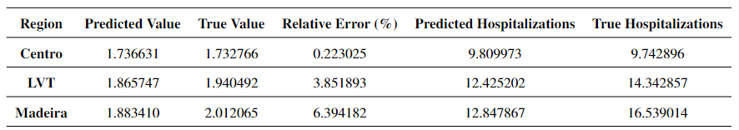
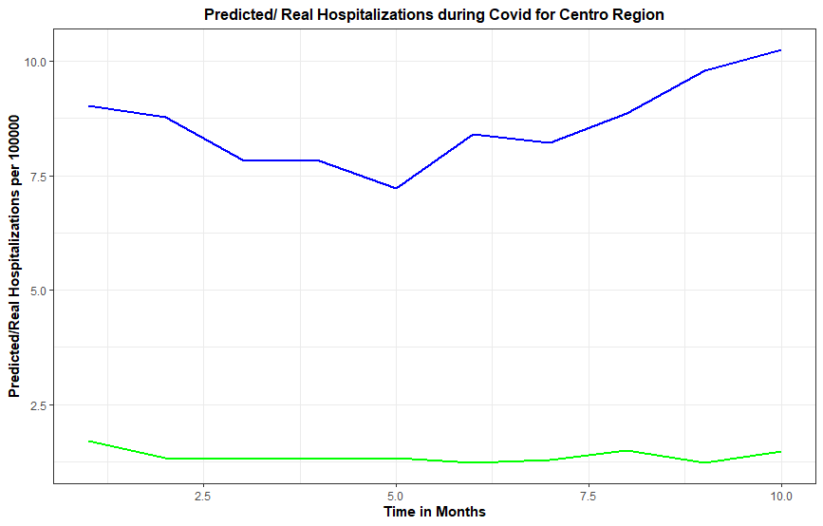
3.3 Prediction
Table 4: Prediction Results for Age group 6.
Figure 9: Hospitalizations per 100.000 residents of Age Group 6, for Centro Region, from March 2020 until December 2020.

Slide 16
4. Conclusions
It was possible to infer a positive link between two singled out pollutants, NO2 and CO, and respiratory diseases;
The models used to study the effect of the pollutants were taken to study the sudden drop in hospitalizations during the COVID-19 pandemic seen in the data;
The predicted values from the models show that during the pandemic, the hospitalizations due to respiratory disease decreased significantly;
Men’s health may be more affected by pollution than women’s;
Infants through young adults are susceptible to more air pollutants than other age groups;
The older half of the working population, aged [45,65[, being the best modelled group, are thus presumably less exposed to other random factors that could influence their respiratory system.

Slide 17
Impact of Air pollution On Hospitalizations from respiratory disease
89789 ..| Augusto Marques
92434 ..| Catarina Rodrigues
92626 ..| Filipa Costa
92643 ..| Patrícia Roxo
101475 | Maximilian Buxadé
Professor: Maria do Rosário De Oliveira Silva

