Slide 2
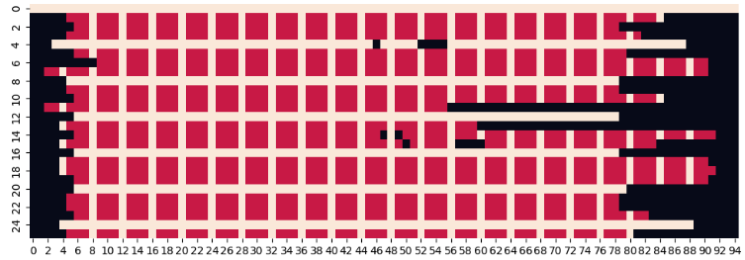
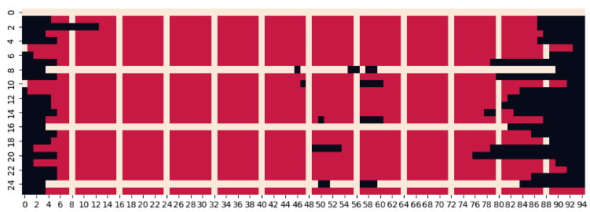
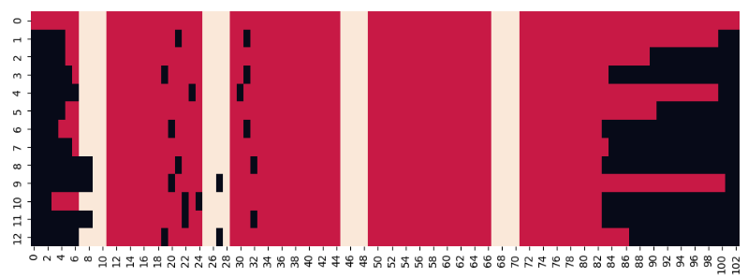
MSA RAG model training
Grid mask
Pretrained single-seq model (154M)
Training data | #Tokens | Training sample weight
cogdata_task_ur50_task | 15.2B | 0.085
cogdata_task_ur90_task | 37.9B | 0.195
cogdata_task_colab_c_task | 37.7B | 0.195
cogdata_task_colab_m_task | 103.4B | 0.525
Step=4
~43%
Mask = 1
Mask = 0
512 * 1024 * 381469=200B
Step=8
~23%
Random mask
Row mask
Query seq mask
Span mask
Col mask
Grid mask
Span mask
/nfs_beijing_ai/xingyi/plm_scaling_law/mlm/checkpoints/mlm_154M_all1ep
/nfs_beijing_ai/xingyi/scaling_law/configs/scaling_law/mlm/mlm_154M_all1ep.sh

Slide 3
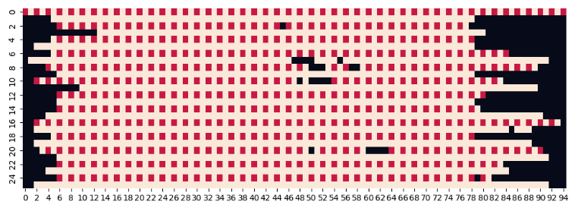
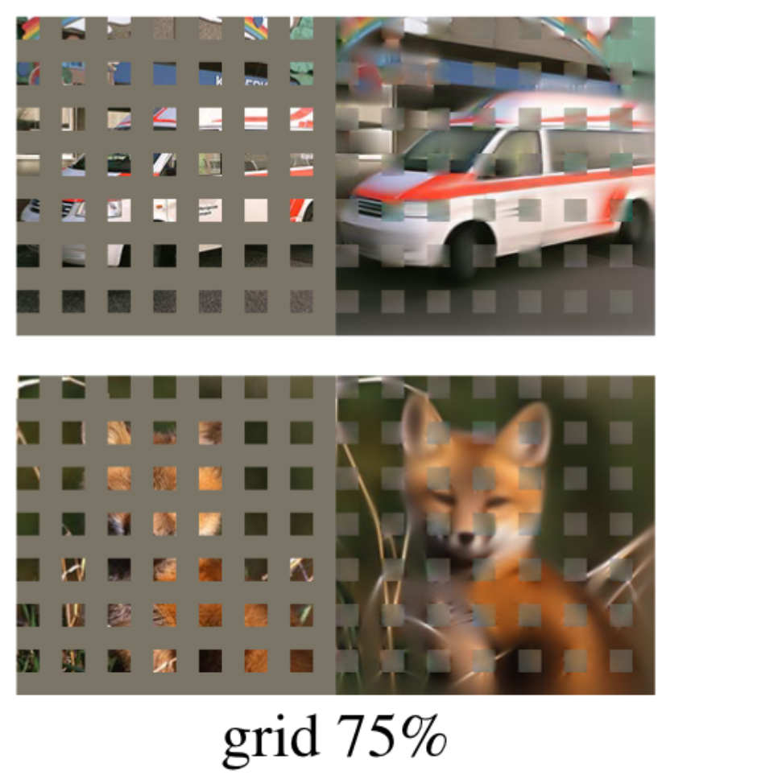


Grid mask
Step=2
~75%
Mask = 1
Mask = 0
Step=4
~43%
Theoretical masking rate:
$$\frac{NL}{Step}+\frac{NL}{Step}−\frac{N}{Step}∗\frac{L}{Step}$$
Step=8
~23%
$$\frac{2}{Step}−\frac{1}{Step^{2}}$$

Slide 4
MSA RAG: sequence recovery of different masking strategies
PPL
Experiments | Train #MSA | Masking | Dataset 0.5 (col mask 15% & span mask 3)
 |  |  | Val #MSA: 128 | Val #MSA: 50 | Val #MSA: 1
Pretrained ckpt | N/A | N/A | 12.575, 12.921 (+0.35)
rag_154m_uniref50_col15_row02/global_step30517 | 50 | Col mask 15% + Row mask 2% | 10.682, 11.182 (+0.5) | 11.112, 11.729 (+0.62) | 15.985, 16.983 (+1.0)
rag_154m_uniref50_gridmask_step4/global_step9000 | 50 | Grid mask (step=4) | 11.350, 13.875 | 11.598, 13.833 | 14.024, 15.363
rag_154m_uniref50_gridmask_step8/global_step9000 | 50 | Grid mask (step=8) | 11.340, 12.507 | 11.591, 12.691 | 14.072, 15.108
rag_154m_uniref50_gridmask_step8/global_step24000 | 50 | Grid mask (step=8) | 11.222, 12.112 | 11.446, 12.294 | 13.817, 14.696
rag_154m_uniref50_col05_row02_colspan3_msa128/global_step28000 | 128 | Col mask 5% + Col span 3 + Row mask 2% | 10.443, 10.882 (+0.44) | 10.980, 11.441 (+0.46) | 14.508, 14.935 (0.427)
Increase training MSA number from 50 to 128;
50% probability to sample MSA number from 0 to 128;
Col mask 5% + span 3 -> 15% column mask

Slide 5
MSA RAG: sequence recovery of different masking strategies
PPL
Experiments | #MSA | Masking | Datset 0.5
 |  |  | MSA: 128 | MSA: 50 | MSA: 1
Single sequence | 0 | Random mask | 12.575, 12.921
rag_154m_uniref50_random0_col15_row05/global_step6000 | 25 | Col mask 15% + Row mask 5% | 11.575, 12.335 | 11.682, 12.434 | 15.198, 15.724
rag_154m_uniref50_random0_col15_row15/global_step6000 | 25 | Col mask 15% + Row mask 15% | 11.493, 12.235 | 11.573, 12.312 | 14.913, 15.324
rag_154m_uniref50_col15_row02/global_step30517 | 50 | Col mask 15% + Row mask 2% | 10.682, 11.182 | 11.112, 11.729 | 15.985, 16.983
rag_154m_uniref50_gridmask_step4/global_step9000 | 50 | Grid mask (step=4) | 11.350, 13.875 | 11.598, 13.833 | 14.024, 15.363
rag_154m_uniref50_gridmask_step8/global_step9000 | 50 | Grid mask (step=8) | 11.340, 12.507 | 11.591, 12.691 | 14.072, 15.108
rag_154m_uniref50_gridmask_step8/global_step24000 | 50 | Grid mask (step=8) | 11.222, 12.112 | 11.446, 12.294 | 13.817, 14.696
rag_154m_uniref50_col05_row02_colspan3_msa128/global_step28000 | 128 | Col mask 5% + Col span 3 | 10.443, 10.882 | 10.980, 11.441 | 14.508, 14.935
Experiments |  | #MSA | Masking
rag_154m_uniref50_random0_col15_row05 | global_step6000 | 25 | Col mask 15% + Row mask 5%
rag_154m_uniref50_random0_col15_row15 | global_step6000 | 25 | Col mask 15% + Row mask 15%
rag_154m_uniref50_col15_row02 | global_step30517 | 50 | Col mask 15% + Row mask 2%
rag_154m_uniref50_gridmask_step4 | global_step9000 | 50 | Grid mask (step=4)
rag_154m_uniref50_gridmask_step8 | global_step9000
rag_154m_uniref50_gridmask_step8 | global_step24000 | 50 | Grid mask (step=8)
rag_154m_uniref50_col05_row02_colspan3_msa128 | global_step28000 | 128 | Col mask 5% + Col span 3

Slide 6
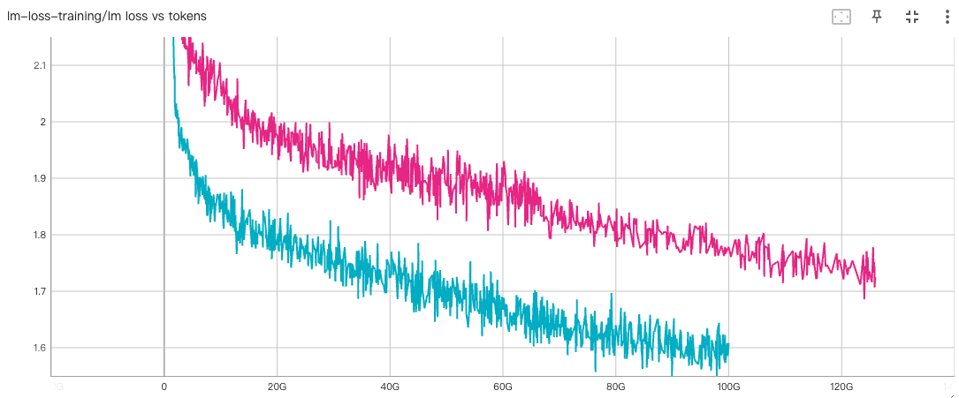
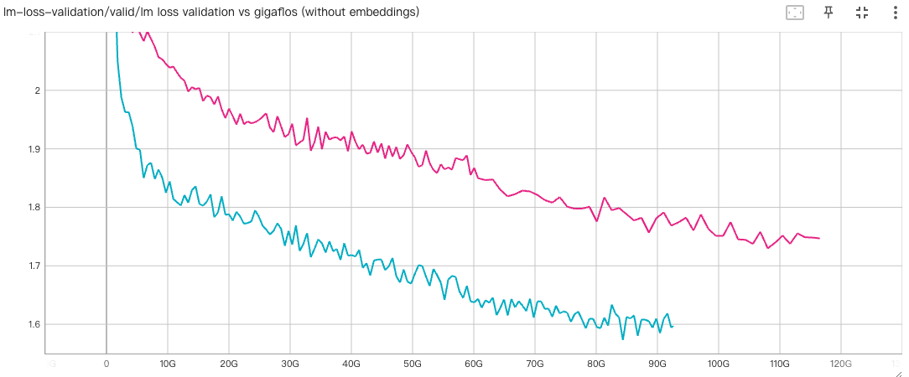
MSA RAG: learning curve
Col mask: 5% + span 3
MSA=128
Col mask: 15%
MSA=50

Slide 7
More MSA sequences produce higher recovery
Checkpoint: rag_154m_uniref50_col15_row02
ID=0.9
ID=0.5
N=400
N=417
PPL (MSA) – PPL (SingleSeq)

Slide 8
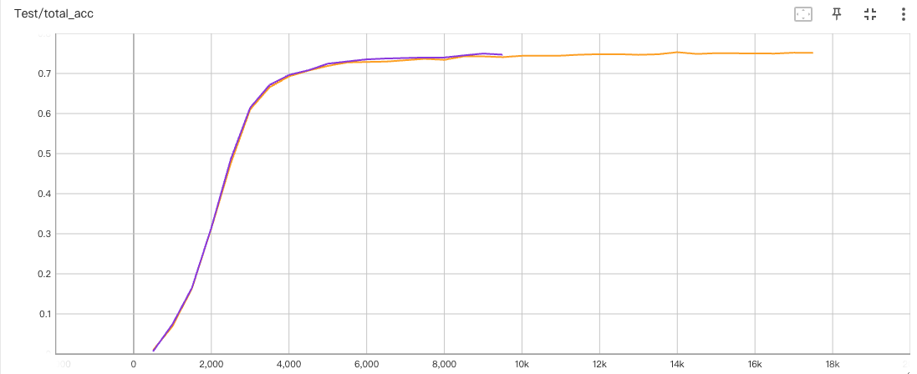
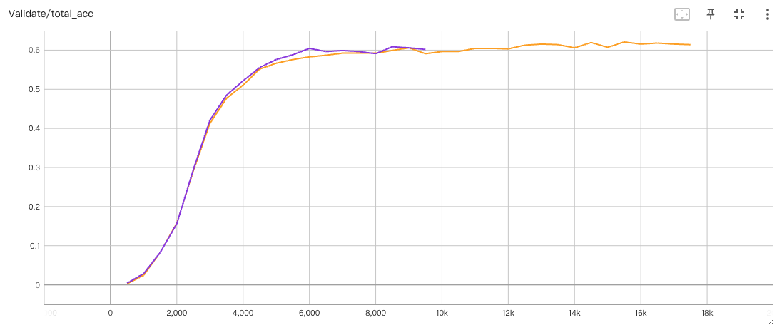
MSA RAG: fold classification
Test
0.7497
0.7531
Checkpoint: rag_154m_uniref50_col15_row02
MSA: 50
MSA: 128
Validation
0.6087
0.6209

Slide 9
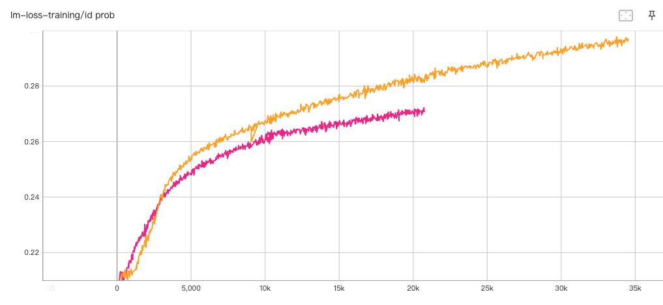
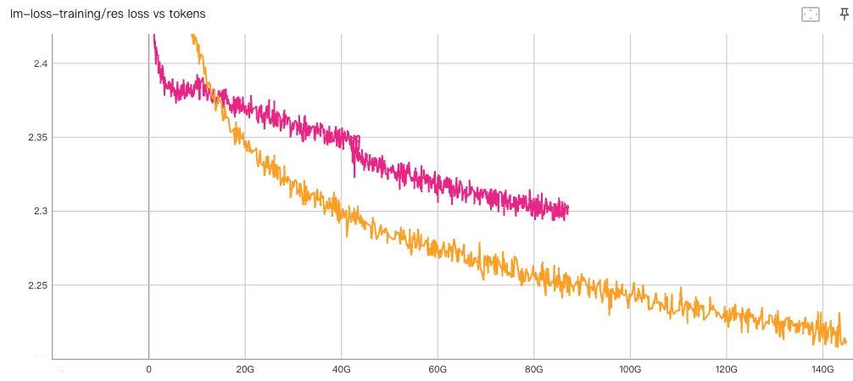
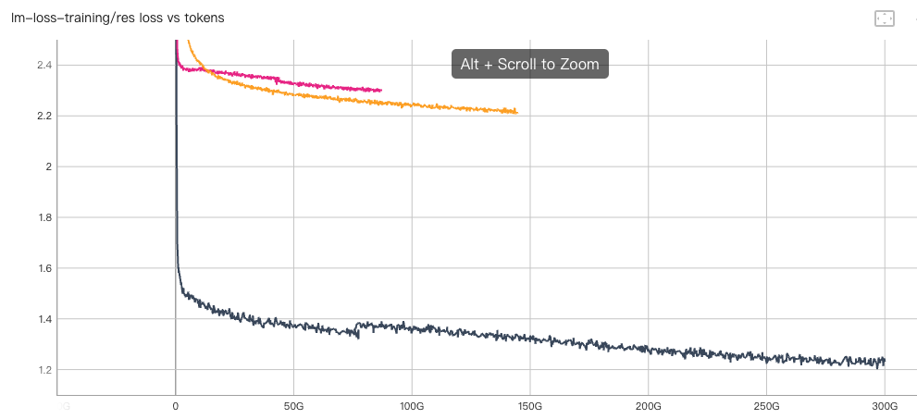
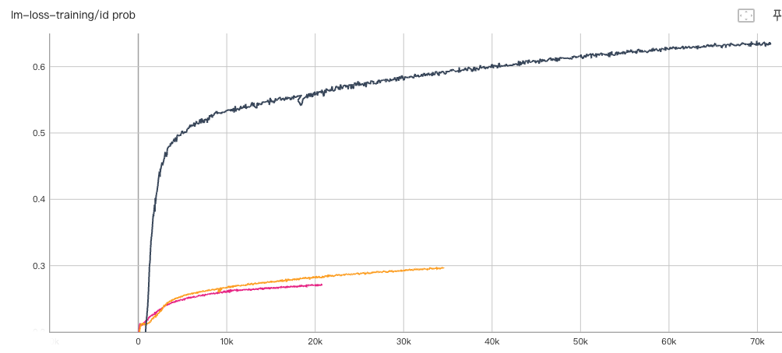
ColabFold retriever
ID prob
Residue loss
GPT model with MLM checkpoint
GPT model with GPT checkpoint
UniClust30: GPT model with GPT checkpoint
MLM checkpoint (mlm_3b_all5ep_noreg_tk200b_cl1024_bsz1m_scratch) may train more tokens on ColabFold datasets

