Slide 1
Custom Ansible Modules
Florin Lipan

Slide 2
What?
„Reusable, standalone scripts that can be used by Ansible”
„They return information to ansible by printing a JSON string to stdout before exiting”
„They take arguments in one of several ways”

Slide 3
Why?
Services that are not mapped to existing Ansible modules
Custom logic that is not mapped to existing Ansible modules
Interfacing with other programming languages
Hiding complexity behind a simple interface

Slide 4
1378
Sa'im al-Dahr is hanged, for blowing the nose off the Sphinx.

Slide 5
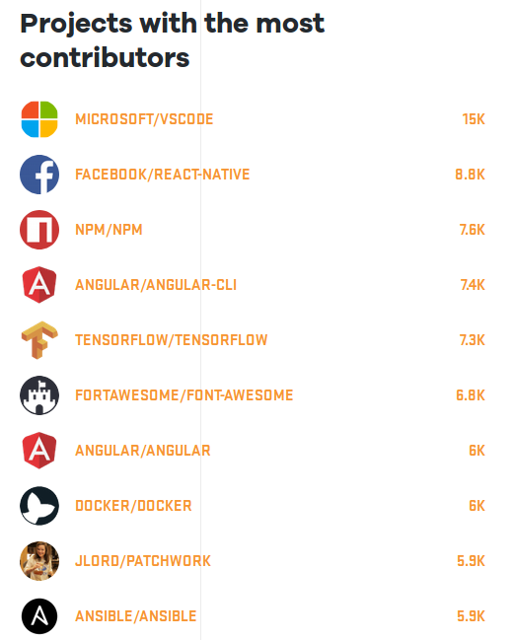
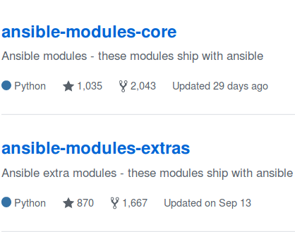
1378

Slide 6
Why not?
Consider roles
Consider action/vars/lookup/inventory plugins

Slide 7
Most basic module
# library/most_basic_module.py
#!/usr/bin/env python
import sys
def main():
sys.stdout.write('{"changed":true}')
if __name__ == '__main__':
main()

Slide 8
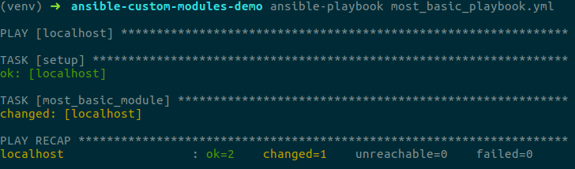
Most basic playbook
- hosts: localhost
connection: local
tasks:
- most_basic_module:

Slide 9
AnsibleModule
# library/my_module.py
#!/usr/bin/env python
from ansible.module_utils.basic import AnsibleModule
def main():
module = AnsibleModule(
argument_spec=dict(),
supports_check_mode=False
)
result = dict()
result["changed"] = True
module.exit_json(**result)
if __name__ == '__main__':
main()

Slide 10
Custom output (1)
# library/my_module.py
#!/usr/bin/env python
from ansible.module_utils.basic import AnsibleModule
def main():
module = AnsibleModule(
argument_spec=dict(),
supports_check_mode=False
)
result = dict()
result["changed"] = True
result["my_data"] = {"hello": "world"}
module.exit_json(**result)
if __name__ == '__main__':
main()

Slide 11
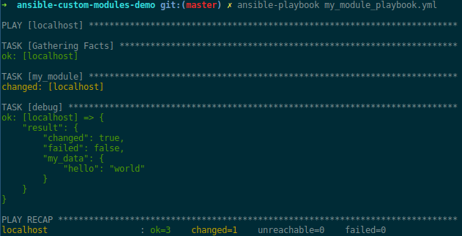
Custom output (2)
- hosts: localhost
connection: local
tasks:
- my_module:
register: result
- debug: var=result

Slide 12
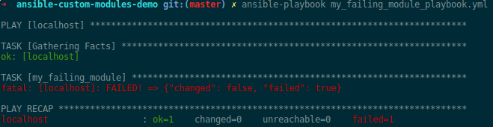
Failing
# library/my_failing_module.py
#!/usr/bin/env python
from ansible.module_utils.basic import AnsibleModule
def main():
module = AnsibleModule(
argument_spec=dict(),
supports_check_mode=False
)
result = dict()
result["failed"] = True
module.exit_json(**result)
if __name__ == '__main__':
main()

Slide 13
Arguments (1)
# library/my_module_with_args.py
# ...
argument_spec = {
'name': {'type': 'str', 'required': True},
'scores': {'type': 'list', 'required': False, 'default': []}
}
module = AnsibleModule(
argument_spec=argument_spec,
supports_check_mode=False
)
name = module.params["name"]
scores = module.params["scores"]
#...

Slide 14
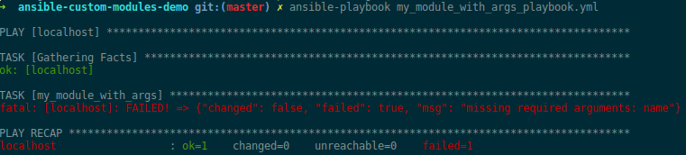
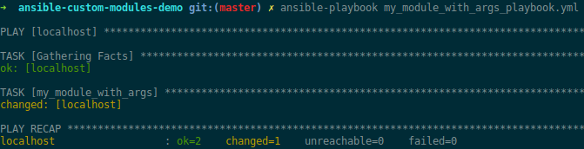
Arguments (2)
- hosts: localhost
connection: local
tasks:
- my_module_with_args: name="florin" scores="{{ [1, 2, 3] }}"

Slide 15
Arguments (3)
# library/my_module_with_args.py
# ...
argument_spec = {
'name': {'type': 'str', 'required': True},
'scores': {'type': 'list', 'required': False, 'default': []},
'state': {'choices': ['present', 'absent'], 'default': 'present'},
'options': {'type': 'dict', 'default': {}},
}
#...

Slide 16
Arguments (4)
# library/my_module_with_more_args.py
# ...
module = AnsibleModule(
argument_spec=argument_spec,
required_together=[
['name', 'scores'],
],
required_one_of=[
['state', 'options']
],
mutually_exclusive=[
['name', 'options']
],
supports_check_mode=False
)
#...

Slide 17
Other languages: Ruby (1)
# library/my_ruby_module.rb
#!/usr/bin/env ruby
require "json"
params = {}
arguments = File.read(ARGV[0])
arguments.split(" ").each do |argument|
key, value = argument.split("=")
next unless key && value
params[key] = value
end
# This is how you fetch parameters
params["name"]
puts ({ changed: true, params: params }).to_json

Slide 18
Other languages: Ruby (2)
- hosts: localhost
connection: local
tasks:
- my_ruby_module: name="florin" state="present"
register: result
- debug: var=result
<1.2.3.4> PUT /tmp/tmpsZsEbg TO /home/ubuntu/.ansible/tmp/ansible-tmp-1511273742.3-225952978315588/my_ruby_module.rb

Slide 19
Recap
Pass, cast and validate arguments
(Use different programming languages)
Hide complexity
Build "user"-friendly interfaces

Slide 20
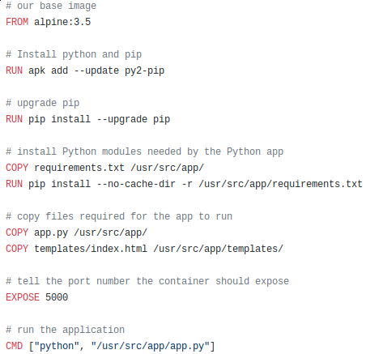
A "user"-friendly interface?

Slide 21
Something simple...

Slide 22
Building infrastructure
- hosts: localhost
connection: local
tasks:
- microservice:
name: "some-service"
instance_type: "t2.small"
instance_count: 2
db_instance_type: "db.t2.small"
db_engine: "postgres"
db_storage: 5
public_lb: yes
state: "present"

Slide 23
How?
Use (sane) defaults
Use conventions (e.g. DNS)
Hide complexity
Idempotence

Slide 24
Questions?
https://github.com/lipanski/ansible-custom-modules-demo

Slide 25
Reference
http://docs.ansible.com/ansible/latest/list_of_all_modules.html
http://docs.ansible.com/ansible/latest/dev_guide/developing_modules.html
http://docs.ansible.com/ansible/latest/dev_guide/developing_modules_general.html

