Slide 1


CS250 - SDLC
Comprehensive Analysis of Scrum-Agile to Waterfall for Software Development Lifecycle Modeling
By: Phillip Cowan

Slide 2
Objectives
Explaining Agile Roles: Explain the various roles on a Scrum-Agile Team by identifying each role and describing its importance.
Explaining Agile Phases: Explain how the various phases of the SDLC work in an Agile approach. Identify each phase and describe its importance.
Describing Waterfall Model: Describe how the process would have been different in a waterfall development approach rather than the Agile approach you used. For instance, you might discuss how a particular problem in development would have proceeded differently.
Waterfall or Agile Approach: Explain the factors to consider when choosing a waterfall or Agile approach, using your course experience to back up your explanation.

Slide 3
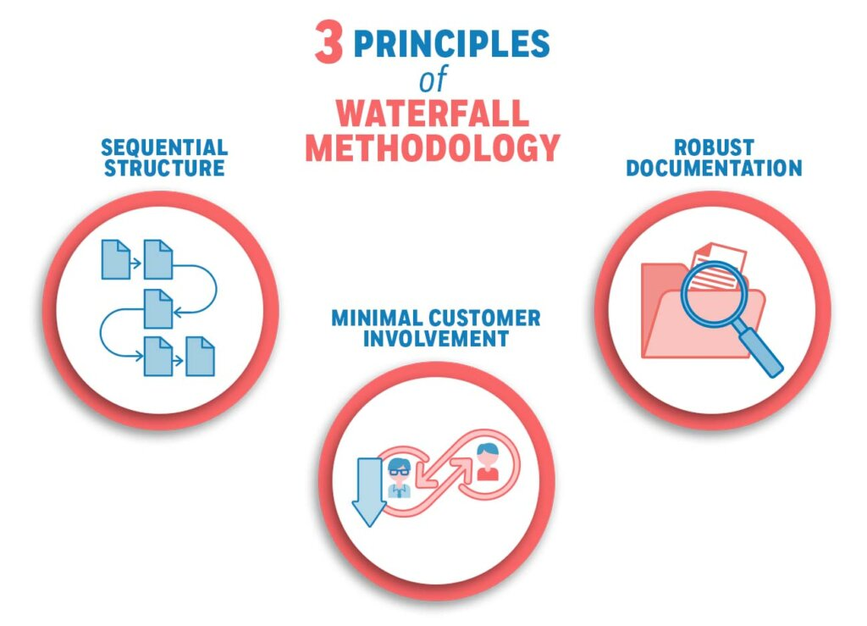
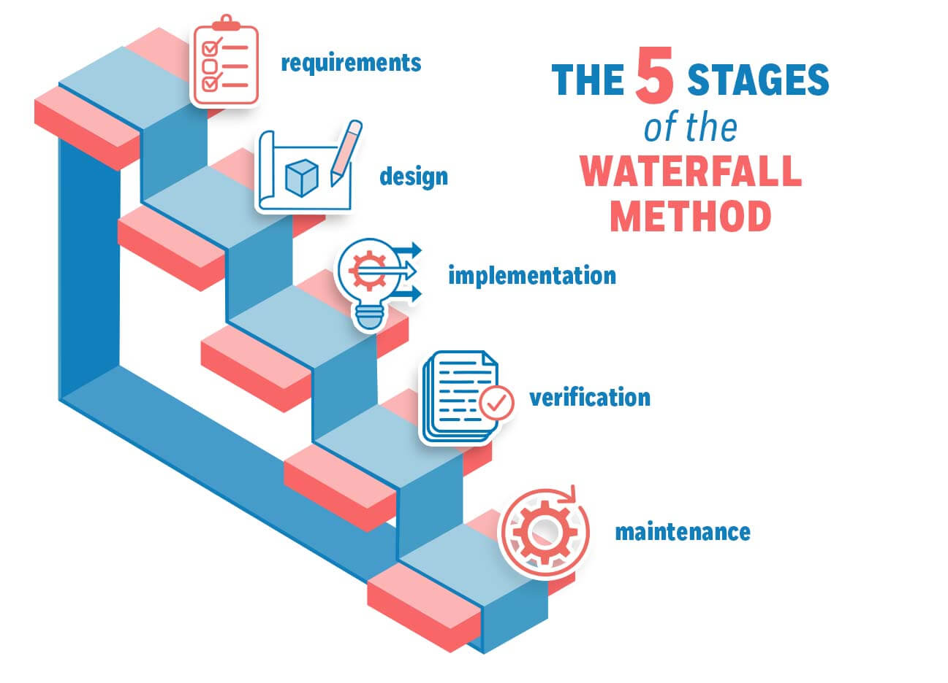
Waterfall
Linear and Sequential
Distinct Goals for each Phase
No turning back once a phase has been completed
Plan Driven with detailed requirements and documentation

Slide 4
Top destinations using Waterfall
If we had completed the Top Destinations project using the more traditional waterfall approach…
Less customer feedback and interaction overall – no case studies and feedback from sprint reviews.
No changes or flexibility – for example we wouldn’t have been able to change from top destinations overall to more wellness retreat focused.
More likely to face delays while sorting out the specific requirements rather than relying on the feedback of the customers and tailoring it to them.

Slide 5
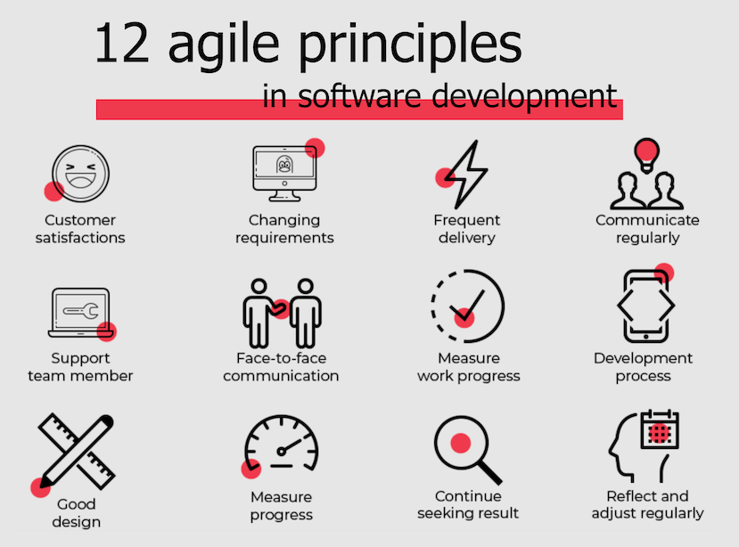
Agile
Adaptive, continuous improvement method, iterative.
Process adaptability and customer satisfaction focused.
Allows for rapid delivery of a working software product piecewise.
Minimal documentation requirements comparatively
High individual dependencies
“Individuals and Interactions over processes and tools. Working software over comprehensive documentation. Customer collaboration over contract negotiation. Responding to change over following a plan.”

Slide 6
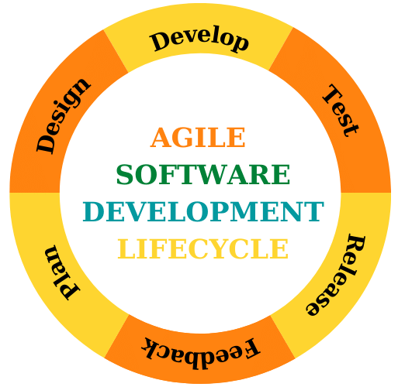
Agile Phases
Concept & Planning
Design – Develop – Test
Deploy & Review
Repeat above as as needed.
Launch Public Version

Slide 7
Scrum Roles
Product Owner
Voice of the Customer and Stakeholders
Responsible for maximizing value of the product and managing the backlog
Scrum Master
Servant Leader, Facilitator, coach
Responsible for ensuring team follows Scrum procedures, minimizing distractions and enable the teams. self-organization
Development Team
Self-organized, Cross-functional, committed.
Responsible for meeting sprint requirements, collaborating, and participating

Slide 8
Top destinations using Agile-Scrum
Since we were using agile …
We were able to change the focus from top destinations overall more wellness retreat focused destinations.
Initial case studies mapped the features needed and feedback from sprint reviews allowed quick changes without delaying the deliverables.
Had there been more changes needed before launch was ready we could have circled back over multiple sprints updating and maximizing customer satisfaction with the product prior to official release.
(Similar to Early Access games or beta versions which rely on customer feedback and analytics to prioritize updates and polish features before release to market)

Slide 9
Factors to Consider
Requirements
Agile: Complex or evolving requirements
Stakeholder Involvement
Agile: Continual feedback and regular meetings
Waterfall: Hands-off approach beyond initial planning and requirements
Timeline Flexibility
Agile: Short iterations/sprints and deliver value quickly.
Waterfall: Non-flexible – fixed timeline for each phase and task
Risk
Agile: Acceptable part of the process, adapt to correct issues as they come up.
Waterfall: Planning and design are risk management focused, anything missed during project that is unplanned will need to be patched later.
Waterfall: Clear, well-defined, and fixed.

Slide 10

References
Walker, A. (2014, Mar 21). The agile march madness bracket: Picking the best bracket. https://www.credera.com/blog/management-consulting/agile-march-madness-bracket-picking-best-bracket/
Bestarion (2025, May 22). Agile Methodology: Definition, Phases and Types https://bestarion.com/us/agile-methodology/#Benefits_of_Agile_Methodology
Tutorials Point. Learn SDLC https://www.tutorialspoint.com/sdlc/index.htm
ScrumGuides (2020) The 2020 Scrum Guide https://scrumguides.org/
Cobb, C. G. (2015). The project manager’s guide to mastering Agile: Principles and practices for an adaptive approach. John Wiley & Sons. https://research.ebsco.com/linkprocessor/plink?id=7668dde5-7ba6-35a3-8cf4-b4aeb8440d2d
Overeem, B. (2017). Characteristics of a great Scrum team. https://www.infoq.com/articles/great-scrum-team/

