Slide 1
(Lipchen98 – SSMS)
LIPCHEN98 Specialty Chemical Consultant
(LIPCHEN98 特殊化工咨询顾问公司）
August 2024

Slide 2
Objectives and Customers
(Lipchen98 – SSMS)
Offer free technical services for the customers on the material sciences related characterization and processing questions
Separation science plays a critical role in many industrial processes and applications.
We can be called as Lipchen98 – SSMS (Lipchen98 – SSMS)

Slide 3

Separation Science
(Lipchen98 – SSMS)
Separation science and techniques play critical roles in many industrial processes and applications. They are especially important in Specialty Chemical industries to ensure the success on the product development, performance evaluation, quality control, troubleshooting and characterization. Separation science is a broad and complicated field. Here we just focused on some popular chromatographic separation techniques and applications.
Just as Dr. Giddings described in his book “Unified Separation Science” that unifies the complex welter of techniques used for chemical separations by clearly formulating the concepts that are common to them. The mass transport phenomena underlying all separation processes are developed in a simple physical-mathematical form. The limitations and optimum performance of alternative separation techniques and the factors enhancing and limiting separation power can thus be described and explored.”
“Unified Separation Science by J. Calvin Giddings is a great book for people starting in any type of separation sciences. It is easy to understand and explains many important concepts that are necessary to understand the chromatographic phenomena.”

Slide 4
Technical Services: Separation and Characterization Techniques
(Lipchen98 – SSMS)
i. Chromatography
GC, HPLC, GPC, IC, FFF
ii. Spectroscopy
FTIR, NMR, AFM, NIR, MS, MALDI
iii. Thermal
DSC, TGA, DMA, TMA
iv. Compatibility
VTS, calorimetry

Slide 5
Techniques used in Materials Characterization
(Lipchen98 – SSMS)
Characterization Techniques:
i. Chromatography
ii. Spectroscopy
iii. Thermal
iv. Compatibility
Materials:
i. Polymers
ii. Water treatment and oil field
iii. Mining chemicals
iv. Polymer additive
v. Coating chemicals (melamine, epoxy and urethane)
vi. Energetics
vii. Resin and Composite
1. Phenolic Resin
2. Epoxy Resin
3. Amino Resin
4. Isocyanate
5. Polyimide
6. Polyacrylate

Slide 6
Materials Science Study the properties and applications of materials of construction or manufacture (such as ceramics, metals, polymers, and composites). Materials Science Study the properties and applications of materials of construction or manufacture (such as ceramics, metals, polymers, and composites). Materials scientists work with diverse types of materials (e.g., metals, polymers, ceramics, liquid crystals, composites) for a broad range of applications (e.g., energy, construction, electronics, biotechnology, nanotechnology) employing modern processing and discovery principles (e.g., casting, additive manufacturing ...
(Lipchen98 – SSMS)
Materials Science and Characterization

Slide 7
Technical Services: Materials
(Lipchen98 – SSMS)
i. Polymers
Hydroxyl terminated, carboxyl terminated polymers, polyester, polyamide
ii. Water treatment and oil field
Acrylate polymer
iii. Mining chemicals
Cynate
iv. Polymer additive
Phenolic and analine type antioxidant
v. Coating chemicals (melamine, epoxy and urethane)
vi. Energetic material
TNT, HMX, RDX, NG, NC, CL-20
vii. Resin and Composite
1. Phenolic Resin
Novolac and resole
2. Epoxy Resin
Aromatic and aliphatic epoxy, curative
3. Amino Resin
4. Isocyanate
Aromatic and aliphatic isocyanate, curative
5. Polyimide

Slide 8
Prepare A Proposal after The Meeting with A Customer
(Lipchen98 – SSMS)
Objective
Summarize what has been talked
What you will get
What we are going to do
What will be the cost

Slide 9
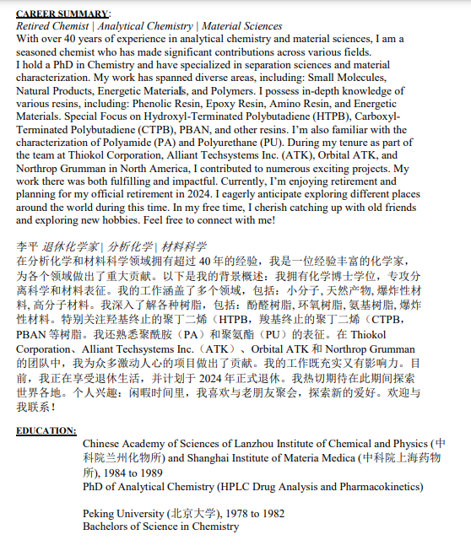
CAREER SUMMARY
(Lipchen98 – SSMS)

Slide 10
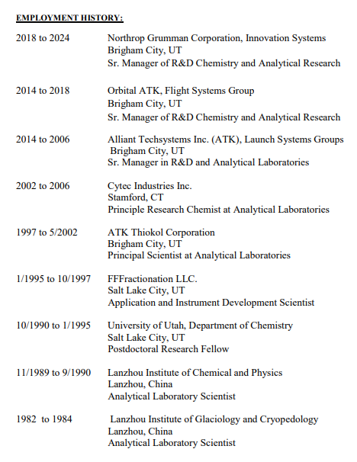
CAREER SUMMARY
(Lipchen98 – SSMS)

Slide 11
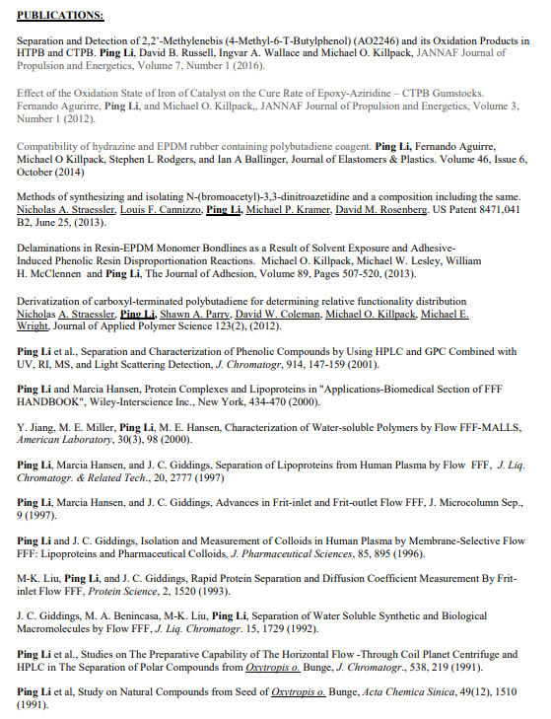
Publications
(Lipchen98 – SSMS)

Slide 12
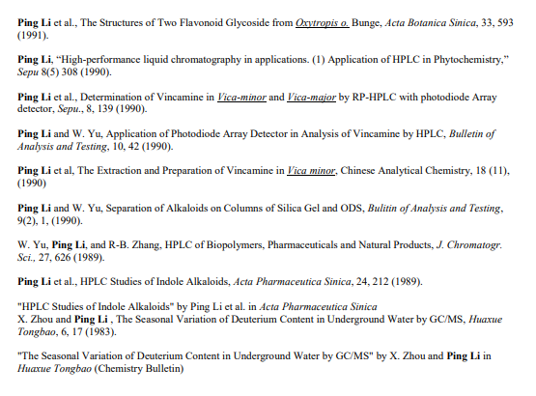
Publications
(Lipchen98 – SSMS)

