Slide 1
INTRODUCTION TO WEB DEVELOPMENT
Presented by: Renan Cavalcanti
420-DW1-AS
Gr. 07460

Slide 2
CSS Introduction
CSS stands for Cascading Style Sheets. It's a stylesheet language used to describe the presentation of a document written in HTML. CSS controls how the web content looks, allowing you to set the layout, colors, fonts, and more, making web pages visually appealing and professionally styled.

Slide 3
CSS Anatomy
CSS rulesets, comprising selectors and declarations, target elements on the page to apply styles. This foundational structure enables the customization of layout, colors, fonts, and more, enhancing the user experience.
CSS Selectors
CSS Properties
CSS Values

Slide 4
CSS Selectors
Selectors are how CSS identifies which HTML elements to style. They can target:
elements directly (e.g., p for paragraphs)
by class (.classname), by ID (#idname)
by their attributes ([type="text"])
Advanced selectors, like pseudo-classes (:hover, :focus) and pseudo-elements (::before, ::after), allow styling of specific element states or parts. Understanding selectors is crucial for effectively applying styles.

Slide 5
CSS Specificity
A system to determine which styles apply to an element when multiple rules conflict. It's crucial for resolving style conflicts in web development.
Specificity Hierarchy:
Inline Styles (highest specificity)
IDs (#example)
Classes, Attributes, and Pseudo-classes (.example, [type="text"], :hover)
Elements and Pseudo-elements (div, ::before) (lowest specificity)
https://specificity.keegan.st/

Slide 6
Inheritance in CSS
Inheritance is a mechanism in CSS where some property values set on parent elements are inherited by their child elements.
Not all CSS properties are inherited, but those that make sense to be passed from parent to child (e.g., font-family, color) usually are.
The inherit keyword can force inheritance on properties that don't normally inherit.

Slide 7
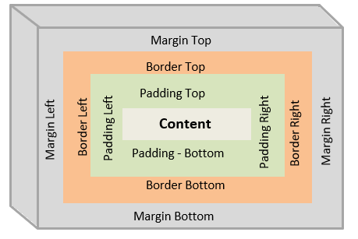
Box Model CSS
The CSS Box Model is a fundamental concept that describes how HTML elements are represented and structured on a web page. It encompasses margins, borders, padding, and the actual content.

Slide 8
Box Model
Components of the Box Model
Content: The area where text and images appear.
Padding: Space between the content and the border.
Border: Surrounds the padding (if any) and content.
Margin: The outermost layer that defines space between the element and surrounding elements.

Slide 9
Property Display
The display property is a cornerstone of CSS, controlling the layout behavior of elements on a web page. It determines if an element is displayed and how it interacts with other elements.
Key Values of display:
block: Elements take up the full width available, with a new line before and after.
inline: Elements do not start on a new line and only occupy their necessary width.
inline-block: Combines features of both inline and block, allowing block-level elements to sit inline.
none: Completely removes the element from the document flow, as if it does not exist.
flex and grid: Enable advanced layout techniques, allowing for flexible and two-dimensional layouts, respectively.

Slide 10
Box Sizing
The box-sizing property in CSS controls how the width and height of an element are calculated. It determines whether the padding and border of an element are included in the element's dimensions.
content-box: The default CSS box model where width and height only include the content, not padding or border.
border-box: Width and height include content, padding, and border, but not the margin.

Slide 11
Overflow Property
The overflow property in CSS dictates what should happen if content overflows an element's box. This is crucial in managing the layout and ensuring content is presented cleanly.
visible: Overflowing content is not clipped and renders outside the element's box.
hidden: Overflowing content is clipped, and the rest outside the box is invisible.
scroll: Adds scrollbars to the container, allowing users to scroll to see the hidden content.
auto: Browser decides whether to add scrollbars based on the content's size.

Slide 12
Float Property
The float property in CSS is used to place an element on the left or right side of its container, allowing other elements to wrap around it.
left: The element floats to the left of its containing block.
right: The element floats to the right of its containing block.
none: The element does not float, displaying in the normal flow (default).
The clear property can be used on subsequent elements to prevent them from flowing around the floated element.
Values: left, right, both, none.

Slide 13
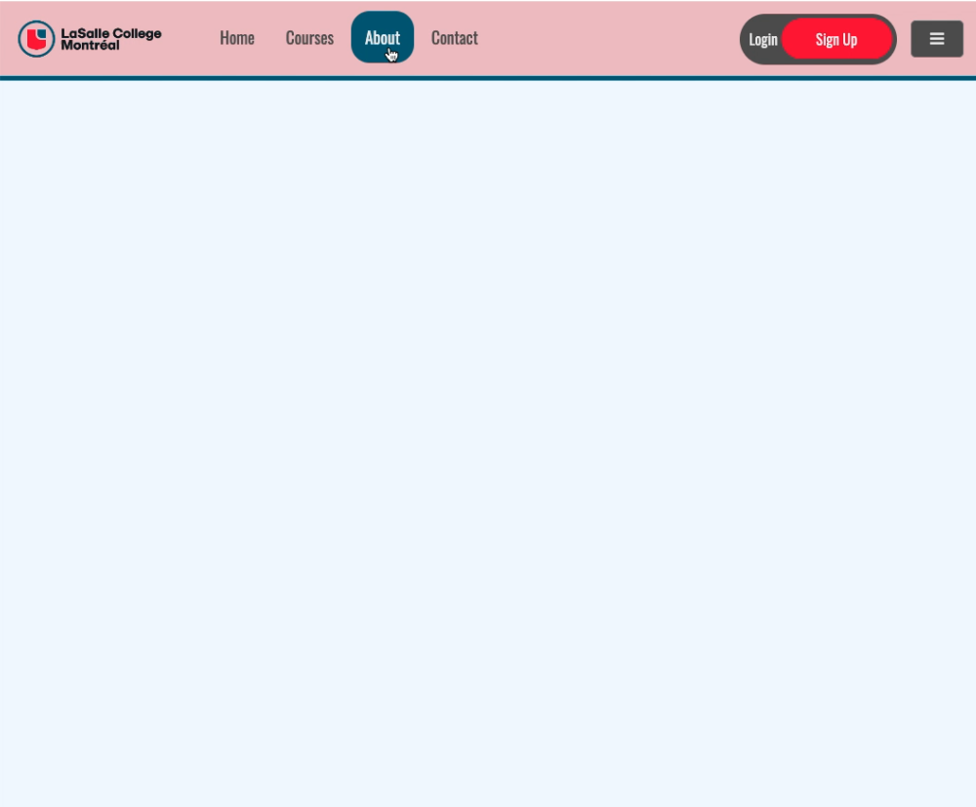
Exercise

