Slide 1
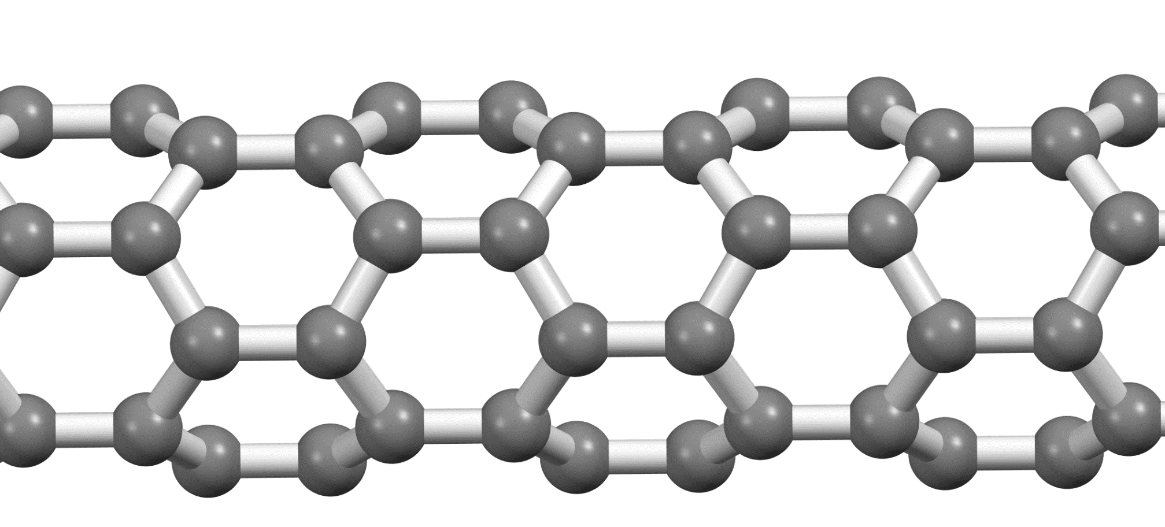
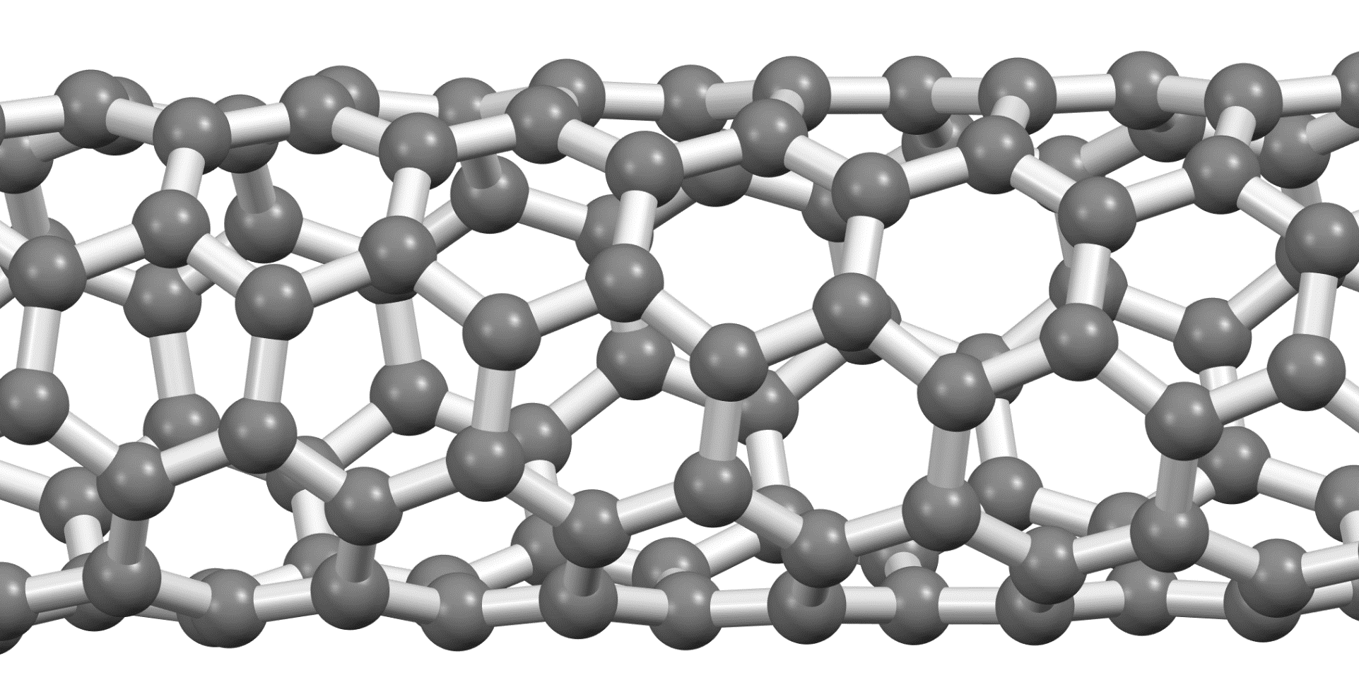
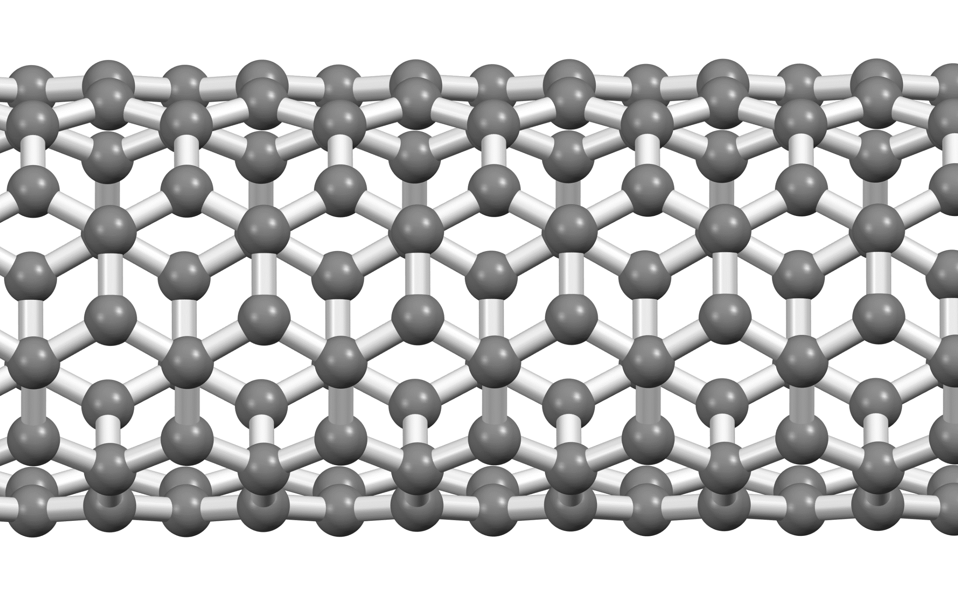
a)
b)
Diâmetro do SWCN
a₁
0.4
0.5
0.6
0.7
0.8
0.9
nm
Zig-Zag
(n,0)
a₂
+n
(0,0)
(1,0)
(2,0)
(3,0)
(4,0)
(5,0)
(6,0)
(7,0)
(8,0)
(9,0)
(10,0)
(11,0)
(1,1)
Armchair
(2,2)
(3,3)
Chiral
(n,m)
(4,4)
1.42 Å
(5,5)
(6,6)
Metálico
Semicondutor (Tipo 1)
Semicondutor (Tipo 2)
(7,7)
Armchair
(n=m)
Zig-Zag
+m
c)
ABC-r
AA
AB
AB-o
A
0.00 meV
0.0 kcal/mol
0.05 meV
0.001 kcal/mol
1.16 meV
0.027 kcal/mol
5.38 meV
0.12 kcal/mol
39.5 meV
0.91 kcal/mol
Energia Relativa

Slide 2
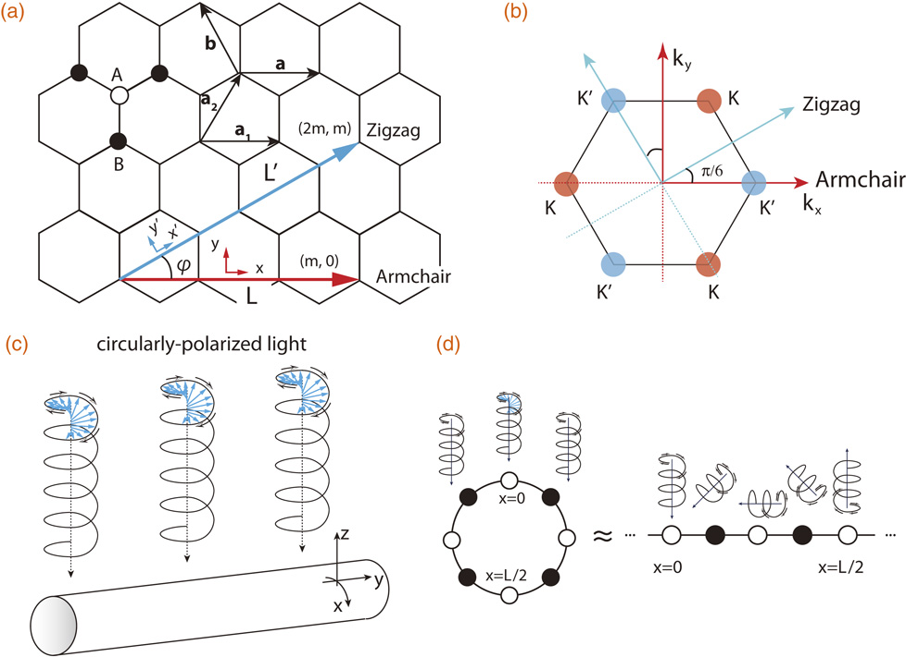

Slide 3
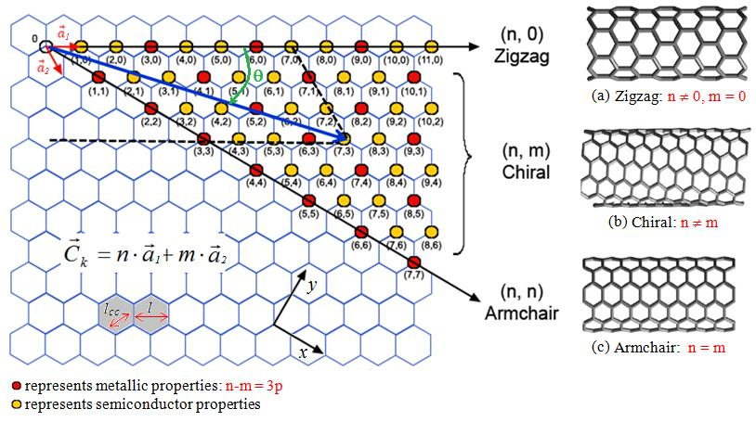
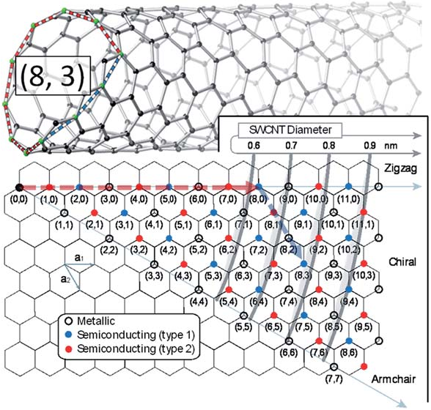

Slide 4
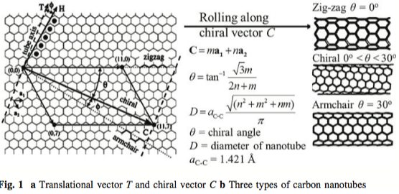
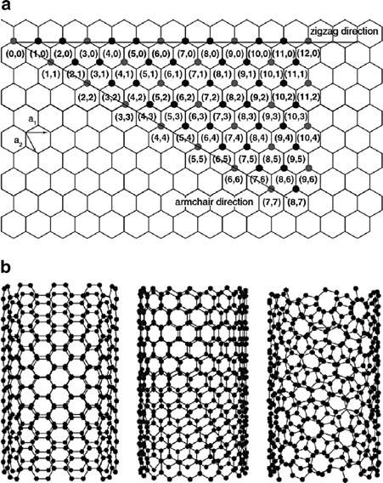
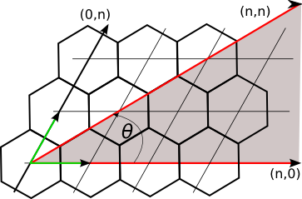

Slide 5
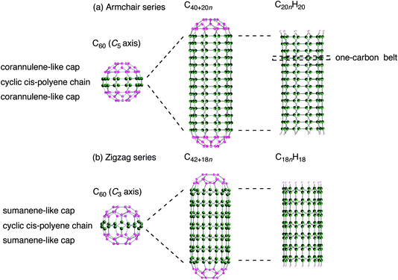
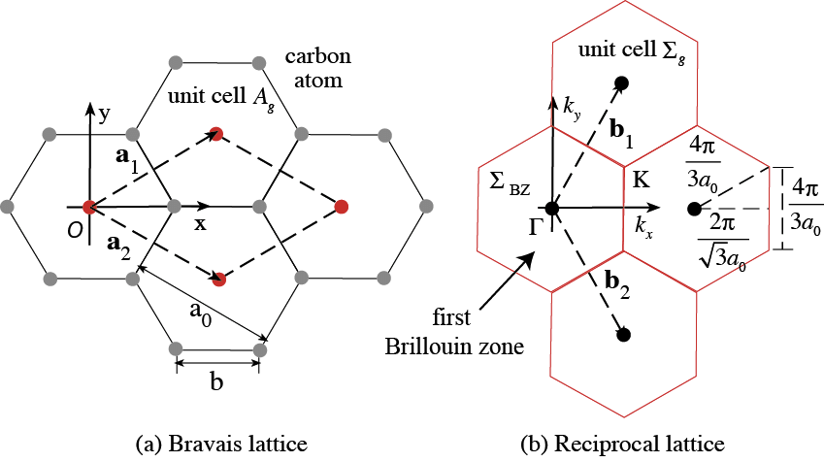

Slide 6
Diâmetro do SWCN
b)
0.6
0.7
0.8
0.9
nm
Zig-Zag
(n,0)
(0,0)
(1,0)
(2,0)
(3,0)
(4,0)
(5,0)
(6,0)
(7,0)
(8,0)
(9,0)
(10,0)
(11,0)
+n
(1,1)
(2,2)
(3,3)
Chiral
(n,m)
(4,4)
(5,5)
(6,6)
Metálico
Semicondutor (Tipo 1)
Semicondutor (Tipo 2)
(7,7)
Armchair
(n=m)
+m

