Slide 1


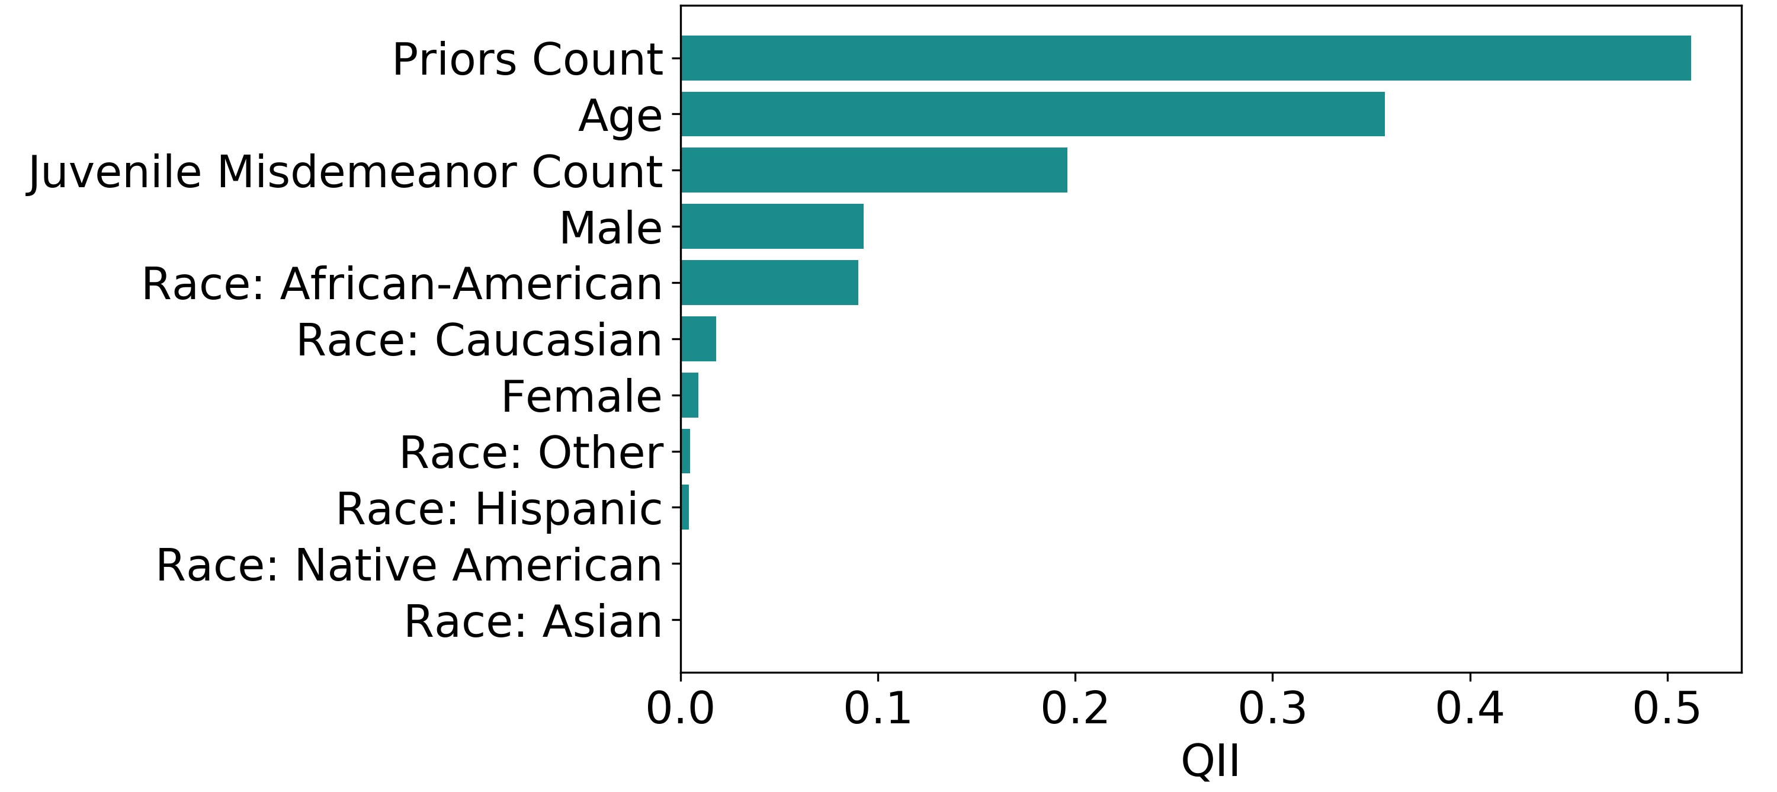
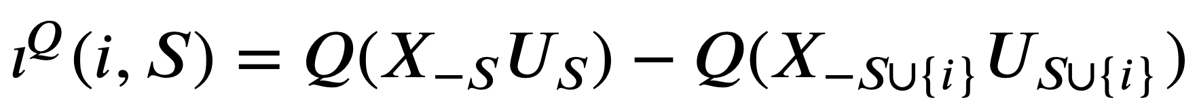
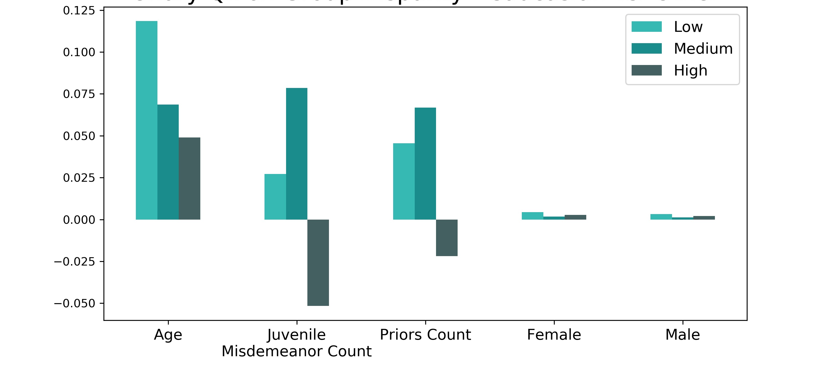
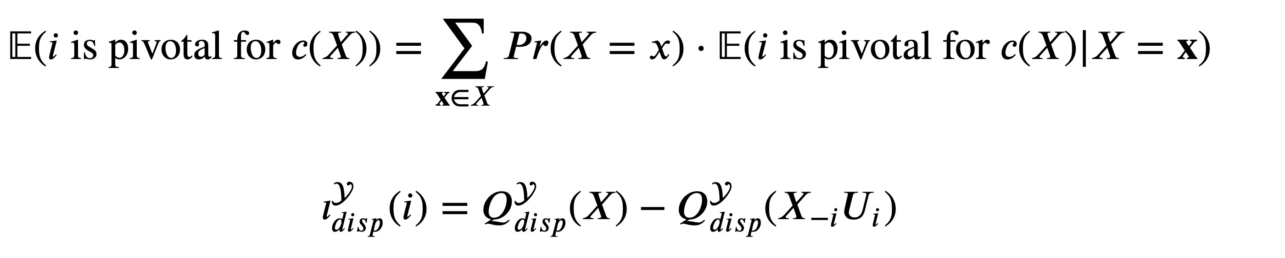
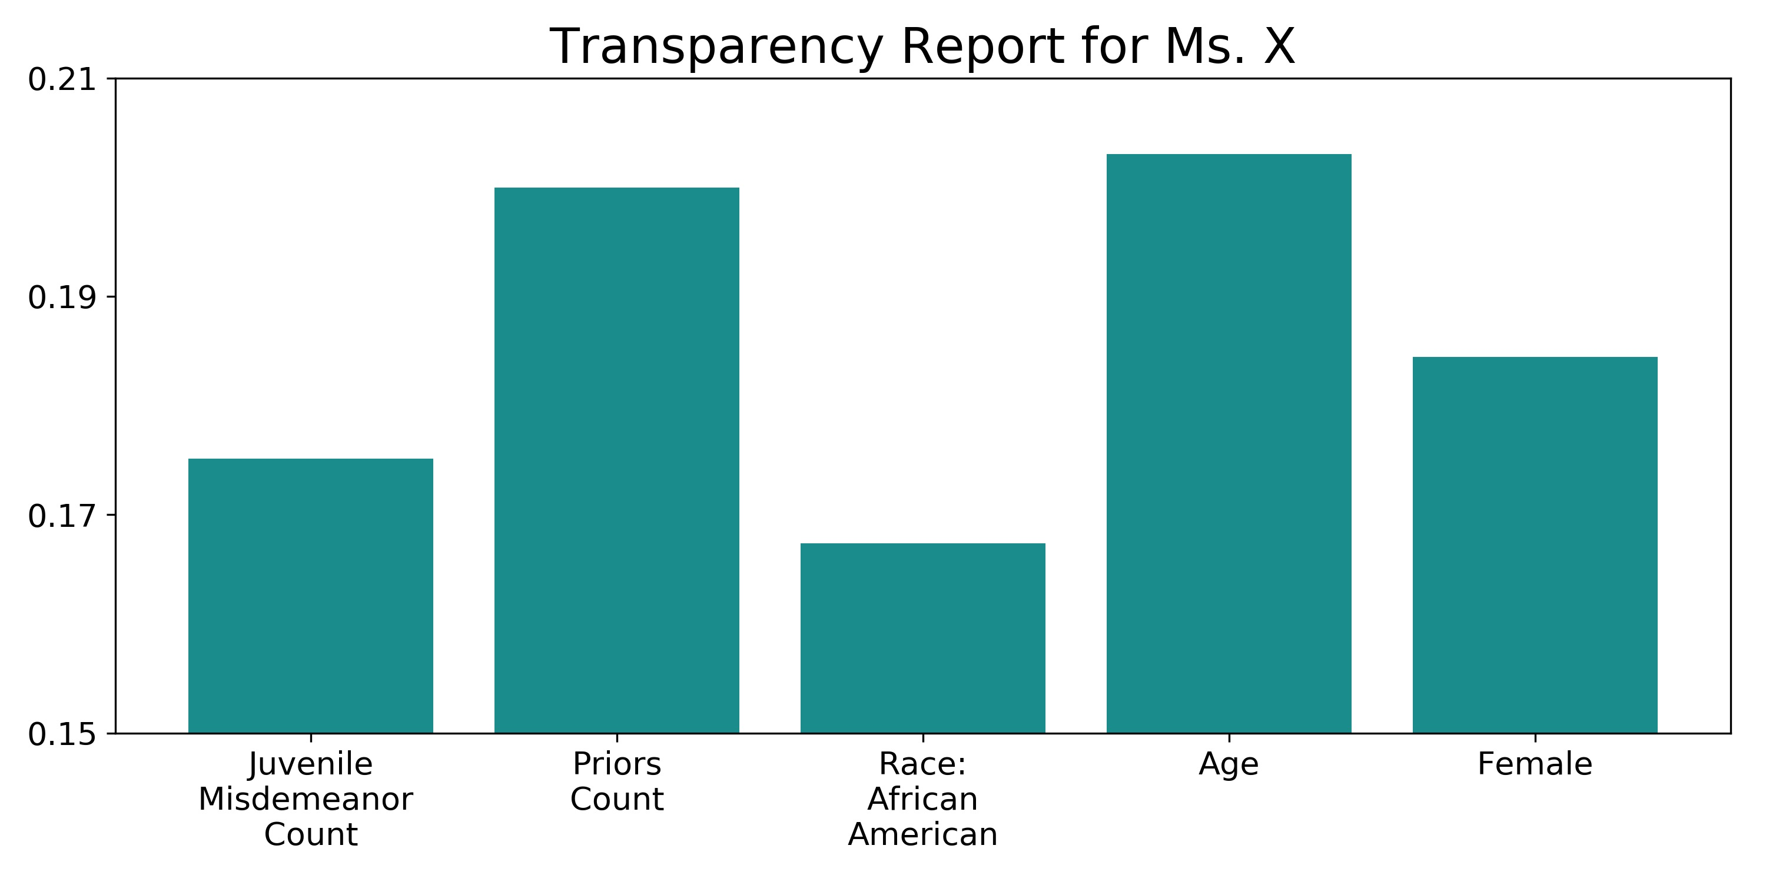
A study of influence of inputs on automated recidivism decisions
Karina Huang, Lipika Ramaswamy Institute for Applied Computational Science, Harvard University
INTRODUCTION
RESULTS
METHOD II: MARGINAL QII
Automated decision making has gained popularity in hiring and sentencing procedures. Fairness of automated processes, however, remains an open question due to limited interpretability of the black box models.
The Quantitative Input Influence (QII) framework (Datta et al., 2016) offers effective and straight-forward explanations of algorithms by quantifying the influence of input features on individual and group observations.
Influence is computed as a difference between the actual feature distribution and a random feature distribution.
We applied this framework to classification algorithms, using criminal records of 7,214 individuals in Broward County, FL, to investigate fairness of COMPAS assignment of decile scores.
We modeled the assignment of violence decile scores using individuals’ Age, Sex, Race, Priors, and Misdemeanor Counts. We trained three classifiers and report on the Decision Tree.
Figure 1. Unary QIIs on Individual Outcomes
Transparency reports can provide individuals with detailed information on (un)expected classification outcomes.
Marginal QII, reflected in transparency reports, represents the influence of a single feature within a subset of features.
One influence measure for marginal QII is the Shapley value. This metric is grounded in cooperative game theory.
Figure 2. Unary QII on Group Disparity – Caucasian vs. Other
DISCUSSION
Unary QII
Figure 1 shows that the feature with the highest influence is Priors Count, followed by Age and Juvenile Misdemeanor Count.
Group disparity reports that for predicted low and medium decile scores, these three features appear to bias for or against Caucasians.
Note that the direction of bias is not captured by this measure. Further, the magnitude of bias is arguably minor given the scale.
Marginal QII
A transparency report is presented for Ms. X in Figure 3. The Decision Tree classifier predicted a high violence decile score for Ms. X, when her assigned violence decile score was low.
The result might be surprising at first glance. However, the transparency report shows that the most influential features that led to this classification were Age and Priors Count.
This alerts us of the problematic behaviors of the underlying classifier, which heavily weights Age.
METHOD I: UNARY QII
Figure 3. Transparency Report for Ms. X
Unary QII on individual outcomes communicates the average influence of a feature on all individuals in the dataset. Intuitively, this influence represents how important a feature is to predicting the outcome.
Unary QII on group outcomes/group disparity denotes the influence of a feature on a group of individuals.
The quantity of interest for unary QII is the probability of being predicted a given decile score category.
Ms. X’s Information
Age | 26
Juvenile Misdemeanor Count | 0
Juvenile Felony Count | 0
Juvenile Other Count | 0
Priors Count | 2
Violence Decile Score (Category) | 4 (Low)
Race | African-American
Two-Year Recid | Yes
Notes:
1

