Slide 1

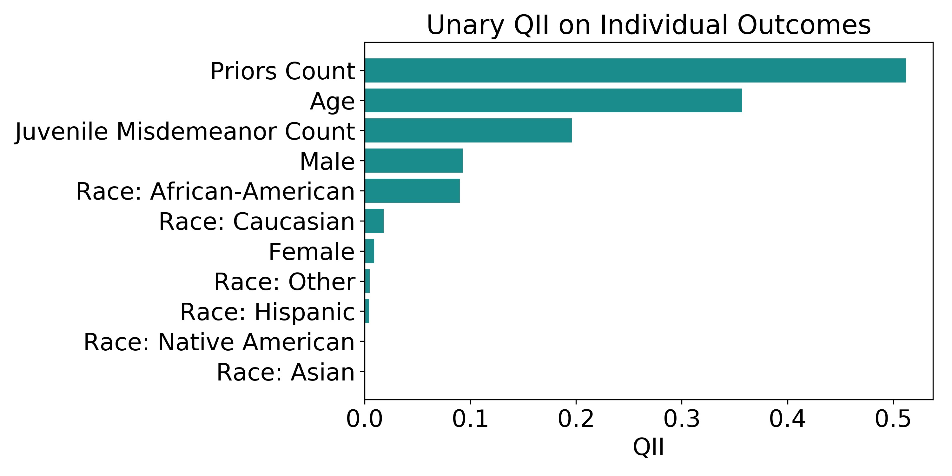
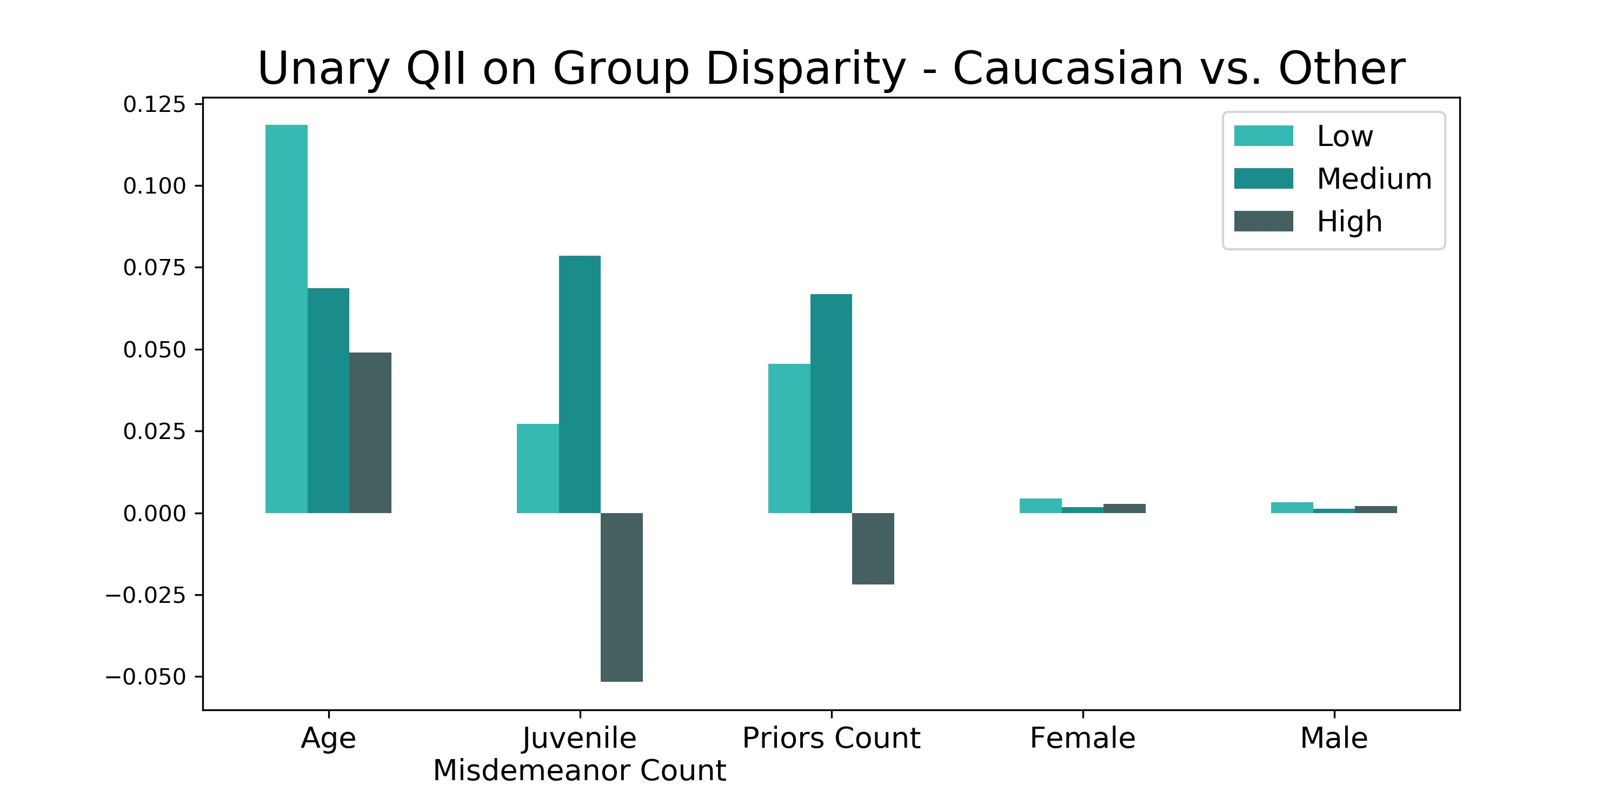
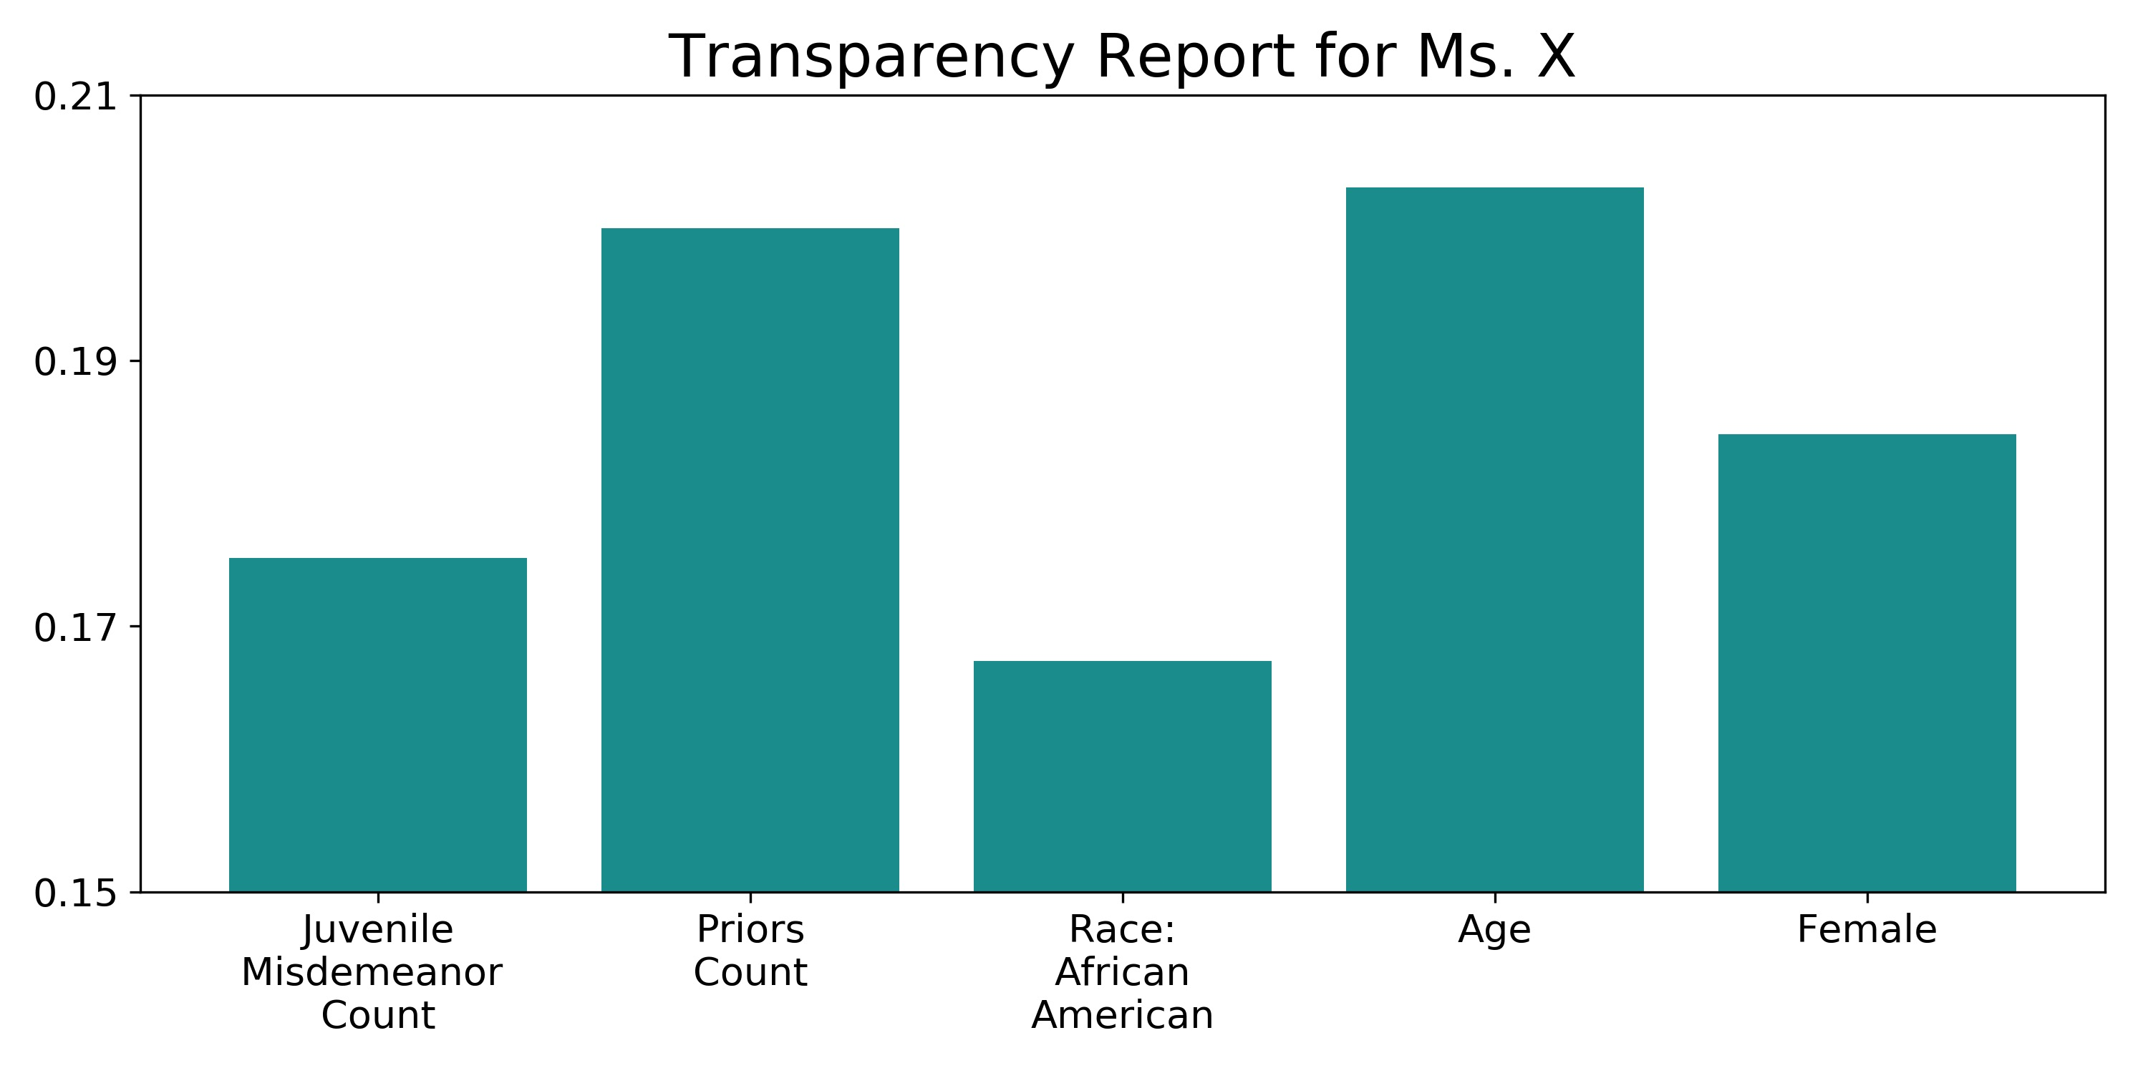
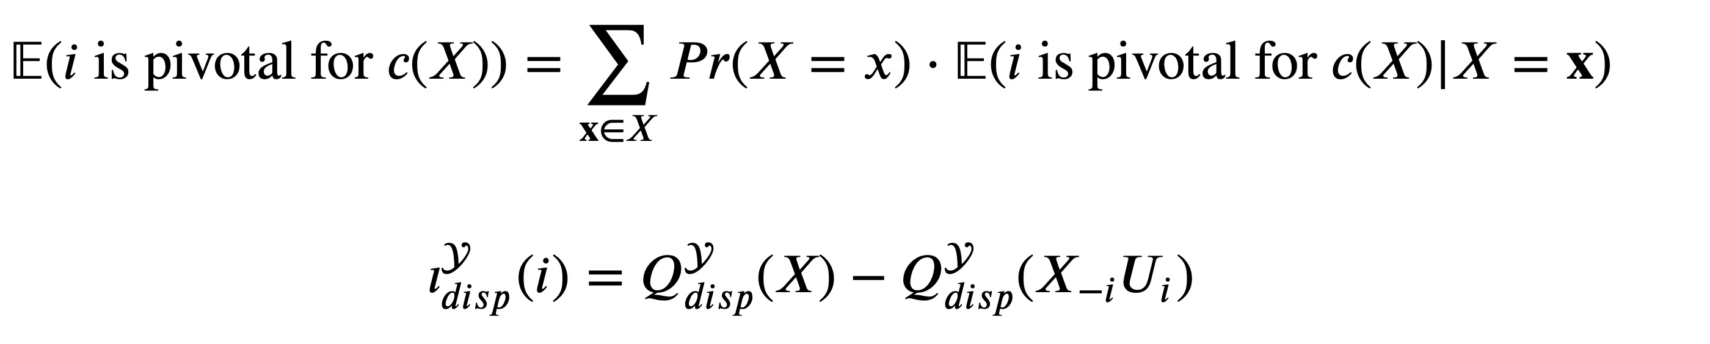
Quantitative Input Influence: A study of influence of inputs in recidivism decisions
Karina Huang, Lipika Ramaswamy
INTRODUCTION
RESULTS
METHOD II: MARGINAL QII
Automated decision making has gained popularity in hiring and sentencing procedures.
Fairness of such automated processes, however, remains questionable due to limited interpretability of the black box models.
The Quantitative Input Influence (QII) framework (Datta et al., 2016) offers effective and straight-forward explanations of algorithms by quantifying the influence of input features on individual and group observations.
Influences are acquired by comparing the difference in the quantity of interests (e.g. probability of being hired) between using the actual, and a random feature distribution.
Note that unary QIIs are specific to algorithms, regardless of true response values. Marginal QIIs are tied to prediction accuracies.
We applied this framework to classification algorithms, using the COMPAS dataset, to investigate fairness of COMPAS assignment of decile scores.
In particular, we investigate in this study:
Unary QII on individual and group outcomes
Marginal QII on individual outcomes
--
Marginal QII
Ms. X’s Information
Age | 26
Juvenile Misdemeanor Count | 0
Juvenile Felony Count | 0
Juvenile Other Count | 0
Priors Count | 2
Violence Decile Score (Category) | 4 (Low)
Race | African-American
Two-Year Recid | Yes
DISCUSSION
METHOD I: UNARY QII
Unary QII on individual outcomes communicates the average influence of a feature on all individuals in the dataset. Intuitively, this influence represents how important a feature is to predicting the outcome.
Unary QII on group outcomes/group disparity denotes the influence of a feature on a group of individuals.
We defined our quantity of interest for unary QII as the probability of being predicted a given decile score category.
Notes:
1

