Slide 1
Continuous Laser PIV design
Liu Hong

Slide 2
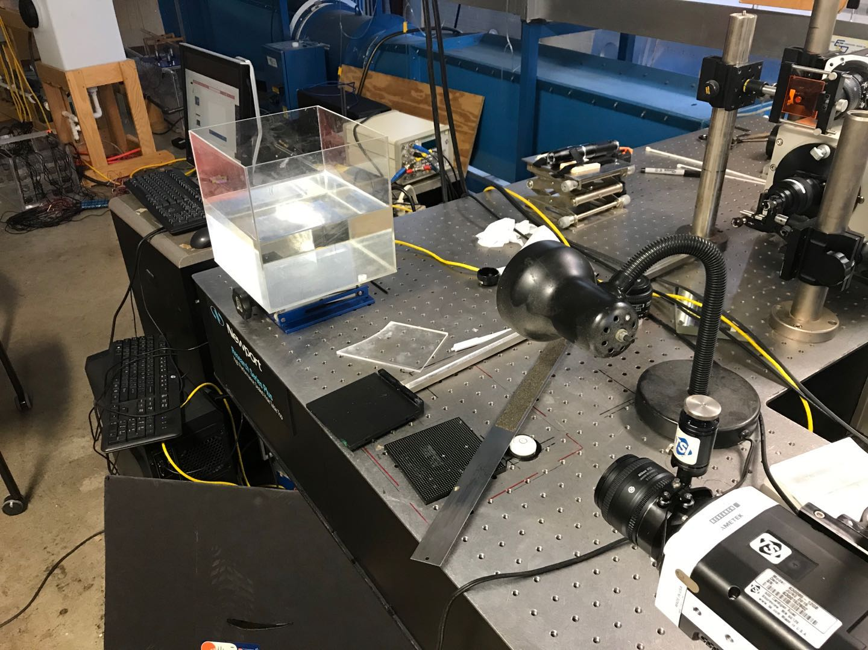
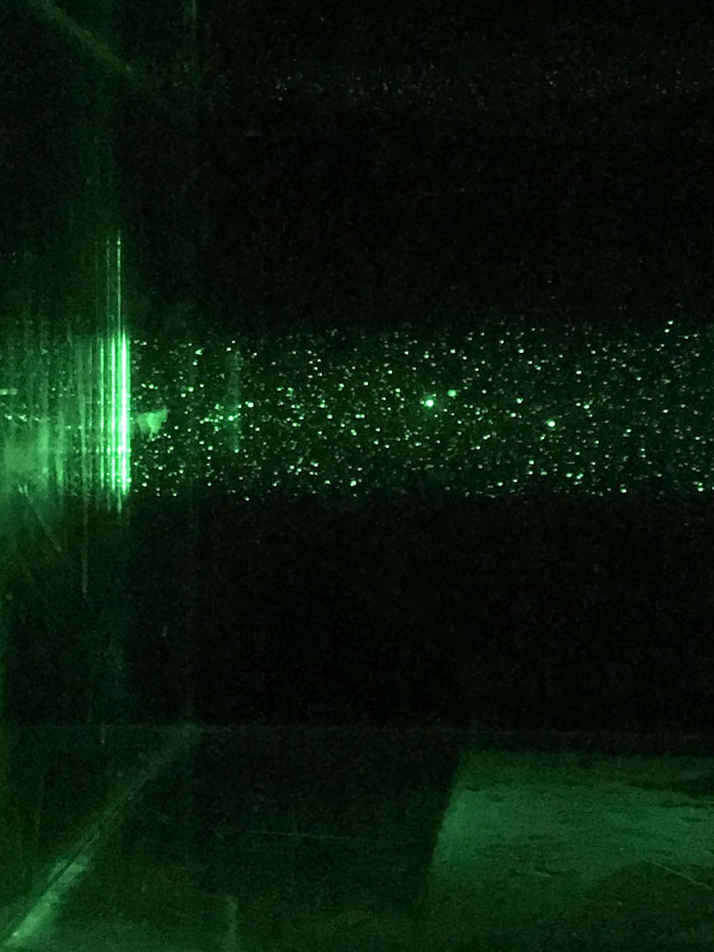
Laser point

Slide 3
Find appropriate delta t
This gif, please view in “slide show” mode

