Slide 1
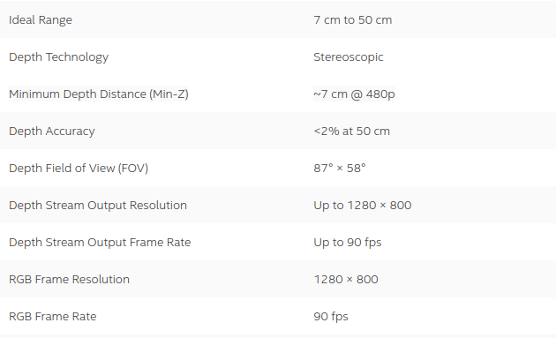
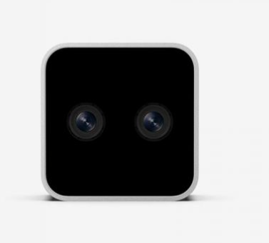
3D depth mapping
Liu Hong

Slide 2
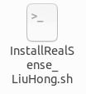
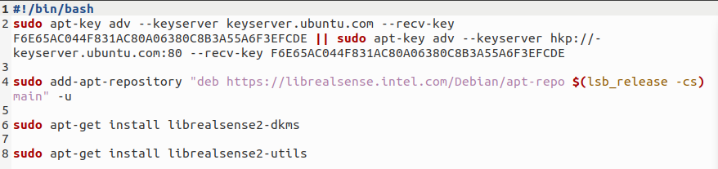
Run bash script install SDK

Slide 3
Install python package
pip install pyrealsense2
Connect camera to desktop
In terminal, “realsense-viewer” check installation and connection of the camera

Slide 4
Run “GetDepth_LiuHong.py” script
This script include 4 parts:
1. activate stereo camera, extract color frame and depth frame information as stream
(1290x720, 30 fps)
2. Load preset camera parameter “cameraSettings.json” file, which already include all
Optimized setting to get high quality depth image for 7-30cm range.
3. Clean and filter reconstructed depth map to offer stable depth detection.
Final output is the “depth” matrix, which include all depth information (unit meter) as distance from target to camera.
4. Visualize the depth map with color image. When you run the script with your project, you may disable this part. But this part can help to debug the program.

Slide 5
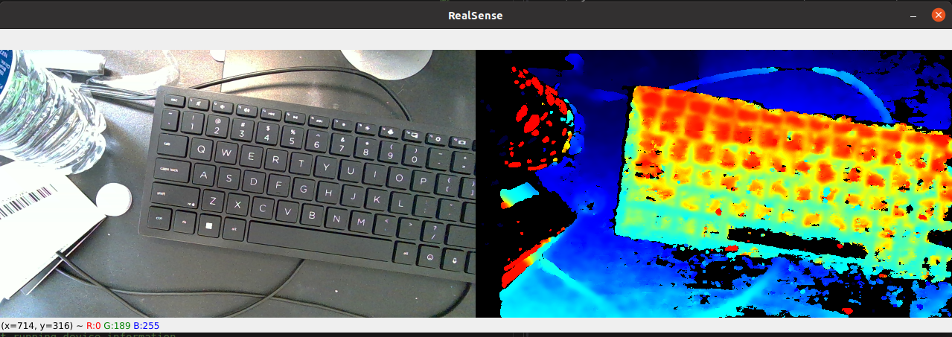
Demo video: demo.mp4

