Slide 1
Person Identification System
Group 2: Lee Joosung, Jordan Stickley, Shinya Honda, Liping Huang, Jenna Davis

Slide 2
Project Goals
The Person Identification System will track unknown people from video footage by labeling them using physical attributes. It will then be able to track the person from non-overlapping video feeds to predict where they will end up.

Slide 3
Purpose
The Person Identification System is designed to track persons at a local scale due to the increased criminal and terrorist activities around the world in public places such as airports, schools, and shopping centers.

Slide 4
Constraints
Uses a network ELP Mini USB Cameras.
A computer with at least 2.4 GHz Intel core i3 or higher.
Python 3.6 and Open CV 3.3+ must be supported.
Runs on Microsoft Windows 10 (32bit/64bit), Linux, and OS X

Slide 5
Functional Requirement 3.1.1[US1]
A user shall be able to see the main view of the tracking application in order to detect and track movement of people.
Source: Team Discussion.
Priority: 1
Introduction: Upon accessing the application with their browser, the user can see the main view.
Inputs: None
Processing: None.
Output: Web page
Error Handling: Display relevant message when no data exists.

Slide 6
Functional Requirement 3.1.2[US2]
A user shall be able to see how many cameras are configured from the main view.
Source: Team Discussion.
Priority: 2
Introduction: All known cameras are displayed.
Inputs: Camera data read from the database.
Processing: Loading camera information from the database and rendering as a list.
Error Handling: Display message when couldn’t communicate with database.

Slide 7
Functional Requirement 3.1.3[US3]
A user shall be able to click links to see each camera’s feed.
Source: Team Discussion.
Priority: 3
Introduction: The per-camera view can be seen.
Inputs: A click on the link.
Processing: React to the click event and render the video stream from the selected camera.
Outputs: Display the video feed.
Error Handling: Camera unavailable displayed.

Slide 8
Functional Requirement 3.1.4[US4]
The Person Identification System shall display a label and a tracking rectangle on moving people.
Source: Customer meeting.
Priority: 4
Introduction: 1. A box is drawn around moving people, and is labeled appropriately.
Inputs: Video.
Processing: Person detection algorithm based on neural net identifies and returns coordinates for drawing the bounding box.
Outputs: Display the lable and the rectangle enclosing moving people.
Error Handling: None.

Slide 9
Functional Requirement 3.1.5[US5]
The user shall be able to see the camera label and neighboring cameras from the main camera view screen.
Source: Team Discussion.
Priority: 5
Introduction: Neighboring camera links are available to click and the specific camera label is in view.
Input:Camera identification information that is read from the database.
Processing: None.
Outputs: The active camera label and hyperlinks for neighboring cameras.
Error Handling: None.

Slide 10
Functional Requirement 3.1.6[US7]
The movement tracking system shall take control of the camera and will capture person movement information into a database.
Source: Team Discussion.
Priority:1
Introduction: Camera can be activated, movement data can be detected, and tracking information can be stored in a database.
Input:Video Data
Processing:
Output: None.
Error Handling: A message is displayed showing that Camera data was unable to be communicated with the database.

Slide 11
Functional Requirement 3.1.7[US9]
3.1.7 The movement tracking system shall label a tracked person that’s moving into a later camera with their original label.
Source: Team Discussion.
Priority: 6
Introduction: Original label is rendered in new camera.
Input: Tracking information from database.
Processing: Seach information of the person in the database, if found, label them with that information.
Output: Original label on tracked person who has moved into a new camera.
Error Handling: None.

Slide 12
Functional Requirement 3.1.8[US11]
The movement tracking system shall operate autonomously on all camreas, storing their data in a shared database.
Source: Team Discussion.
Priority: 3
Introduction: System accommodates new cameras as they come on line without up front pre-configuration.
Input: None.
Processing: A database and the main web view are able to react to cameras as they are brought online or taken offline.

Slide 13
Non-Functional Requirement 3.2.1[US6]
A user shall be able to see movement indicators on the main screen.
Source: Team Discussion.
Priority:2
Introduction: Idle cameras change to indicate movement and back to idle again as per activity from cameras.
Input:Video Data
Processing: Camera list view is updated periodically to reflect indicators and requires reading this information from the database.
Output: Indicator that movement has occurred on a given camera.
Error Handling: None

Slide 14
Non-Functional Requirement 3.2.2[US8]
The user shall be able to see a textual log of movement activity.
Source: Team Discussion.
Priority: 5
Introduction: Movement activity can be seen in real time and the following information can be seen: id, begin time stamp, end time stamp, origin camera id, predicted destination camera id
Input:Video Data
Processing: The textual log entries are periodically loaded from the database.
Output: Log entries are displayed on the webpage.
Error Handling: A message is displayed showing that Camera data was unable to be communicated with the database.

Slide 15
Non-Functional Requirement 3.2.3[US10]
The movement tracking system shall track multiple people at the same time.
Source: Customer meeting.
Priority: 7
Introduction: Each tracked person has a unique label and they are successfully tracked as per any other movement.
Input: Tracking information from database.
Processing: Database analysis of the tracking data.
Output: Different database entries for each unique person being tracked as well as on-screen labeling.
Error Handling: None.

Slide 16
Non-Functional Requirement 3.2.4[US12]
The Person Identification System shall be able to work with a variable amount of cameras.
Source: Customer meeting.
Priority: 5
Introduction: The PIS will be able work with a variable amount of cameras.
Input: Remote camera system and correspoding video controller software.
Processing:Detect when new cameras come online.
Output: Updated camera list in main web view.
Error Handling: Message is displayed showing that a camera was unable to connect properly.

Slide 17
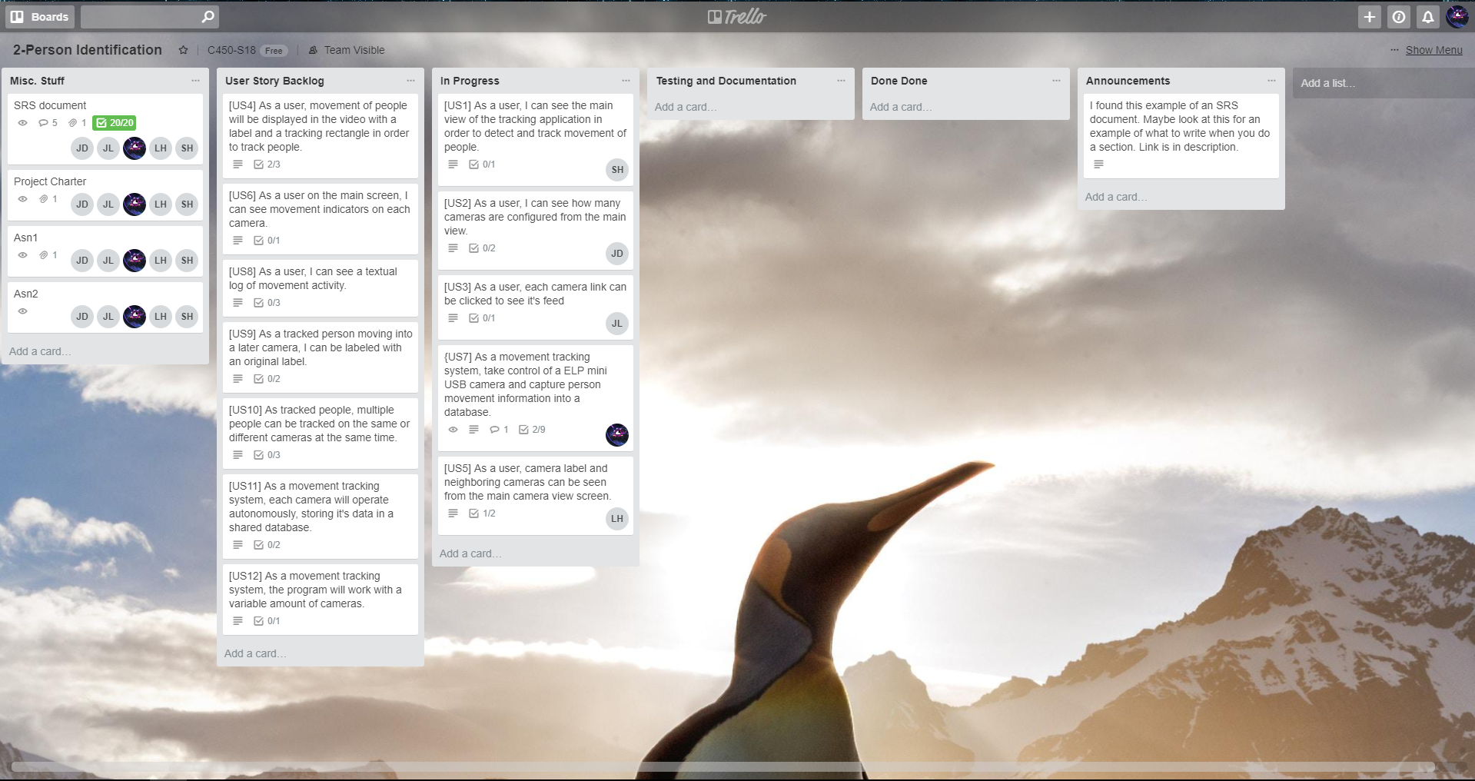
Trello board

Slide 18
Burndown chart

Slide 19
Percentage Chart
Not done: 85%
[US7]: 6%
[US5]: 2%
[US4]: 7%

