Slide 1
Health Clinical System
COMP308 Group Project
Professor: Ilia Nika
Liping Wu
Zhaobin Bu
Yanbo Wang
2020/4/17

Slide 2
Team
Liping Wu
Business and Requirements Analysis and Design
Database Models design and implementation
Back End / Front-End/ REACT AI/ Youtube
Testing / Code Organization
Documentation
Zhaobin Bu
project analysis and design
Back End / Front-End/Diagram
Yanbo Wang
Sign up and log in

Slide 3
Project Architecture and Technology
Back-end: NODE.JS / MONGODB / EXPRESS
Front-end : REACT
AI- Tensorflow
Creative: Youtube framework, Diagram

Slide 4
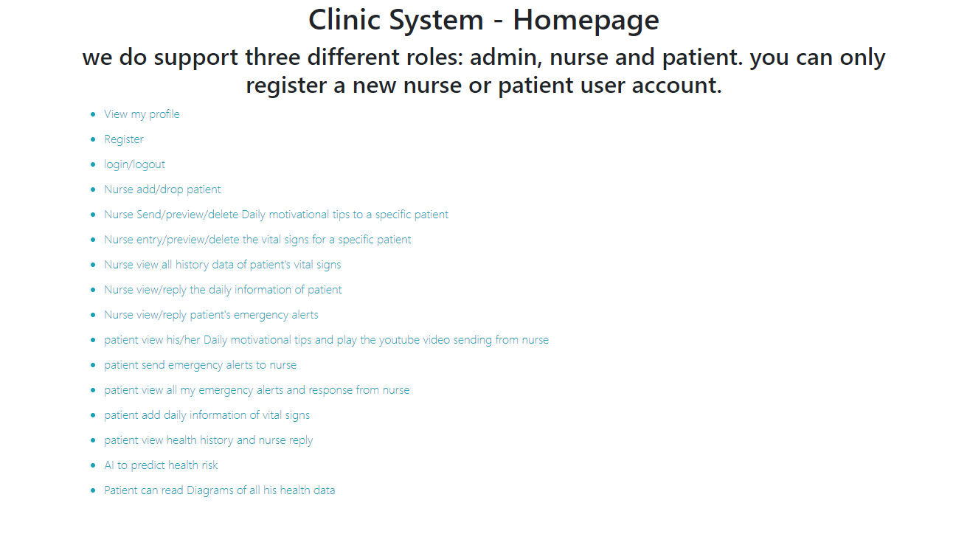
Home Page

Slide 5
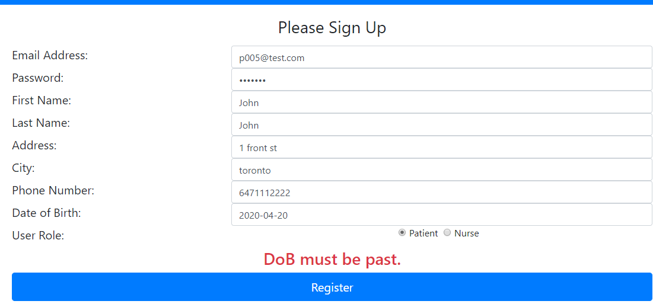
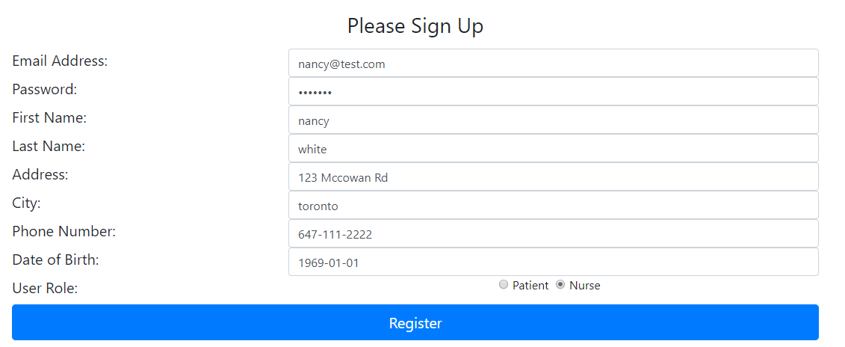
Patient sign up

Slide 6
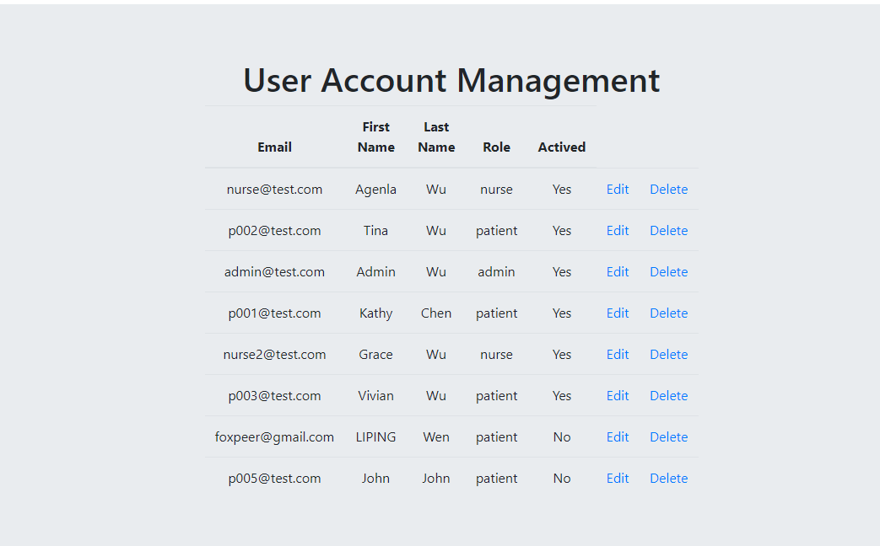
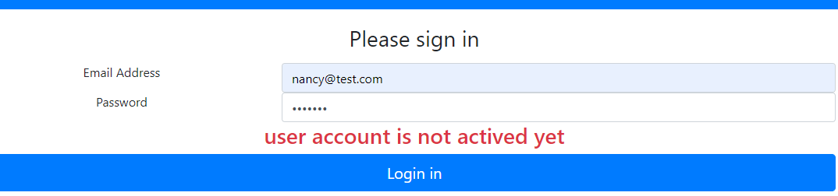
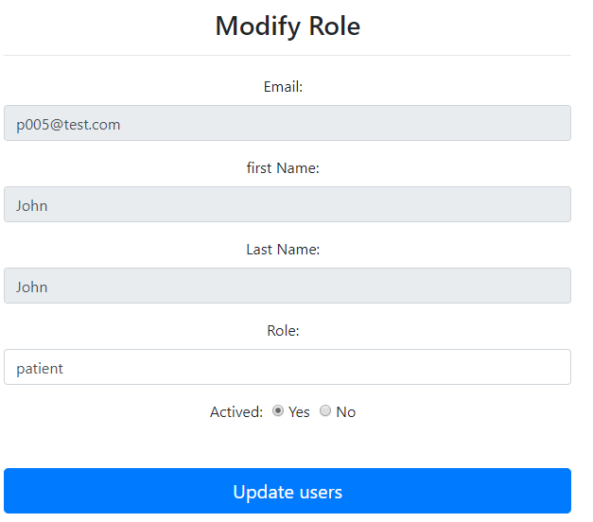
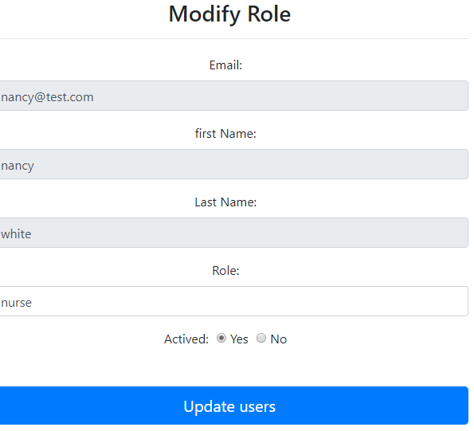
Admin

Slide 7
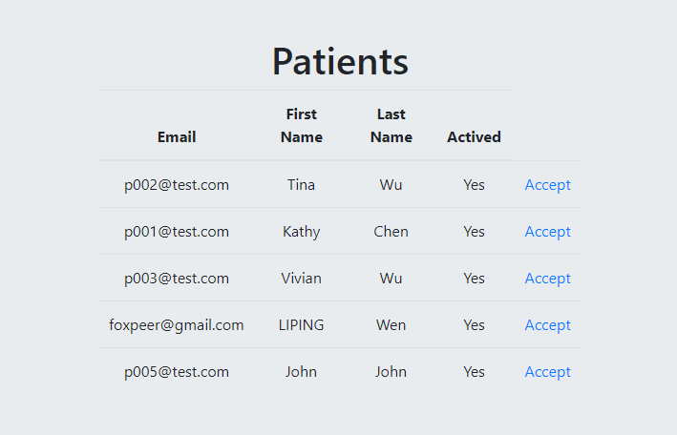
Nurse-view all patients

Slide 8
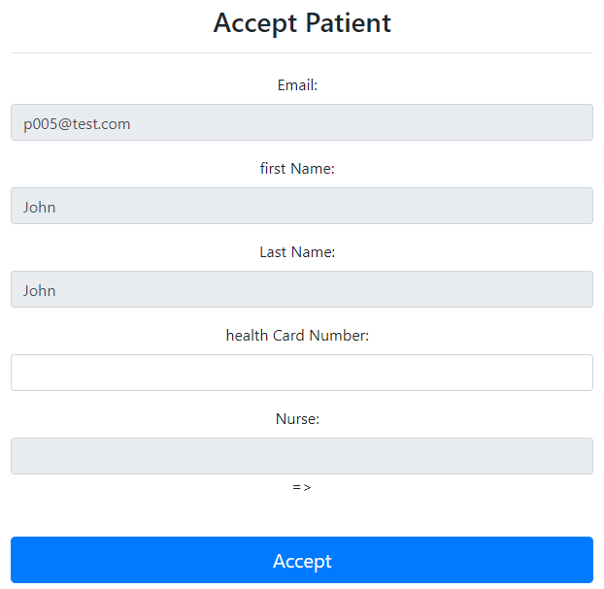
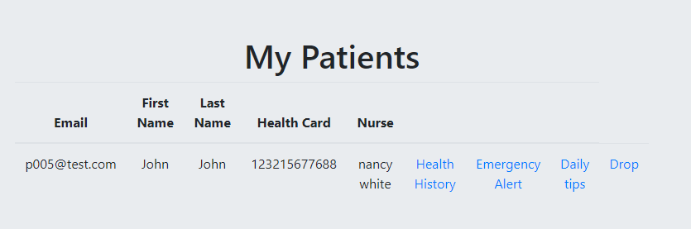
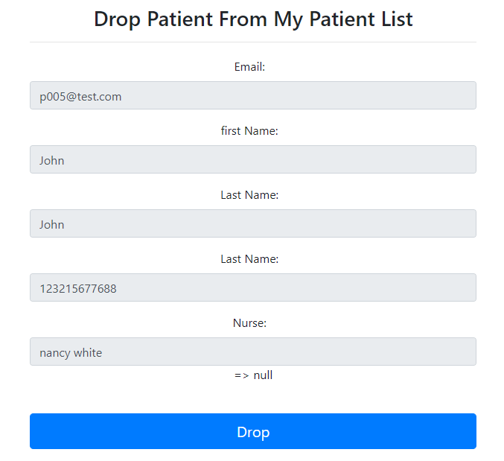
Nurse-accept /drop patient

Slide 9
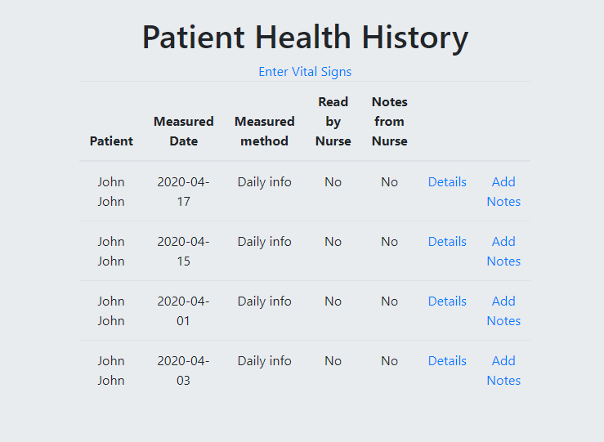
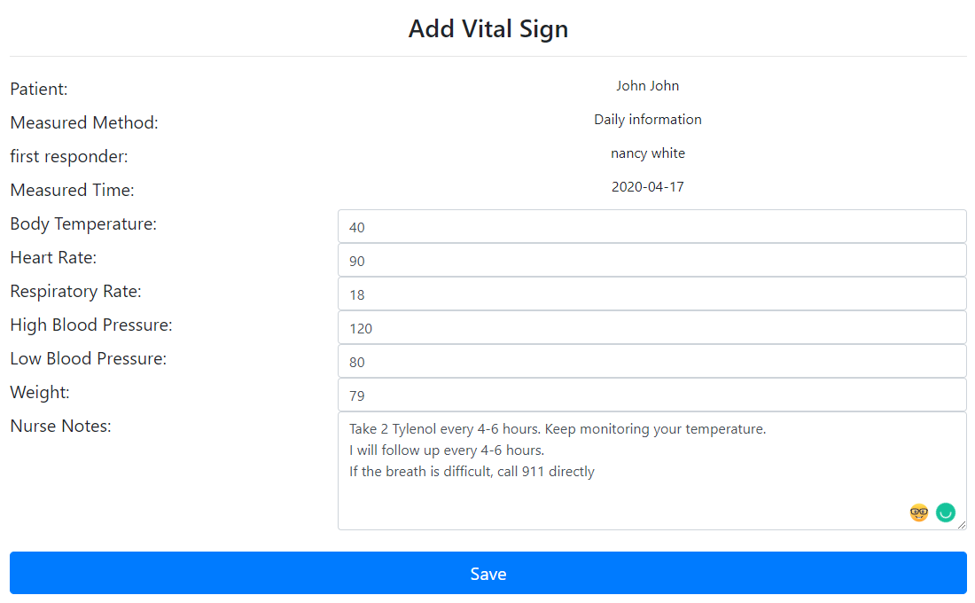
Nurse- Patient health history

Slide 10
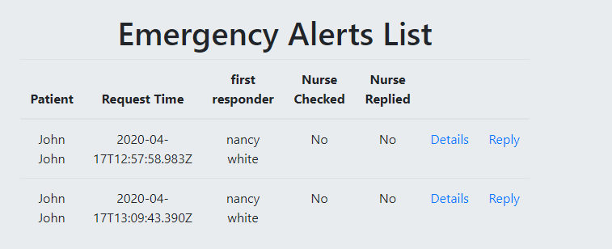
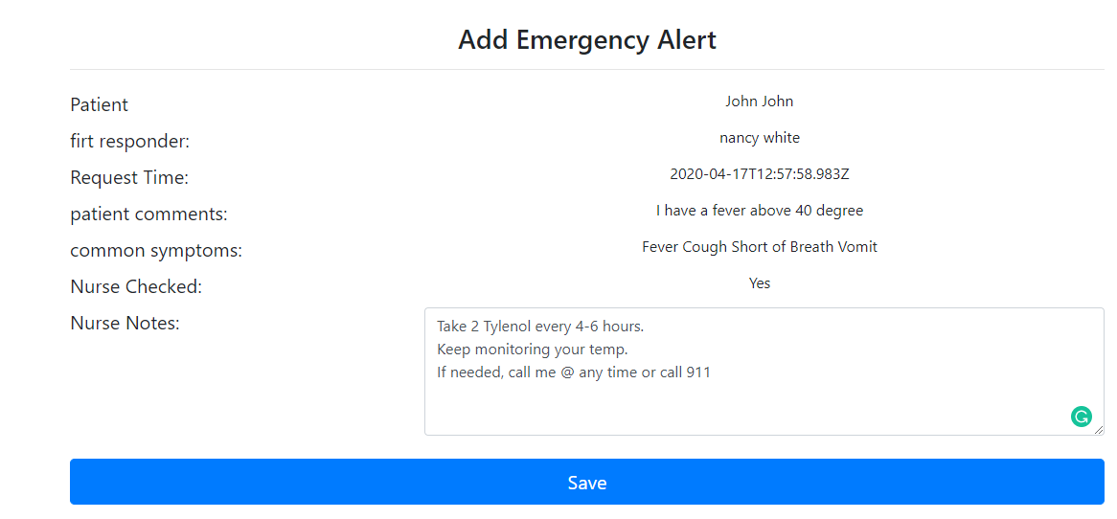
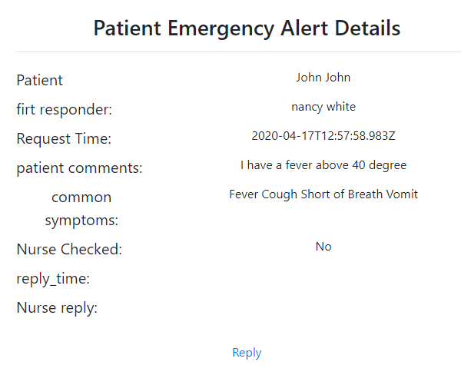
Nurse- Patient’s Emergency Alerts

Slide 11
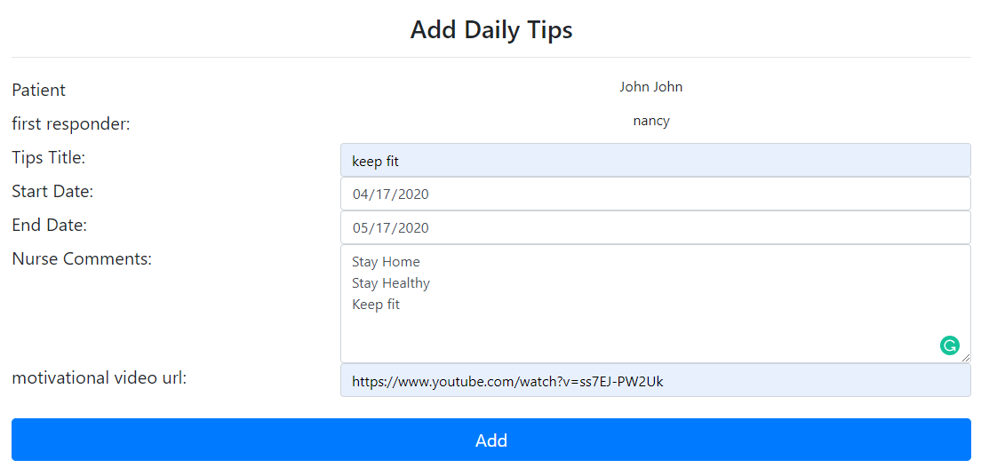
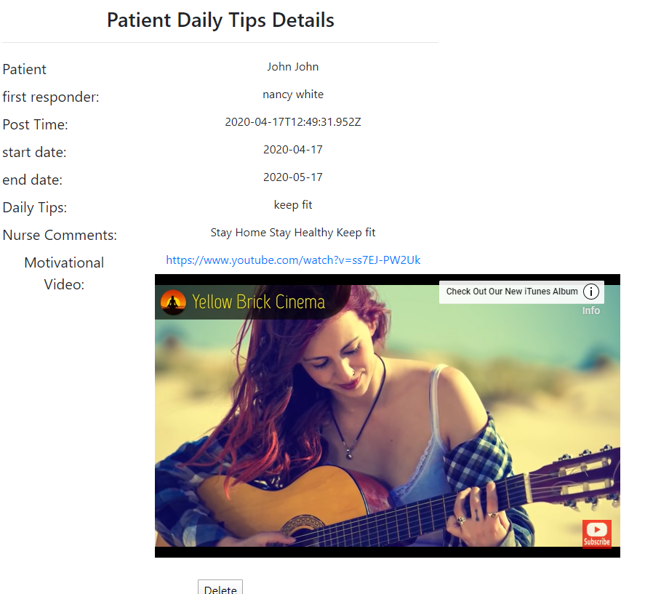
Nurse –add Daily tips to a patient

Slide 12
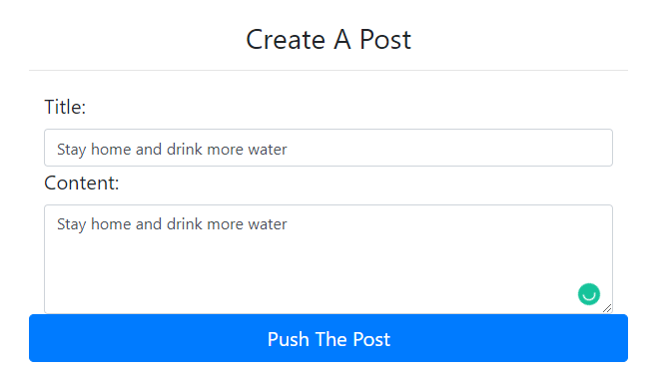
Nurse- Creat a Post to all her patients

Slide 13
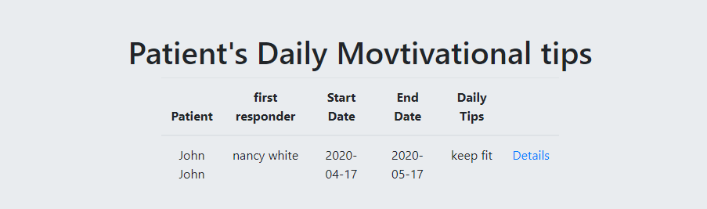
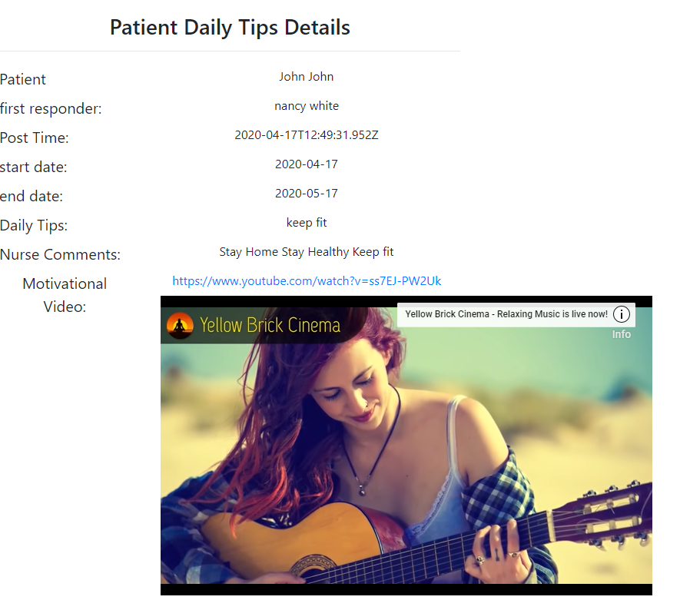
Patient- View my daily Motivational tips

Slide 14
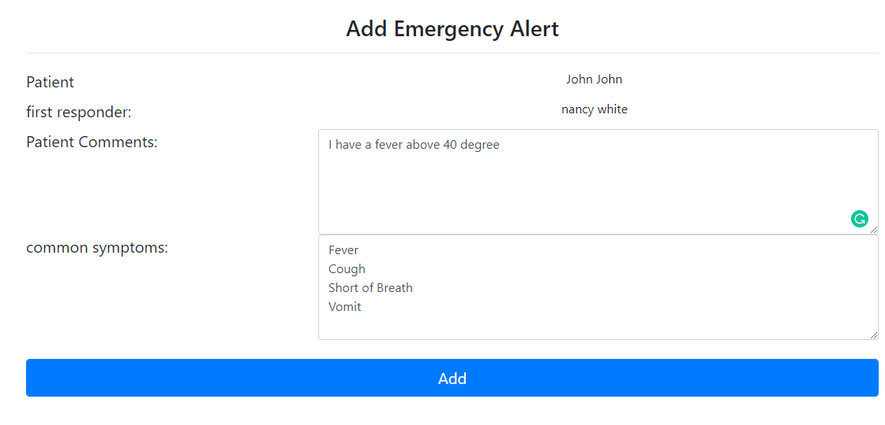
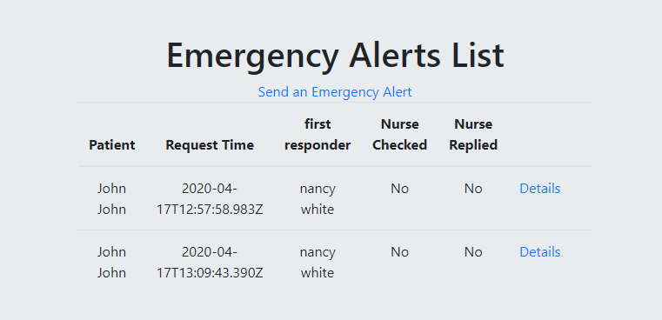
Patient- add an Emergency alert to the nurse

Slide 15
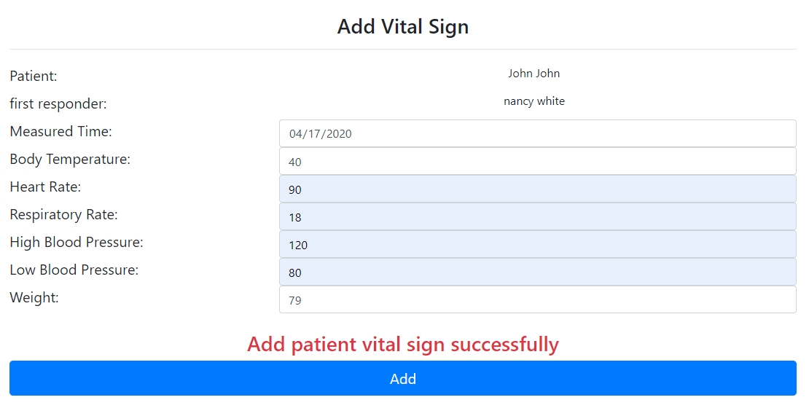
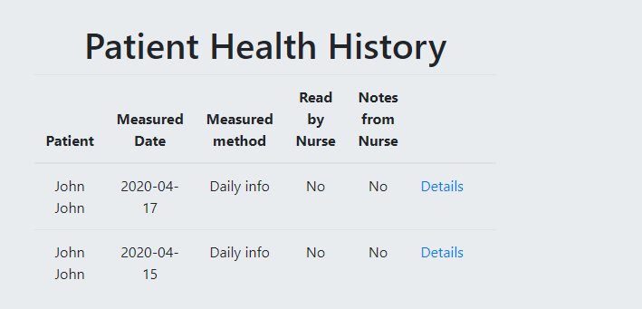
Patients- add daily vital signs

Slide 16
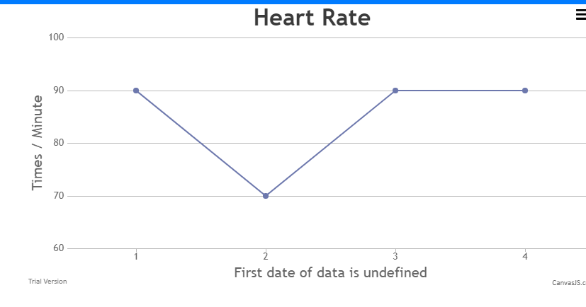
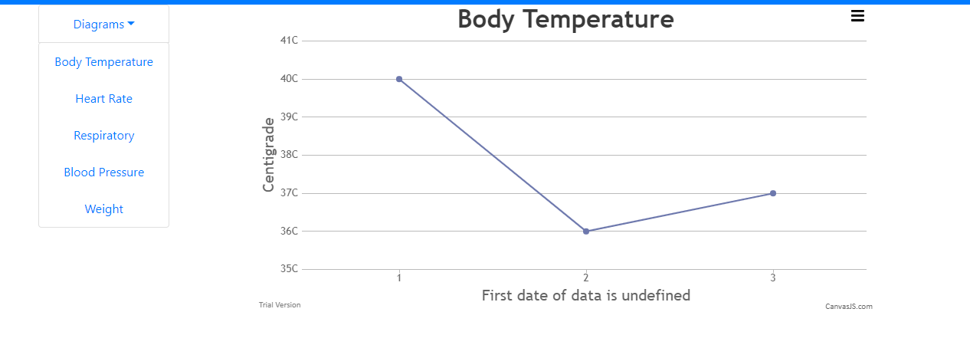
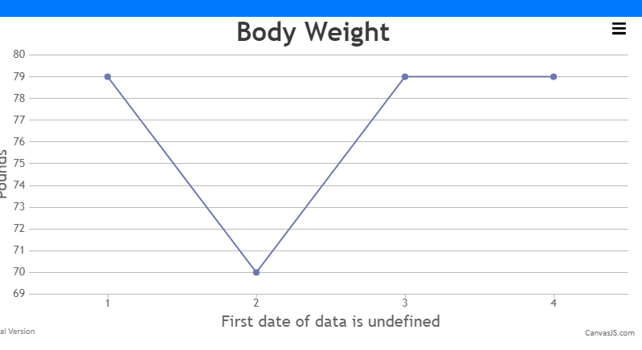
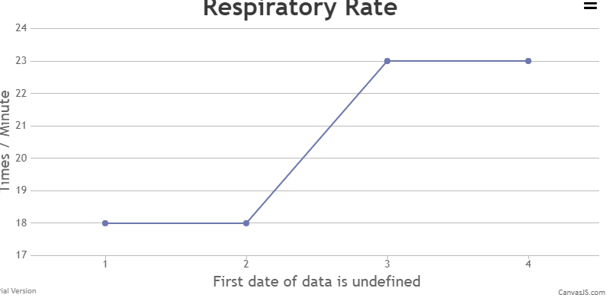
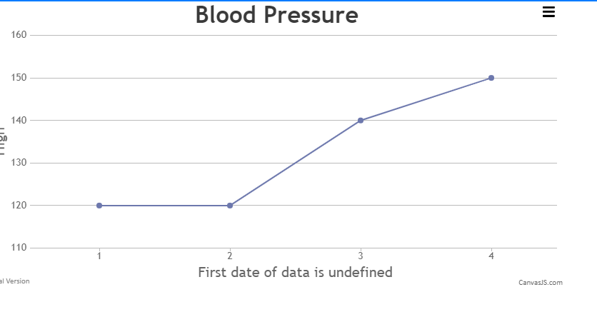
Diagrams

Slide 17
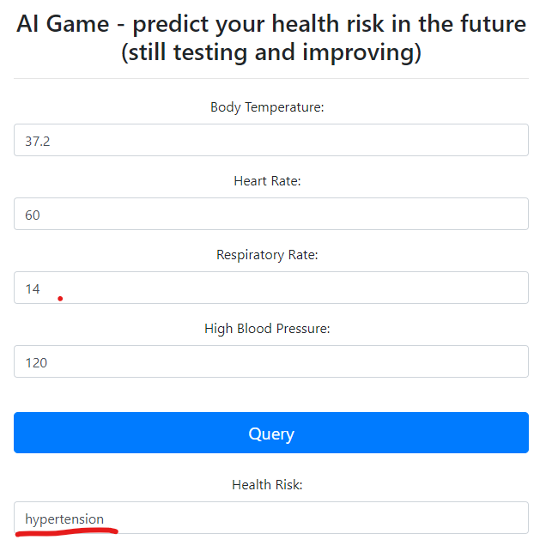
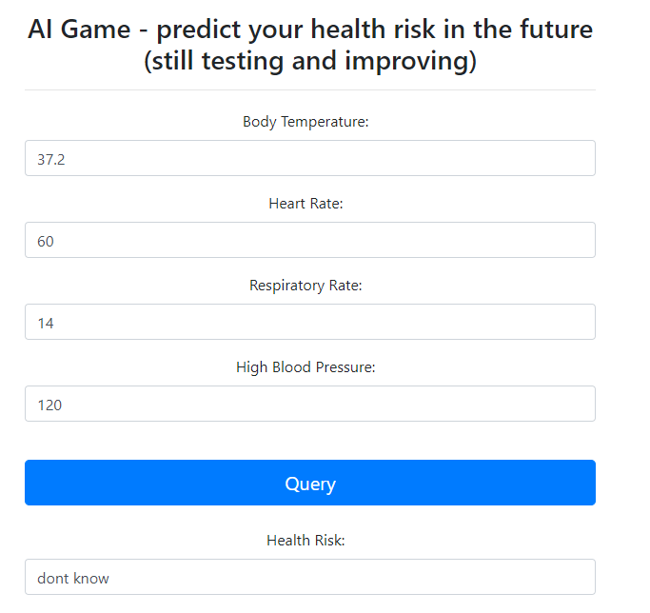
Al

Slide 18
Q&A
Thank you!

