Slide 1
Phase II (Due March 22)
Mobile App Development CSCI 2356 2023

Slide 2
Introduction
The project consists of making a game for kids aged 5-6 to continue learning the Mi'kmaq words already present in the Phase I software that was analyzed.
In these slides the main sample screens are presented first.
In these slides, the main sample screens are followed by the new skills you will require to complete Phase II, as well as some technical clarifications

Slide 3
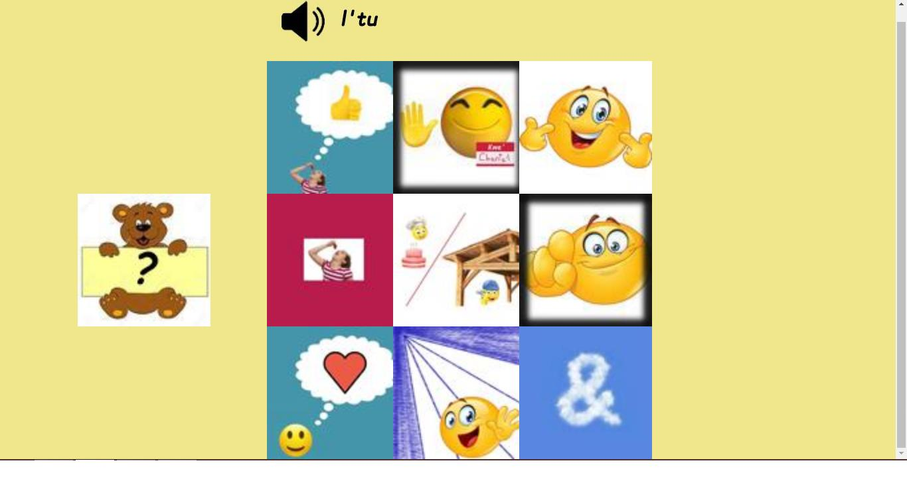
Sample Screen (Start)

Slide 4
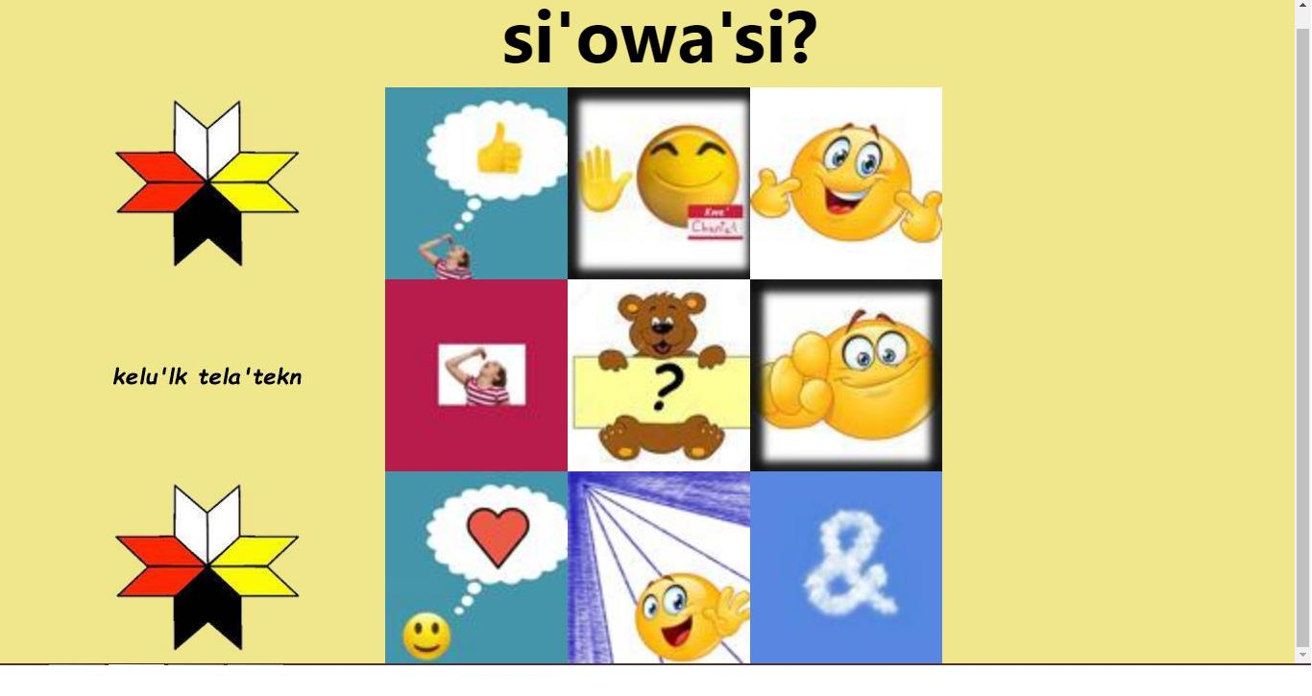
Sample Screen (Correct Answer)

Slide 5
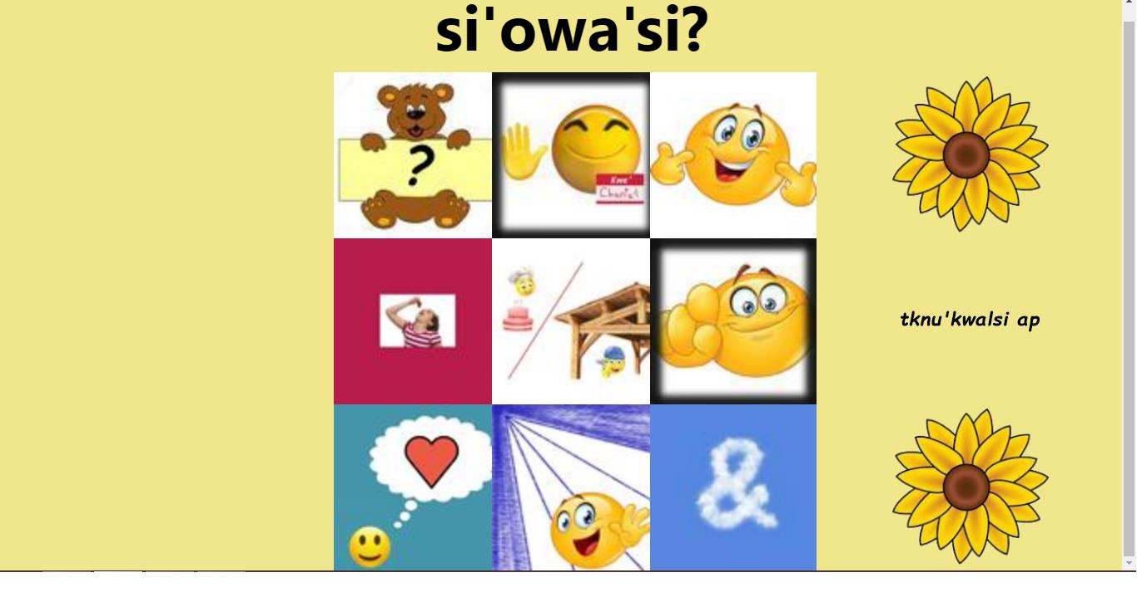
Sample Screen (Incorrect Answer)

Slide 6
Technical Info
The 3 screens just presented take up an entire Desktop PC screen. If your group is entirely MAC based, you need to test your code in LA278.
You must use the Bootstrap grid system to position elements
When "si'owa'si?" is displayed all pointer events are suspended, except for clicking on "si'owa'si?". How is this done?
You need to play audio of each of the words. How is this done?

Slide 7
Technical Info
Use the HTML Drag and Drop API described in W3Schools. Note that this API does not work for mobile devices. This is OK since this software is going to be used on a desktop PC attached to a Smart board.
You may have to use the setTimeout JavaScript function, in order to overcome JavaScript's non-blocking, asynchronous nature.

Slide 8
Technical Info
How do you prevent an image being dragged from disappearing when being dragged over an already visible image? See the next slide for one successful strategy!
How will you know when the answer is correct?
How do you create a random number?
How do you restart the game?

Slide 9
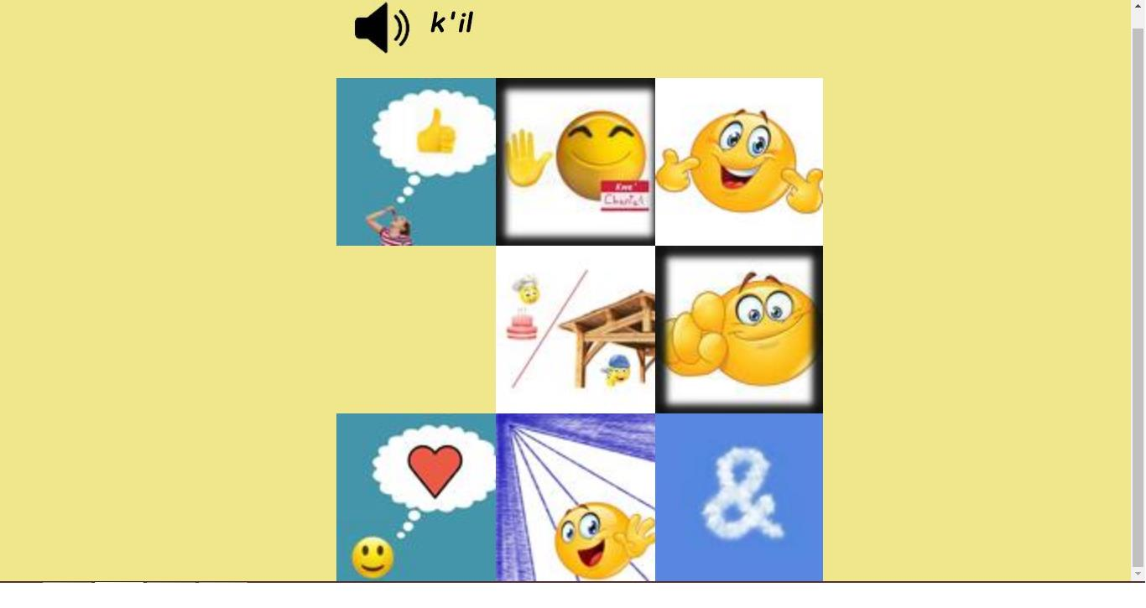
Technical Info (Although the bear picture being dragged is not visible in this slide, because I wanted you to see underneath it, the missing square is where the bear is. Note this is before the bear has been dropped.)

Slide 10
Technical Info
When you click on the speaker icon, you hear the word being said
The bear is draggable
Once you place the bear, you cannot move it to another position
si'owa'si? should be magenta when you hover over it, and the cursor should change to a hand
Note the spacing at the very top of all the pages is approximately equal to the space you see right below the speaker icon and the "si'ows'si?" Phrase
There should be no scroll bar.

Slide 11
Grading
Submit all the Phase II files in a zip folder, including any libraries like jQuery, to the dropbox "P2".
Submit the P2 tally to the associated dropbox "P2 Tally"
Grading out of 20:
10 points for functionality
7 points for documentation
3 points for exactly matching proportions with the screens presented in these slides

