Slide 1
Data Analysis with Python
My story with Python

Slide 2
Data Analysis with Python
Business background
Counterparty Credit Risk(CCR)
Over-the-counter(OTC) derivatives are subject to CCR

Slide 3
Data Analysis with Python
Other data analysis tools:
Excel/VBA
SQL
C++
…

Slide 4
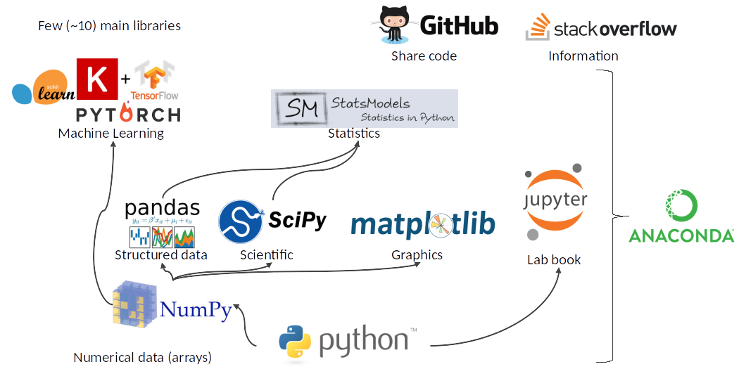
Python ecosystem

Slide 5

Numerical Computation with Numpy
N-Dim Array
Vectorization
Rich indexing/slicing
Broadcasting
Fast Computation Tools
Comprehensive math functions
Random number generators
Linear Algebra routine, FFT, etc.
Well-optimized C code

Slide 6

Analyze tabular data with Pandas
The high-level data analysis
Series/DataFrame with integrated indexing.
Reading/Writing to different formats.
Intelligent data alignment, handling missing data.
Flexible reshaping and pivoting
Powerful groupby to enable split-apply-combine data
Merging and joining
Hierarchical indexing provides way to work with high dimensional data.
Time series functionality.
…

Slide 7

Data visualization with Matplotlib

