Slide 1
About me
BS Computer Science
ME Engineering Management
Stayed technical my whole career
Software development, business analysis, team lead, data architecture and analytics
In a corporate culture: Big=IBM, Medium and Start-up

Slide 2
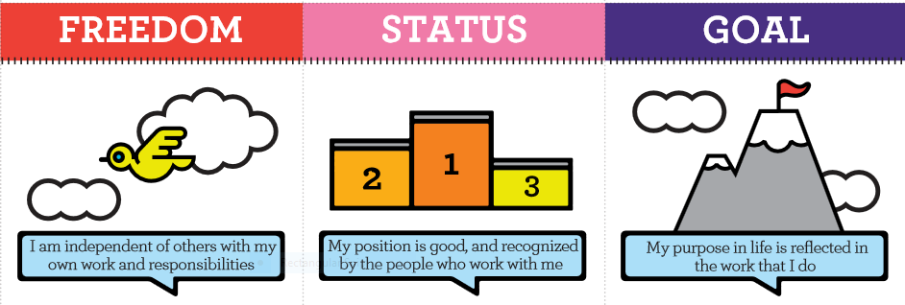
Decide what YOU want
TED Talk
How to know your life's purpose in 5 minutes - Adam Leipzig
https://www.youtube.com/watch?v=vVsXO9brK7M
Treat your career as a data science problem
What values are you optimizing for?
What constraints are you under?
Book: Doing Data Science, p. 359
http://dl.finebook.ir/book/5c/14507.pdf
Intrinsic Motivators (Jurgen Apello)
https://1qjpt15fhlq3xjfpm2utibj1-wpengine.netdna-ssl.com/wp-content/uploads/2016/01/Moving-Motivators-2015-self-print-Letter-English.pdf

Slide 3
Be bold and confident
Saying Yes!
Don’t be too self critical
“Actual competence may weaken self-confidence” (Doing Data Science, p. 352)
Finding a mentor
Book: Lean In by Sheryl Sandberg
TED Talk: http://www.ted.com/talks/sheryl_sandberg_why_we_have_too_few_women_leaders
Imposter Syndrome – various articles on web

Slide 4
Biases – yours and theirs
Saying No!
Don’t be afraid to negotiate
Find good environments
Support other women
Book: Lean In by Sheryl Sandberg
Givers and Takers
https://hbr.org/2013/04/in-the-company-of-givers-and-takers
For Women in Tech Ageism is Getting Old
https://www.thoughtworks.com/insights/blog/women-tech-ageism-getting-old

