Slide 1








a
a
a
a
a
H
H
H
···
···
···
example of a
example of H
Classifier
a
A
H
···
Learning: optimise parameters using labelled data

Slide 2





high dimension data space
$$x_{μ}$$
$$W_{1}$$
$$W_{2}$$
$$W_{3}$$
$$W_{4}$$
Detect intrinsic structure in data

Slide 3





Environment
$$a_{1}$$
$$r_{1}$$
$$S_{1}$$
Agent
Agents automatically determines the ideal behaviour, in order to maximize its performance

Slide 4
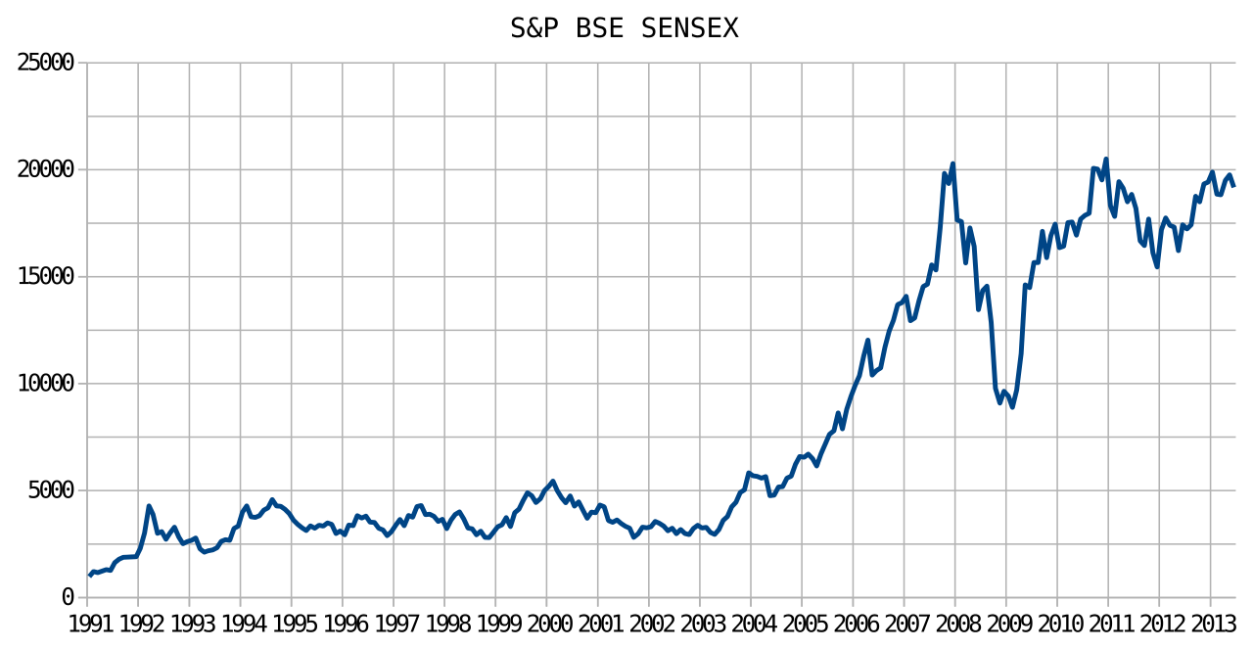
This Photo by Unknown Author is licensed under CC BY-SA

Slide 5
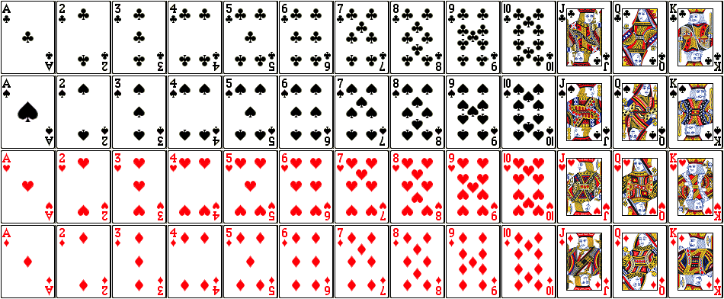
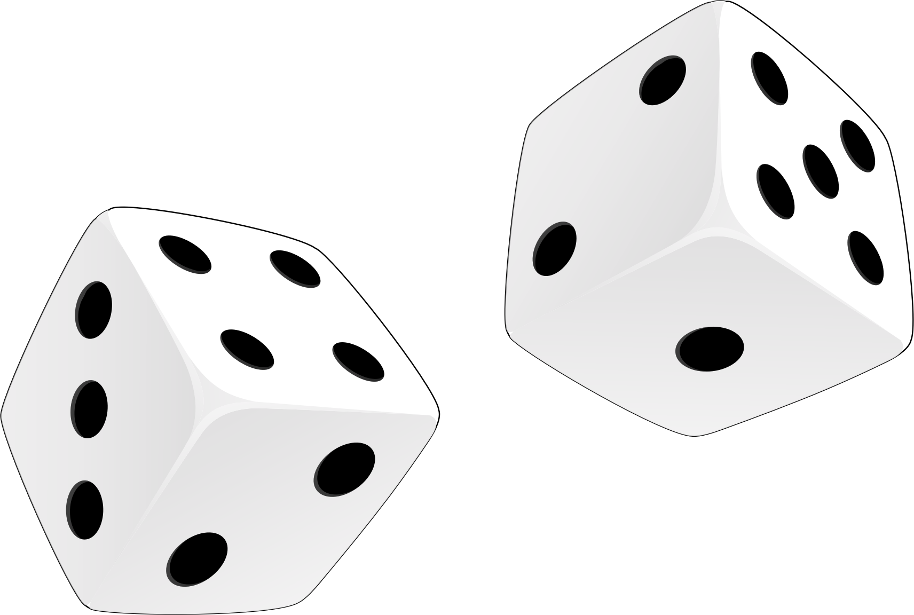
This Photo by Unknown Author is licensed under CC BY-SA

