Slide 1
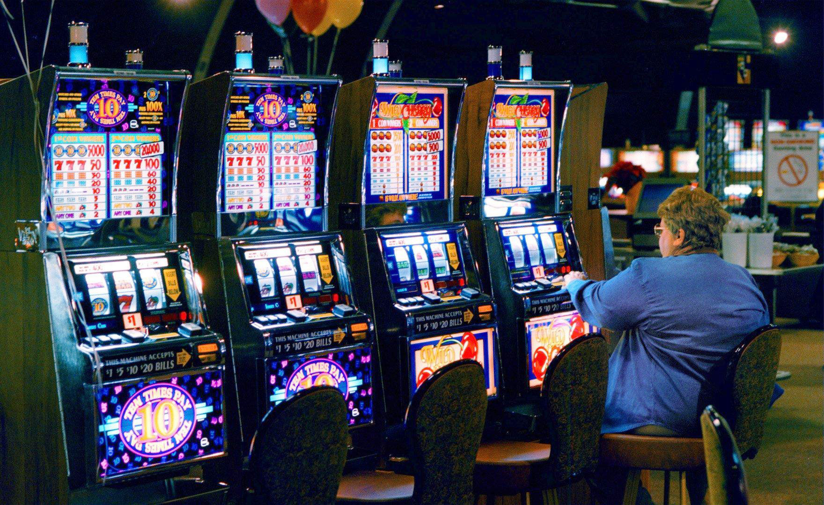
This Photo by Unknown Author is licensed under CC BY

Slide 2
Uncertainty ← noise a measurements through
finite size of data sets
Probability Theory:
quantification and manipulation of uncertainty
This Photo by Unknown Author is licensed under CC BY
Decision Theory:
the reasoning underlying an agent's choices
Optimal Predictions

Slide 3
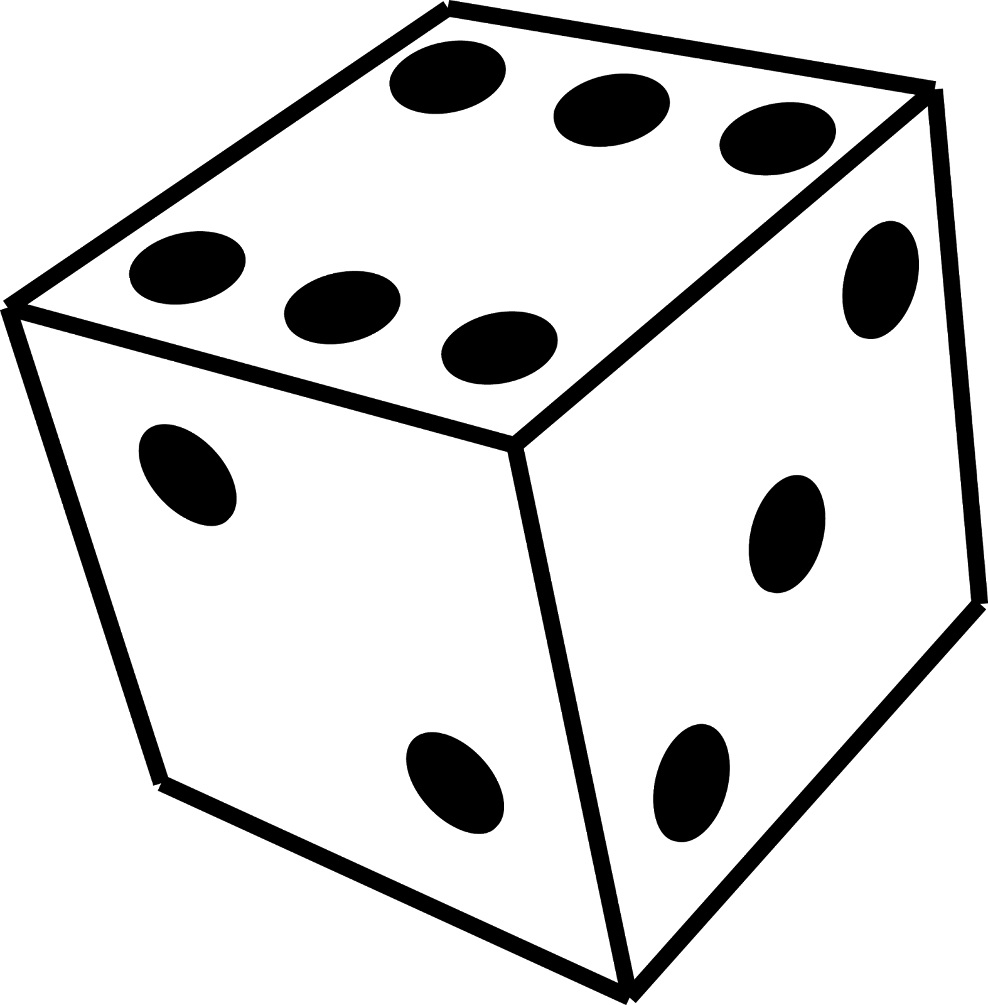

Slide 4
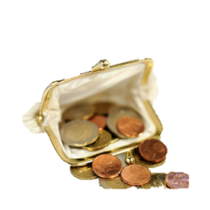

This Photo by Unknown Author is licensed under CC BY-SA
This Photo by Unknown Author is licensed under CC BY-NC-ND

Slide 5
