Slide 1
Analysis of individual learning curves on an online game
Seongmuk Gang
Supervisor: Dr. Tom Stafford
Notes:
Hello, my name is Seongmuk Gang. I’m going to tell you about my personal project, “Analysis of individual learning curves on an online game, which is under Dr. Tom Stafford’s supervision.

Slide 2
Outline
Motivation
Problem and Objectives
Methods
Data Curation (Filtering, Deformation, Clustering)
Function Fitting
Discussion and Conclusion
Notes:
I’ve divided my presentation into 4 main areas.
Firstly, I’ll briefly explain the motivation, current studies’ problems and objectives of my presentation.
Then, I’ll move on to the technical methods.
Finally, I’ll finish my presentation with discussion and conclusion.

Slide 3
Motivation
Which shape of learning curve do individuals follow?
Skill acquisition & Learning processes
Newell, A., & Rosenbloom, P. S. (1981). Mechanisms of skill acquisition and the law of practice. Cognitive skills and their acquisition, 1, 1–55.
Ericsson, K. A., Krampe, R. T., & Tesch-Römer, C. (1993). The role of deliberate practice in the acquisition of expert performance. Psychological review, 100(3), 363.
Notes:
Well, I’m interested in “how people learn a new skill” and “which process we follow while learning”.
if we investigate the learning curves on the performances of law in practice, we can understand these questions.
---------------------------------------------------------------------------------------------------------------------------------------------------------
As Newell said that ”curve fitting with benefit of a model” would provide effective understanding of skill acquisition and learning processes (Newell & Rosenbloom, 1981)

Slide 4
Problems & Objectives
Power law is an artifact
Person 1
Person 2
Person
Averaged Learning Curve
Donner, Y., & Hardy, J. L. (2015). Piecewise power laws in individual learning curves. Psychonomic bulletin & review, 22(5), 1308– 1319.
Gallistel, C. R., Fairhurst, S., & Balsam, P. (2004). The learning curve: implications of a quantitative analysis. Proceedings of the national academy of Sciences of the united States of america, 101(36), 13124–13131.
Notes:
However, the laws that can show the learning processes are few in Psychology, and the most popular law in practice is power law, but it may not provide the concise information of the individual learning processes.
Because, “the power law is an artificial learning curve”.
클릭.After averaging many individuals, the feature for individuals will disappear.
Therefore, it is possible that “Individuals may show many different shapes of learning curve”. Some may follow power law, others are exponential, and others may show step-like curve.
---------------------------------------------------------------------------------------------
Donner insisted that “if many exponential learning curves are averaged, it will result in power law.”

Slide 5




Problems & Objectives
Power law is an artifact
Laboratorial result
Stafford, T., & Dewar, M. (2014). Tracing the trajectory of skill learning with a very large sample of online game players. Psychological Science, 25(2), 511–518.
Notes:
Secondly, many investigation of the learning curve has been performed in the laboratories.
클릭. Which means, they used to invite some experts in some specific fields, and this restriction may result in the learning curve showing only the power law.

Slide 6

Problems & Objectives
Power law is an artifact
Laboratorial result
Investigate individual learning curves
On-line game, Axon, data set
Stuart, P. (2009). Axon - a game for science [Computer software manual]. (Retrieved February 3, 2014, from http://preloaded.com/ axon-game-science/)
Notes:
Therefore, this project has the aims as these.
Investigate individuals on a large amount of data set, which was collected from the on-line game, Axon. developed by Preload for Welcome trust
Let’s now move on to the methods how the analysis was implemented.
------------------------------------------------------------------------------------------------------
온라인 게임 이유:
an online game involving rapid perception, decision making, and motor responding.
Large amount.
Various kind of people

Slide 7


Methods 1. Data Curation
Discovering
Cleaning
Transforming
Integrating
Deduplicating
Stonebraker, M., Bruckner, D., Ilyas, I. F., Beskales, G., Cherniack, M., Zdonik, S. B., . . . Xu, S. (2013). Data curation at scale: The data tamer system. In Cidr.
Notes:
The first thing I did is data curation task.
Definition: “Data curation is the act of discovering a data source(s) of interest, cleaning and transforming the new data, semantically integrating it with other local data sources, and deduplicating the resulting composite.”
Unfortunately, the raw data set of the on-line game contains many ’undefined’ or ’unrepresentable values’, and some values are not valid, such as the starting play time is later than the time play finished.

Slide 8
Methods 1. Data Curation
Cleaning
Incrementally accommodating
Normalising
Clustering
Stonebraker, M., Bruckner, D., Ilyas, I. F., Beskales, G., Cherniack, M., Zdonik, S. B., . . . Xu, S. (2013). Data curation at scale: The data tamer system. In Cidr.
Notes:
Thus, the data source needs refining processes until the gemstone of the data set could gleam with the evidence of valuable information.
On the left, these are the tasks of data curation for the on-line game data set.
As a result, raw data set having 854,064 players were cleaned, and then reduced to 22,832 individuals.

Slide 9

Methods 2. Clustering
Discontinuous data!
Score
?
Attempt
Notes:
However, unfortunately, even curated data set has the problem of discontinuity. Although it is unknown why the data were not been recorded appropriately, almost all individual data have this issue.

Slide 10
Methods 2. Clustering
Truncate 15 attempts
Score
?
?
15
Attempt
Performance in the early attempts may remain at the last
Stafford, T., & Dewar, M. (2014). Tracing the trajectory of skill learning with a very large sample of online game players. Psychological Science, 25(2), 511–518.
Notes:
So, I analysed groups in which players show the similar learning patterns in the early 15 attempts, instead of analysing individual learning curves of about each 22,000 players, because I assume early leaning pattern may last until the later learning processes.
So, 쉼표. I truncated 15 attempts of data for each player, grouped players having similar pattern within 15 attempts.
----------------------------------------------------------------------------------------------------------------------------------------------------------------------------------------------------
As Stafford said that “greater initial variation in performance is linked to higher subsequent performance” and “players with higher initial scores tend to progress faster”,

Slide 11

Methods 2. Clustering
Truncate 15 attempts
Score
?
?
15
Attempt
Cluster 1
Cluster 2
Cluster
Stafford, T., & Dewar, M. (2014). Tracing the trajectory of skill learning with a very large sample of online game players. Psychological Science, 25(2), 511–518.
Notes:
For clustering, I used K-mean cluster method with competitive learning algorithm.
To explain shortly about this method,
Firstly I assumed there are n number of clusters.
At the same time, all players are arranged to the initialsed clusters based on this equation, which compares the distance between each point of individuals and the centorids of each cluster.
Then, the Squared sum of all distances are calculated as the criteria of how well the data set is clusterd.

Slide 12
Methods 2. Clustering
Truncate 15 attempts
Score
?
?
15
Attempt
Cluster 1
Cluster 2
Cluster
Stafford, T., & Dewar, M. (2014). Tracing the trajectory of skill learning with a very large sample of online game players. Psychological Science, 25(2), 511–518.
Notes:
After iterating these three steps sufficiently, clustering algorithm stops at the breaking criteria, which the difference between a previous squared sum and the current squared sum is below than a threshold.
As a result, about 22,832 players in the data set can be clustered properly.

Slide 13
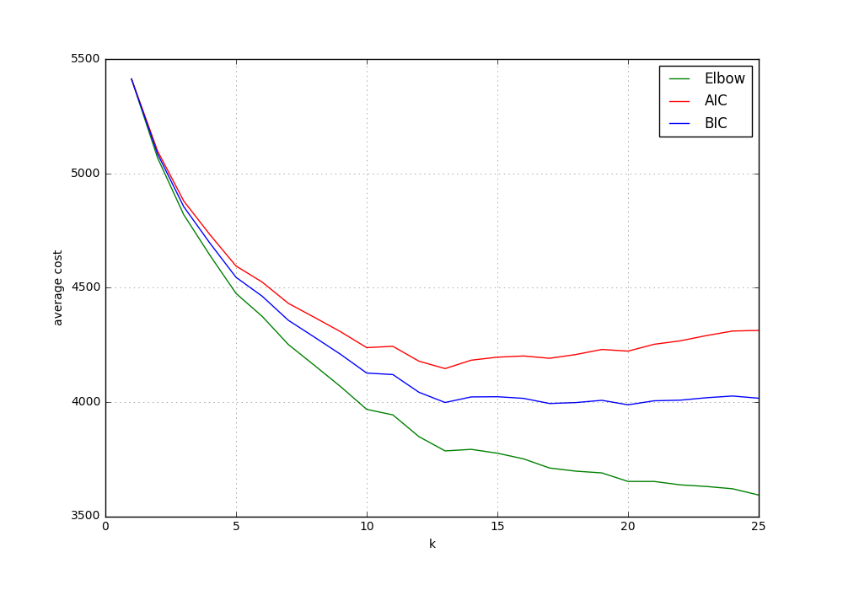
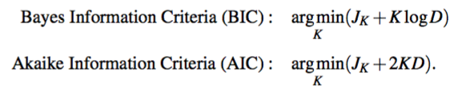
Methods 2. Clustering
Cluster 1
Cluster 2
Cluster 13
Stafford, T., & Dewar, M. (2014). Tracing the trajectory of skill learning with a very large sample of online game players. Psychological Science, 25(2), 511–518.
Notes:
However, there is a crux of K-Means clustering, “the optimal number of clusters is unknown”.
The on-line game data set has no predefined information of how many groups showing what the similar learning patterns are.
For this, I used Bayes Information Criteria (BIC) and Akaike Information Criteria (AIC), as well as elbow method.
In elbow method, the more a number of clusters, the less the value of the cost function. This is the elbow method plotted as green line.
But, BIC and AIC proportionally compensates with 2KD or KlogD , decreasing the value of cost function for various number of K.
After plotting those three criteria, I chose moderately the optimal number of cluster is 13, as two graphs of AIC and BIC start to increase at that point.
------------------------------------------------------------
In high dimensions, AIC criteria gives ”high penalty for many clusters”

Slide 14
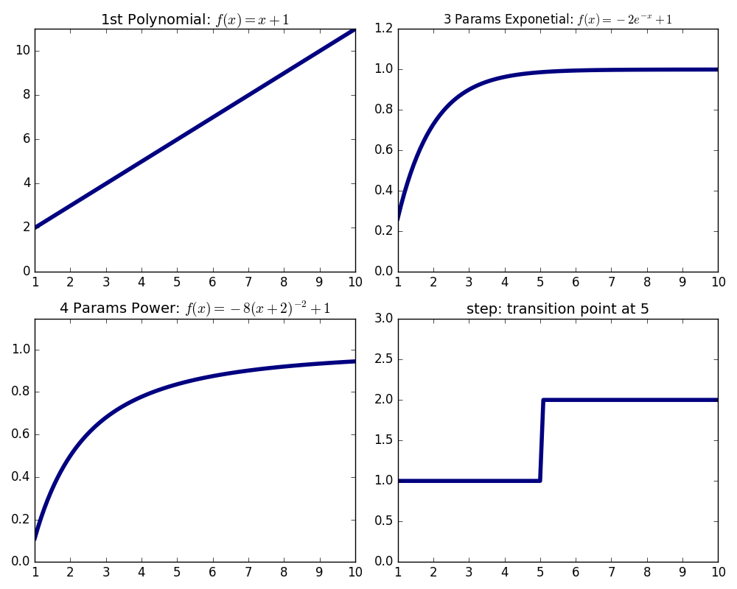
Methods 3. Function Fitting (models)
Single curve model:
Murre, J. M., & Chessa, A. G. (2011). Power laws from individual differences in learning and forgetting: mathematical analyses. Psychonomic bulletin & review, 18(3), 592–597.
Kounios, J., & Beeman, M. (2009). The aha! moment the cognitive neuroscience of insight. Current directions in psychological science, 18(4), 210–216.
Notes:
The last thing for this analysis is to fit some possible models to the clustered 13 groups.
There are four possible underlying models for a single curve fitting.
basis model from 1st to 10th polynomial function, exponential model, and power model with various number of parameters, and step function.
------------------------------------------------------------------------------------------------------------
aha! Moment or abrupt learning process represented by was tested.

Slide 15
Methods 3. Function Fitting
Piecewise curve model:
piecewise exponential model
piecewise power model
piecewise step-like model
piecewise exponential and step-like model
piecewise exponential and polynomial model
piecewise power and step-like model
piecewise power and polynomial model
Donner, Y., & Hardy, J. L. (2015). Piecewise power laws in individual learning curves. Psychonomic bulletin & review, 22(5), 1308– 1319.
Notes:
For the situation that individuals may show piecewise-like leaning curve, these 7 combination between previous 4 functions were set.
Concerning the number of pieces, these piecewise functions have from 2 pieces to 10 pieces.
In all situation of different function fittings, they result in the loss of squared sum.

Slide 16

Methods 3. Function Fitting (criteria)
Criteria:
Squared loss function:
Choice of Transition points:
Over-fitting and Regularisation: AIC and BIC
Notes:
So, in order to identify which model is the best fitting learning curve, squared loss function, the same as K- mean clustering algorithm, was also used as an criterion for comparing those 11 possible models.
Choice of transition points and the over-fitting when increasing the number of pieces are the problem of piecewise function fitting. The more number of pieces are, the lower loss piecewise functions have,
Therefore, AIC and BIC method were used to choose the optimal number of pieces.
And… 쉬고. I want to explain the solution of how to find the optimal transition points.

Slide 17
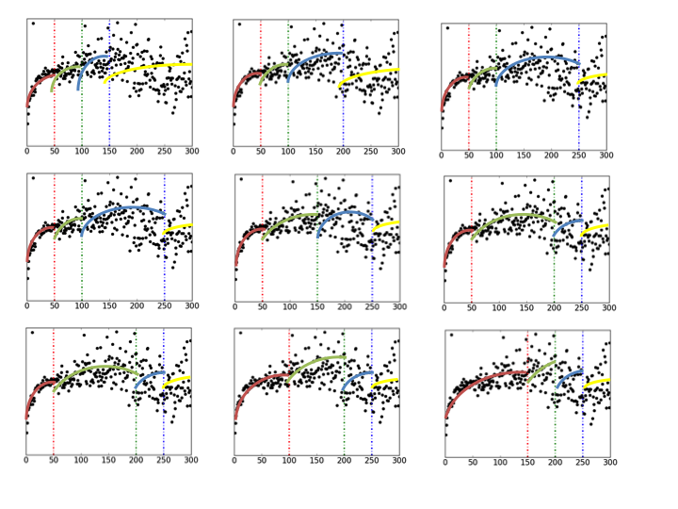
Methods 3. Function Fitting (criteria)
Choice of transition Points: example in a graph
Piece
Transition point shift
Notes:
For example, let’s suppose there are four pieces with window 50.
The first, second transition point are set with window 50, and the last transition point shifts, varying its position.
In the same manner, other transition points also shift in order.
At these all situation, squared sum loss are recorded to the corresponding matrix, with the shape of a number of pieces 가리키며 and a number of transition point shift.
For this example, the matrix will have the shape of 4 by 3.
-------------------------------------------------------------------------------
If I divided an individual data set, it will show this 9 patters.

Slide 18
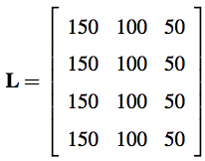
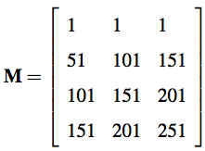
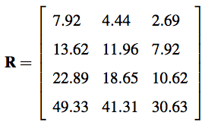
Methods 3. Function Fitting (criteria)
Piece range matrix,
Transition point matrix,
Errors lose matrix,
300?
greater?
mapping
Choice of transition Points: 3 matrices
Check!
Notes:
These are the corresponding matrix, range of piece, transition points, and errors lose matrix.
The optimal transition will have the least cost value under these three conditions.
First, is the range of pieces plausible? It should have 300 range.
Are the position of the transition points reasonable? The previous transition point has to be lower than later one.
Finally, mapping those positions to the errors lose matrix will provide the optimal transition points and the least errors lose value.

Slide 19
Methods 3. Function Fitting (criteria)
Choice of transition Points: Select
Piece
Transition point shift
Notes:
Then, 가리키며 this transition point was selected for the piecewise function with 4 pieces.
So, 쉬고 that’s the general picture regarding the methods of how to find the best fitting learning curve to each clusters.
Next, I’d like to discuss of the curve fitting result and conclude my presentation.

Slide 20
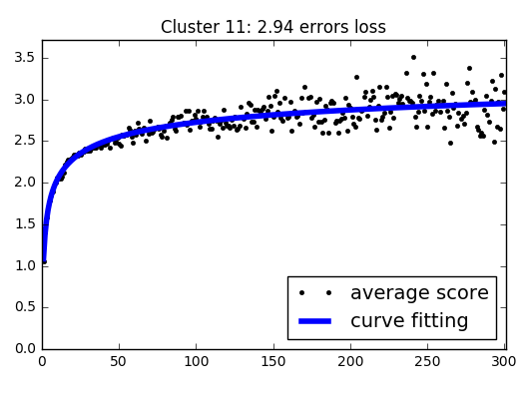
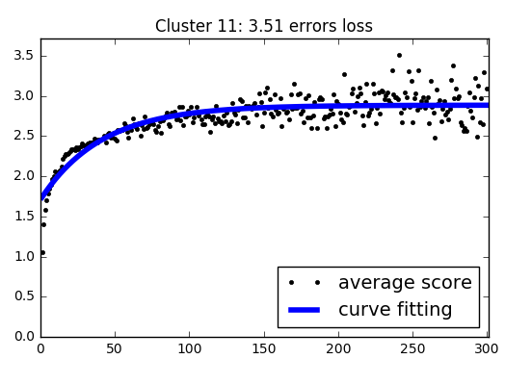
Discussion & Conclusion (averaged data)
Power Law vs. Exponential Law :
Power Law
(2.94 errors loss)
Exponential Law
(3.51 errors loss)
Murre, J. M., & Chessa, A. G. (2011). Power laws from individual differences in learning and forgetting: mathematical analyses. Psychonomic bulletin & review, 18(3), 592–597.
Notes:
Firstry, I Identified Murre’s argument that -> single exponential function may fit better for individuals than a power function, as it is produced by many averaged individual exponential functions (Murre & Chessa, 2011).
As he said, 클릭 power function with 4 parameters showed better fitting result than exponential function with 3 parameters on the averaged the data set of 13 clusters.
But, this is not true for the clustered data set.

Slide 21
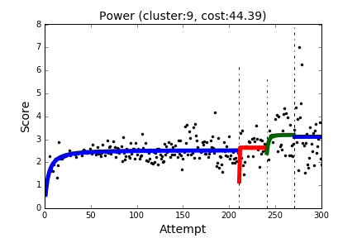
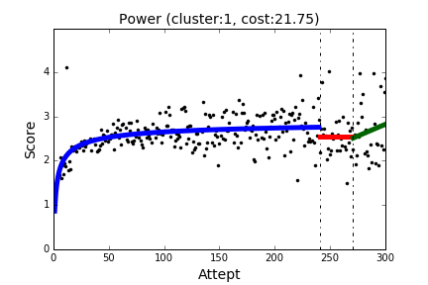
Discussion & Conclusion (clustered data set)
Piecewise curves:
7 clusters
(power functions)
3 clusters
(power + polynomial function)
Notes:
7 clusters showed piecewise power function, and 3 clusters showed the curve combined with power and polynomial functions.

Slide 22
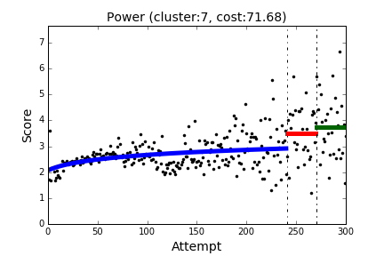
Discussion & Conclusion
Piecewise curves:
1 cluster
(power + step functions)
Notes:
And 1 individuals sowed piecewise power and step function.

Slide 23
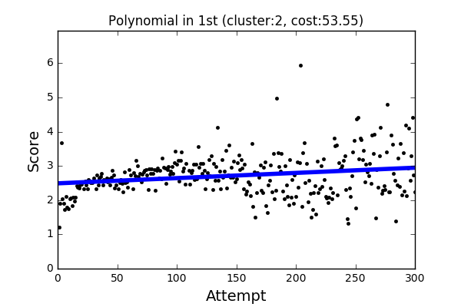
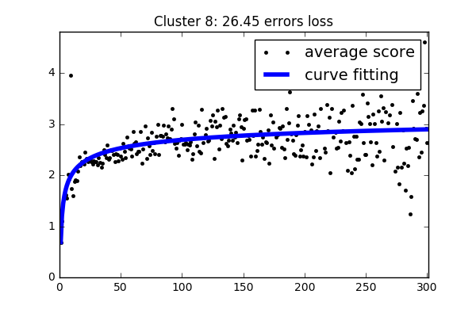
Discussion & Conclusion (clustered data set)
Single curves:
1 cluster
(1st order polynomial function)
1 cluster
(Power function)
Notes:
Only 2 clusters have a single curve, as the best fitting model; first order polynomial function and power function.
The interesting thing is that first order polynomial function was fitted best.
It can be assumed that some people learn slowly but steadily. Although their learning process is slow, they might be experts after sufficient time, because the learning curve increase without limitation, while others approaches to the asymptotes.

Slide 24
Discussion & Conclusion
Power curve is dominant
Exploitation and exploration
Not exactly individual learning curves
Small window
Factor analysis
Notes:
In conclusion, the most dominant model is piecewise power law. Even in the piecewise functions, power law models always appear before the first transition point.
This may be because the data sets which were trained by various models are also averaged data sets, rather than actually fitting on the each player.
For the future work, I’d like to test those models on the each individual, if I can get perfect data set without discontinuity problem, and I want to find which factor, it means which shape of learning curves, may affect the averaged learning curve.
For the computational complex reason, I used the minimum window 30 for piecewise function. But transition points can be within 30, the minimum window. So, I will train the data set with smaller window in order to find the best transition points.
Finally, I believe I could link the result to the exploration/exploitation trade-off of reinforcement learning.
The practice before the first transition point for almost all clusters shows the monotonic improvement in the early phases, getting slower and slower. Finally it approaches the asymptote.
All of them, except polynomial learning curve, follow this power law learning process early in the learning. At the end of the power curve, which is near to asymptote, scores became fluctuated until it reaches to the first transition, then they showed different shape of learning curves with significantly fluctuated scores; but higher than the value of asymptotes.
Which may imply “individuals tend to take the exploitation actions at the beginning of the game, and they does not choose the exploration actions at the beginning. Then, when they feel that their learning process became significantly slow, they try and explore different methods, in order to improve their performance.”
Thank you for listening. Do you have any questions?

Slide 25
Methods 3. Function Fitting (criteria)
Choice of transition Points: recoding to matrix
Number of pieces
Number of
transition point shift

