Slide 1
Crop Recommendation System
Using Soil & Climate Data
Imtiyaz Alamshah (2024AIML132)
Raibagkar Harshal Gopalrao (2024AIML057)
Shah Hima Kiranbhai (2024AIML011)
Upadyayula V Sharma (2023AIML070)
Lipsa Mishra (2023AIML067)
Mentor: Dr. Aniruddha Dasgupta

Slide 2
Agenda
1. Introduction
2. Dataset & Features
3. Data Preparation
4. Modeling
5. Deployment & Application
6. Conclusion & Future Work

Slide 3
System Overview
The crop recommender system utilizes the Kaggle Crop Recommendation Dataset, consisting of soil parameters (N, P, K), temperature, pH, rainfall, and a crop label to build a robust prediction model pipeline.
The goal is to recommend optimal crops for cultivation based on local soil and climate data, using automated data cleaning, feature engineering, and machine learning.

Slide 4
Importance
✔ Optimize agricultural yield
✔ Reduce risk of crop failure
✔ Improve resource utilization
✔ Support sustainable farming

Slide 5
Data & Features
The main features include Nitrogen (N), Phosphorus (P), Potassium (K), pH, Rainfall, and Temperature. The target variable is the crop type, which is label encoded for the model.
Domain-aware engineered features are created, including bins for pH (acidic, neutral, alkaline), rainfall (low, medium, high), and temperature (cool, warm, hot).

Slide 6
Features
Nitrogen (N)
Phosphorus (P)
Potassium (K)
Temperature (°C)
pH value
Rainfall (mm)

Slide 7
Target Variable
Crop label (rice, maize, moong, wheat, rapeseed)

Slide 8
Workflow & Preprocessing
The pipeline includes reading local CSV data, type correction, handling missing values, and transforming outliers using IQR capping and encoding categorical features.
Stratified sampling ensures balanced data splits for train, validation, and test sets.

Slide 9
Modeling
The core engine is a RandomForestClassifier, wrapped in a pipeline that preprocesses both numeric and categorical features using imputation, encoding, and scaling.
Feature importance is estimated through permutation importance and model-based importances for reporting.

Slide 10
Performance & Evaluation
Validation and test set evaluation uses classification report metrics (precision, recall, f1-score, support) and confusion matrices.
The pipeline achieves strong accuracy and macro averages, confirming robust predictive performance.

Slide 11
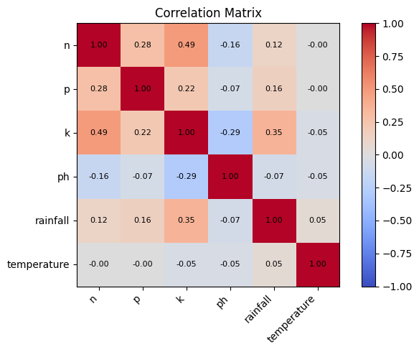
Visualizations

Slide 12
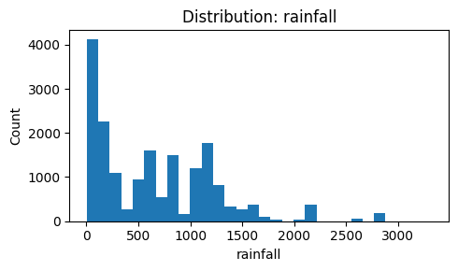
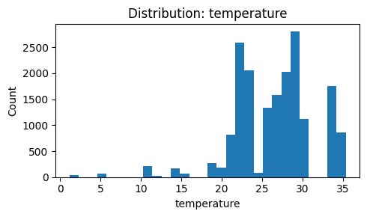
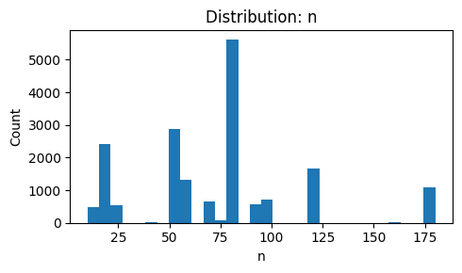
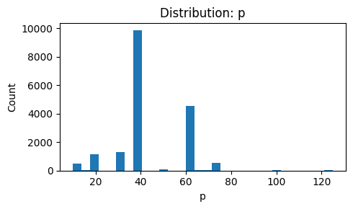
Distribution

Slide 13
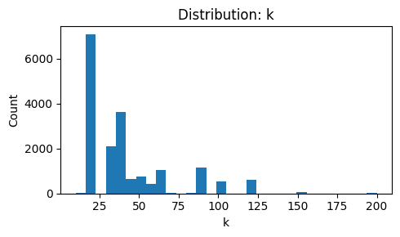
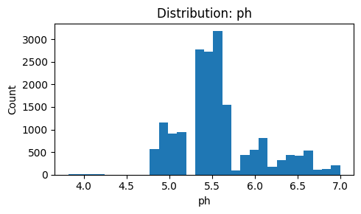
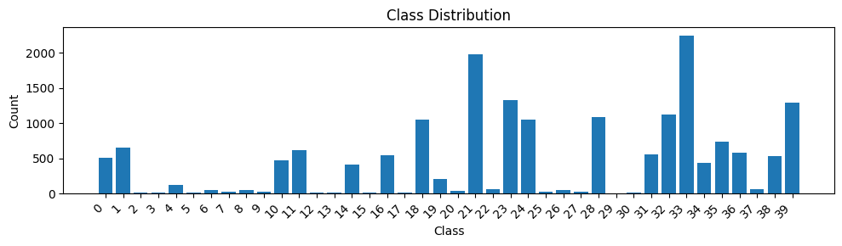
Distribution

Slide 14
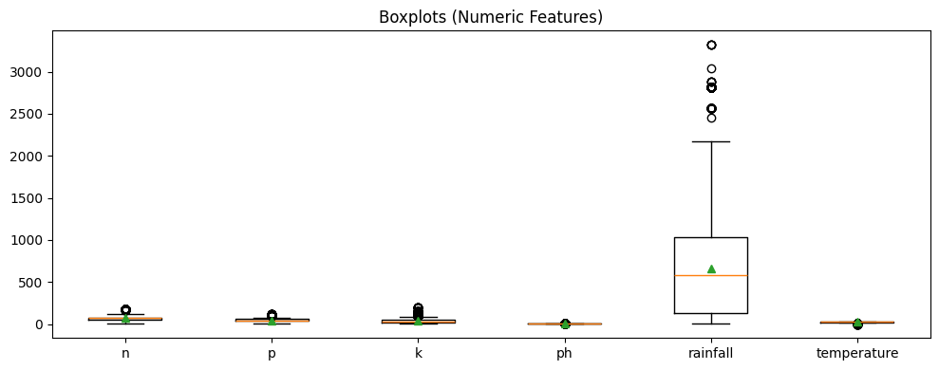
Box Plots

Slide 15
Model Selection
Algorithms:
- Random Forest

Slide 16
Model Training
✔ Train/Validation/Test split
✔ Stratified wherever possible
✔ Preprocessing pipeline (impute → encode → scale numeric (optional))
✔ Fit baseline & evaluate on validation set

Slide 17
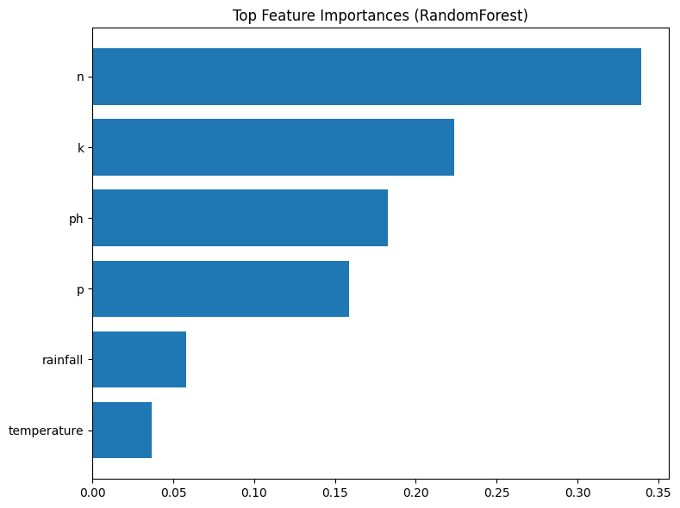
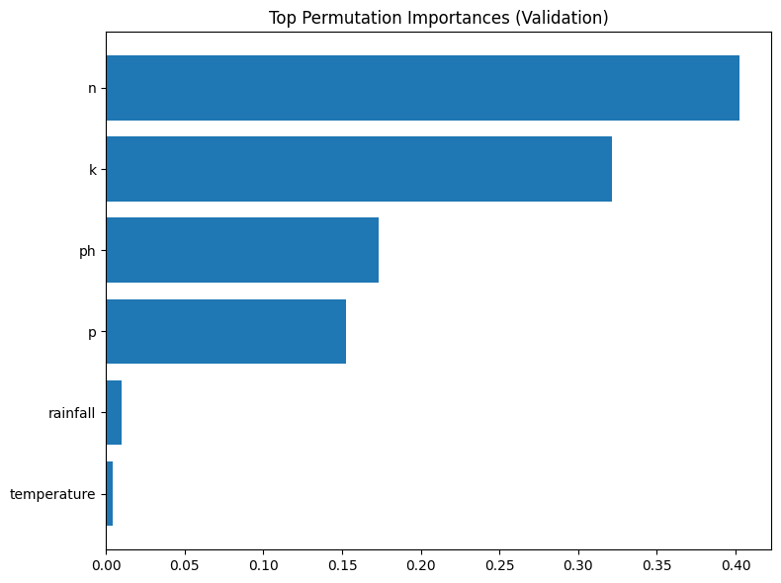
Feature Importance

Slide 18
References
Dataset: Kaggle Crop Recommendation Dataset
Supporting Research: Agricultural ML studies, climate data analysis

