Slide 1

Crop Recommendation System
Leveraging Machine Learning for Smarter Farming

Slide 2

Agenda
Team Introduction
Problem Statement
Dataset & Features
Methodology Overview
Modeling Approach
Key Insights & Feature Importance

Slide 3


Team Presentation
RAIBAGKAR HARSHAL GOPALRAO
2024AIML057
IMTIYAZ ALAMSHAH
2024AIML132
UPADYAYULA VENKATESWARA SHARMA
2024AIML070
LIPSA MISHRA
2024AIML067
SHAH HIMA KIRANBHAI
2024AIML011

Slide 4

1.
Problem Statement
Farmers face challenges in choosing the right crop based on soil and climate.
Goal: Recommend suitable crops using ML based on soil nutrients and weather.

Slide 5

Dataset selection:
Explored multiple data sets from different sources including Kaggle, zenodo.org data.gov.in, upag.gov.in, agri.telangana.gov.in.
We selected following data based on criteria –
Volume of data (18k + records)
Clear features and target variables
Structured data
Strong correlation between features and target variable

Slide 6
Dataset & Features -1
Based on the above criteria following 2 datasets are considered 1. Using multifile dataset with. data integration, feature aggregation and record linking
https://www.kaggle.com/datasets/pyatakov/india-agriculture-crop-production
https://www.kaggle.com/datasets/dhamur/monthly-district-avg-rainfall-19012017
https://www.kaggle.com/datasets/ishankat/daily-wholesale-commodity-prices-india-mandis
https://www.kaggle.com/datasets/atharvaingle/crop-recommendation

Slide 7
Dataset & Features -2
Source: Kaggle Crop Recommendation Dataset
https://www.kaggle.com/datasets/irakozekelly/crop-recommendation-dataset
Features: N, P, K, temperature, humidity, pH, rainfall
Target: Crop label (multi-class)

Slide 8
Workflow Overview
Data Loading
EDA
Model Training and testing
1
3
5
2
4
6
Preprocessing
Modeling
Deployment

Slide 9
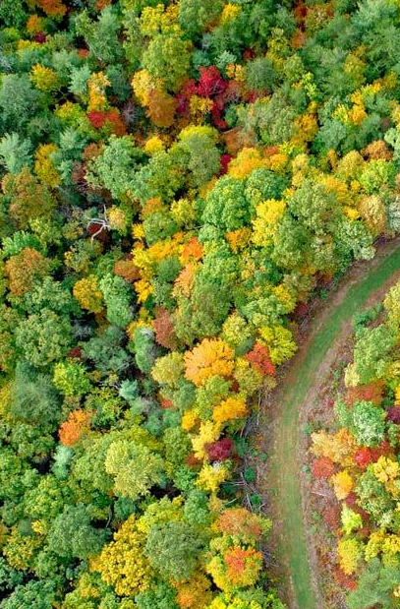
Methodology Overview
Data Loading & Preprocessing: Correcting data types, handling missing values, detecting outliers (IQR/Z-score), and Encoding target and categorical variables
Exploratory Data Analysis (EDA): Analyzing feature correlations, distributions, and class balance
Feature Engineering: Creating new features by binning continuous variables like pH (into acidic/neutral/alkaline categories), rainfall, and temperature

Slide 10

Modeling Approach
Modeling
The data is split into training, validation, and test sets using a 70/15/15 ratio, and then a Random Forest classifier is trained
Evaluation
Assessing the model using metrics like Accuracy, Precision, Recall, and F1-score.

Slide 11
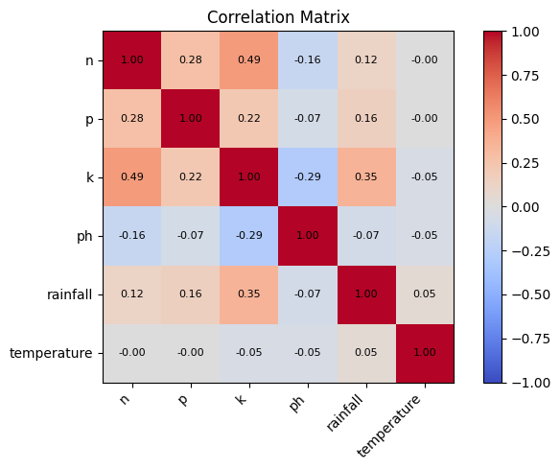
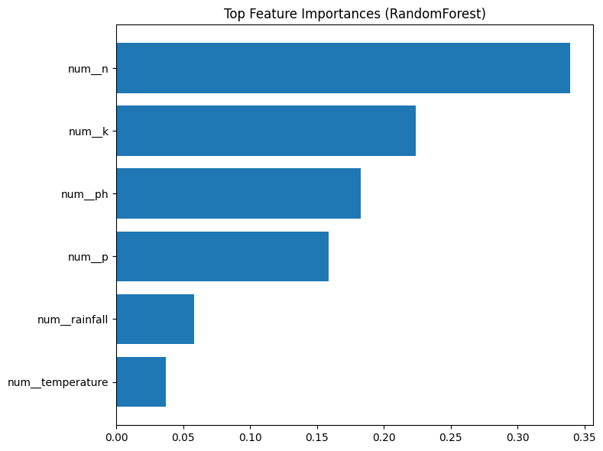
Correlation Heatmap (Actual) & Model: Feature Importance (Actual)
S
W
O
T

Slide 12

Key Insights and Feature Importance
Key Insights: Soil nutrients, particularly N, P, and K levels, along with soil pH, are strong influencers of crop suitability.
Climate factors such as rainfall and temperature provide crucial seasonal context for recommendations.
The final model offers practical and explainable recommendations for farmers.
Feature Importance: The model's internal metrics (Random Forest) and permutation importance were used to identify the most impactful features. This confirms that both soil and climate variables are vital for accurate predictions

Slide 13
Modeling Algo Selection
Tree based models fits the best for this scenario.
Why?
Features (N, P, K, rainfall, pH temperature) are structured numeric values.
Decision-tree ensembles like Random Forest/XGBoost:
Naturally handles non-linear feature interactions (e.g., rainfall × pH combinations).
Perform well with mixed feature scales (no strict need for scaling).
Robust against outliers and multicollinearity.

Slide 14
Modeling Strategy
Start with Random Forest as baseline.
Move to XGBoost/LightGBM for performance optimization.
Monitor class imbalance and adjust with class weights or resampling if needed.
Use feature importance plots to interpret which environmental factor most affects crop prediction.

Slide 15
Deployment Strategy:
Stack: FastAPI (Python) + Nginx + TypeScript.
Packaging: Two containers (API, Web) via Docker Compose; UI proxies /api to backend
Artifact: Model (.pkl/joblib) in image; consistent preprocessing inside sklearn pipeline.
Run: docker compose up --build → UI at http://<hostname>, API at /api.
Security (good to have): Localhost or self-signed TLS (mkcert).
Model Registry/Packaging (good to have): MLflow
.

Slide 16
Deployment & Next Steps
Bringing the Solution to Farmers
<Paste the UI Screeshot of Streamlit application we built>
Develop a user-friendly Streamlit web application where farmers can input their local soil and climate data to get crop recommendations.
Integrate real-time weather & regional agronomy rules
Support multilingual farmer-friendly UI

Slide 17
Key Insights and Feature Importance
Key Insights: Soil nutrients, particularly N, P, and K levels, along with soil pH, are strong influencers of crop suitability.
Climate factors such as rainfall and temperature provide crucial seasonal context for recommendations.
The final model offers practical and explainable recommendations for farmers.
Feature Importance: The model's internal metrics (Random Forest) and permutation importance were used to identify the most impactful features. This confirms that both soil and climate variables are vital for accurate predictions

Slide 18
Thanks!
ANY QUESTIONS?

