Slide 1

Crop Recommendation System
Leveraging Machine Learning for Smarter Farming

Slide 2

Agenda
Team Introduction
Problem Statement
Dataset & Features
Methodology Overview
Modeling Approach
Key Insights & Feature Importance

Slide 3


Team Presentation
RAIBAGKAR HARSHAL GOPALRAO
2024AIML057
IMTIYAZ ALAMSHAH
2024AIML132
UPADYAYULA VENKATESWARA SHARMA
2024AIML070
LIPSA MISHRA
2024AIML067
SHAH HIMA KIRANBHAI
2024AIML011

Slide 4

1.
Problem Statement
Farmers face challenges in choosing the right crop based on soil and climate.
Goal: Recommend suitable crops using ML based on soil nutrients and weather.

Slide 5
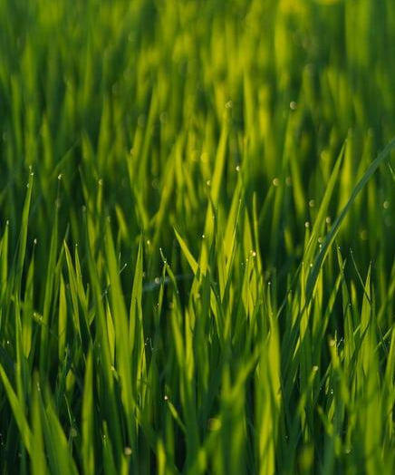
Dataset & Features
Source: Kaggle Crop Recommendation Dataset
Features: N, P, K, temperature, humidity, pH, rainfall
Target: Crop label (multi-class)

Slide 6
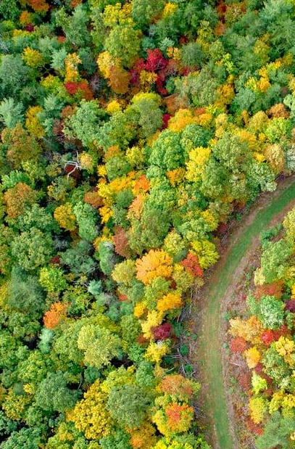
Methodology Overview
Data Loading & Preprocessing: Correcting data types, handling missing values, detecting outliers (IQR/Z-score), and Encoding target and categorical variables
Exploratory Data Analysis (EDA): Analyzing feature correlations, distributions, and class balance
Feature Engineering: Creating new features by binning continuous variables like pH (into acidic/neutral/alkaline categories), rainfall, and temperature

Slide 7

Modeling Approach
Modeling
The data is split into training, validation, and test sets using a 70/15/15 ratio, and then a Random Forest classifier is trained
Evaluation
Assessing the model using metrics like Accuracy, Precision, Recall, and F1-score.

Slide 8

Key Insights and Feature Importance
Key Insights: Soil nutrients, particularly N, P, and K levels, along with soil pH, are strong influencers of crop suitability.
Climate factors such as rainfall and temperature provide crucial seasonal context for recommendations.
The final model offers practical and explainable recommendations for farmers.
Feature Importance: The model's internal metrics (Random Forest) and permutation importance were used to identify the most impactful features. This confirms that both soil and climate variables are vital for accurate predictions

Slide 9
Deployment & Next Steps
Bringing the Solution to Farmers
<Paste the UI Screeshot of Streamlit application we built>
Develop a user-friendly Streamlit web application where farmers can input their local soil and climate data to get crop recommendations.
Integrate real-time weather & regional agronomy rules
Support multilingual farmer-friendly UI

Slide 10
Workflow Overview
Data Loading
EDA
Model Training and testing
1
3
5
2
4
6
Preprocessing
Modeling
Deployment

Slide 11
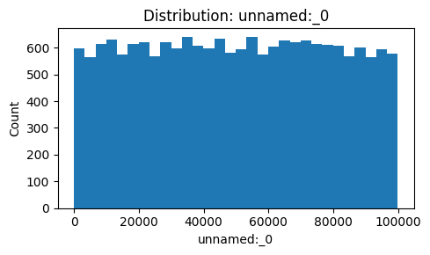
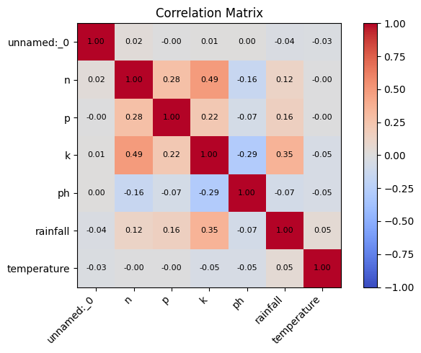
Correlation Heatmap (Actual) & Model: Feature Importance (Actual)
S
W
O
T

Slide 12
Thanks!
ANY QUESTIONS?

