Slide 1
E_HELPERS
Aim-To provide Electronics automation over GSM

Slide 2
BENEFITS OVER OTHER AUTOMATION SERVICES
Cost per setup is very less
Easy controlls , only through dialler keys.
Level of security is high.
Minimal power usage is guaranted.
.

Slide 3
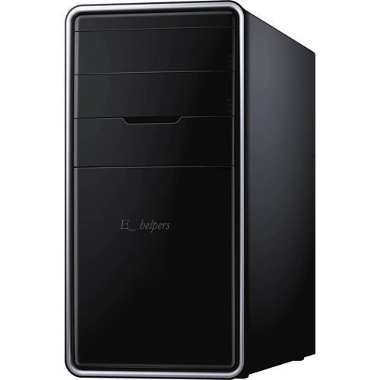
OUR PRODUCTS

