Slide 1
Introduction
Principles of Programming Languages (CS213)
Prof. M. N. Sahoo
sahoom@nitrkl.ac.in
sahoo.manmath@gmail.com

Slide 2
Introduction
1
Language evolution
  Machine level laguage
    difficult for large programs
  Assembly level language
    Set of mnemonics
    Assembler: converts assembly level mnemonics to m/c level instructions
    Rewriting same programs for different m/c was cumbersome
  High level language
    Fortran (mid 1950s) followed by Lisp and Algol
    Compilers: converts high level to assembly or m/c level instructions

Slide 3
Introduction
2
Why are there so many programming languages?
  Evolution
    we've learned better ways of doing things over time
    eg. goto statement ---> conditional and looping constructs Structure variable assignment ---> copy constructor in OOP
  Special purposes
    C is good for low level system programming
    COBOL is good for business processing
  Personal preference
    Matter of taste
    Some are convergant with recursions but some opt for iterations.
    Some prefer pointer but some dont.

Slide 4
Introduction
3
What makes a language successful?
  expresive power with more features (C, Lisp, Algol, Perl)
  ease of learning (BASIC, Pascal, LOGO)
  easy of implementation (BASIC, Forth)
  open source : wide dissemination at minimal cost (Pascal, Java)
  excellent compilers : possible to compile to very good (fast/small) code (Fortran)
  backing of a powerful sponsor (Visual Basic by microsoft)
  standardization
    Ensures portability accross platforms

Slide 5
Introduction
4
The programming language Spectrum
  Declarative (focus is on what to do)
    Functional (Lisp, Scheme, ML)
    Dataflow (Id, Val)
    Logic, constraint based (Prolog, Spreadsheets)
  Imperative (focus is on what and how to do)
    Von Neumann (C, Ada, Fortran...)
    Scripting (Perl, Python, PHP...)
    Object oriented (Smalltalk, C++, Java)

Slide 6
Introduction
5
Declarative languages
  Functional language
    Computational model is based on defining a set of functions
    In fact, the whole program is considered a function, which in turn contains many other functions
  Dataflow language
    Computational model is based on the information (tokens) flow among a set of functional nodes.
    The nodes are triggered by the arrival of input tokens
  Logic, constraint based language
    Computational model is defined to find the values that satisfies certain relationships that are defined through a set of logical rules

Slide 7
Introduction
6
Imperative languages
  Von Neumann language
    Means of computation is modification of variables
    Unlike functinal languages, the modification of variables may have impact on subsequent statements
  Scripting language
    Subset of Von Neumann language
    Developed for specific purposes
    Awk -- for report generation, PHP & Java script -- for web page designing
  Object oriented language
    Is a Von Neumann language with more structured model of computations

Slide 8
Introduction
7
Why study programming languages?
  Understand obscure features
    eg. union over structure, use of .* operator
  To choose a language with low implementation cost (eg. Avoid call by value for large data set)
  Makes it easier to learn new language
  Make good use of debuggers, linkers, loaders & related tools
  Simulate important features in the languages those lack them
    Lack of recursion by iterations
    Lack of symbolic constants/enums by const variables
  Make better use of language technology

Slide 9
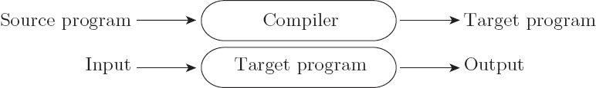
Compilation vs. Interpretation
8
Compilation vs. interpretation
  not opposites
  not a clear-cut distinction
Pure Compilation
  The compiler translates the high-level source program into an equivalent target program (typically in machine language), and then goes away:

Slide 10

Compilation vs. Interpretation
9
Pure Interpretation
  Interpreter stays around for the execution of the program
  Interpreter is the locus of control during execution

Slide 11
Compilation vs. Interpretation
10
Interpretation:
  Greater flexibility because it can change code on the fly (eg. in Prolog, Lisp)
  Better diagnostics (error messages)
Compilation
  Better performance

Slide 12
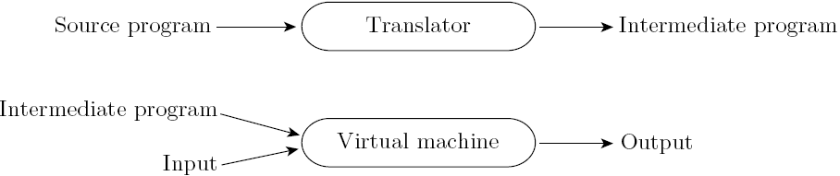
Compilation vs. Interpretation
11
Most language implementations include a mixture of both compilation and interpretation

Slide 13
Compilation vs. Interpretation
12
Implementation strategies:
  Preprocessor before interpretation
    Removes comments and white space
    Groups characters into tokens (keywords, identifiers, numbers, symbols)
    Expands abbreviations

Slide 14
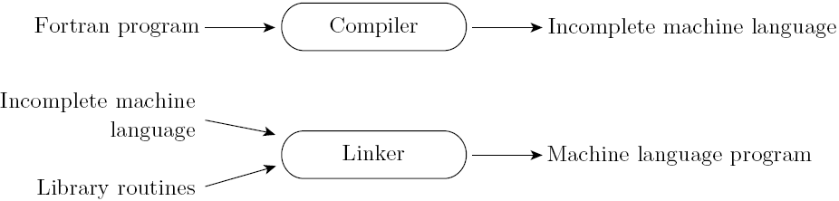
Compilation vs. Interpretation
13
Implementation strategies:
  Library of Routines and Linking
    Compiler uses a linker program to merge the appropriate library of subroutines (e.g., math functions such as sin, cos, log, etc.) into the final program:

Slide 15
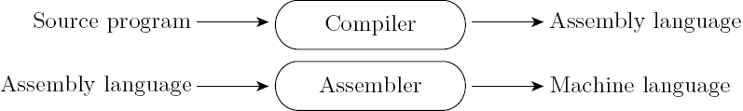
Compilation vs. Interpretation
14
Implementation strategies:
  Post-compilation Assembly
    Facilitates debugging (assembly language easier for people to read)
    Isolates the compiler from changes in the format of machine language files (only assembler must be changed, is shared by many compilers)

Slide 16
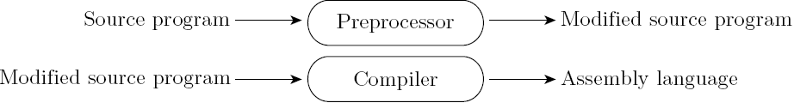
Compilation vs. Interpretation
15
Implementation strategies:
  The C Preprocessor (conditional compilation)
    Preprocessor deletes portions of code, which allows several versions of a program to be built from the same source

Slide 17
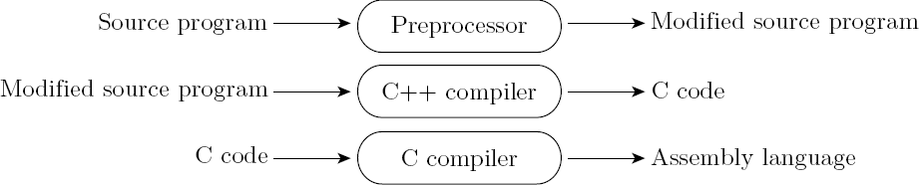
Compilation vs. Interpretation
16
Implementation strategies:
  Source-to-Source Translation (C++)
    C++ implementations based on the early AT&T compiler generated an intermediate program in C, instead of an assembly language:

Slide 18
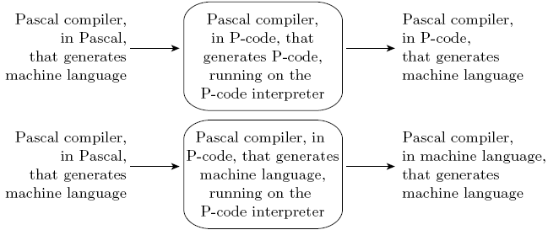
Compilation vs. Interpretation
17
Implementation strategies:
  Some compilers are self hosting
  Achieved by Bootstrapping

Slide 19
Compilation vs. Interpretation
18
Bootstrapping for interpreted languages:
  Pascal to P-code compiler P1, written in Pascal,
  Pascal to P-code compiler P2, written in P-code,
  A P-code interpreter I1, written in Pascal
  Translate I1 (by hand) into I2 in machine language (easy)
  Run P2 on I2 to compile any Pascal programs into P-code
  In case of any change to P1: Run P2 on I2 to compile P1 to its corresponding P-code

Slide 20
Compilation vs. Interpretation
19
Bootstrapping for compiled languages:
  Pascal to machine language compiler P3, written in Pascal,
  Pascal to P-code compiler P2, written in P-code,
  A P-code interpreter I1, written in Pascal
  Translate I1 (by hand) into I2 in machine language (easy)
  Run P2 on I2 with P3 as input to output P4, a Pascal to machine language compiler in P-code
  Run P4 on I2 with P3 as input to output P5, a Pascal to machine language compiler in machine language

Slide 21
Compilation vs. Interpretation
20
Implementation strategies:
  Compilation of Interpreted Languages
    The compiler generates code that makes assumptions about decisions that won’t be finalized until runtime. If these assumptions are valid, the code runs very fast. If not, a dynamic check will revert to the interpreter.

Slide 22
Compilation vs. Interpretation
21
Implementation strategies:
  Dynamic and Just-in-Time Compilation
    In some cases a programming system may deliberately delay compilation until the last possible moment.
      Lisp or Prolog invoke the compiler on the fly, to translate newly created source into machine language, or to optimize the code for a particular input set.
      The Java language definition defines a machine-independent intermediate form known as byte code. Byte code is the standard format for distribution of Java programs.
      The main C# compiler produces .NET Common Intermediate Language (CIL), which is then translated into machine code immediately prior to execution.

Slide 23
Compilation vs. Interpretation
22
Implementation strategies:
  Microcode
    Assembly-level instruction set is not implemented in hardware; it runs on an interpreter.
    Interpreter is written in low-level instructions (microcode or firmware), which are stored in read-only memory and executed by the hardware.

Slide 24
Compilation vs. Interpretation
23
Compilers exist for some interpreted languages, but they aren't pure:
  selective compilation of compilable pieces and extra-sophisticated pre-processing of remaining source.
  Interpretation of parts of code, at least, is still necessary for reasons above.
Unconventional compilers
  text formatters
  silicon compilers
  query language processors

Slide 25
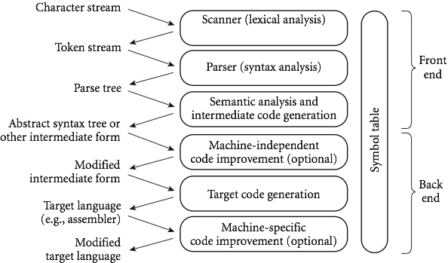
An Overview of Compilation
24
Phases of Compilation

Slide 26
An Overview of Compilation
25
Scanning (Lexical Analysis):
  Brings out lexemes (meaningful sequences in program)
  groups the lexemes into tokens of the form <token_name, attribute_value> and put them into symbol table(ST) for future reference
  token_names are just an abstract symbols for lexemes
  attribute_value is the pointer to the corresponding ST entry
  you can design a parser to take characters instead of tokens as input, but character-by-character processing is slow

Slide 27
An Overview of Compilation
26
Index | Lexeme | Token_name
1 | position | id
2 | initial | id
3 | rate | id
4 | = | ASSIGN
5 | + | op
6 | * | op
7 | 60 | number
Scanning:
(Symbol Table)
If improper lexemes (eg. #$ab) then show error messages
The attributes of the tokens are not decided yet (eg. data _type, scope etc.)

Slide 28
An Overview of Compilation
27
Parsing (Syntax Analysis):
  Checks for the correctness of the syntax by forming parse-tree with the help of context-free-grammar (CFG) for the language.
  Each internal node in parse-tree represents the higher-level constructs such as statement, expression etc. and the children specify their constituents.
  Each external node represents a token/lexeme
  A CFG is a set of recursive rules must be satisfied by every statement of the program

Slide 29
An Overview of Compilation
28
CFG:
  assignment_statement → <id><ASSIGN><expr>
  expr → <id> | <number> |-expr | (expr) | expr<op>expr
  op → + | - | * | /
  ASSIGN → =
Generates syntax error if it does not satisfy the CFG

Slide 30
An Overview of Compilation
29
assignment_statement
<id,1>
<ASSIGN,4>
expr
position
=
expr
<op,5>
expr
<id,2>
+
expr
<op,6>
expr
initial
<id,3>
*
<number,7>
(Parse Tree)
rate
60

Slide 31
An Overview of Compilation
30
Semantic analysis is the discovery of meaning in the program
  Fills the attributes of the ST entries
    e.g. (type of <id>, scope of <id>, no and types of args for a procedure)
  Enforce a large variety of rules
    Every identifier is declared before it is used
    No identifier is used in inappropriate context (eg. int val; val(); or “nitrkl”+7;)
    Subroutine is called with correct number & type of args
    Labels on switch statements are distinct
    Function with non-void return type returns a value explicitly

Slide 32
An Overview of Compilation
31
Only the STATIC semantics are checked at compile time
DYNAMIC semantics are left to be checked at run time
  Array subscript should lie within the bound
  Variables are never used in expressions unless they have been assigned a value
  Pointers are never dereferenced unless they refer to a valid object
Parse tree, created by the parser, is called a concrete syntax tree (detailed one) [most of the nodes are now irrelevant]
Symantic analyzer generates abstract-syntax-tree (AST).
Along with the type checking it performs coercions (implicit type conversions) and reflects those in AST.

Slide 33
An Overview of Compilation
32
=
<id,1>
+
<id,2>
*
<id,3>
inttofloat
NOTE: All variables are declared float
<number,7>
(Abstract Syntax Tree)

Slide 34
An Overview of Compilation
33
Intermediate form (IF): done after semantic analysis (if the program passes all checks)
  IFs must be easy to be produced and easy to be converted to the target code
  e.g (three address code)
each three-address assignment instruction has at most one operator on r.h.s
Each statement has maximum 3 operands
tl = inttofloat(<number,7>)
t2 = <id,3> * tl
t3 = <id,2> + t2
id1 = t3

Slide 35
An Overview of Compilation
34
M/c independent code improvement is done to transform the IF to a more efficient form that can be executed faster and/or takes less memory
  (IF)
        (M/C code)
Code generation phase produces assembly language or m/c level code directly
t1 = <id,3> * 60.0
id1 = <id,2> + t1
LDF R1, <id,3>
MULF R2 , R1 , #60.0
LDF R3 , <id,2>
ADDF R4 , R3 , R2
STF <id,l> , R4

Slide 36
An Overview of Compilation
35
machine-specific optimizations (need understanding of the target machine)
LDF R1, <id,3>
MULF R1 , R1 , #60.0
LDF R2 , <id,2>
ADDF R1 , R1 , R2
STF <id,l> , R1

Slide 37
How Scanner validates tokens ???
36
using regular expressions
A regular expression is one of the following:
  A character
  The empty string, denoted by ∈
  Two regular expressions concatenated
  Two regular expressions separated by | (i.e., or)
  A regular expression followed by the Kleene star (concatenation of zero or more strings)

Slide 38
Regular expressions
37
digit 0 | 1 | 2 | 3 | 4 | 5 | 6 | 7 | 8 | 9
integer digit digit*
L.H.S of represents a token
NOTE
  No token generates itself i.e. no recursion in RE,
  but CFG uses recursions

Slide 39
CFG and Parse Tree
38
expr id | number | -expr | (expr) | expr op expr
op + | - | * | /
Derive parse tree for slope * x + intercept

Slide 40
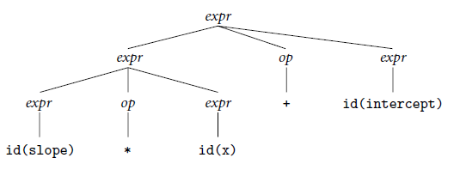
CFG and Parse Tree
39
(Parse tree for slope * x + intercept)

Slide 41
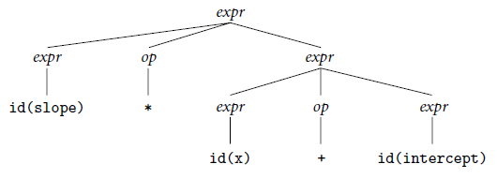
CFG and Parse Tree
40
(Alternative parse tree (less desirable) for slope * x + intercept)

Slide 42
CFG considering precedence & associativity
41
expr term | expr add_op term
term factor | term mult_op factor
factor id | number | -factor | (expr)
add_op + | -
mult_op * | /

Slide 43
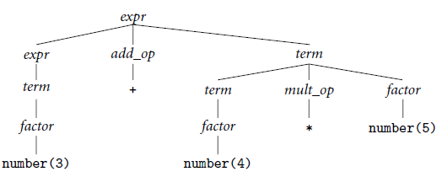
CFG considering precedence & associativity
42
(Parse tree for 3 + 4 * 5, with precedence

Slide 44
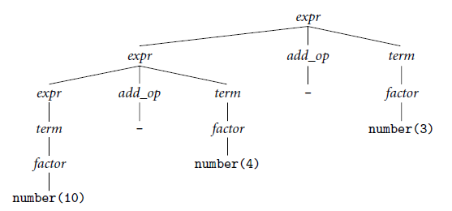
CFG considering precedence & associativity
43
(Parse tree for 10 + 4 - 3, with left associativity)

