Slide 1
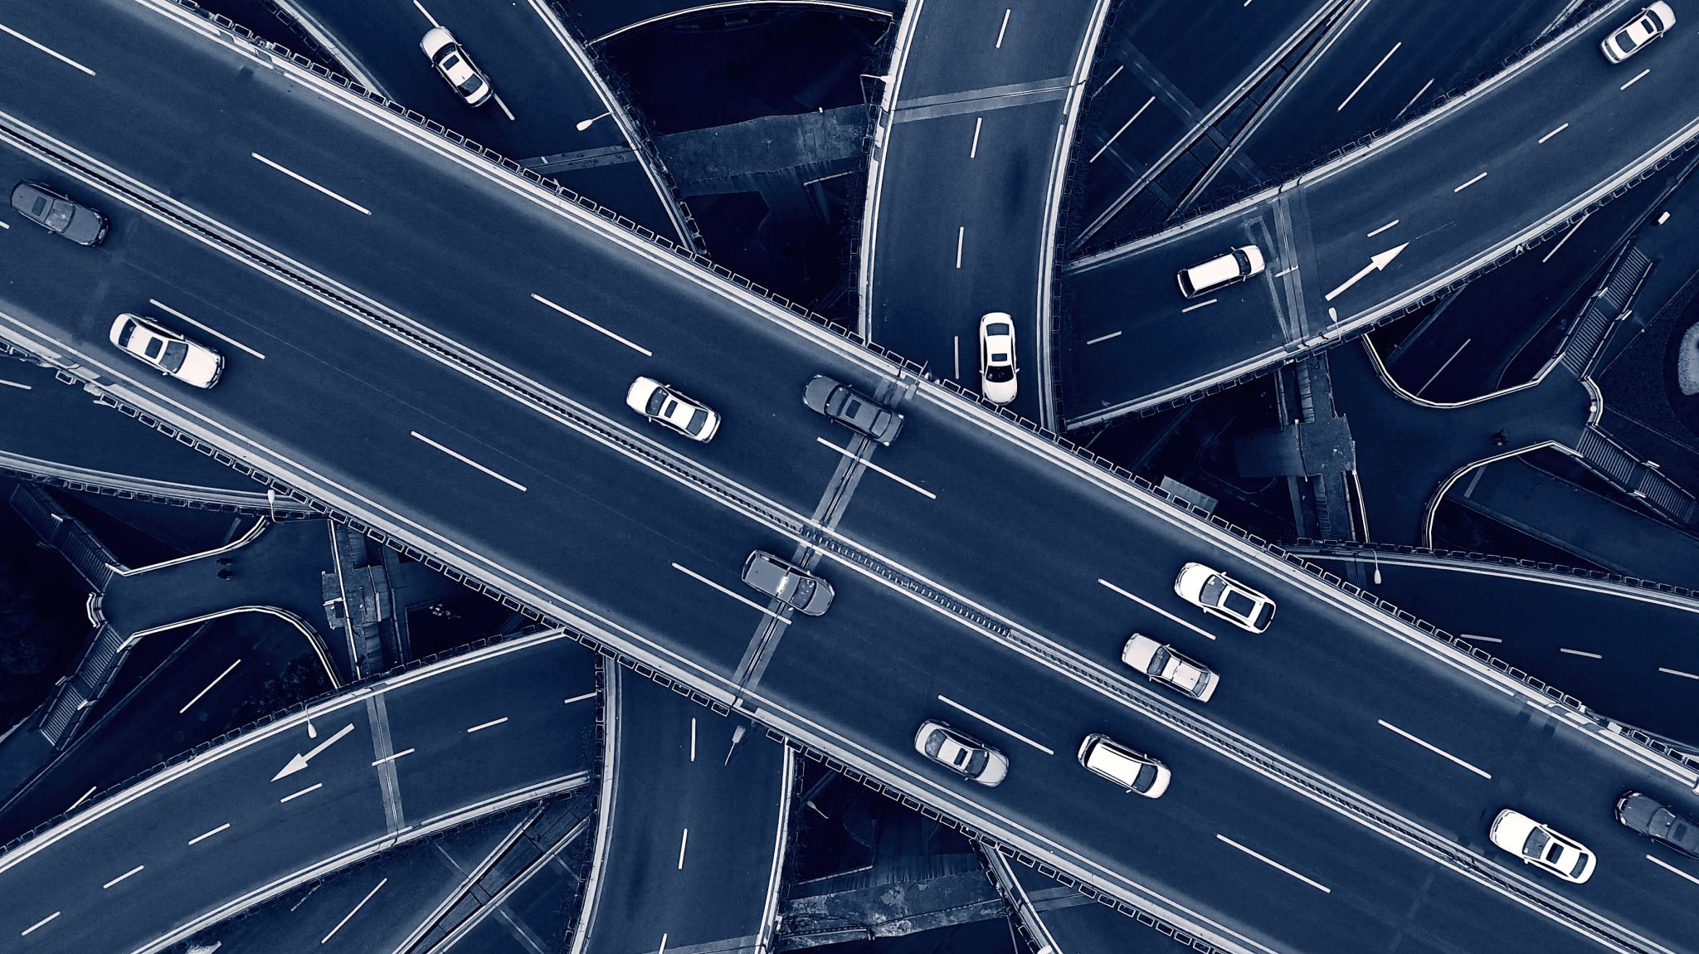
Car plate number recognition
By Lipskyi Danyil

Slide 2
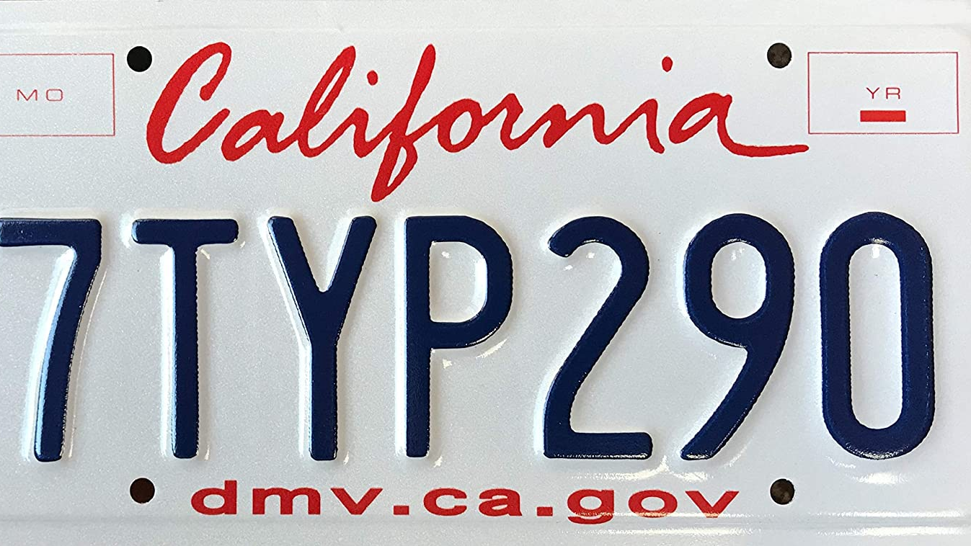
License plate detection

Slide 3
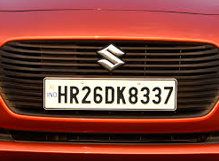
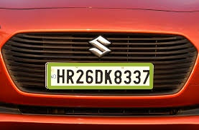
Take the input image
1
Detect license plates using Haar Cascade
2
Get the coordinates and dimensions of the contours of the detected license plate
3

Slide 4
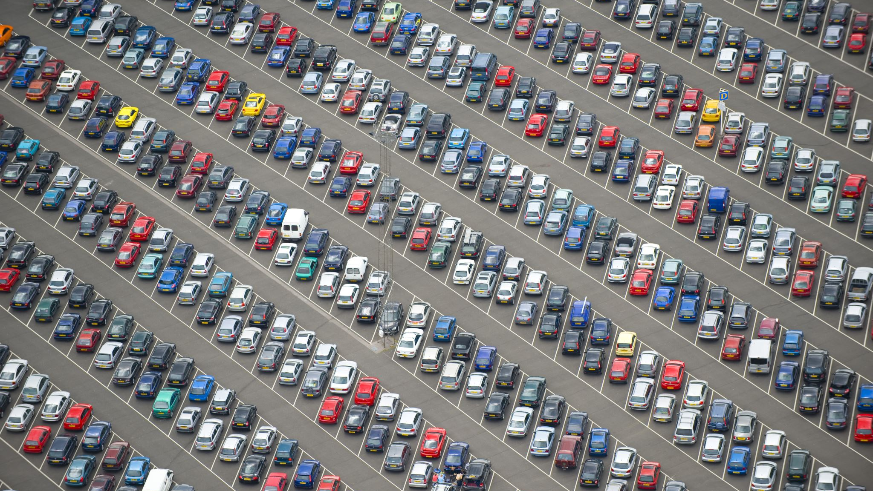
Image processing on the license plate

Slide 5

Resize
Convert a color image to a grayscale image in gray
Convert grayscale image to binary image
Remove unwanted pixels from the border of the object – Eroding
Expand the image
Make image borders white

Slide 6

Segmentation of characters from the license plate

Slide 7

1
Find all the outlines in the input image
2
Calculate the dimensions of the corresponding bounding box
3
Adjust the settings and filter the desired rectangle

Slide 8

Creating a model of machine learning

Slide 9
Start by creating a sequential Sequential model
1
The first layer will be a convolution layer with 16 output filters, a convolution window size (22.22) and "Relu" as a function of activation
2
The second layer will be a convolution layer with 32 output filters, a convolution window size (16.16) and "Relu" as a function of activation
3
The third layer will be a convolution layer with 64 output filters, a convolution window size (8.8) and "Relu" as a function of activation
4
The fourth layer will be a convolution layer with 64 output filters, a convolution window size (4.4) and "Relu" as a function of activation
5
Add a layer of maximum union with the size of the window (4.4)
6
Add drop out
7
Add a layer of Flatten
8
Add 2 thick layers

Slide 10

Model training of convolutional neural network

Slide 11
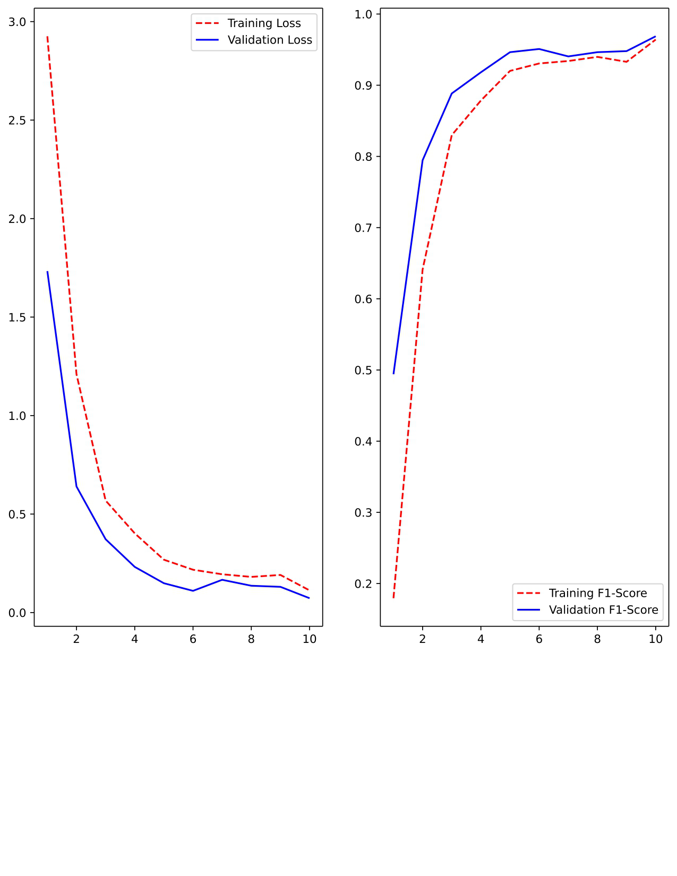
The data contains images of alphabets (AZ) and numbers (0-9) in size 28x28
The data is divided into 2 parts
Generation of additional data using methods of shift in width and height
During 41 epochs the model reaches accuracy of 98.38%

Slide 12
Thanks for your attention

