Slide 1
Probabilistic Models for One-Day Ahead Solar Irradiance Forecasting in Renewable Energy Applications
Carlos V. A. Silva, ICS Dept, University of Hawai`i at Mānoa
Lipyeow Lim, ICS Dept, University of Hawai`i at Mānoa
Duane Stevens, Atmo. Sc. Dept, University of Hawai`i at Mānoa
Dora Nakafuji, Hawaiian Electric Company

Slide 2
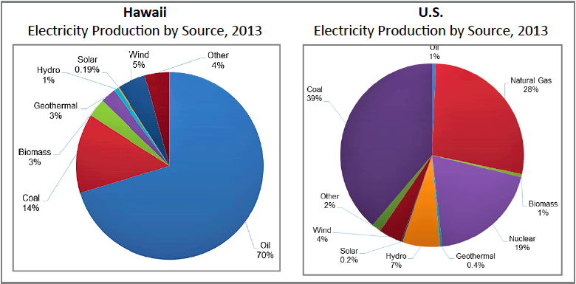
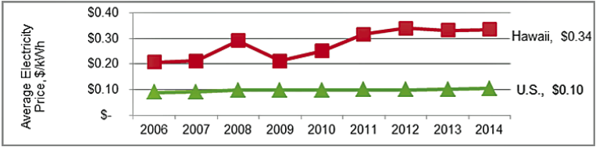
Energy in the State of Hawai`i
State GOAL: 70% renewables by 2030.
In 2013, Hawaii relied on oil for 70% of its energy.
Hawaii’s electricity cost is 3 times the US average

Slide 3

Disconnected Grids
Six independent grids: Kauai, Oahu, Molokai, Lanai, Maui, Hawaii.
UNLIKE MAINLAND
Cannot sell excess production
Cannot buy from neighbors to make up generation shortfall

Slide 4
The Problem with Renewables (Solar, Wind)
Operator of the power grids need to ensure that demand is met (while minimizing cost of power supply thereby maximizing profit).
Demand (Load)
Consumers like us!
Supply (Generation)
Conventional power plants
Solar/Wind Farms
Rooftop Solar
Some uncertainty, but well understood to some degree. In Hawaii, humid and hot weather can create load!
Deterministic, but takes many hours to bring up additional generation units if the load spikes.
Higher uncertainty due to weather, but geographically centralized.
Weather (solar irradiance & wind) forecasting can lower the uncertainty!
Higher uncertainty due to weather, but geographically distributed.

Slide 5
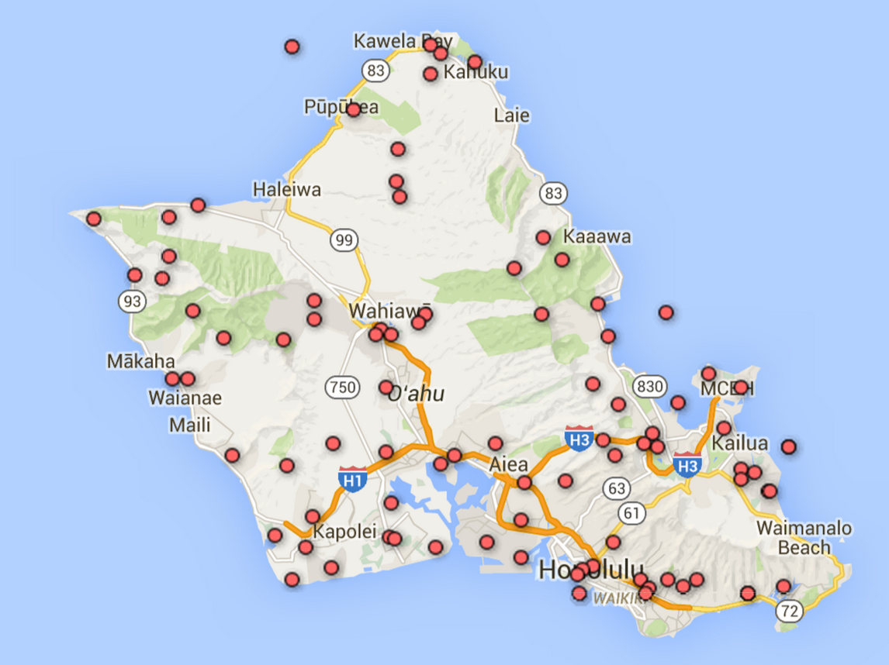
Weather Data Sources on the Island of O’ahu
SCBH1 Variable Description
TMPF Temperature,
RELH Relative Humidity,
SKNT Wind Speed,
GUST Wind Gust,
DRCT Wind Direction,
QFLG Quality check flag,
SOLR Solar Radiation,
TLKE Water Temperature,
PREC Precipitation accumulated,
SINT Snow interval,
FT Fuel Temperature,
FM10_hr_Fuel Moisture,
PEAK Peak_Wind Speed,
HI2424 Hr High Temperature,
LO2424 Hr Low Temperature,
PDIR Peak_Wind Direction,
VOLT Battery voltage

Slide 6
Problem Statement
Solar Irradiance
S(t)
Forecast time points
time (hours)
Today
Now
Day Ahead
Weather station data (mainly solar irradiance) normalized to hourly samples. Given all sensor data today (sunset), predict the solar irradiance for the next day (8am-5pm).
Probabilistic Models (including Naïve Bayes)
Linear Regression
Evaluation Criteria
Mean Absolute Error (hourly)
MAE = Σ | Predicted – Actual |

Slide 7
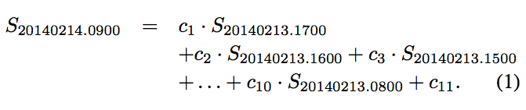
Linear Regression
Solar Irradiance
S(t)
Forecast time points
time (hours)
Today
Now
Day Ahead
Construct one LR model for each forecast time point (8am-5pm) the next day:

Slide 8

Probabilistic Models: Preprocessing
Data
(SCBH hourly)
Discretized
Daily Weather V. Profiles
Forecast Error
Clustering
(K-means)
Sliding
Windows
Conditional
Probability Distribution
1-Day Ahead Forecast
Use clustering algorithms (K-means) to discretize the solar irradiance for each day into a discrete profile. K=5.
Hourly data is transformed into a sequence of discrete profile IDs.
Construct joint probability distributions for sequence assuming stationarity,
Notes:
SCBH surface station observations
Currently only SOLAR irradiance observations

Slide 9
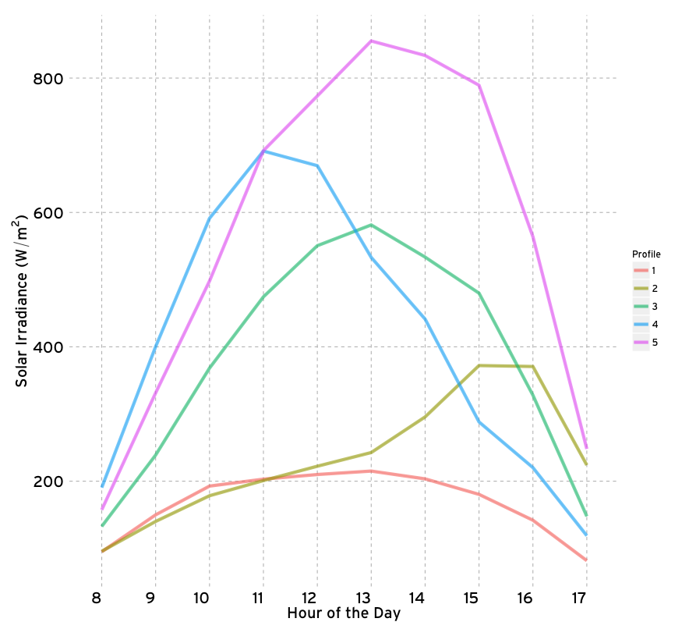
Discretized Solar Irradiance Profiles
Scoffield Station (SCBH1) using data from 2012-2013
K-means (best of 100 runs)

Slide 10
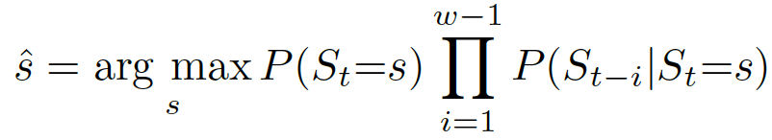
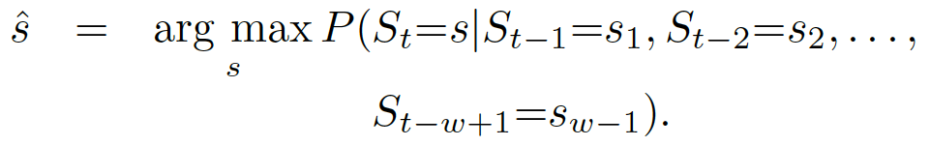
Probabilistic Models: Prediction
After getting distributions from historical data
Naïve Bayes:
Fixed-Order Markov models (w is fixed)

Slide 11

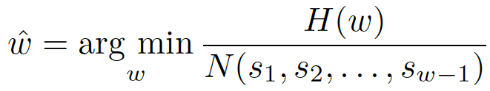
Probabilistic Models: Variable Order
Fixed-Order:
Variable-Order Markov models (w is chosen dynamically)
using entropy
Entropy+Support

Slide 12
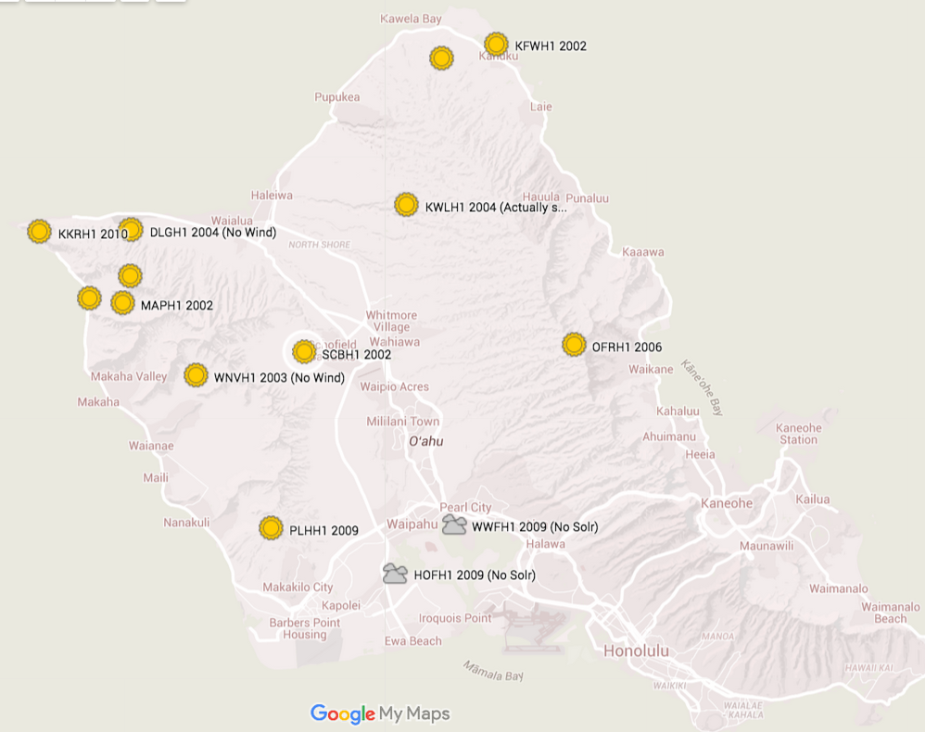
Experiments
Data:
Training: 2012, 2013
Testing: 2014
5 Stations
Error Measure
Mean Absolute Error
SCBH1
C0875

Slide 13
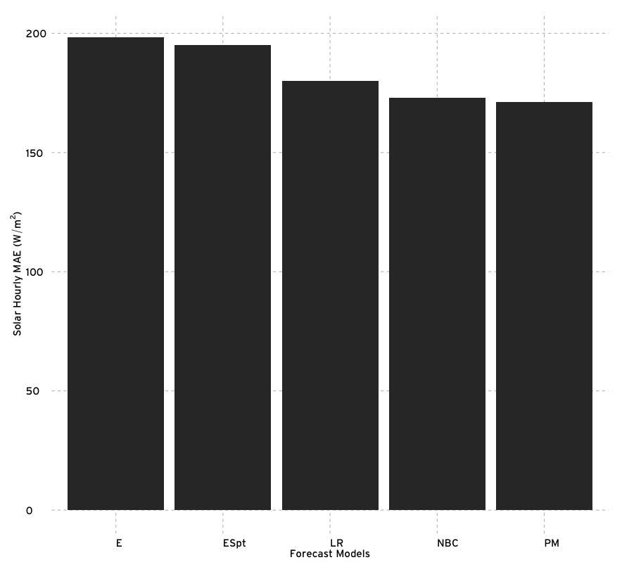
Overall Performance
SCBH1 station
Probabilistic with fixed w=2 has lowest error
Despite high average errors, entropy & entropy+support are better predictors of cloudy days

Slide 14
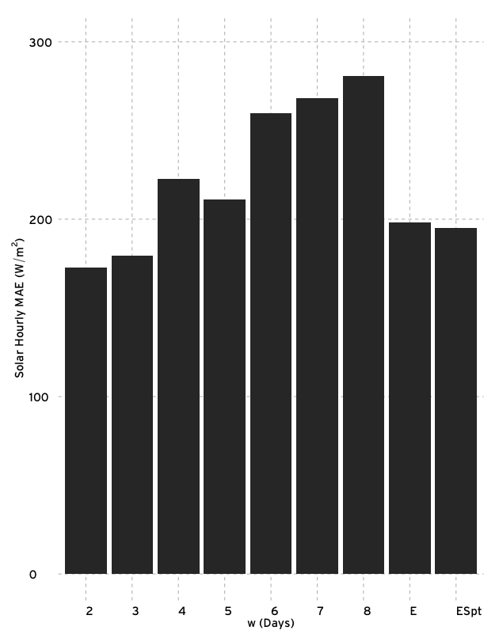
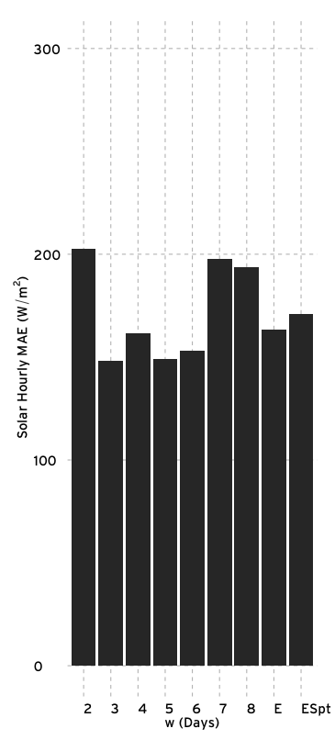
MAE for Probabilistic Methods
Best value for w different for C0875 (and other stations), but still low.
SCBH1
C0875

Slide 15
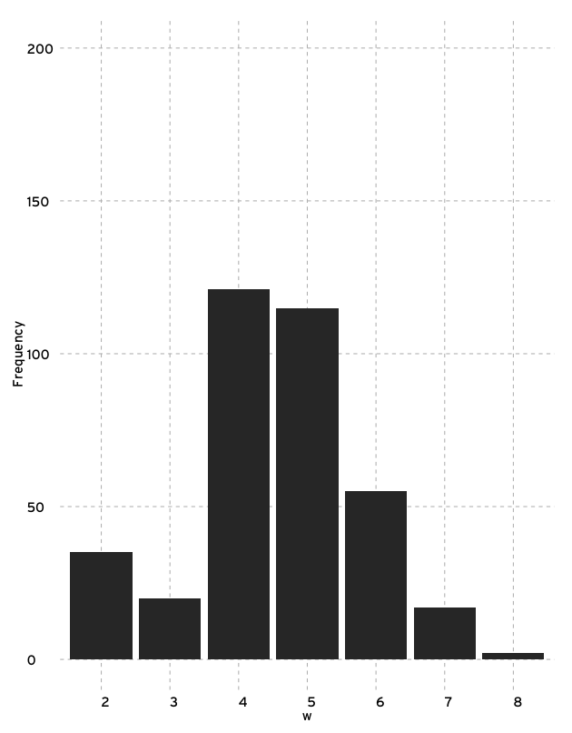
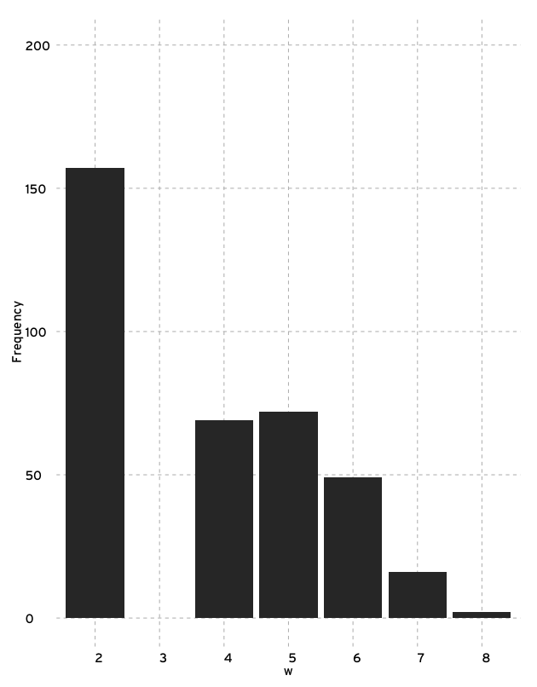
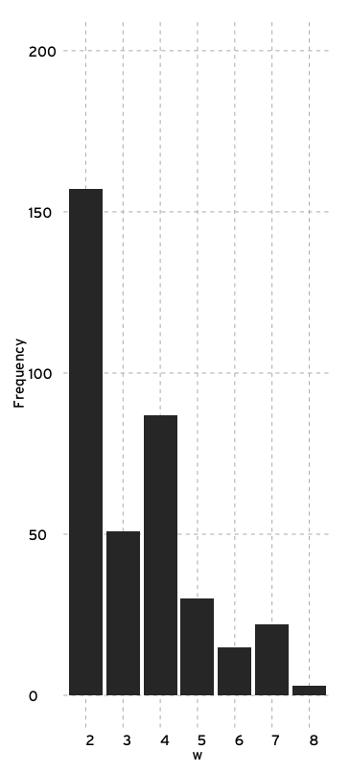
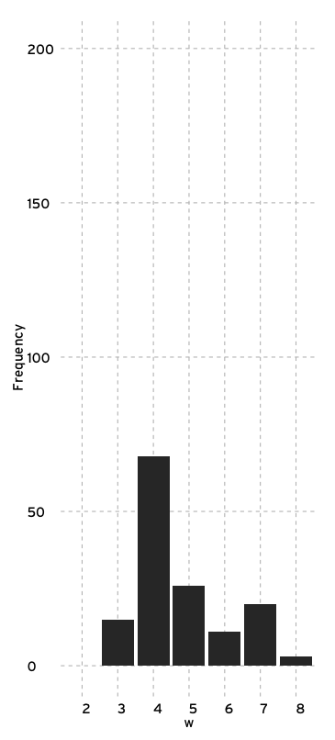
Choice of w
SCBH1
C0875
Entropy Choice
EntropySpt Choice
Entropy Choice
EntropySpt Choice
Notes:
Support does change the distribution of w chosen

Slide 16
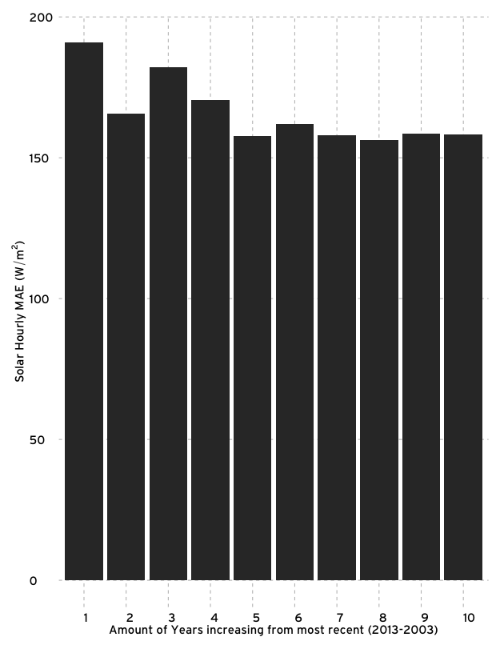
How much training data ?
Target Year: 2014
Model:
P(St | St-1) ; SCBH1
Training Years
(2013)
(2013, 2012)
(2013, 2012 , 2011)
….

Slide 17
Conclusions & Future Work
Probabilistic models are on average better than linear regression for 1-Day Forecasting
Small window size works best (Markovian)
One to two years of training data sufficient
Future work : incorporate larger weather features from GFS data

Slide 18
Questions ?

Slide 19
Backup Slides

Slide 20
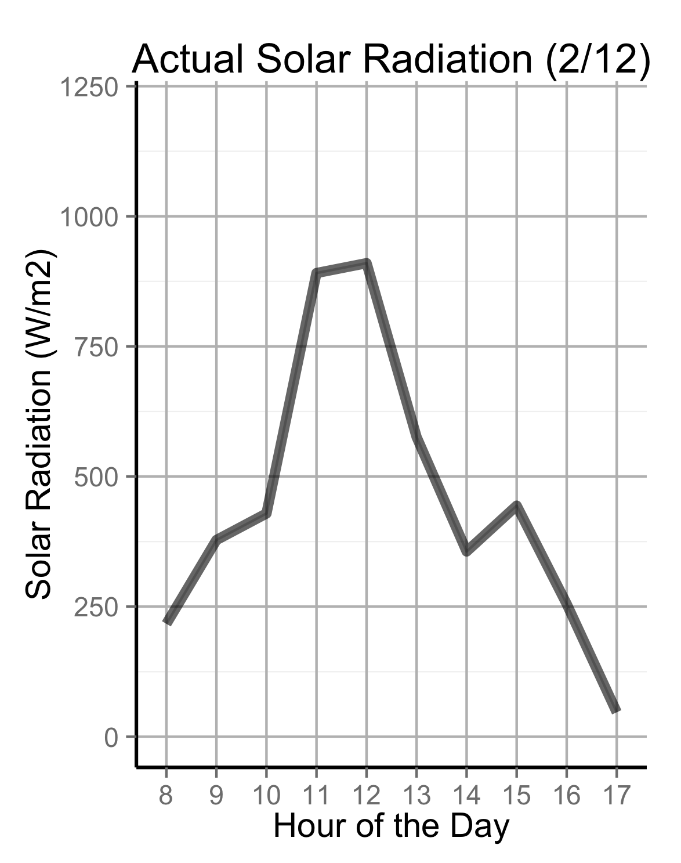
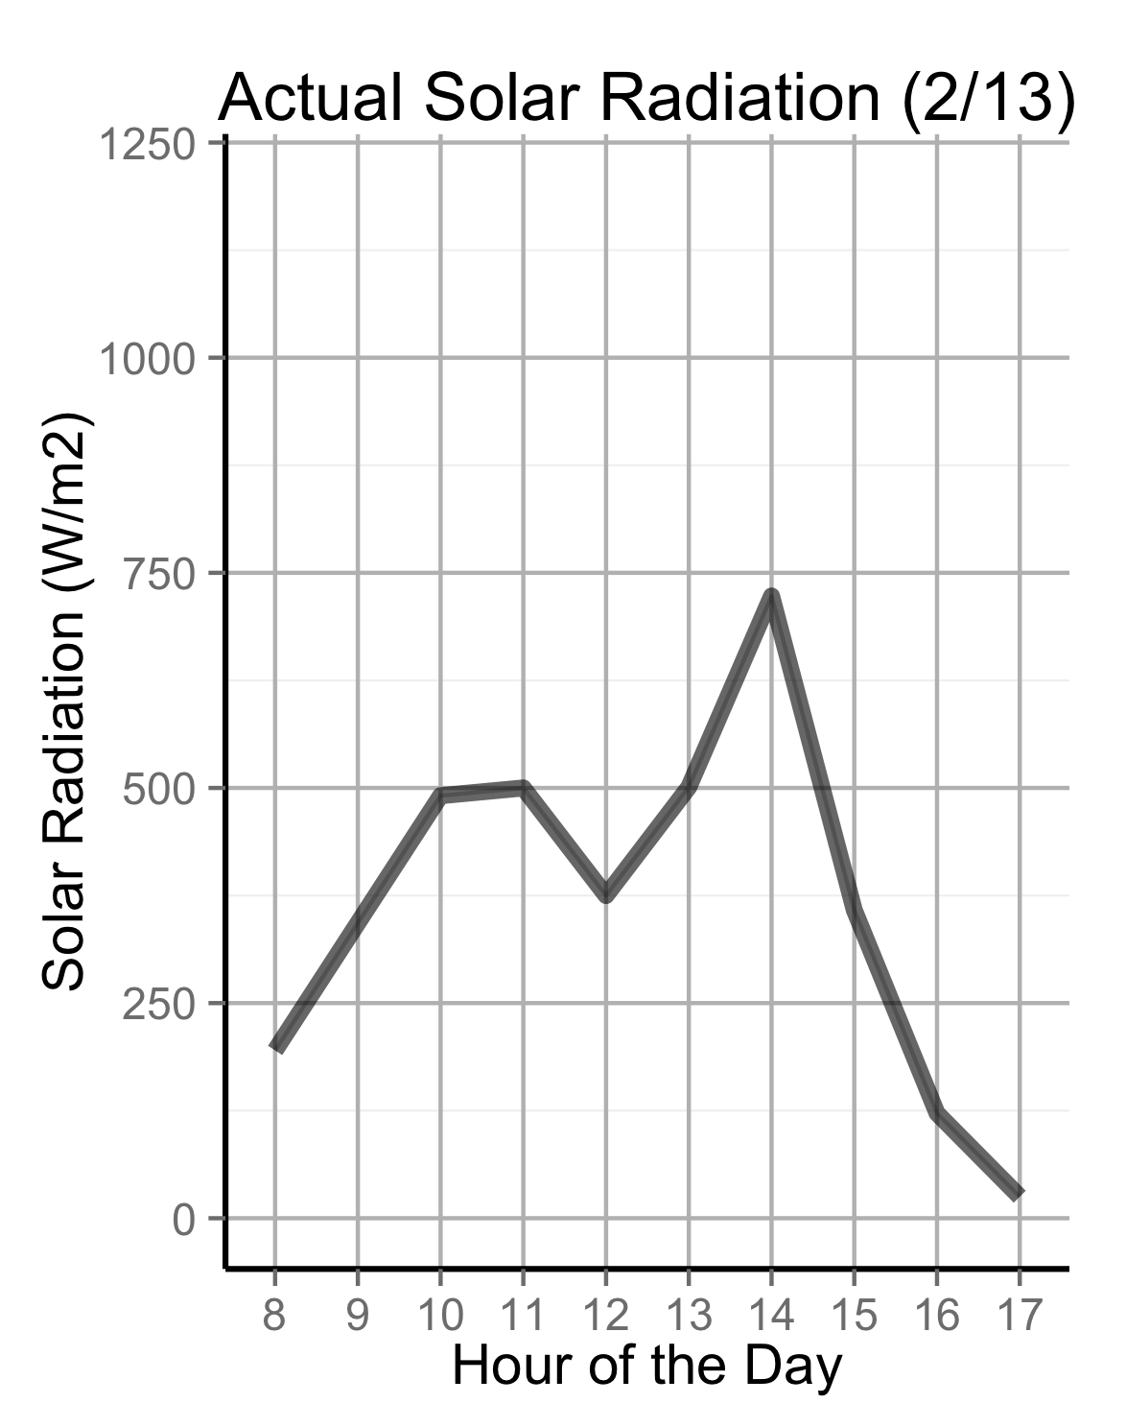
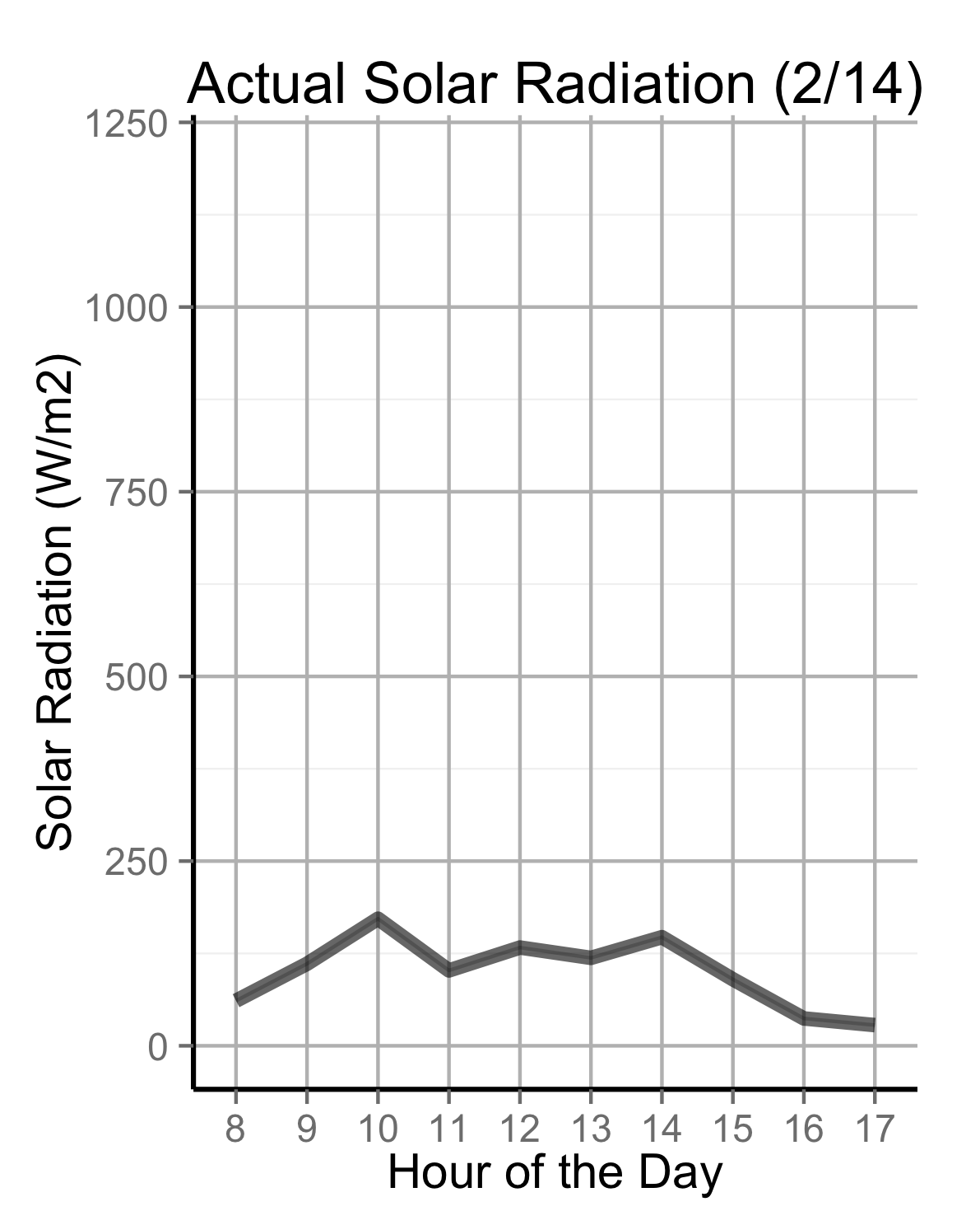
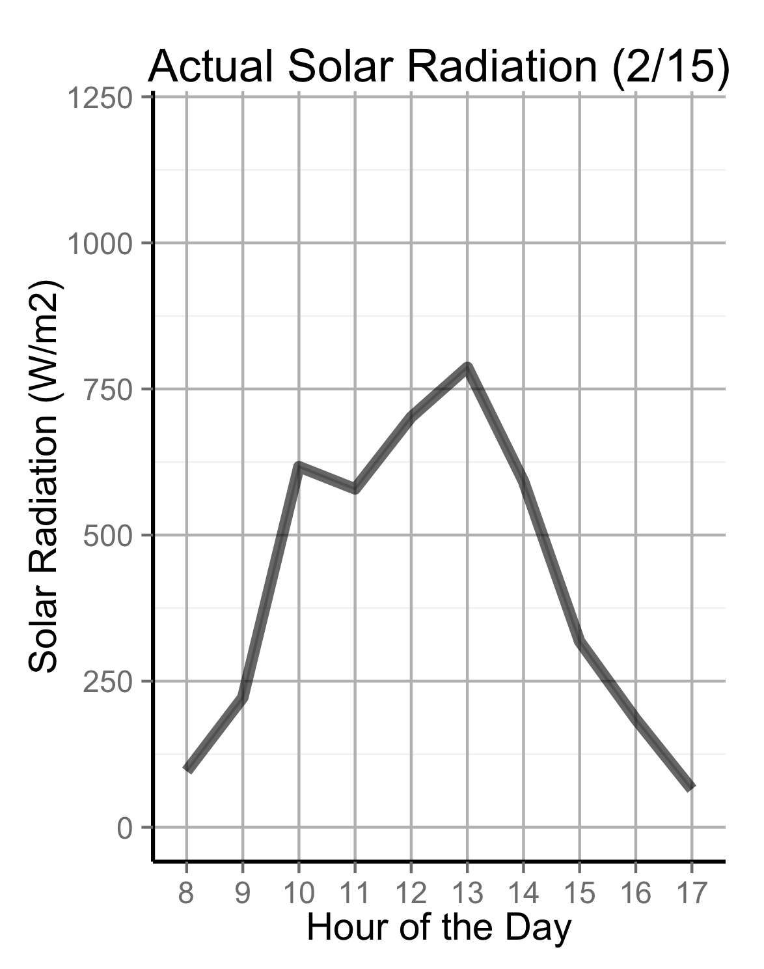
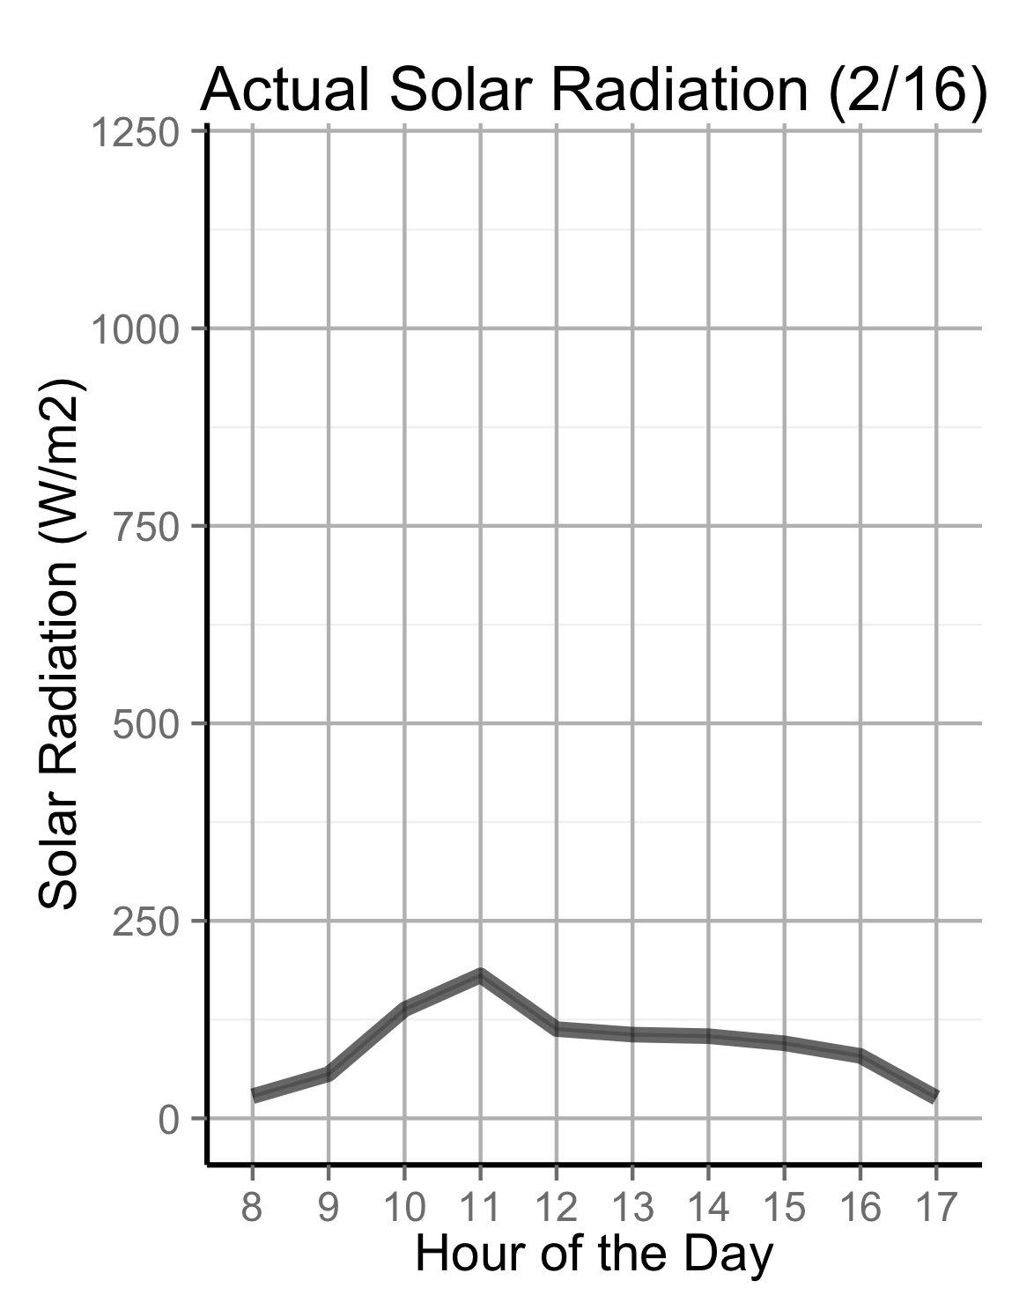
5-day Sequence of Solar Irradiance

Slide 21
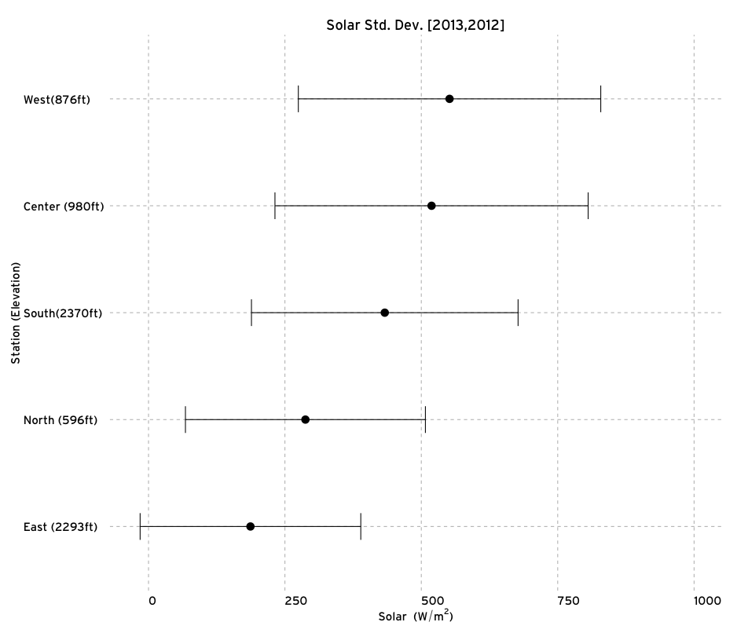
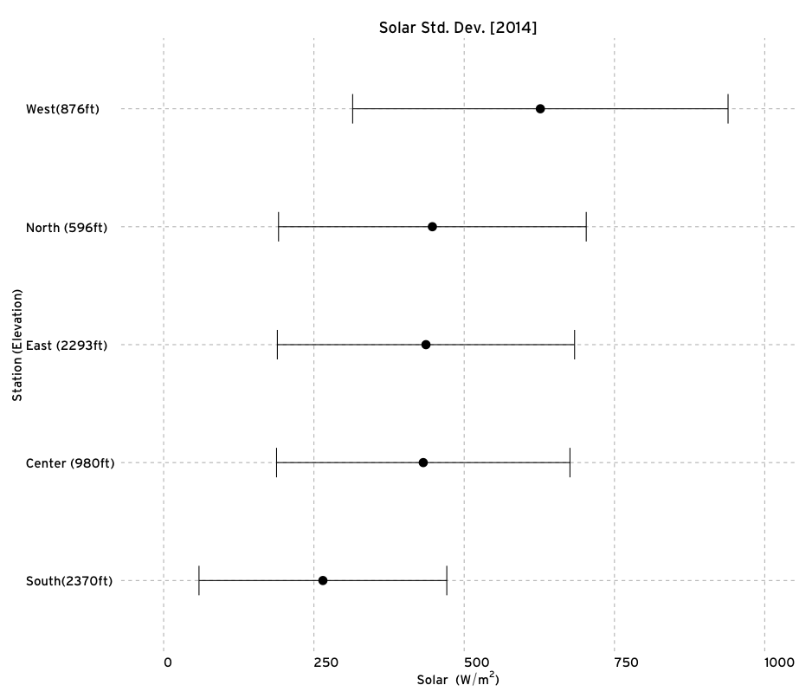
Mean & Std. Dev. for Solar Irradiance
Actual Solar Std. Dev. and Mean on Training Data
Actual Solar Std. Dev. and Mean on Test Data
Notes:
All plots range from -20 to 1000 (W/m^2).

Slide 22
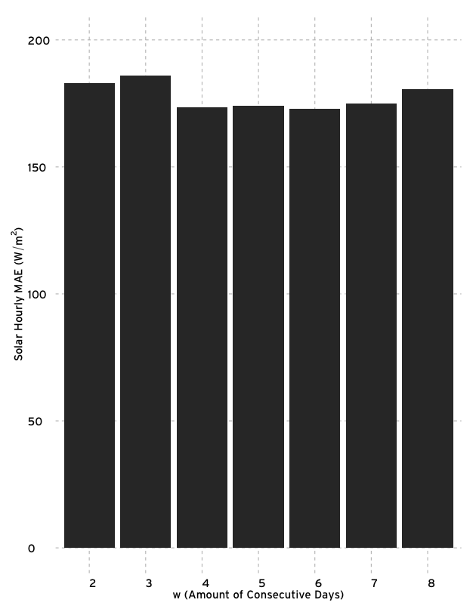
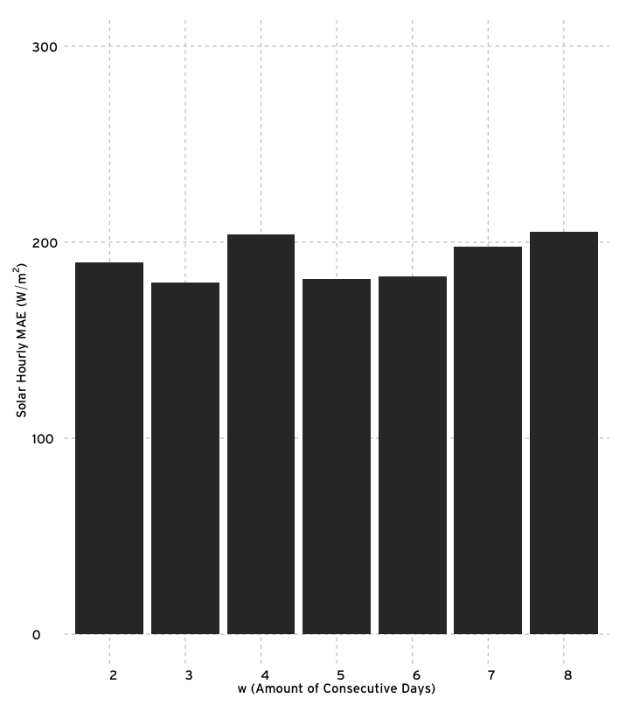
Naive Bayes Classifier
SCBH1
C0875

Slide 23
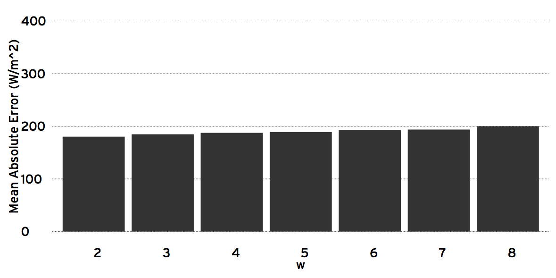
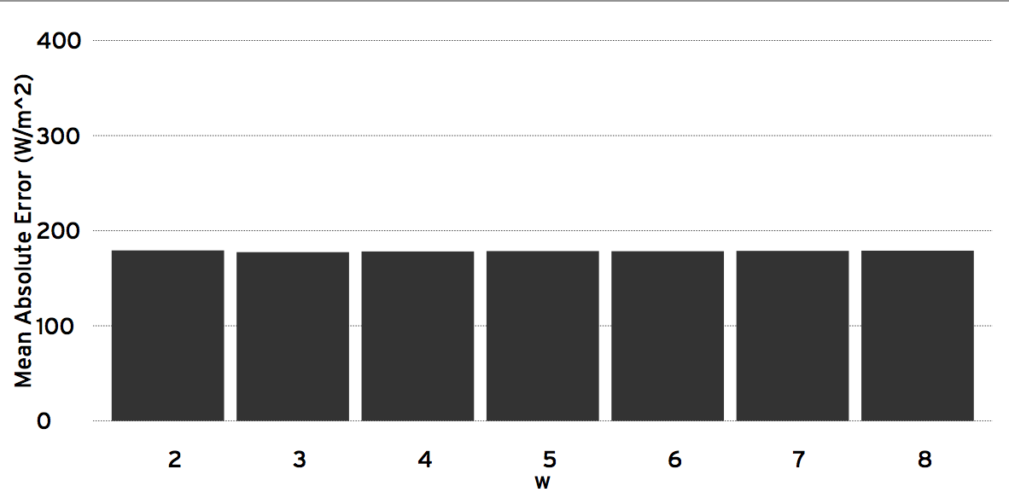
Linear Regression
SCBH1
C0875

