Slide 1
Introduction to Business Intelligence
Assoc. Prof. Lipyeow Lim
Information & Computer Sciences
University of Hawai`i at Mānoa

Slide 2
Objectives
Have a broad understanding of business intelligence.
Be able to decide what kind of BI analytics would be suitable for your situation
Understand the process of setting up a BI system
Understand how to store and query data using a database system
Be able to model data using Entity-Relationship diagrams.
Understand how to integrate data from diverse data sources into a data warehouse.
Understand online analytical queries and apply them
Understand data mining tools and apply them

Slide 3
What is Business Intelligence?
A set of methodologies,
processes,
architectures, and
technologies
that transform raw data into
meaningful and useful information
used to enable more effective
strategic, tactical, and operational insights
and decision-making
Decisions
Insight
Information
Raw Data

Slide 4
Types of Analytics
Predefined Queries
Reports & Dashboards
Data Integration
Fusing diverse data
Metadata management
Big Data Analytics
Scale-out architectures
Streaming systems
Ad hoc Queries
Interactive visualization
Search-based discovery
Advanced Analytics
Predictive data mining
Simulation & optimization
Increasing Sophistication

Slide 5
Types of Analytics
Predefined Queries
Reports & Dashboards
Data Integration
Fusing diverse data
Metadata management
Big Data Analytics
Scale-out architectures
Streaming systems
Ad hoc Queries
Interactive visualization
Search-based discovery
Advanced Analytics
Predictive data mining
Simulation & optimization
Increasing Sophistication
Database / Data Warehouse Technology
Data Mining Tools
Search Engines
Workflow Systems
Cluster (eg. Hadoop)

Slide 6
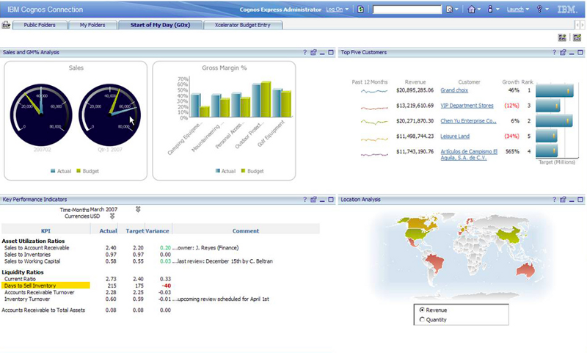
Predefined Queries
Automatically generated
Reports : batch-based
Dashboards : near “real-time”
Limited interactivity
Pre-defined performance metrics
Financial
Non-financial

Slide 7

Multi-dimensional View
Analyze performance metrics by multiple dimension: time, location, etc
Each dimension can be organized into hierarchies.
14
Product
Year
Region
13
Quarter
State
12
Month
City
11
L3
Date
Office
L2
L1
Location
t-4
t-3
t-2
t-1
Time

Slide 8
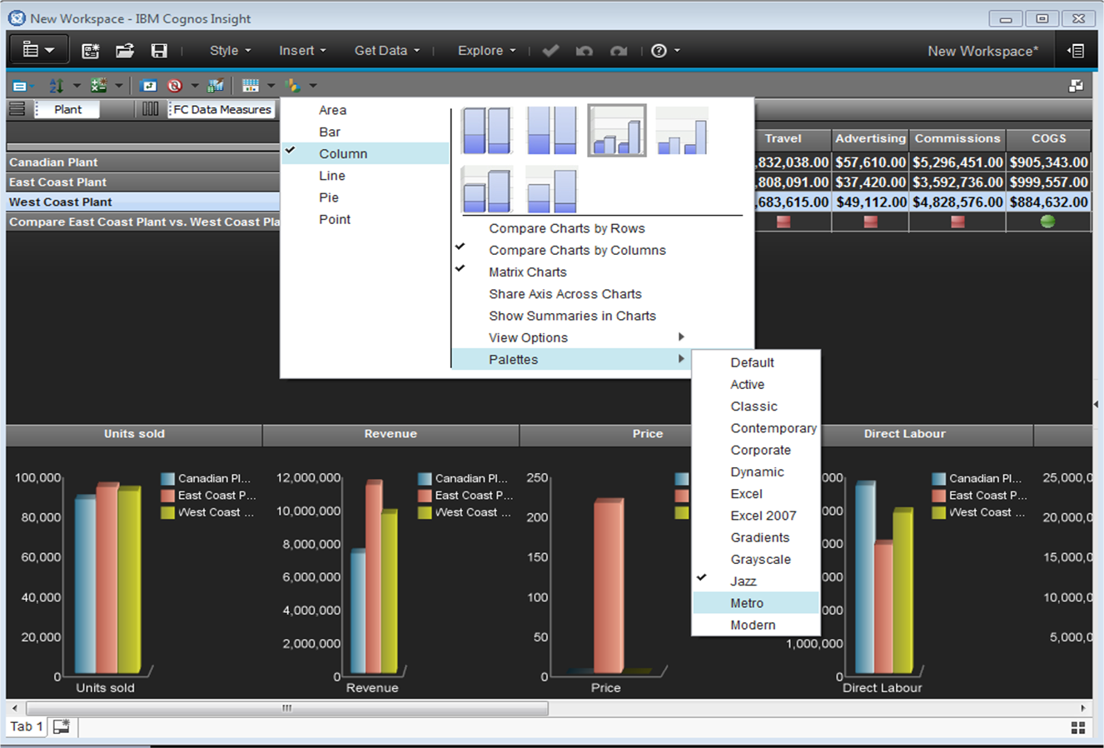
Ad Hoc Queries
Interactive visualization
query builders
Exploratory & search-based discovery
eg. find past projects having a similar performance profile.

Slide 9
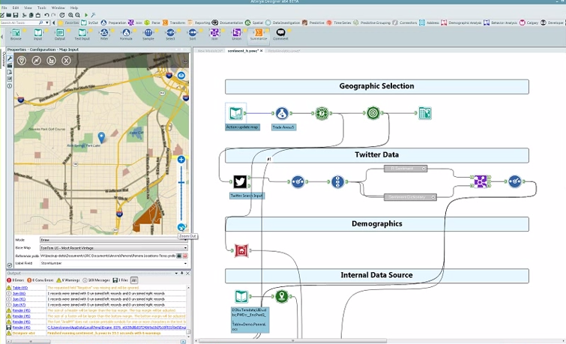
Data Integration
Fusing diverse data (text, emails, excel)
Structured data
Semi-structured data
Unstructured data
Metadata Management
Context metadata
Data sources
Schemas
Terminologies
Notes:
Alteryx
https://www.youtube.com/watch?v=4YETfKQUtrY

Slide 10
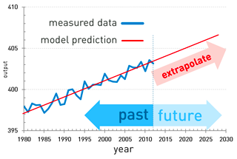
Advanced Analytics
Predictive data mining
Creating models from historical data
Extrapolate into the future or the unknown
Simulation & optimization
What-if analysis

Slide 11
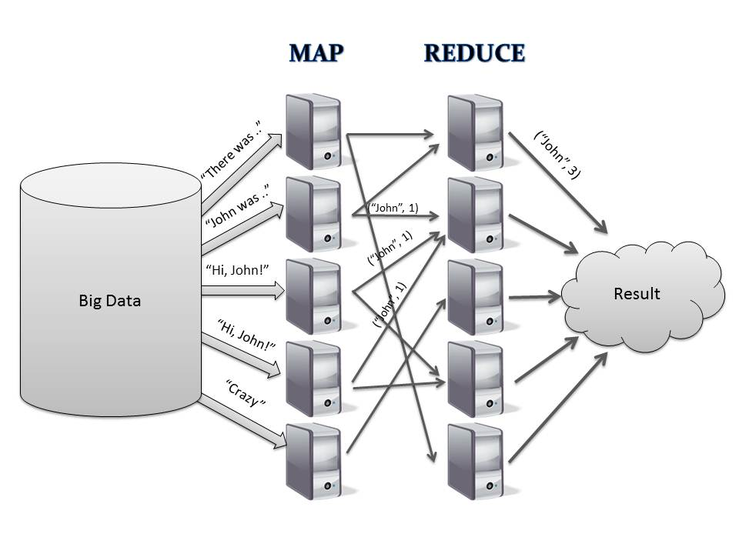
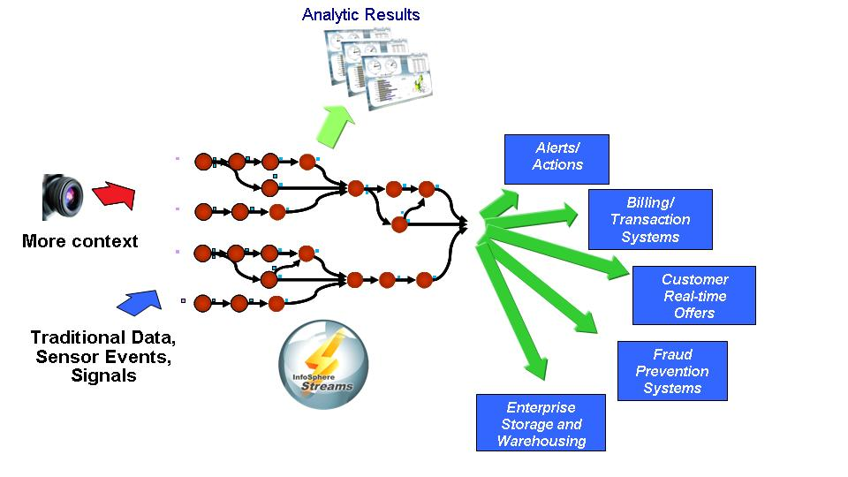
Big Data
Scale-out cluster architectures
Map-Reduce/Hadoop
Streaming systems
5 V’s:
Volume
Velocity
Variety
Variability
Veracity
Notes:
http://public.dhe.ibm.com/common/ssi/ecm/en/imc14802usen/IMC14802USEN.PDF

Slide 12
Examples
IBM Cognos, Boeing. https://www.youtube.com/watch?v=9Oh9LFOe0fM
Oracle BI Interactive report: https://www.youtube.com/watch?v=_16y-7HmsfA
Microsoft BI: https://www.youtube.com/watch?v=N8FbarXC0Og
Data Integration. Alteryx. https://www.youtube.com/watch?v=4YETfKQUtrY
IBM. Manufacturing. Predictive. https://www.youtube.com/watch?v=4vhbz7Lu9Hw
IBM. http://public.dhe.ibm.com/common/ssi/ecm/en/ytc03622usen/YTC03622USEN.PDF
IBM. Centerpoint. Streams. https://www.youtube.com/watch?v=s7CzeSlIEfI
http://public.dhe.ibm.com/common/ssi/ecm/en/imc14802usen/IMC14802USEN.PDF
Notes:
IBM. Banking. https://www.youtube.com/watch?v=Fe5nZKkB9T8

Slide 13
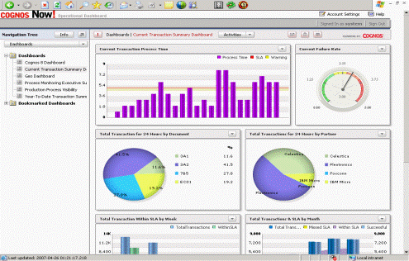
BI Process
Query Processing
& Visualization
What you want:
Performance Metrics
Reports/Dashboards
Data Warehouse
What data
you have
Data Source
Data Source
Extract-Transform-Load (ETL)
Data Source

Slide 14
Another Architecture
Query Processing & Visualization
Data Mart 1
Extract
Transform
Load
Financial
Data Warehouse/ Repository
What data
you have
Data Mart 2
Data Source
Operations
Data Source
Extract
Transform
Load
(ETL)
Data Mart 3
Data Source
CRM

Slide 15
Methodologies
The Classic Waterfall Model
Business process POV:
Change management
Systems POV:
Software Development Methodologies
Requirements Analysis
Users, stakeholders
BI needs
Requirements
Design
Implementation
Verification
Maintenance
Iterate

Slide 16
Discussion
What performance metrics are important for your unit?
List and prioritize the metrics
What are the “dimensions” of the metrics?
over each month, over each organization unit, over each project, over each geographical region
How often should each metric be reported ?

Slide 17
BI Concepts
2. Data Modeling
Data Warehouse
4. OLAP & Data Mining
1. Database Systems
Data Source
Data Source
3. Data Integration : ETL
Data Source

Slide 18

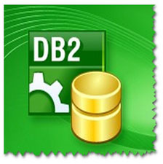

Database Systems
A database (DB) is a collection of related data.
A database management system (DBMS) is a collection of computer program that enables the user to
Create DBs, Tables, Indexes etc.
Store & update large amounts of data
Query data using a query language (eg. SQL)
Support durability in the face of failures
Control concurrent access to data from multiple users

Slide 19
Relational Data Model
The header row (along with data types) is called the “schema”
Structure data in a relation (a “table”)
Fixed number of columns
Variable number of rows
A relational database = set of relations
A relation = set of rows/tuples
Employee
ID | Name | Address | City | Dept
23312 | John | 10 Kuhio Ave. | Honolulu | 4
31899 | Alice | 51 Manoa Rd | Honolulu | 5
21115 | Tim | 455 Ewa St | Kapolei | 2
The primary key uniquely identifies a row
A foreign key points to data in another table.

Slide 20
Querying Relational Data
Filter by columns:
SELECT Name,
City
FROM Employee
Filter by rows:
SELECT *
FROM Employee
WHERE Dept=4 AND
City=‘Honolulu’
Join tables together:
SELECT *
FROM Employee E,
Department D
WHERE E.Dept=D.DID
Department
Employee
DID | Name | Bldg
2 | Exec | A
3 | HR | A
4 | Ops | C
5 | Sales | D
ID | Name | Address | City | Dept
23312 | John | 10 Kuhio Ave. | Honolulu | 4
31899 | Alice | 51 Manoa Rd | Honolulu | 5
21115 | Tim | 455 Ewa St | Kapolei | 2

Slide 21
Exercise: Write SQL queries
Find names of employees who live in Kapolei.
Find IDs of employees who work in the HR dept.
Find names and addresses of employees who live in Honolulu and work in building A.
Department
Employee
DID | Name | Bldg
2 | Exec | A
3 | HR | A
4 | Ops | C
5 | Sales | D
ID | Name | Address | City | Dept
23312 | John | 10 Kuhio Ave. | Honolulu | 4
31899 | Alice | 51 Manoa Rd | Honolulu | 5
21115 | Tim | 455 Ewa St | Kapolei | 2

Slide 22
Group By Queries
Can be any aggregation function: AVG, SUM, MAX, MIN, etc
SELECT City, COUNT(*)
FROM Employee
GROUP BY City
Groups rows using the values in a given column.
Employee
ID | Name | Address | City | Dept
23312 | John | 10 Kuhio Ave. | Honolulu | 4
31899 | Alice | 51 Manoa Rd | Honolulu | 5
21115 | Tim | 455 Ewa St | Kapolei | 2
47565 | Rick | 7 Waialae Av | Honolulu | 2
16768 | Kira | 34 Kuloa Av | Kapolei | 5
City | Count(*)
Honolulu | 3
Kapolei | 2
Results consists of one row per group!

Slide 23
Exercise: Group-by Queries
Find the number of employees living in each city.
Find the number of employees working in each department.
Find the number of employees working in each building.
Department
Employee
DID | Name | Bldg
2 | Exec | A
3 | HR | A
4 | Ops | C
5 | Sales | D
ID | Name | Address | City | Dept
23312 | John | 10 Kuhio Ave. | Honolulu | 4
31899 | Alice | 51 Manoa Rd | Honolulu | 5
21115 | Tim | 455 Ewa St | Kapolei | 2

Slide 24
Data Warehouse vs Operational Data Stores
Operational Data
Stores (ODS)
Process analytics directly on ODS ?
Data Source
Query &
Visualization
Data Warehouse
Data Source
ETL
Data Source

Slide 25
BI Concepts
2. Data Modeling
Data Warehouse
4. OLAP & Data Mining
1. Database Systems
Data Source
Data Source
3. Data Integration : ETL
Data Source

Slide 26
Data Modeling
Given that you know the application requirements, how do you design the database tables ?
What kind of analytics should the DW support ? What performance metrics ? What dimensions ?
Requirements
What data is need ? How should data be organized?
Use Entity-Relationship (ER) model. Sometimes called conceptual modeling.
Logical Data Model
What database tables are needed? What views, indexes, etc ?
Auto-generated from ER model & other info.
Physical Data Model

Slide 27
Entity-Relationship Model
name
since
ID
address
DID
name
Employees
Works_In
Departments
m
1
Entities - rectangle
Relationships - diamond shape
cardinality ratios
Attributes - oval shape
Atomic (no repetitions)
Primary keys are underlined
Represent “Sets” of objects.
Based on Set Theory

Slide 28
Relationships: Cardinality Ratios
1:1
m:m
1:m
m:1
Consider binary relationship (between 2 entities)
1:1
1:m or m:1
m:m (many-to-many)

Slide 29




Crows Feet Notation
Industrial ERD often use the crows feet notation
0 or more
1 or more
exacty 1
zero or 1

Slide 30
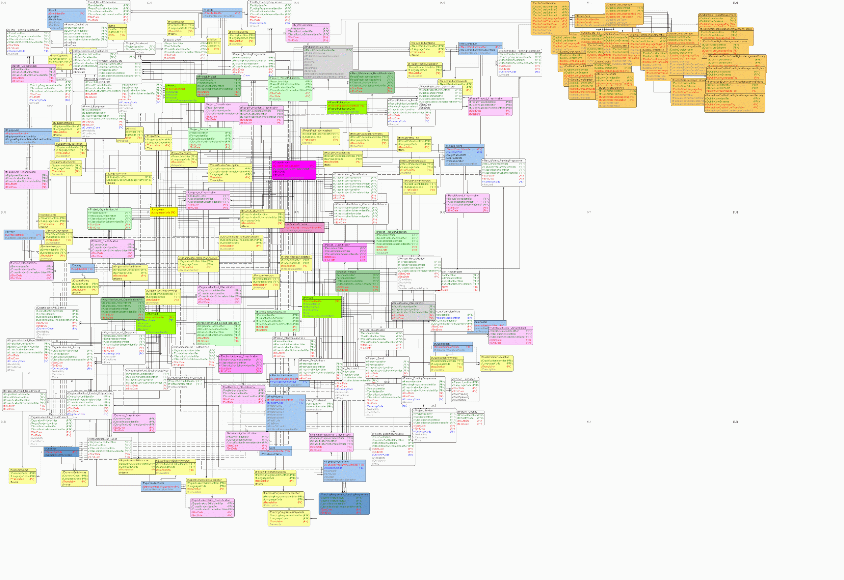
Example of a realistic ERD

Slide 31
How to draw an E-R Diagram ?
What data is needed by the application system ?
What are the main “concepts” in the data ? -- Entities
What are the relationships between the concepts (entities) ?
What are the cardinality ratios?
What attributes does the application system need for each entity and relationship ?
What attributes can be used a primary key for each entity ?
Drawing E-R diagrams forces you to clarify your thinking of the structure and meaning of the data!

Slide 32
From ERD to Schema
Employees(ID,name,
address)
WorksIn(ID,since,DID)
Departments(DID,name)
name
name
since
ID
address
DID
Employees
Works_In
Departments
m
1
Mapping rules
Each entity gets one table
Each relationship gets one table
If relationship is 1:1, all 3 tables can merge into one
If relationship is 1:m or m:1, table for relationship can merge with entity (many-side)
Employees(ID,name,
address, since, DID)
Departments(DID,name)

Slide 33
Exercise: Data Modeling
Design a data model for the operational database of a car rental company to manage their customers, rental cars, insurance, etc. State any assumptions you made.

Slide 34
Entity, Relationship or Attribute?
name
ID | Name | Address
135 | John | 13 El Camino, Santa Clara, CA 91051
178 | Mary | 38 E Manoa Rd, Honolulu, HI 96822
198 | Tom | 22 Kuloa Av, Kapolei, HI 96707
ID
address
Employees
What if application needs both office and home address?
What if employee has many addresses ?
What if application needs street name, city, province fields in each address ?

Slide 35
What makes a good ERD ?
Captures all relevant data needed by application
Faithful to the semantics of the application data
Minimize redundant data
Simple is good. If model is too complicated, ask yourself
What are other ways of conceptualizing the entities and relationships ?
Should some relationships become entities ?
Should some entities become relationships ?
Should some attributes become entities ?

Slide 36
Star Schema
Common data model for supporting BI queries
Dimension Hierarchy
Time
TimeID | Date | Week | Month | Quater | Year
Dimensions
Fact table Transaction data
Sales
PID | TimeID | LocID | Sales | Qty
Measures
Performance metrics
Product
PID | Pname | Category | Price
Locations
LocID | City | State | Country

Slide 37
Example: Snowflake Schema
some dimensional hierarchy is normalized into a set of smaller dimension tables, forming a shape similar to snowflake
time
time_key
day
day_of_the_week
month
quarter
year
item
Sales Fact Table
supplier
item_key
item_name
brand
type
supplier_key
time_key
supplier_key
supplier_type
item_key
branch_key
branch
location_key
location
city
branch_key
branch_name
branch_type
units_sold
location_key
street
city_key
city_key
city
province_or_street
country
Measures
dollars_sold
avg_sales

Slide 38
Example: Constellation
Galaxy/Constellation schema
Multiple fact tables share dimension tables
time
time_key
day
day_of_the_week
month
quarter
year
item
Shipping Fact Table
Sales Fact Table
item_key
item_name
brand
type
supplier_type
time_key
item_key
time_key
shipper_key
item_key
from_location
branch_key
branch
to_location
location_key
location
branch_key
branch_name
branch_type
dollars_cost
shipper
units_sold
location_key
street
city
province_or_street
country
units_shipped
shipper_key
shipper_name
location_key
shipper_type
dollars_sold
avg_sales

Slide 39
Exercise: Data Warehouse Schema
Pick one of the performance metrics and the associated dimensions and design the data warehouse schema for that performance metric.

Slide 40
BI Concepts
2. Data Modeling
Data Warehouse
4. OLAP & Data Mining
1. Database Systems
Data Source
Data Source
3. Data Integration : ETL
Data Source

Slide 41
Data Integration: Why?
Operations DB
Employee DB
Twitter Feeds
Excel Files
…..
Query Q
BI Queries
Data resides in several different databases with different structures and access policies
Our view of the world may be different from the view of the databases
Notes:
http://en.wikipedia.org/wiki/Data_integration
http://homepages.inf.ed.ac.uk/libkin/teach/dataintegr14/index.html

Slide 42
Data Integration: Federation Approach
DB1
DB2
DB3
DBn
…..
Q1
Q2
Q3
Qn
V1
V2
V3
Vn
Answer Q by querying the views V1, V2, V3, … Vn.
Database with global schema never materialized!
--- Sometimes called “Federation”
Query Q
Global Schema G

Slide 43
Data Integration: ETL Approach
DB1
DB2
DB3
DBn
…..
Q1
Q2
Q3
Qn
V1
V2
V3
Vn
Extract-Transform-Load
Integration Database
Query Q
Global Schema G

Slide 44
Schema Level
DB1
DB2
…..
DBn
Sale (from region’s ODS)
Date | Item | Store | Qty | Amt | Tax
Q1
Q2
Qn
V1
V2
Vn
Sale Fact Table
Schema mapping
PID | TimeID | LocID | Sales | Qty
Data Warehouse
Global Schema G
Fact Table from Star Schema
Schema mapping can be expressed as queries

Slide 45
A Simple Example (1)
Permanent Staff
Courses
name | age | salary
teacher | course | semester | enrollment
Query: List all courses taught by permanent staff during Winter 2007
V1
V2
name
teacher | course | semester
Do both DBs encode names in the same way?
Is “Winter 2007” a valid value in D2.semesters?
Run fragments of the queries on the public views and construct the answer?
ETL V1 and V2 into a local data warehouse ?
SELECT V2.course
FROM V1, V2
WHERE V1.name=V2.teacher
and V2.semester=‘Winter 2007’

Slide 46
A Simple Example (2)
Query: Find computer science permanent staff who taught during the Winter 2007 semester, and their phone numbers.
V1 ~ Permanent Staff
V2 ~ Courses
name
teacher | course | semester
D3 ~ Comp. Sci. Dept
D4 ~ University Dir.
employee | phone | office
employee | school | phone
Do D3.employee, D4.employee, V1.name, & V2.teacher refer to the same category of objects ? How do we harmonize their encoding ?
Where to get phone information ?
use D3.phone
use D4.phone
use both D3.phone and D4.phone
D3.phone and D4.phone may use different formats
What if phone is different in D3 & D4 ? Inconsistent data !
What if phone missing in both D3 & D4 ? incomplete data !

Slide 47
Key Steps in Data Integration
Specify the global and local data models (schemas)
Data formats of attributes and their meaning
Abbreviations, terminology, ontologies
Map local to global schemas
Decide data quality policies
Resolve overlaps/duplicates
Handle missing data
Handle inconsistent data
Choose an ETL tool
Attributes with the same name may mean different things! Eg. Income
Values of attributes with the same name may use different terminologies. Eg. medical drug
How to determine if customer from insurance DB and patient from HIS refer to same person ?

Slide 48
Exercise: List the integration problems
Global Schema
Patient(
ID int primary key,
address_num int,
address_street char(80),
city char(20),
province char(10))
Local Schema
Customer(
ID char(10) primary key,
username char(8))
CustAddr( CID char(10) FK
References Customer,
address_line1 char(80), address_line2 char(80), city char(12),
province char(2))

Slide 49
BI Concepts
2. Data Modeling
Data Warehouse
4. OLAP & Data Mining
1. Database Systems
Data Source
Data Source
3. Data Integration : ETL
Data Source

Slide 50
Star Schema
Dimension Hierarchy
Time
TimeID | Date | Week | Month | Quater | Year
Dimensions
Fact table Transaction data
Sales
PID | TimeID | LocID | Sales | Qty
Measures
Performance metrics
Product
PID | Pname | Category | Price
Locations
LocID | City | State | Country

Slide 51
OLAP Queries
Sales (Fact Table)
Aggregation queries: aggregate a measure over one or more dimensions.
Find total sales for each location
Find total sales for each time period
Top-k queries
Find top five products ranked by total sales.
Slicing and Dicing: Equality and range selections on one or more dimensions.
Find total sales for a single product line at a single location.
PID | TimeID | LocID | Sales | Qty
14
13
Product
12
11
L3
L2
L1
Location
t-4
t-3
t-2
t-1
Time

Slide 52
More OLAP Queries
Roll-up: Aggregating at different levels of a dimension hierarchy.
Given total sales by city, we can roll-up to get sales by state.
Drill-down: The inverse of roll-up.
Given total sales by state, can drill-down to get total sales by city.
Can also drill-down on different dimension to get total sales by product for each state.
Pivoting: Aggregation on selected dimensions.
Pivoting on Location and Time yields this cross-tabulation:
Region
State
City
Store
Year\State | WI | CA | Total
1995 | 63 | 81 | 144
1996 | 38 | 107 | 145
1997 | 75 | 35 | 110
Total | 176 | 223 | 339

Slide 53
Comparison with SQL Queries
The cross-tabulation obtained by pivoting can also be computed using a collection of SQLqueries:
SELECT SUM(S.sales)
FROM Sales S, Times T, Locations L
WHERE S.timeid=T.timeid AND S.locid=L.locid
GROUP BY T.year, L.state
Year\State | WI | CA | Total
1995 | 63 | 81 | 144
1996 | 38 | 107 | 145
1997 | 75 | 35 | 110
Total | 176 | 223 | 339
SELECT SUM(S.sales)
FROM Sales S, Times T
WHERE S.timeid=T.timeid
GROUP BY T.year
SELECT SUM(S.sales)
FROM Sales S, Location L
WHERE S.locid=L.locid
GROUP BY L.state

Slide 54
The CUBE Operator
All
Timeid
Generalizing the previous example, if there are k dimensions, we have 2^{k} possible SQL GROUP BY queries that can be generated through pivoting on a subset of dimensions.
CUBE pid, locid, timeid BY SUM Sales
Equivalent to rolling up Sales on all eight subsets of the set {pid, locid, timeid}; each roll-up corresponds to an SQL query of the form:
Pid
Locid
Pid
Timeid
Pid
Locid
Locid
Timeid
Pid,Locid,Timeid
SELECT SUM(S.sales)
FROM Sales S
GROUP BY grouping-list
Lots of work on optimizing the CUBE operator

Slide 55
Data Mining
Data mining is the exploration and analysis of large quantities of data in order to discover
valid,
novel,
potentially useful, and
ultimately understandable
patterns in data.
Example pattern (Census Bureau Data): If (relationship = husband), then (gender = male). 99.6%
The patterns hold in general.
We did not know the pattern beforehand
We can devise actions from the patterns
We can interpret and comprehend the patterns.

Slide 56
Data Mining Workflow
Offline Training Phase:
Training Data:
Past observations
Learn Model
Model
Online Prediction Phase:
Model
Predict
Prediction
Observation

Slide 57
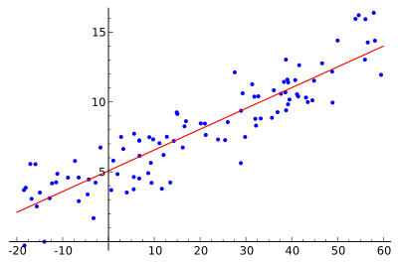
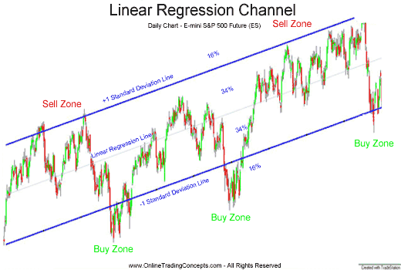
Linear Regression
Assumes a linear relationship between two variables x & y (extensible to more variables).
Model: y = m*x +c
Training Data: past observations of x and y values
Learning algorithm: Least-squares method
Prediction algorithm: plugs a value of x into the model to get y.

Slide 58
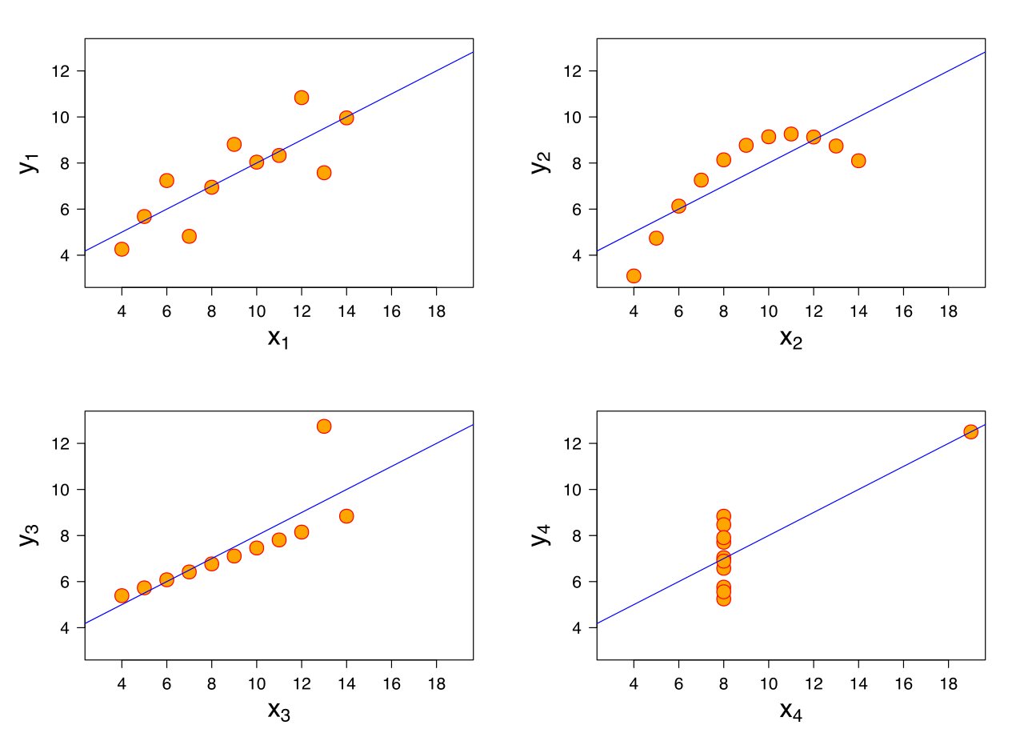
Pitfalls with Linear Regression
Non-Linearity
Data may not be linear!
Check scatter plot.
Use kernel trick.
Outliers
Outlier data can affect model
Detect and discard outliers.

Slide 59
Frequent Itemset Mining
Detect patterns in co-occurrence of “items”
Model: A set of itemsets & their occurrence frequencies
Training Data: Past observations of items
Learning algorithm: A Priori Algorithm
Prediction algorithm: Given an observed itemset, model can predict likely co-occurring item.
TID | CID | Date | Item | Qty
111 | 201 | 5/1/99 | Pen | 2
111 | 201 | 5/1/99 | Ink | 1
111 | 201 | 5/1/99 | Milk | 3
111 | 201 | 5/1/99 | Juice | 6
112 | 105 | 6/3/99 | Pen | 1
112 | 105 | 6/3/99 | Ink | 1
112 | 105 | 6/3/99 | Milk | 1
113 | 201 | 5/10/99 | Pen | 1
113 | 201 | 5/10/99 | Milk | 1
114 | 201 | 6/1/99 | Pen | 2
114 | 201 | 6/1/99 | Ink | 2
114 | 201 | 6/1/99 | Juice | 4
114 | 201 | 6/1/99 | Water | 1

Slide 60
Frequent Itemset & Association Rules
The support of an itemset {A,B,...} is the fraction of transactions that contain {A,B,...}
{Pen, Ink, Milk}, Support: 50%
{Pen, Ink}, Support: 75%
Association rules : LHS => RHS
Eg. {Pen, Ink} => {Milk}
Support = 50%
Confidence = 66%
TID | CID | Date | Item | Qty
111 | 201 | 5/1/99 | Pen | 2
111 | 201 | 5/1/99 | Ink | 1
111 | 201 | 5/1/99 | Milk | 3
111 | 201 | 5/1/99 | Juice | 6
112 | 105 | 6/3/99 | Pen | 1
112 | 105 | 6/3/99 | Ink | 1
112 | 105 | 6/3/99 | Milk | 1
113 | 201 | 5/10/99 | Pen | 1
113 | 201 | 5/10/99 | Milk | 1
114 | 201 | 6/1/99 | Pen | 2
114 | 201 | 6/1/99 | Ink | 2
114 | 201 | 6/1/99 | Juice | 4
114 | 201 | 6/1/99 | Water | 1

Slide 61
Decision Trees
Learns a decision process modeled as a tree from past examples.
Model: A tree where each internal node is a decision point
Training Data: Past observations of “decisions”
Learning algorithm: C4.5 and others.
Prediction algorithm: Given an observation, walk the decision tree to predict outcome.
Age
<=25
>25
CarType
Yes
Sedan
Sports,Truck
Yes
No
Decision Tree for High Risk Car Renters

Slide 62
Decision Tree (cont)
Age
<=25
>25
Predictor
attributes
Age | CarType | HighRisk
23 | Sedan | F
30 | Sports | F
36 | Sedan | F
25 | Truck | T
30 | Sedan | F
23 | Truck | T
30 | Truck | F
25 | Sports | T
18 | Sedan | F
CarType
Yes
Dependent
attribute
Sedan
Sports,Truck
numerical
categorical
Yes
No
Age
30
35
Yes:
No:

Slide 63
Clustering
centroids
Clustering is the process of organizing objects into groups whose members are similar in some way
Model: A set of k centroids (representative profile) of k groups
Training Data: Past observations of “features” of objects
Learning algorithm: K-means, K-medoids, Hierarchical Agglomerative Clustering etc.
Prediction algorithm: Given an observation of an object, find the nearest centroid and that is the group the object belongs to.

Slide 64
Why are clusters useful ?
Classification : determine which profile/group an observed object belong to.
Outlier detection : If an observed object is far from any group, then it may be an outlier or an anomaly.
A distance/similarity function must be defined between objects.
c2
c1
c3

Slide 65
What Data Mining to Use?
Does the data have labeled classes ?
Yes
No
Supervised Learning
Unsupervised Learning
Is the data discrete or continuous?
Frequent Itemset
discrete
continuous
Clustering
Decision Trees
Linear Regression

Slide 66
Discussion
Which performance metrics will benefit from data mining ?
What historical data sets are available ?

Slide 67
Big Picture
1. Get requirements
2. Design DW schema
Data Warehouse
6. Test & iterate
3. Find data source
Data Source
5. Implement using ETL tool and BI platform
Data Source
Data Source
4. Map data source to DW schema

