Slide 1
Query-Aware Compression of Join Results
LIM Lip Yeow, University of Hawai`i at Mānoa
Christopher M. Mullins, University of Hawai`i at Mānoa
Christian Lang, Acelot Inc.
EDBT 2013: 29-40

Slide 2

Motivation
DBMS
SQL Query
Network
Query Result
Result
Col1 | Col2/3 | Col4 | Col5
A | X | L | E
A | X | M | F
A | Y | L | F
B | X | L | E
B | X | M | F
R1
R2
Col1 | Col2
A | X
A | Y
B | X
Col3 | Col4 | Col5
X | L | E
X | M | F
Y | L | F
col2=
col3
Notes:
Data is not always local to user
Query results can be large with joins, leading to long transfer and response times over the network
Good idea to compress query results
Existing compression techniques cannot exploit underlying structure of join results

Slide 3
Query-Aware Compression
Use redundancy information from the query to compress the results.
Identify the redundancy structure from the query
Use redundancy structure to compress query results
This approach is orthogonal and often complementary to existing compression techniques (gzip, etc.)

Slide 4
Redundancy Structure
Each join in a query potentially introduces redundancy
Model the redundancy using a join tree
Query Plan
Join Tree
Notes:
Take query plan involving all parts the query, trim anything that isn’t a join
New leaves are treated as relations, even if they’re not real relations in the schema
Note that Q’ is the subset of Q having Q.B < b5

Slide 5
Compression Using Join Trees
Maintain dictionaries for each relation in the join tree
Encode each tuple in result set using dictionary keys corresponding to rows they are joined from
Recursively apply the encoding
Result
Col1 | Col2/3 | Col4 | Col5
A | X | L | E
A | X | M | F
A | Y | L | F
B | X | L | E
B | X | M | F
R1
R2
Col1 | Col2
A | X
A | Y
B | X
Col3 | Col4 | Col5
X | L | E
X | M | F
Y | L | F

Slide 6
Overview
1.query
Query Client
Result Decoder
Result Encoder
Query Server
Database
4.query result (incremental)
4. Join tree
5. Compressed
results (incremental)
2.query
3.query results
Nested Dictionary
Nested Dictionary
Network
Client-Side
Server-Side

Slide 7
Review of Symmetric Dictionary Encoding
Col1
Col1
A
A
A
B
B
A
DBMS
Network
A
A
B
B
 | 1 | 2
Col1
Push(Col1, A)
 | 1 | 2
Col1
A
B
(1)
A
B
(1)
(1)
Push(Col1, B)
(2)
(2)

Slide 8
Example
Raw data (A,X,L,E), (A,X,M,F), (A,Y,L,F), (B,X,L,E), (B,X,M,F)
= approx. 400 bytes (each field 20 bytes)
Joined tables get their own dictionaries
Dictionary contains unique tuples from joined
Encode tuples from Result as indexes of tuples from dictionaries
R1
R2
Col1 | Col2
A | X
A | Y
B | X
Col3 | Col4 | Col5
X | L | E
X | M | F
Y | L | F
Result
Col1 | Col2/3 | Col4 | Col5
A | X | L | E
A | X | M | F
A | Y | L | F
B | X | L | E
B | X | M | F
Notes:
(AX,1) means we’re inserting “AX” into dictionary for table 1
(1,1) means we’re encoding a row in the result using #1 from table 1 dict., and #1 from table2 dict.

Slide 9
Example
Index | 1 | 2 | 3
R1 | AX
R2 | XLE
Joined tables get their own dictionaries
Dictionary contains unique tuples from joined
Encode tuples from Result as indexes of tuples from dictionaries
R1
R2
Col1 | Col2
A | X
A | Y
B | X
Col3 | Col4 | Col5
X | L | E
X | M | F
Y | L | F
Transmitted data with compression:
Push (R1, AX)
Push (R2, XLE)
(1,1)
Result
Col1 | Col2/3 | Col4 | Col5
A | X | L | E
A | X | M | F
A | Y | L | F
B | X | L | E
B | X | M | F
Notes:
(AX,1) means we’re inserting “AX” into dictionary for table 1
(1,1) means we’re encoding a row in the result using #1 from table 1 dict., and #1 from table2 dict.

Slide 10
Example
Index | 1 | 2 | 3
R1 | AX
R2 | XLE | XMF
Joined tables get their own dictionaries
Dictionary contains unique tuples from joined
Encode tuples from Result as indexes of tuples from dictionaries
R1
R2
Col1 | Col2
A | X
A | Y
B | X
Col3 | Col4 | Col5
X | L | E
X | M | F
Y | L | F
Transmitted data with compression:
Push (R1, AX)
Push (R2, XLE)
(1,1)
Push (R2, XMF) (1,2)
Result
Col1 | Col2/3 | Col4 | Col5
A | X | L | E
A | X | M | F
A | Y | L | F
B | X | L | E
B | X | M | F
Notes:
(AX,1) means we’re inserting “AX” into dictionary for table 1
(1,1) means we’re encoding a row in the result using #1 from table 1 dict., and #1 from table2 dict.

Slide 11
Example
Index | 1 | 2 | 3
R1 | AX | AY
R2 | XLE | XMF | YLF
Joined tables get their own dictionaries
Dictionary contains unique tuples from joined
Encode tuples from Result as indexes of tuples from dictionaries
R1
R2
Col1 | Col2
A | X
A | Y
B | X
Col3 | Col4 | Col5
X | L | E
X | M | F
Y | L | F
Transmitted data with compression:
Push (R1, AX)
Push (R2, XLE)
(1,1)
Push (R2, XMF) (1,2)
Push (R1, AY)
Push (R2, YLF)
(2,3)
Result
Col1 | Col2/3 | Col4 | Col5
A | X | L | E
A | X | M | F
A | Y | L | F
B | X | L | E
B | X | M | F
Notes:
(AX,1) means we’re inserting “AX” into dictionary for table 1
(1,1) means we’re encoding a row in the result using #1 from table 1 dict., and #1 from table2 dict.

Slide 12
Example
Index | 1 | 2 | 3
R1 | AX | AY | BX
R2 | XLE | XMF | YLF
Joined tables get their own dictionaries
Dictionary contains unique tuples from joined
Encode tuples from Result as indexes of tuples from dictionaries
R1
R2
Col1 | Col2
A | X
A | Y
B | X
Col3 | Col4 | Col5
X | L | E
X | M | F
Y | L | F
Transmitted data with compression:
Push (R1, AX)
Push (R2, XLE)
(1,1)
Push (R2, XMF) (1,2)
Push (R1, AY)
Push (R2, YLF)
(2,3)
Push (R1, BX)
(3,1)
Result
Col1 | Col2/3 | Col4 | Col5
A | X | L | E
A | X | M | F
A | Y | L | F
B | X | L | E
B | X | M | F
Notes:
(AX,1) means we’re inserting “AX” into dictionary for table 1
(1,1) means we’re encoding a row in the result using #1 from table 1 dict., and #1 from table2 dict.

Slide 13
Example
Index | 1 | 2 | 3
R1 | AX | AY | BX
R2 | XLE | XMF | YLF
Joined tables get their own dictionaries
Dictionary contains unique tuples from joined
Encode tuples from Result as indexes of tuples from dictionaries
R1
R2
Col1 | Col2
A | X
A | Y
B | X
Col3 | Col4 | Col5
X | L | E
X | M | F
Y | L | F
Transmitted data with compression:
Push (R1, AX)
Push (R2, XLE)
(1,1)
Push (R2, XMF) (1,2)
Push (R1, AY)
Push (R2, YLF)
(2,3)
Push (R1, BX)
(3,1) (3,2)
Result
Col1 | Col2/3 | Col4 | Col5
A | X | L | E
A | X | M | F
A | Y | L | F
B | X | L | E
B | X | M | F
Notes:
(AX,1) means we’re inserting “AX” into dictionary for table 1
(1,1) means we’re encoding a row in the result using #1 from table 1 dict., and #1 from table2 dict.

Slide 14
Example
Raw data (A,X,L,E), (A,X,M,F), (A,Y,L,F), (B,X,L,E), (B,X,M,F)
= approx. 400 bytes (each field 20 bytes)
Joined tables get their own dictionaries
Dictionary contains unique tuples from joined
Encode tuples from Result as indexes of tuples from dictionaries
R1
R2
Col1 | Col2
A | X
A | Y
B | X
Col3 | Col4 | Col5
X | L | E
X | M | F
Y | L | F
Transmitted data with compression:
Push (R1, AX)
Push (R2, XLE)
(1,1)
Push (R2, XMF) (1,2)
Push (R1, AY)
Push (R2, YLF)
(2,3)
Push (R1, BX)
(3,1) (3,2)
= approx. 340 bytes
Result
Col1 | Col2/3 | Col4 | Col5
A | X | L | E
A | X | M | F
A | Y | L | F
B | X | L | E
B | X | M | F
Notes:
(AX,1) means we’re inserting “AX” into dictionary for table 1
(1,1) means we’re encoding a row in the result using #1 from table 1 dict., and #1 from table2 dict.

Slide 15
Example
Raw data (A,X,L,E), (A,X,M,F), (A,Y,L,F), (B,X,L,E), (B,X,M,F)
= approx. 400 bytes (each field 20 bytes)
Joined tables get their own dictionaries
Dictionary contains unique tuples from joined
Encode tuples from Result as indexes of tuples from dictionaries
R1
R2
Col1 | Col2
A | X
A | Y
B | X
Col3 | Col4 | Col5
X | L | E
X | M | F
Y | L | F
Transmitted data with compression:
Push (R1, AX)
Push (R2, XLE)
(1,1)
Push (R2, XMF) (1,2)
Push (R1, AY)
Push (R2, YLF)
(2,3)
Push (R1, BX)
(3,1) (3,2)
Result
Col1 | Col2/3 | Col4 | Col5
A | X | L | E
A | X | M | F
A | Y | L | F
B | X | L | E
B | X | M | F
Can use column dictionaries to further improve compression
Notes:
(AX,1) means we’re inserting “AX” into dictionary for table 1
(1,1) means we’re encoding a row in the result using #1 from table 1 dict., and #1 from table2 dict.

Slide 16
Recursive Example
Each node in the join tree has a dictionary
Each base relation in the join tree has a dictionary for each of its columns (omitted in examples), and one to encode tuples
Join Tree

Slide 17
Col1 | Col2/3 | Col4 | Col5/6 | Col7
A | X | L | E | R
A | X | L | E | S
A | X | M | F | R
A | Y | L | F | R
B | X | L | E | R
B | X | L | E | S
B | X | M | F | R
1
Col1 | Col2/3 | Col4 | Col5
A | X | L | E
A | X | M | F
A | Y | L | F
B | X | L | E
B | X | M | F
2
Col6 | Col7
E | R
E | S
F | R
3
4
Col1 | Col2
A | X
A | Y
B | X
Col3 | Col4 | Col5
X | L | E
X | M | F
Y | L | F

Slide 18
Col1 | Col2/3 | Col4 | Col5/6 | Col7
A | X | L | E | R
A | X | L | E | S
A | X | M | F | R
A | Y | L | F | R
B | X | L | E | R
B | X | L | E | S
B | X | M | F | R
From: 1 .1 2.1
From: 3.1 4.1
1
Col1 | Col2/3 | Col4 | Col5
A | X | L | E
A | X | M | F
A | Y | L | F
B | X | L | E
B | X | M | F
2
Col6 | Col7
E | R
E | S
F | R
3
4
Col1 | Col2
A | X
A | Y
B | X
Col3 | Col4 | Col5
X | L | E
X | M | F
Y | L | F

Slide 19
Dictionaries
Col1 | Col2/3 | Col4 | Col5/6 | Col7
A | X | L | E | R
A | X | L | E | S
A | X | M | F | R
A | Y | L | F | R
B | X | L | E | R
B | X | L | E | S
B | X | M | F | R
 | 1 | 2 | 3
1 | (1,1)
2 | ER
3 | AX
4 | XLE
Transmitted Data
1
Col1 | Col2/3 | Col4 | Col5
A | X | L | E
A | X | M | F
A | Y | L | F
B | X | L | E
B | X | M | F
2
Col6 | Col7
E | R
E | S
F | R
Push (3,AX)
Push (4,XLE)
Push (1,(1,1))
Push (2,ER)
(1,1)
3
4
Col1 | Col2
A | X
A | Y
B | X
Col3 | Col4 | Col5
X | L | E
X | M | F
Y | L | F

Slide 20
Col1 | Col2/3 | Col4 | Col5/6 | Col7
A | X | L | E | R
A | X | L | E | S
A | X | M | F | R
A | Y | L | F | R
B | X | L | E | R
B | X | L | E | S
B | X | M | F | R
From: 1 .1 2.2
1
Col1 | Col2/3 | Col4 | Col5
A | X | L | E
A | X | M | F
A | Y | L | F
B | X | L | E
B | X | M | F
2
Col6 | Col7
E | R
E | S
F | R
3
4
Col1 | Col2
A | X
A | Y
B | X
Col3 | Col4 | Col5
X | L | E
X | M | F
Y | L | F

Slide 21
Dictionaries
Col1 | Col2/3 | Col4 | Col5/6 | Col7
A | X | L | E | R
A | X | L | E | S
A | X | M | F | R
A | Y | L | F | R
B | X | L | E | R
B | X | L | E | S
B | X | M | F | R
 | 1 | 2 | 3
1 | (1,1)
2 | ER | ES
3 | AX
4 | XLE
Transmitted Data
1
Col1 | Col2/3 | Col4 | Col5
A | X | L | E
A | X | M | F
A | Y | L | F
B | X | L | E
B | X | M | F
2
Col6 | Col7
E | R
E | S
F | R
Push (3,AX)
Push (4,XLE)
Push (1,(1,1))
Push (2,ER)
(1,1)
Push (2,ES)
(1,2)
3
4
Col1 | Col2
A | X
A | Y
B | X
Col3 | Col4 | Col5
X | L | E
X | M | F
Y | L | F

Slide 22
Col1 | Col2/3 | Col4 | Col5/6 | Col7
A | X | L | E | R
A | X | L | E | S
A | X | M | F | R
A | Y | L | F | R
B | X | L | E | R
B | X | L | E | S
B | X | M | F | R
From: 1 .2 2.3
From: 3.1 4.2
1
Col1 | Col2/3 | Col4 | Col5
A | X | L | E
A | X | M | F
A | Y | L | F
B | X | L | E
B | X | M | F
2
Col6 | Col7
E | R
E | S
F | R
3
4
Col1 | Col2
A | X
A | Y
B | X
Col3 | Col4 | Col5
X | L | E
X | M | F
Y | L | F

Slide 23
Dictionaries
Col1 | Col2/3 | Col4 | Col5/6 | Col7
A | X | L | E | R
A | X | L | E | S
A | X | M | F | R
A | Y | L | F | R
B | X | L | E | R
B | X | L | E | S
B | X | M | F | R
 | 1 | 2 | 3
1 | (1,1) | (1,2)
2 | ER | ES | FR
3 | AX
4 | XLE | XMF
Transmitted Data
1
Col1 | Col2/3 | Col4 | Col5
A | X | L | E
A | X | M | F
A | Y | L | F
B | X | L | E
B | X | M | F
2
Col6 | Col7
E | R
E | S
F | R
Push (3,AX)
Push (4,XLE)
Push (1,(1,1))
Push (2,ER)
(1,1)
Push (2,ES)
(1,2)
Push (4,XMF)
Push (1,(1,2))
Push (2,FR)
(2,3)
3
4
Col1 | Col2
A | X
A | Y
B | X
Col3 | Col4 | Col5
X | L | E
X | M | F
Y | L | F

Slide 24
Col1 | Col2/3 | Col4 | Col5/6 | Col7
A | X | L | E | R
A | X | L | E | S
A | X | M | F | R
A | Y | L | F | R
B | X | L | E | R
B | X | L | E | S
B | X | M | F | R
And so on…
Raw: ~700 bytes
Compressed: ~460 bytes
1
Col1 | Col2/3 | Col4 | Col5
A | X | L | E
A | X | M | F
A | Y | L | F
B | X | L | E
B | X | M | F
2
Col6 | Col7
E | R
E | S
F | R
3
4
Col1 | Col2
A | X
A | Y
B | X
Col3 | Col4 | Col5
X | L | E
X | M | F
Y | L | F

Slide 25
Limitations
Can’t handle GROUP BY at root
Can handle query plans using GROUP BY on non-root nodes
Treat results of GROUP BY as a relation
Generally can’t handle computed columns
Can handle when all columns involved are to be included in the result set
Re-compute values on client side
Notes:
Computed columns: can transmit the constituents of the computation and the function to compute the column

Slide 26
Experiments Setup
Used TPC-H dataset
Constructed six join-only queries
Compressed result set using
gzip only
Query-aware compression only
gzip and query-aware compression
Measured compression ratio, execution time
Compression ratio = raw size / compressed size
Size of database controlled by scale factor parameter
Varied to study performance for different result set sizes
Notes:
Queries derived from those provided with the TPC-H dataset with extra operations removed

Slide 27
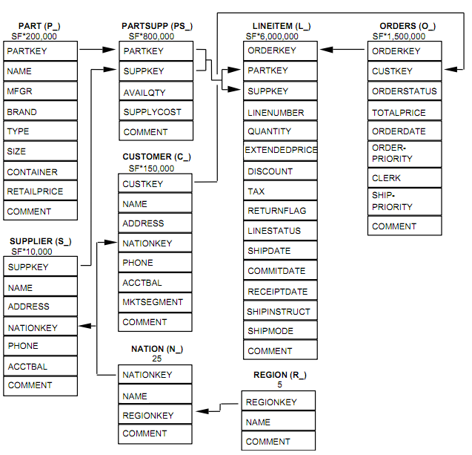
TPC-H Schema
http://www.tpc.org/tpch/spec/tpch2.14.0.pdf

Slide 28
Queries Used
2 joins: customer ⊳⊲ (orders ⊳⊲ lineitem)
3 joins: (part ⊳⊲ partsupp) ⊳⊲ (supplier ⊳⊲ nation)
1 join: supplier ⊳⊲ lineitem
1 join: customer ⊳⊲ orders
5 joins: ((customer ⊳⊲ orders) ⊳⊲ lineitem) ⊳⊲ (supplier ⊳⊲ (nation ⊳⊲ region))
4 joins: (part ⊳⊲ partsupp) ⊳⊲ (supplier ⊳⊲ (nation ⊳⊲ region))

Slide 29
Result Set Growth

Slide 30
Results (Unbounded Dictionaries)

Slide 31
Fixed-Size Dictionaries
For large result sets, cannot let dictionaries grow arbitrarily large (especially in the client)
Solve by fixing the size of the dictionaries
When full, evict entries to make room
Compressor / Decompressor are in sync
When compressor pushes entry onto full dictionary, it evicts an entry and sends the new one to the decompressor
Upon receiving new entry, decompressor also has full dictionary, so uses the same eviction policy to make room and adds the new entry
Notes:
Briefly mention eviction policies – Least recently used, least recently added, etc. Mention we use LRA because it’s cheap and usually pretty close to what we want

Slide 32
Compression Ratio (100KB dictionarIES)

Slide 33
Compression ratio (200KB dictionaries)

Slide 34
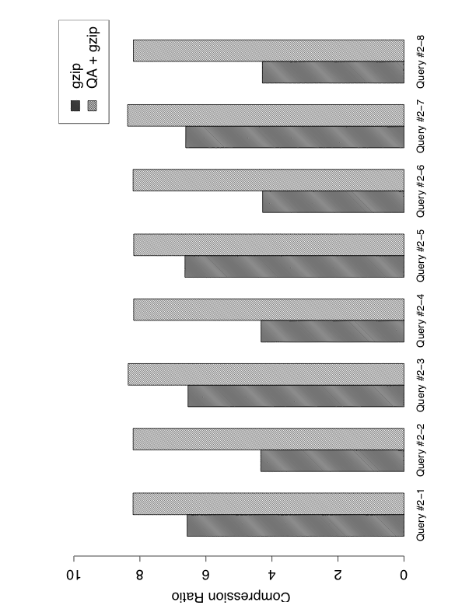
Join Orders
⊳⊲
Join order
affects how values are clustered in the result
affects compressibility
⊳⊲
⊳⊲
Part
Partsupp
Supplier
Nation

Slide 35
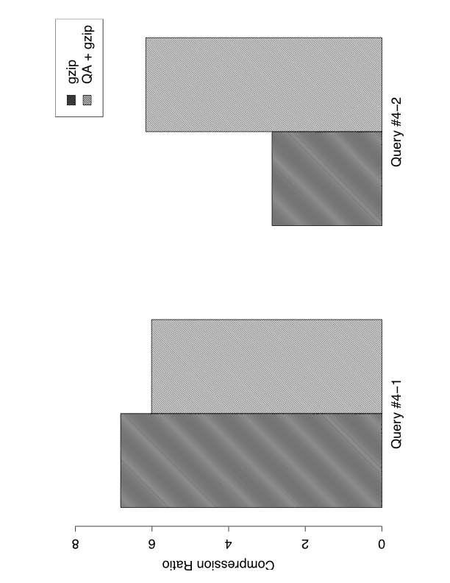
Join Orders (cont.)
⊳⊲
Customer
Orders

Slide 36
Dividing capacity across dictionaries
Question: how to best divide capacity across all dictionaries?
Naïve solution: divide evenly
Problem: some won’t need as much room
Problem: cannot account for temporal locality
Static solution: estimate sizes of dictionaries based on count statistics
Problem: cannot account for temporal locality
Problem: these stats are not necessarily readily available
Dynamic solution
Let dictionaries grow until capacity is reached
Look for signs of temporal locality
Reassign capacities appropriately
Notes:
DEFINE TEMPORAL LOCALITY!
Naïve solution – mention the NATION and REGION tables, which have O(1) entries for arbitrary scale factor
Static solution – mention we don’t consider this much because the next solution is better

Slide 37
Dynamic Allocation of Dictionary Sizes
Dictionaries allowed to grow until total capacity is reached. Let the size of dictionary j be N_{j}
Periodically, for each dictionary j, evict S_{j} oldest entries
S_{j} determined based on heuristic
Re-assign space to dictionary j proportional to N_{j}-S_{j}
Older
Newer
index | 0 | 1 | 2 | 3 | 4
value | a | b | c | d | e
# accesses | 10 | 10 | 10 | 8 | 5
rel.distance | 0 | 0 | 0 | -0.2 | -0.5

Slide 38
Dictionary set Size (50 KB)

Slide 39
Dictionary Set Size (200KB)

Slide 40
Execution Speed
Notes:
Mention that implementation is a prototype and could certainly be improved upon

Slide 41
Conclusions / Future Work
Results somewhat promising
Supplements existing compression techniques
Provides compression ratios sometimes 2x what gzip alone can provide
Future Work: Algorithm can be extended to exploit additional sources of redundancy
Functional Dependencies
Constrained Functional Dependencies

Slide 42
Questions?

Slide 43
Naïve Method: Column Dictionaries
Col1 | Col2/3 | Col4 | Col5
A | X | L | E
A | X | M | F
A | Y | L | F
B | X | L | E
B | X | M | F
Assign each column a dictionary
Push unseen values onto dictionary
Reference dictionary code rather than value
Col1 | Col2
A | X
A | Y
B | X
Col3 | Col4 | Col5
X | L | E
X | M | F
Y | L | F

Slide 44
Naïve Method: Column Dictionaries
Would usually transmit:
A,X,L,E
Col1 | Col2/3 | Col4 | Col5
A | X | L | E
A | X | M | F
A | Y | L | F
B | X | L | E
B | X | M | F
Col1 | Col2
A | X
A | Y
B | X
Col3 | Col4 | Col5
X | L | E
X | M | F
Y | L | F

Slide 45
Naïve Method: Column Dictionaries
Would usually transmit:
A,X,L,E
Col1 | Col2/3 | Col4 | Col5
A | X | L | E
A | X | M | F
A | Y | L | F
B | X | L | E
B | X | M | F
Instead, populate dictionaries:
Push “A” onto 1 (Code = 1)
Push “X” onto 2 (Code = 1)
Push “L” onto 3 (Code = 1)
Push “E” onto 4 (Code = 1)
Col1 | Col2
A | X
A | Y
B | X
Col3 | Col4 | Col5
X | L | E
X | M | F
Y | L | F

Slide 46
Naïve Method: Column Dictionaries
Would usually transmit:
A,X,L,E
Col1 | Col2/3 | Col4 | Col5
A | X | L | E
A | X | M | F
A | Y | L | F
B | X | L | E
B | X | M | F
Instead, populate dictionaries:
Push “A” onto 1 (Code = 1)
Push “X” onto 2 (Code = 1)
Push “L” onto 3 (Code = 1)
Push “E” onto 4 (Code = 1)
And encode tuple using dictionary:
(1,1,1,1)
Col1 | Col2
A | X
A | Y
B | X
Col3 | Col4 | Col5
X | L | E
X | M | F
Y | L | F

Slide 47
Naïve Method: Column Dictionaries
Would usually transmit:
A,X,L,E
Col1 | Col2/3 | Col4 | Col5
A | X | L | E
A | X | M | F
A | Y | L | F
B | X | L | E
B | X | M | F
 | 1 | 2
1 | A
2/3 | X
4 | L
5 | E
Transmitted Data
Col1 | Col2
A | X
A | Y
B | X
Col3 | Col4 | Col5
X | L | E
X | M | F
Y | L | F
(1,A)
(2,X)
(3,L)
(4,E)
(1,1,1,1)

Slide 48
Naïve Method: Column Dictionaries
Would usually transmit:
A,X,M,F
Col1 | Col2/3 | Col4 | Col5
A | X | L | E
A | X | M | F
A | Y | L | F
B | X | L | E
B | X | M | F
 | 1 | 2
1 | A
2/3 | X
4 | L | M
5 | E | F
Transmitted Data
Col1 | Col2
A | X
A | Y
B | X
Col3 | Col4 | Col5
X | L | E
X | M | F
Y | L | F
(1,A)
(2,X)
(3,L)
(4,E)
(1,1,1,1)
(3,M)
(4,F)
(1,1,2,2)

Slide 49
Naïve Method: Column Dictionaries
Would usually transmit:
A,Y,L,F
Col1 | Col2/3 | Col4 | Col5
A | X | L | E
A | X | M | F
A | Y | L | F
B | X | L | E
B | X | M | F
 | 1 | 2
1 | A
2/3 | X | Y
4 | L | M
5 | E | F
Transmitted Data
Col1 | Col2
A | X
A | Y
B | X
Col3 | Col4 | Col5
X | L | E
X | M | F
Y | L | F
(2,Y)
(1,2,1,2)
(1,A)
(2,X)
(3,L)
(4,E)
(1,1,1,1)
(3,M)
(4,F)
(1,1,2,2)

Slide 50
Naïve Method: Column Dictionaries
Col1 | Col2/3 | Col4 | Col5
A | X | L | E
A | X | M | F
A | Y | L | F
B | X | L | E
B | X | M | F
And so on…
If each column is 20 bytes…
Raw: ~400 bytes
Compressed: ~280 bytes
Transmitted Data
Col1 | Col2
A | X
A | Y
B | X
Col3 | Col4 | Col5
X | L | E
X | M | F
Y | L | F
(2,Y)
(1,2,1,2)
(1,A)
(2,X)
(3,L)
(4,E)
(1,1,1,1)
(3,M)
(4,F)
(1,1,2,2)

