Slide 1
Research Topics in Information Systems and Services
Lipyeow Lim
Assistant Professor
Information and Computer Sciences

Slide 2
Agenda
Information Systems & Services Focus Area
Overview, Faculty & Resources
Secondary Exam
Primary Exam
Research topics
Optimizing Content Freshness of Relations Extracted From the Web Using Keyword Search
Mining Workflows for Data Integration Patterns
Optimizing Sensor Data Acquisition for Energy-Efficient Smartphone-based Continuous Event Processing

Slide 3
Information Systems & Services
All aspects of organizing, retaining and retrieving information
Storage and indexing methods
Storage technologies and storage format
Indexing structures and algorithms
Information retrieval and search strategies
Search and query models for structured, semi-structured, unstructured data
Citation indexes and impact factors
Relevance ranking algorithms
Personalized information systems
User modeling and user profiles
Information filtering systems.

Slide 4
Faculty and Resources
http://discourse.ics.hawaii.edu/workspace/144/note/547
Peter Jasco’s Topics
http://www2.hawaii.edu/~jacso/iss-faq/
Luz Quiroga’s Topics
http://www2.hawaii.edu/~lquiroga/service/ISRsecAreasLMQ.htm
http://www2.hawaii.edu/~lquiroga/service/ISRprimAreasLMQ.htm
Lipyeow Lim’s Topics
http://www2.hawaii.edu/~lipyeow/cisiss.html

Slide 5
Secondary Exam
Data storage
storage devices (disk, flash etc), data structures and organization.
Data models
relational, XML, RDF, unstructured text, multi-media.
Query languages
Keyword search, SQL, SPARQL, XPath, XQuery, XSLT, streamSQL.
Indexing
B+tree, inverted indexes, R-trees, XML indexes, RDF indexes
Query optimization
access path selection, statistics, cost models, plan enumeration, search space pruning.
Courses: ICS 321 Data Storage and Retrieval

Slide 6
Primary Exam
Distributed/parallel data management
Parallel database paradigm, Map-Reduce paradigm, parallel programming paradigms (eg. MPI)
Consistency requirements of distributed data processing.
Cloud computing and data management
Virtualization technology
Scientific data management
cf traditional business data
Challenges posed by scientific applications in astronomy, bioinformatics, genomics, environmental sensors etc
Semantic web technologies
Leveraging RDF and OWL for data processing, data integration, and knowledge management
Challenges and opportunities
Courses : ICS421 Database Systems & ICS624 Advanced Data Management

Slide 7
Data Management
Motivation:
http://www.youtube.com/watch?v=EWL312zbEKg
http://www.youtube.com/watch?v=DsQ9UxVALSs
http://www.youtube.com/watch?v=jbkSRLYSojo
Core questions:
What is the best way to store data ?
How do we query and/or update the data ?
How to speed up queries ?
Research Drivers:
New applications.
New data types. New query types

Slide 8
Optimizing Content Freshness of Relations Extracted From the Web Using Keyword Search
Mohan Yang (Shanghai Jiao Tong University),
Haixun Wang (Microsoft Research Asia),
Lipyeow Lim (UHM)
Min Wang (HP Labs China)

Slide 9
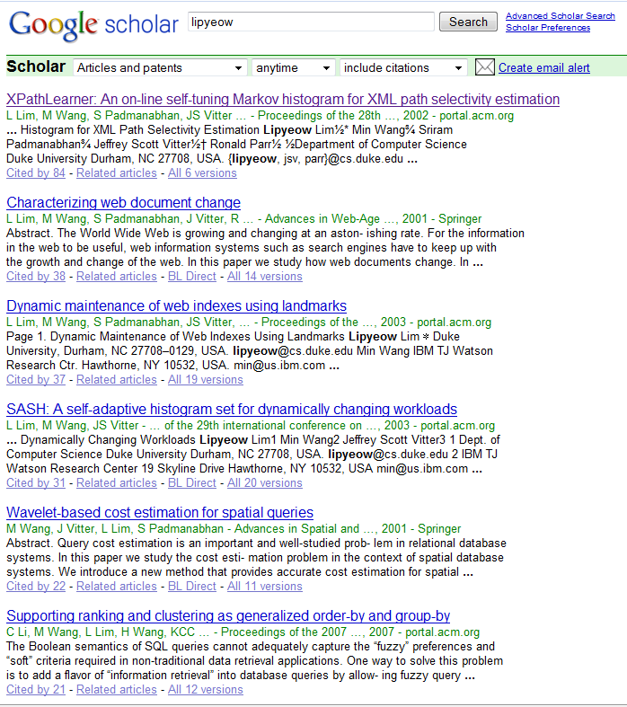
Motivating Application
Management at a prominent research institute wanted to analyze the impact of the publications of its researchers ...
Employee | Publication | Citation
Lipyeow | XPathLearner ... | 84
Lipyeow | Characterizing... | 38
Haixun | Clustering by ... | 308
Haixun | Mining concept ... | 424
... | ... | ...
Notes:
Maintain a local database of each researcher’s publications and their citation counts
Researcher’s publish papers all the time
Papers are cited by other papers all the time

Slide 10
The Simple Solution
Loop
Q = set of keyword queries
Foreach q in Q
Send q to Google Scholar
Scrape the first few pages into tuples
Update local relation using scraped tuples
Sleep for t seconds
End Loop
Query Google Scholar using researcher’s name and/or publication title to get
new publications and
updated citation counts

Slide 11
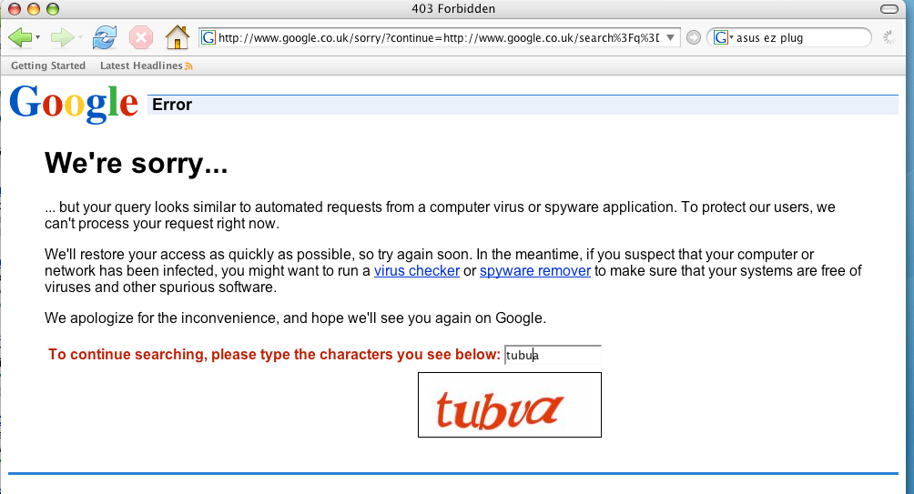
Problem with the Simple Solution
Everyone trying to use Google in the building got this screen !

Slide 12
The Elegant Solution
All this hacking (including the solution I am about to present) could be avoided if there was an API to get structured relations from Google Scholar.
Google
Scholar
Repository
Employee | Publication | Citation
Lipyeow | XPathLearner ... | 84
Lipyeow | Characterizing... | 38
Haixun | Clustering by ... | 308
Haixun | Mining concept ... | 424
... | ... | ...
API (SQL?)
Linking Open Data effort might address this issue...

Slide 13

But ...
Such API’s don’t exist (yet?)
And ...
I need those citation counts by next week!

Slide 14
Problem Statement
Local database periodically synchronizes its data subset with the data source
Data source supports keyword query API only
Extract relations from the top k results (ie first few result pages) to update local database
At each synchronization,
find a set of queries that will maximize the “content freshness” of the local database.
Only relevant keywords are used in the queries
Keywords cover the local relation
Number of queries should be minimized
Result size should be minimized
NP-Hard by reduction to Set Cover

Slide 15
Picking the Right Queries ...
Loop
Q = set of keyword queries
Foreach q in Q
Send q to Google Scholar
Scrape the first few pages into tuples
Update local relation using scraped tuples
Sleep for t seconds
End Loop
The simple algorithm is fine, we just need to pick the right queries...
Not all tuples are equal – some don’t get updated at all, some are updated all the time
Some updates are too small to be significant

Slide 16
Mining Workflows for Data Integration Patterns

Slide 17
Bio-Informatics Scenario
Other
Data
DNA
Sequence
Data
Transcriptomic
Data
Protein
Data
Metabolomic
Each category has many online data sources
Each data source may have multiple API and data formats
Workflow is like a program or a script
A connected graph of operations

Slide 18
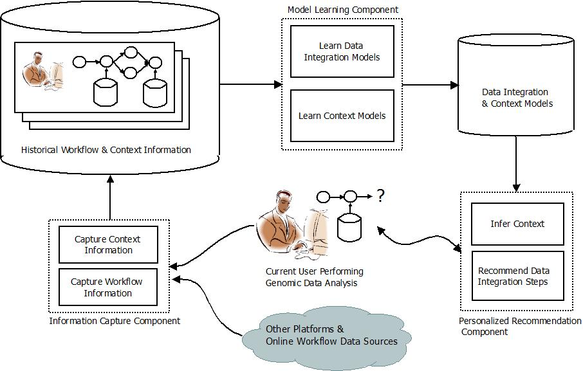
A Data Integration Recommender
Data integration patterns
Generalize on key-foreign key relationships
Associations between schema elements of data and/or processes
Analyze historical workflows to extract data integration patterns
Make personalized recommendations to users as they create workflows

Slide 19
Problems & Tasks
What are the different types of data integration patterns we can extract from workflows ?
How do we model these patterns ?
How do we mine workflows for these patterns ?
How do we model context ?
How do we make recommendations ?

Slide 20
Optimizing Sensor Data Acquisition for Energy-Efficient Smartphone-based Continuous Event Processing
Lipyeow Lim
University of Hawai`i at Mānoa
Archan Misra
Singapore Management University

Slide 21




Telehealth Scenario
Alerts can notify emergency services or caregiver
Wearable sensors transmit vitals to cell phone via wireless (eg. bluetooth)
Phone runs a complex event processing (CEP) engine with rules for alerts
SPO2
ECG
HR
Temp.
Acc.
...
IF Avg(Window(HR)) > 100
AND Avg(Window(Acc)) < 2
THEN SMS(doctor)

Slide 22

Energy Efficiency
Energy consumption of processing
Sensors: transmission of sensor data to CEP engine
Phone: acquisition of sensor data
Phone: processing of queries at CEP engine
Optimization objectives
Minimize energy consumption at phone
Maximize operational lifetime of the system.
This Talk
This Talk

Slide 23

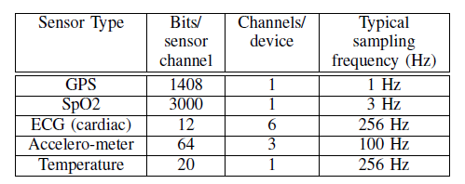
Sensor Data Acquisition
Constant sampling rate
802.11 (wifi) uses 2 power modes: active, idle
Bluetooth has 3 modes: active, idle, sleep (not relevant).
Time needed to switch modes
Energy expended to switch
3D acc.
ECG, EMG, GSR
Bluetooth
Or 802.11
Or 802.15

Slide 24
Query Model
AVG(SPO2, 5s) < 98%
AND
SPREAD(Acc, 10s) < 2g
AND
AVG(HR, 10s) < 75
Alert
OR
AVG(SPO2, 5s) < 95%
SPREAD(Acc, 10s) > 4g
AND
AND
AVG(HR, 10s) > 100
A query is a boolean combination of predicates
Predicates
Aggregation functions over a time-based window of sensor data
Traditional push model
A given query is evaluated whenever a new sensor reading arrives

Slide 25
Continuous Evaluation
if Avg(S2, 5)>20 AND S1<10 AND Max(S3,10)<4 then email(doctor).
Push
When t_{i} of Si arrives
Enqueue t_{i} into W_{i}
If Q is true,
Then output alert
CEP Engine
S1
3
1
w1
Eval Query
S2
9 2 5 6 9
w1
S3
0
1 0 0 1 1 2 3 1 4 3
w3
1 0 0 1 1 2 3 1 4
Pull
Loop
Acquire t_{i} for Si
Enqueue t_{i} into W_{i}
If Q is true,
Then output alert
End loop

Slide 26
Key Ideas
Pull model
Evaluate a query every ω seconds
Acquire only data that is needed
Evaluation order of predicates matter!
Shortcircuiting can avoid data acquisition
Batching

Slide 27
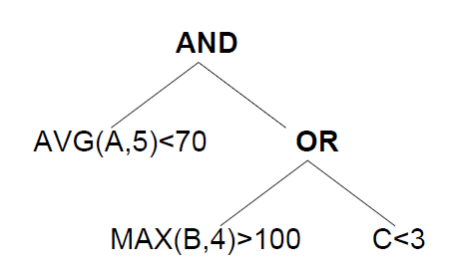
Example: ω=7
1
2
3
Time 5: eval order is 3,1,2
Time 12: eval order is 1,2,3
Time 19: eval order is 2,3,1

Slide 28
Evaluation Order
if Avg(S2, 5)>20 AND S1<10 AND Max(S3,10)<4 then email(doctor).
Predicate | Avg(S2, 5)>20 | S1<10 | Max(S3,10)<4
Acquisition | 5 * .02 = 0.1 nJ | 0.2 nJ | 10 * .01 = 0.1 nJ
Pr(false) | 0.95 | 0.5 | 0.8
Acq./Pr(f) | 0.1/0.95 | 0.2/0.5 | 0.1/0.8
Evaluate predicates with lowest energy consumption first
Evaluate predicates with highest false probability first
Hence, evaluate predicate with lowest normalized acquisition cost first.

Slide 29
A Lot More Work Needed
Improve simulator
Disjunctive normal form query representation
More realistic data generators
Trade-off between semantics of the query with energy
Estimation algorithms for P(pred=true)
Condition on context
Batching: wait say 3 ω before query evaluation
Design and implement the algorithm
Evaluation via simulation
End-to-end evaluation on Android phone
Maximize operational lifetime of phone+sensors

Slide 30
Other projects
Cloud-based SQL Processor for Scientific Applications
Benchmarking work
Query optimization for parallel SQL processing
Elastic & dynamic parallelization
Develop a journal version of: Optimizing Access Across Multiple Hierarchies in Data Warehouses
Data compression of Join Query Result Sets

