Slide 1
Agenda
SIGMOD 2010 Paper: Optimizing Content Freshness of Relations Extracted From the Web Using Keyword Search
Cloud-based Parallel DBMS
Mining Workflows for Data Integration Patterns
Energy Efficient Complex Event Processing

Slide 2
Optimizing Content Freshness of Relations Extracted From the Web Using Keyword Search
Mohan Yang (Shanghai Jiao Tong University),
Haixun Wang (Microsoft Research Asia),
Lipyeow Lim (UHM)
Min Wang (HP Labs China)

Slide 3
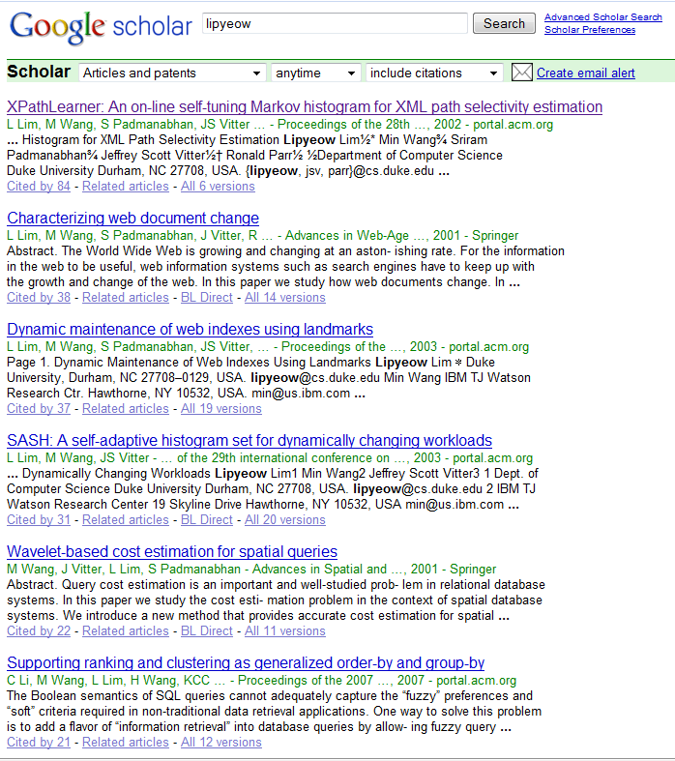
Motivating Application
Management at a prominent research institute wanted to analyze the impact of the publications of its researchers ...
Employee | Publication | Citation
Lipyeow | XPathLearner ... | 84
Lipyeow | Characterizing... | 38
Haixun | Clustering by ... | 308
Haixun | Mining concept ... | 424
... | ... | ...
Notes:
Maintain a local database of each researcher’s publications and their citation counts
Researcher’s publish papers all the time
Papers are cited by other papers all the time

Slide 4
The Simple Solution
Loop
Q = set of keyword queries
Foreach q in Q
Send q to Google Scholar
Scrape the first few pages into tuples
Update local relation using scraped tuples
Sleep for t seconds
End Loop
Query Google Scholar using researcher’s name and/or publication title to get
new publications and
updated citation counts

Slide 5
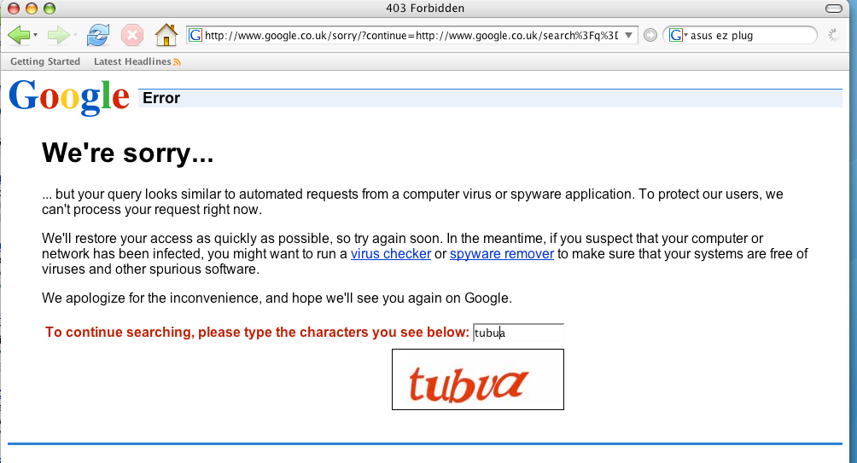
Problem with the Simple Solution
Everyone trying to use Google in the building got this screen !

Slide 6
The Elegant Solution
All this hacking (including the solution I am about to present) could be avoided if there was an API to get structured relations from Google Scholar.
Google
Scholar
Repository
Employee | Publication | Citation
Lipyeow | XPathLearner ... | 84
Lipyeow | Characterizing... | 38
Haixun | Clustering by ... | 308
Haixun | Mining concept ... | 424
... | ... | ...
API (SQL?)
Linking Open Data effort might address this issue...

Slide 7

But ...
Such API’s don’t exist (yet?)
And ...
I need those citation counts by next week!

Slide 8
Problem Statement
Local database periodically synchronizes its data subset with the data source
Data source supports keyword query API only
Extract relations from the top k results (ie first few result pages) to update local database
At each synchronization,
find a set of queries that will maximize the “content freshness” of the local database.
Only relevant keywords are used in the queries
Keywords cover the local relation
Number of queries should be minimized
Result size should be minimized
NP-Hard by reduction to Set Cover

Slide 9
Picking the Right Queries ...
Loop
Q = set of keyword queries
Foreach q in Q
Send q to Google Scholar
Scrape the first few pages into tuples
Update local relation using scraped tuples
Sleep for t seconds
End Loop
The simple algorithm is fine, we just need to pick the right queries...
Not all tuples are equal – some don’t get updated at all, some are updated all the time
Some updates are too small to be significant

Slide 10
Greedy Probes Algorithm
1. Q = empty set of queries
2. NotCovered = set L of local tuples
3. While not stopping condition do
4. K = Find all keywords associated with NotCovered
5. Pick q from PowerSet(K) using heuristic equation
6. Add q to Q
7. Remove tuples associated with q from NotCovered
8. End While
Could be based on size of Q or coverage of L
What should greedy heuristic do ?
Local coverage : a good query will get results to update as much of the local relation as possible
Server coverage : a good query should retrieve as few results from the server as possible.
A good query updates the most critical portion of the local relation to maximize “content freshness”

Slide 11
Content Freshness
Employee | Publication | Citation
Lipyeow | XPathLearner | 87
Local
Employee | Publication | Citation
Lipyeow | XPathLearner | 84
Server
Weighted tuple dissimilarity
Some tuples are more important to update
= w(local)*d(local,server)
Content Freshness
Example:
w(l) = l.citation = 84
d(l,s) = | l.citation – s.citation | = 3
Catch: local DB does not know the current value of citation on the server!

Slide 12
Content Freshness (take 2)
Estimate the server value of citation using an update model based on
Current local value of citation
Volatility of the particular citation field
Time elapsed since last sync.
F(l,t) estimates the dissimilarity between the local tuple and the server tuple at time t assuming an update model

Slide 13
Greedy Heuristic
Query efficiency
To give higher priority to “unfresh” tuples, we weight the local coverage with the freshness
Catch: local DB does not know server coverage!
Estimate server coverage using statistical methods
Estimate server coverage using another sample data source (eg. DBLP)

Slide 14
Experiments
Data sets:
Synthetic data
Paper citations (this presentation)
DVD online store
Approximate Powerset(K) with all keyword pairs
Result Extraction
Method 1: scan through all result pages
Method 2: scan only the first result page

Slide 15
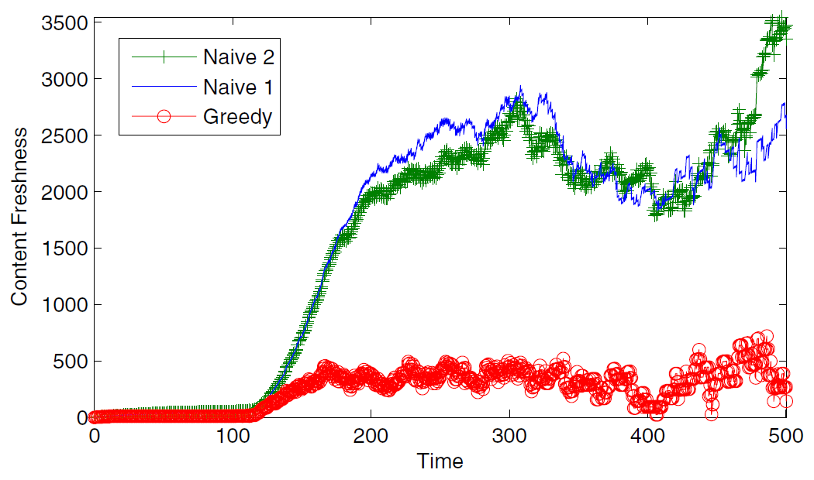
Content Freshness
Synthetic citation data based on known statistics
A Poisson-based update model used to estimate freshness
10 queries are sent at each sync
Naive 1 & 2 sends simple ID-based queries

Slide 16
Optimizations
1. Q = empty set of queries
2. NotCovered = set L of local tuples
3. While not stopping condition do
4. K = Find all keywords associated with NotCovered
5. Pick q from PowerSet(K) using heuristic equation
6. Add q to Q
7. Remove tuples associated with q from NotCovered
8. End While
K can be large
Power Set is exponential
Approximate K using most frequent k keywords
Approximate Power Set using subsets up to size m=2 or 3.

Slide 17
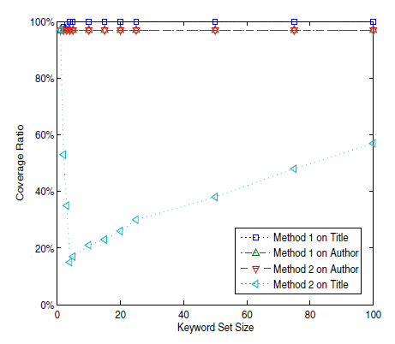
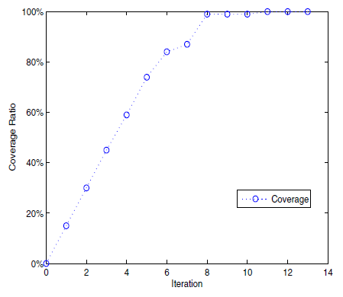
Coverage Ratio
Top 5 frequent keywords from title & Method 1
Coverage ratio is the fraction of local tuples covered by a set of queries
Result Extraction
Method 1: scan through all result pages
Method 2: scan only the first result page

Slide 18
Conclusion
Introduced the problem of maintaining a local relation extracted from a web source via keyword queries
Problem is NP-Hard, so design a greedy heuristic-based algorithm
Tried one heuristic, results show some potential
Still room for more work – journal paper

Slide 19
Cloud-based Parallel DBMSs

Slide 20
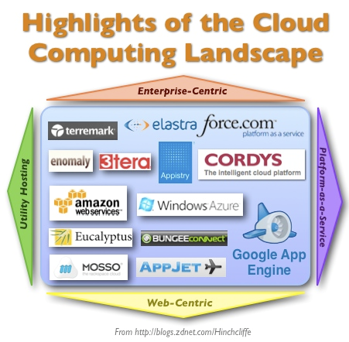
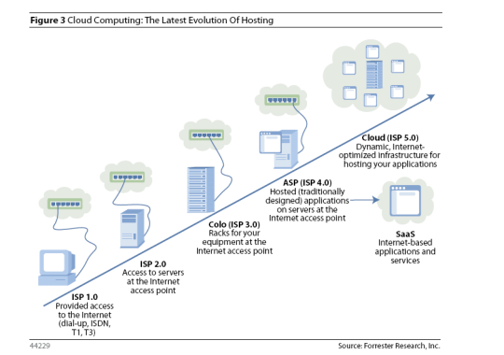
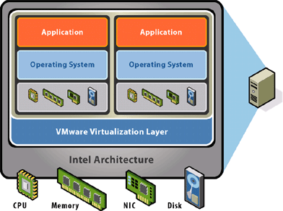
Cloud Computing

Slide 21
Shared-Nothing Parallel Database Architecture
Physical Server
Physical Server
Physical Server
Physical Server
CPU
CPU
CPU
CPU
Memory
Memory
Memory
Memory
Disk
Disk
Disk
Disk
Network

Slide 22
Logical Parallel DBMS Architecture
results
query
Parallel DB layer
Parallel DB layer
Catalog DB
DBMS
DBMS
DBMS
Data Fragments
Data Fragments
Network

Slide 23
Horizontal Fragmentation: Range Partition
sid | sname | rating | age
22 | dustin | 7 | 45
29 | brutus | 1 | 33
31 | lubber | 8 | 55
32 | andy | 4 | 23
58 | rusty | 10 | 35
64 | horatio | 7 | 35
Partition 1
sid | sname | rating | age
29 | brutus | 1 | 33
32 | andy | 4 | 23
Partition 2
Range Partition on rating
Partition 1: 0 <= rating < 5
Partition 2: 5 <= rating <= 10
sid | sname | rating | age
22 | dustin | 7 | 45
31 | lubber | 8 | 55
58 | rusty | 10 | 35
64 | horatio | 7 | 35
SELECT *
FROM Sailors S
SELECT *
FROM Sailors S
WHERE age > 30

Slide 24
Fragmentation & Replication
Node 1
Node 2
Node 3
Node 4
P1
P4
P2
P1
P3
P2
P4
P3
Network
Suppose a table is fragmented into 4 partitions on 4 nodes
Replication stores another partition on each node

Slide 25
Query Optimization
Query
SELECT S.ID
FROM Sailors S
WHERE age > 30
π_{ID}(σ_{age>30}( S ))
π_{ID}(σ_{age>30}( S1 U S2 U S3 U S4 ))
U_{i=1..4} (π_{ID}(σ_{age>30}(Si)))
Parse Query
Enumerate Plans
Sailors fragmented and replicated on 4 nodes
S1, S2, S3, S4
S1r, S2r, S3r. S4r
Estimate cost
Size of temporary results
CPU processing cost
Disk IO cost
Shipping temp. results
U
Estimate Cost
π_{S.ID}
...
π_{S.ID}
Choose Best Plan
σ_{S.age>5}
σ_{S.age>5}
S1
S4
Evaluate Query Plan
Choice of S4 or S4r
Result

Slide 26
What changed in the cloud ?
Physical
Physical
Physical
Physical
DBMS
DBMS
DBMS
DBMS
OS
OS
OS
OS
Network
Physical
Physical
Physical
VM
VM
VM
VM
VM
DBMS
DBMS
DBMS
Other
App
DBMS
OS
OS
OS
OS
Network
Virtualization “messes up” CPU, IO, network costs
Migration of VMs possible in principle

Slide 27
Problems & Tasks
Query optimization
What is the impact of virtualization on cost estimation?
What new types of statistics are needed and how do we collect them ?
CPU cost
Disk I/O cost
Network cost
Enabling elasticity
How can we organize data to enable elasticity in a parallel DBMS ?
Scientific applications (eg. astronomy)
Semantic rewriting of complex predicates

Slide 28
Mining Workflows for Data Integration Patterns

Slide 29
Bio-Informatics Scenario
Other
Data
DNA
Sequence
Data
Transcriptomic
Data
Protein
Data
Metabolomic
Each category has many online data sources
Each data source may have multiple API and data formats
Workflow is like a program or a script
A connected graph of operations

Slide 30
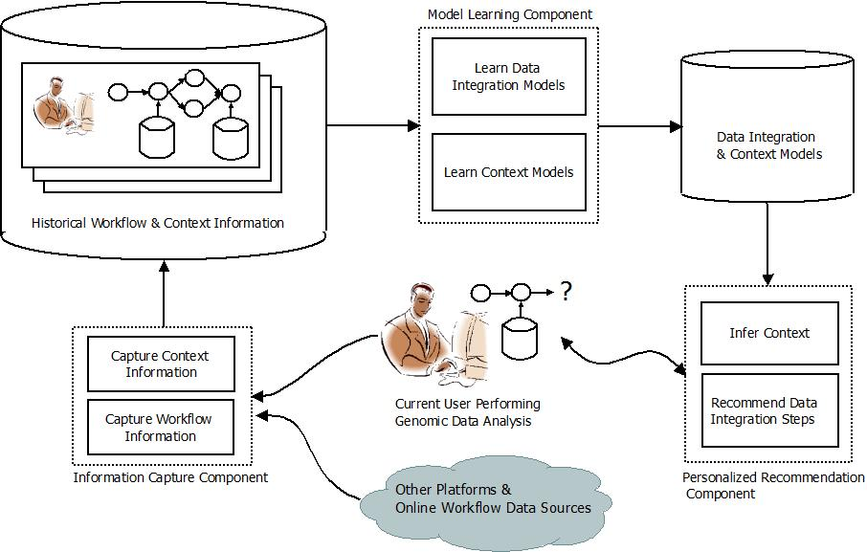
A Data Integration Recommender
Data integration patterns
Generalize on key-foreign key relationships
Associations between schema elements of data and/or processes
Analyze historical workflows to extract data integration patterns
Make personalized recommendations to users as they create workflows

Slide 31
Problems & Tasks
What are the different types of data integration patterns we can extract from workflows ?
How do we model these patterns ?
How do we mine workflows for these patterns ?
How do we model context ?
How do we make recommendations ?

Slide 32
Energy Efficient Complex Event Processing

Slide 33




Telehealth Scenario
Alerts can notify emergency services or caregiver
Wearable sensors transmit vitals to cell phone via wireless (eg. bluetooth)
Phone runs a complex event processing (CEP) engine with rules for alerts
SPO2
ECG
HR
Temp.
Acc.
...
IF Avg(Window(HR)) > 100
AND Avg(Window(Acc)) < 2
THEN SMS(doctor)

Slide 34

Energy Efficiency
Energy consumption of processing
Sensors: transmission of sensor data to CEP engine
Phone: acquisition of sensor data
Phone: processing of queries at CEP engine
Optimization objectives
Minimize energy consumption at phone
Maximize operational lifetime of the system.
Ideas:
Batching of sensor data transmission
Moving towards a pull model
Order of predicate evaluation

Slide 35
Evaluation Order Example
if Avg(S2, 5)>20 AND S1<10 AND Max(S3,10)<4 then email(doctor).
Predicate | Avg(S2, 5)>20 | S1<10 | Max(S3,10)<4
Acquisition | 5 * .02 = 0.1 nJ | 0.2 nJ | 10 * .01 = 0.1 nJ
Pr(false) | 0.95 | 0.5 | 0.8
Acq./Pr(f) | 0.1/0.95 | 0.2/0.5 | 0.1/0.8
Evaluate predicates with lowest energy consumption first
Evaluate predicates with highest false probability first
Hence, evaluate predicate with lowest normalized acquisition cost first.

Slide 36
Continuous Evaluation
if Avg(S2, 5)>20 AND S1<10 AND Max(S3,10)<4 then email(doctor).
CEP Engine
Loop
Acquire t_{i} for Si
Enqueue t_{i} into W_{i}
If Q is true,
Then output alert
End loop
S1
3
1
w1
S2
9 2 5 6 9
w1
S3
0
1 0 0 1 1 2 3 1 4 3
w3
1 0 0 1 1 2 3 1 4
Push model
Data arrival triggers evaluation
Pull model:
Engine decides when to perform evaluation and what order.
Rate problem

Slide 37
Problems and Tasks
What are the energy cost characteristics of different query evaluation approaches with different alert guarantees ?
What is the impact of batching and pull-based transmission ?
Design novel energy efficient evaluation algorithms
How do we estimate the probability of true/false of predicates ?
Experiment on simulated environment
Experiment on Android phone & shimmer sensor environment

Slide 38
Agenda
SIGMOD 2010 Paper: Optimizing Content Freshness of Relations Extracted From the Web Using Keyword Search
Cloud-based Parallel DBMS
Mining Workflows for Data Integration Patterns
Energy Efficient Complex Event Processing

