Slide 1
Optimizing Sensor Data Acquisition for Energy-Efficient Smartphone-based Continuous Event Processing
Lipyeow Lim
University of Hawai`i at Mānoa
Archan Misra
Singapore Management University

Slide 2
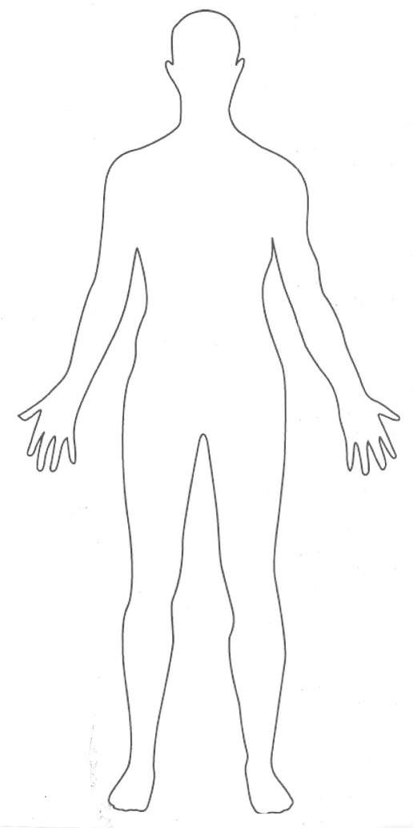
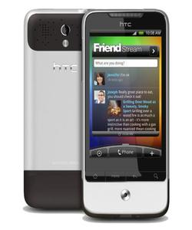
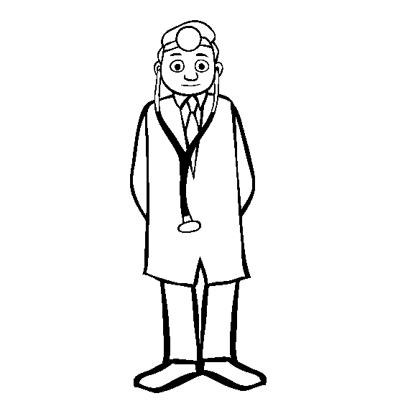

Telehealth Scenario
Alerts can notify emergency services or caregiver
Wearable sensors transmit vitals to cell phone via wireless (eg. bluetooth)
Phone runs a complex event processing (CEP) engine with rules for alerts
SPO2
ECG
HR
Temp.
Acc.
...
IF Avg(Window(HR)) > 100
AND Avg(Window(Acc)) < 2
THEN SMS(doctor)

Slide 3

Energy Efficiency
Energy consumption of processing
Sensors: transmission of sensor data to CEP engine
Phone: acquisition of sensor data
Phone: processing of queries at CEP engine
Optimization objectives
Minimize energy consumption at phone
Maximize operational lifetime of the system.
This Talk
This Talk

Slide 4

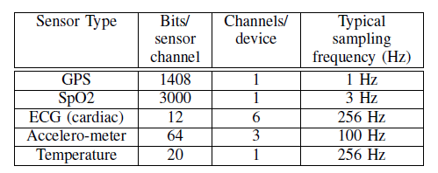
Sensor Data Acquisition
Constant sampling rate
802.11 (wifi) uses 2 power modes: active, idle
Bluetooth has 3 modes: active, idle, sleep (not relevant).
Time needed to switch modes
Energy expended to switch
3D acc.
ECG, EMG, GSR
Bluetooth
Or 802.11
Or 802.15

Slide 5
Query Model
AVG(SPO2, 5s) < 98%
AND
SPREAD(Acc, 10s) < 2g
AND
AVG(HR, 10s) < 75
Alert
OR
AVG(SPO2, 5s) < 95%
SPREAD(Acc, 10s) > 4g
AND
AND
AVG(HR, 10s) > 100
A query is a boolean combination of predicates
Predicates
Aggregation functions over a time-based window of sensor data
Traditional push model
A given query is evaluated whenever a new sensor reading arrives

Slide 6
Continuous Evaluation
if Avg(S2, 5)>20 AND S1<10 AND Max(S3,10)<4 then email(doctor).
Push
When t_{i} of Si arrives
Enqueue t_{i} into W_{i}
If Q is true,
Then output alert
CEP Engine
S1
3
1
w1
Eval Query
S2
9 2 5 6 9
w1
S3
0
1 0 0 1 1 2 3 1 4 3
w3
1 0 0 1 1 2 3 1 4
Pull
Loop
Acquire t_{i} for Si
Enqueue t_{i} into W_{i}
If Q is true,
Then output alert
End loop

Slide 7
Key Ideas
Pull model
Evaluate a query every ω seconds
Acquire only data that is needed
Evaluation order of predicates matter!
Shortcircuiting can avoid data acquisition
Batching

Slide 8
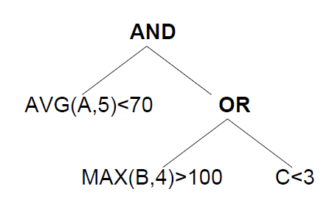
Example: ω=7
1
2
3
Time 5: eval order is 3,1,2
Time 12: eval order is 1,2,3
Time 19: eval order is 2,3,1

Slide 9
Evaluation Order
if Avg(S2, 5)>20 AND S1<10 AND Max(S3,10)<4 then email(doctor).
Predicate | Avg(S2, 5)>20 | S1<10 | Max(S3,10)<4
Acquisition | 5 * .02 = 0.1 nJ | 0.2 nJ | 10 * .01 = 0.1 nJ
Pr(false) | 0.95 | 0.5 | 0.8
Acq./Pr(f) | 0.1/0.95 | 0.2/0.5 | 0.1/0.8
Evaluate predicates with lowest energy consumption first
Evaluate predicates with highest false probability first
Hence, evaluate predicate with lowest normalized acquisition cost first.

Slide 10
Example: ω=3
1
2
3
Time 5: 1,2,3
Time 8: acquisition cost for A becomes cheaper, because some tuples are already in buffer
Acquisition cost depends on state of the buffer at time t

Slide 11
Algorithm
At each ω
Calculate normalized acquisition cost (NAC) based on buffer state and P(pred=true)
Find evaluation order using NAC
Acquire sensor data and eval pred using eval order with shortcircuiting.
What happens if >2 predicates operate on the same sensor data stream?

Slide 12
Simulation Setup
Naive
data from all sensors acquired in batches
ASRS-static
Evaluation order determined once at initialization and never changes
ASRS-dynamic
Evaluation order determined at each ω time period.
Data generated using independent Gaussian distribution

Slide 13
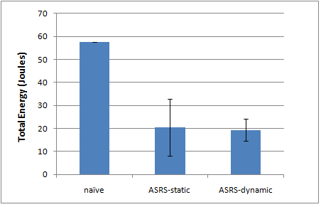
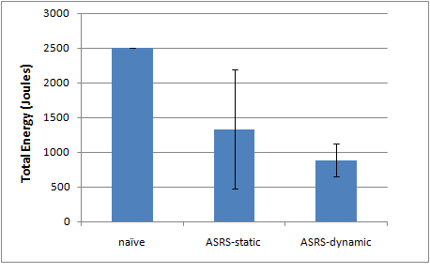
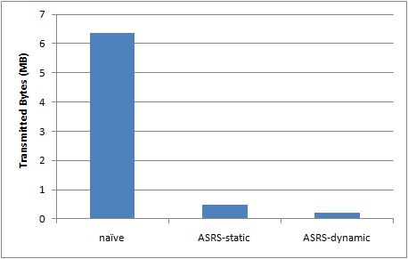
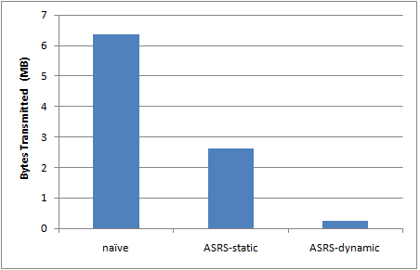
Simulation Results
Bluetooth
802.11
Energy
Bytes

Slide 14
A Lot More Work Needed
Improve simulator
Disjunctive normal form query representation
More realistic data generators
Estimation algorithms for P(pred=true)
Condition on context
Batching: wait say 3 ω before query evaluation
Design and implement the algorithm
Evaluation via simulation
End-to-end evaluation on Android phone
Maximize operational lifetime of phone+sensors

Slide 15
Other projects
Cloud-based SQL Processor for Scientific Applications
Benchmarking work
Query optimization for parallel SQL processing
Elastic & dynamic parallelization
Develop a journal version of: Optimizing Access Across Multiple Hierarchies in Data Warehouses
Data compression of Join Query Result Sets

Slide 16


ACM SIGMOD Programming Contest
Task: A Durable Main-Memory Index Using Flash
Contest ends Mar 31 2011
Skills: C, OS, Algorithms, DB concepts
Why do it?
Great learning experience
Looks good on your resume
Free trip for two to SIGMOD 2011 in Athens!
USD 5000

