Slide 1
Optimizing Sensor Data Acquisition for Energy-Efficient Smartphone-based Continuous Event Processing
Lim Lip Yeow
University of Hawai`i at Mānoa
Archan Misra
Singapore Management University

Slide 2
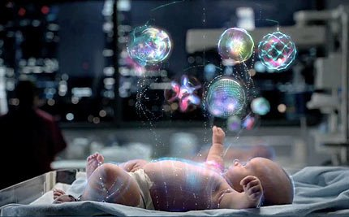

Slide 3
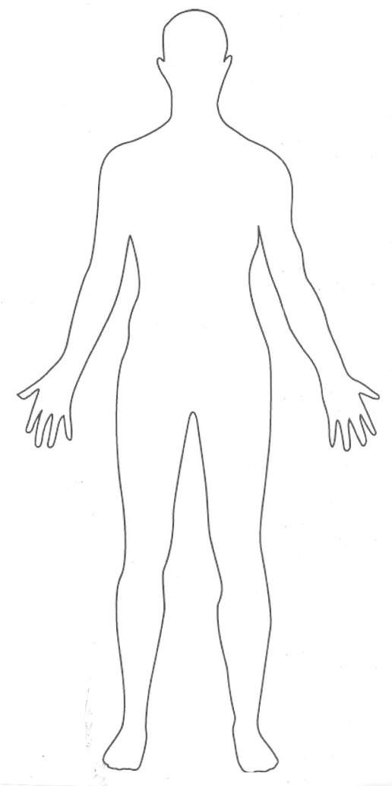
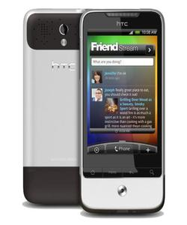


Telehealth Scenario
Alerts can notify emergency services or caregiver
Wearable sensors transmit vitals to cell phone via wireless (eg. bluetooth)
Phone runs a complex event processing (CEP) engine with rules for alerts
SPO2
ECG
HR
Temp.
Acc.
...
IF Avg(Window(HR)) > 100
AND Avg(Window(Acc)) < 2
THEN SMS(doctor)

Slide 4
Continuous/Streaming Evaluation
if Avg(S2, 5)>20 AND S1<10 AND Max(S3,10)<4 then email(doctor).
Algorithm
When t_{i} of Si arrives
Enqueue t_{i} into W_{i}
If Q is true,
Then output alert
CEP Engine
S1
3
1
w1
Eval Query
S2
9 2 5 6 9
w1
S3
0
1 0 0 1 1 2 3 1 4 3
w3
1 0 0 1 1 2 3 1 4
“Push” model

Slide 5
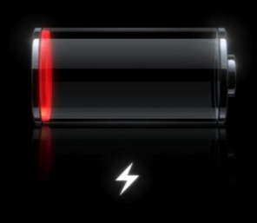
Energy Consumption
Wifi or Bluetooth
SPO2
ECG
HR
Temp.
Acc.
...
Sensor: transmits data
Phone:
receives data
Phone:
evaluate queries

Slide 6
Research Question
Is there a better way to perform such complex event processing that
Minimizes energy consumption at the phone, and/or
Maximizes operational lifetime of the system.

Slide 7
Key Ideas
Pull model
Evaluate a query every ω seconds
Acquire only data that is needed
Evaluation order of predicates matter!
Shortcircuiting can avoid data acquisition
Batching
Assuming fairly smart sensors capable of buffering and supporting “pull”

Slide 8
Query Model
AVG(SPO2, 5s) < 98%
AND
SPREAD(Acc, 10s) < 2g
AND
AVG(HR, 10s) < 75
Alert
OR
AVG(SPO2, 5s) < 95%
SPREAD(Acc, 10s) > 4g
AND
AND
AVG(HR, 10s) > 100
A query is a boolean combination of predicates
Predicates
Aggregation functions over a time-based window of sensor data

Slide 9
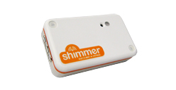
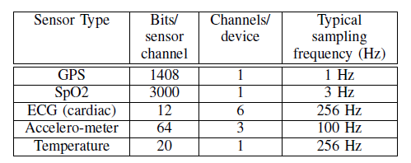
Sensor Data Acquisition
Constant sampling rate
802.11 (wifi) uses 2 power modes: active, idle
Bluetooth has 3 modes: active, idle, sleep (not relevant).
Time needed to switch modes
Energy expended to switch
3D acc.
ECG, EMG, GSR
Bluetooth
Or 802.11
Or 802.15

Slide 10
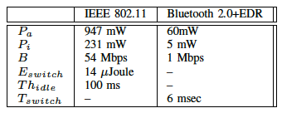
Pulling N Tuples from Sensor
Power
Idle mode consumes P_{i} mW
Active mode consumes P_{a} mW
Sensor rate is f Hz
A tuple is S bits
Bandwidth is B Mbps
Switch
P_{a}
Active
P_{i}
Idle
Time
N*S/B
N/f

Slide 11
Pull-based Evaluation
if Avg(S2, 5)>20 AND S1<10 AND Max(S3,10)<4 then email(doctor).
CEP Engine
Pull
Loop every ω seconds
For each sensor Si
Acquire data for Si
Enqueue data into W_{i}
EndFor
If Q is true,
Then output alert
End loop
S1
1
w1
Eval Query
S2
9 2 5 6 9
w2
S3
1 0 0 1 1 2 3 1 4 3
w3
Complex interaction between ω, stream rates, and predicate windows
If predicate S1<10 is false, why bother to acquire data for S2 nand S3?

Slide 12
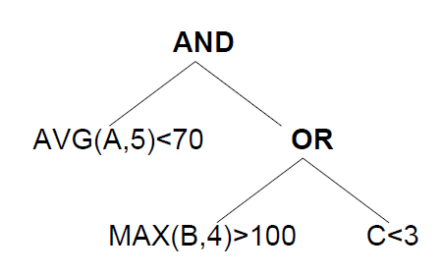
Example: ω=7
P1
Time 5: eval order is P3,P1,P2
Time 12: eval order is P1,P2,P3
Time 19: eval order is P2,P3,P1
P2
P3

Slide 13
Evaluation Order
if Avg(S2, 5)>20 AND S1<10 AND Max(S3,10)<4 then email(doctor).
Predicate | Avg(S2, 5)>20 | S1<10 | Max(S3,10)<4
Acquisition | 5 * .02 = 0.1 nJ | 0.2 nJ | 10 * .01 = 0.1 nJ
Pr(false) | 0.95 | 0.5 | 0.8
Acq./Pr(f) | 0.1/0.95 | 0.2/0.5 | 0.1/0.8
Evaluate predicates with lowest energy consumption first
Evaluate predicates with highest false probability first
Evaluate predicate with lowest normalized acquisition cost first.

Slide 14
Example: ω=3
P1
Time 5: P1,P2,P3
Time 8: acquisition cost for A becomes cheaper, because some tuples are already in buffer
P2
P3
Acquisition cost depends on state of the buffer at time t

Slide 15
Algorithm Sketch
At each ω
Calculate normalized acquisition cost (NAC) based on buffer state and P(pred=true)
Find evaluation order using NAC
Acquire sensor data and eval pred using eval order with shortcircuiting.
What happens if >2 predicates operate on the same sensor data stream?

Slide 16
Simulation Setup
Naive
data from all sensors acquired in batches
ASRS-static
Evaluation order determined once at initialization and never changes
ASRS-dynamic
Evaluation order determined at each ω time period.
Simulation results averages 5 1-hour traces with 95% confidence intervals.
P(pred=true) distributions obtained from half the data streams themselves

Slide 17
Simulation Data & Query
Data streams generated using independent Gaussian distribution
SPO2 ~ N(96,4), 3 Hz, 3000 bits
HR ~ N(80,40), 0.5 Hz, 32 bits
Accel ~ N(0,10), 256 Hz, 196 bits
AVG(SPO2, 5s) < 98%
AND
SPREAD(Acc, 10s) < 2g
AND
AVG(HR, 10s) < 75
Alert
OR
AVG(SPO2, 5s) < 95%
SPREAD(Acc, 10s) > 4g
AND
AND
AVG(HR, 10s) > 100

Slide 18
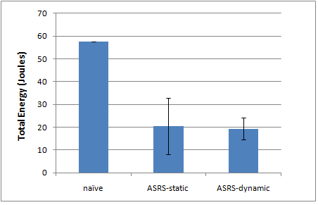
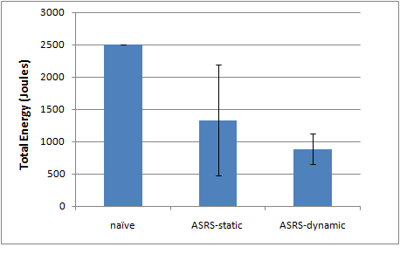
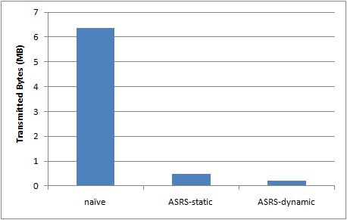
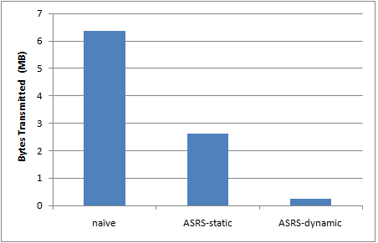
Simulation Results
Bluetooth
802.11
Energy
Bytes

Slide 19
Conclusion
Pull-based processing paradigm can have a significant impact on data acquisition energy consumption
Ordered evaluation of predicates can help shortcircuit the evaluation and avoid costly data acquisition
We proposed evaluation algorithms based on these two observations to minimize data acquisition cost at CEP engine
Results on synthetic traces show that savings up to 70% are possible.

Slide 20
Future Work
Improve simulator
Disjunctive normal form query representation
More realistic data generators
Estimation algorithms for P(pred=true)
Batching: wait say 3 ω before query evaluation
End-to-end evaluation on Android phone
Maximize operational lifetime of phone+sensors

