Slide 1
Social Insurance in Guangdong Province China
Lipyeow Lim & Dennis Streveler

Slide 2
Social Insurance in China
Government sponsored program where risks are transferred to and pooled by the government that is legally required to provide certain benefits
Pension
Workplace Injury
Unemployment
Health
Maternity
Problem: Migrant workers are not able to obtain benefits, because benefits are not portable across county & province boundaries

Slide 3
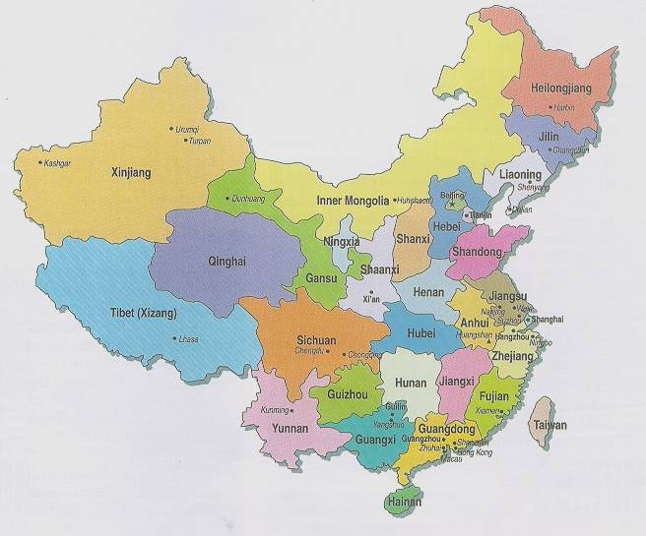
Guangdong Province
Population 105 M
Density 1390 / sq mile
68700 sq miles
GDP per capita: USD 7,787
Capital: Guangzhou
Languages: Cantonese, Hakka, Teochew, Leizhou, Mandarin

Slide 4
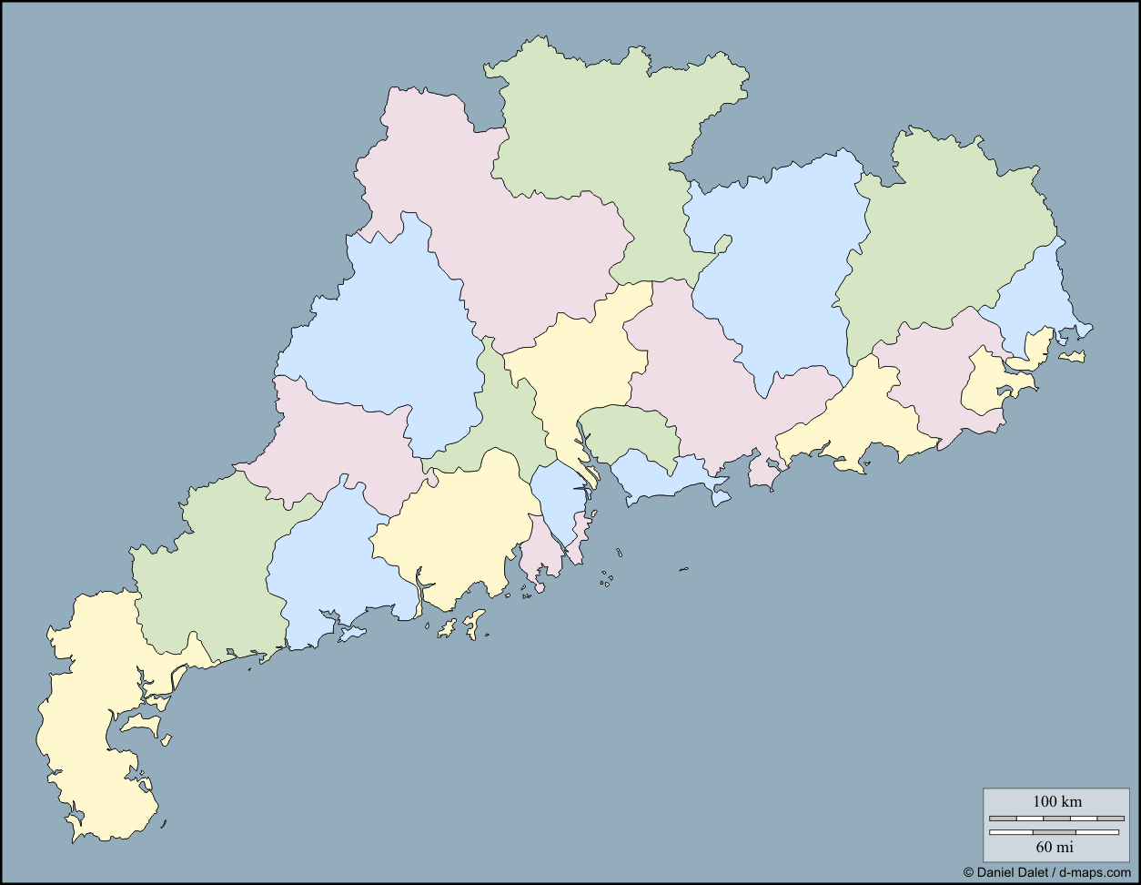
Administrative Subdivisions
21 Prefectures
121 Counties
1581 Townships
Some areas are rich and well developed, some are poor
Varying levels of IT penetration & adoption

Slide 5
IT Problem
Design and build a next generation information system to support the administration of social insurance benefits with a view towards portability of benefits within the province and ultimately across provinces.
Current State:
More developed prefectures have own system with local customizations
Less developed prefectures have minimal IT systems

Slide 6
Sample Business Processes
Local
Getting covered prescription drugs filled at local pharmacies
Checking benefits using a social security card
Verifying that a retiree is still alive
Cross-prefecture
Obtaining medical care in another prefecture city (ultimately in another province)
A retiree decides to retire in another prefecture and needs to get his monthly pension checks
Relocating to a different prefecture
Financial
pooling of funds
financial checks and controls

