Slide 1
Information Management Research
Lipyeow Lim
Assistant Professor
Information and Computer Sciences
http://www2.hawaii.edu/~lipyeow/

Slide 2
Agenda
Motivating Videos
http://www.youtube.com/watch?v=EWL312zbEKg&feature=relmfu
Overview of Information Management
Research Topic #1
Optimizing Content Freshness of Relations Extracted From the Web Using Keyword Search
Research Topic #2
Optimizing Sensor Data Acquisition for Energy-Efficient Smartphone-based Continuous Event Processing

Slide 3
Information Management
Data = Information ?
Core questions:
What is the best way to store data?
How do we query and/or update the data?
How to speed up queries
Research Drivers:
New applications.
New data types. New query types

Slide 4
Traditional Information Management
Business
transactions
Pick a business or application
What data needs to be stored ?
What operations are needed on the data ?
How should the data be stored ?
How should the operations access the data ?

Slide 5
A Bit of History
1970 Edgar F Codd (aka “Ted”) invented the relational model in the seminal paper “A Relational Model of Data for Large Shared Data Banks”
Main concept: relation = a table with rows and columns.
Every relation has a schema, which describes the columns.
Prior 1970, no standard data model.
Network model used by Codasyl
Hierarchical model used by IMS
After 1970, IBM built System R as proof-of-concept for relational model and used SQL as the query language. SQL eventually became a standard.

Slide 6
Data, Database, DBMS
A database : a collection of related data.
Represents some aspect of the real world (aka universe of discourse).
Logically coherent collection of data
Designed and built for specific purpose
Data are known facts that can be recorded and that have implicit meaning.
A data model is a collection of concepts for describing data.
A schema is a description of a particular collection of data, using the a given data model.

Slide 7
DBMS
A database management system (DBMS) is a collection of programs that enables users to
Create new DBs and specify the structure using data definition language (DDL)
Query data using a query language or data manipulation language (DML)
Store very large amounts of data
Support durability in the face of failures, errors, misuse
Control concurrent access to data from many users

Slide 8
Types of Databases
On-line Transaction Processing (OLTP)
Banking
Airline reservations
Corporate records
On-line Analytical Processing (OLAP)
Data warehouses, data marts
Business intelligence (BI)
Specialized databases
Multimedia
XML
Geographical Information Systems (GIS)
Real-time databases (telecom industry)
Special Applications
Customer Relationship Management (CRM)
Enterprise Resource Planning (ERP)
Hosted DB Services
Amazon, Salesforce

Slide 9
Files vs DBMS
Swapping data between memory and files
Difficult to add records to files
Security & access control
Do optimization manually
Good for small data/files
Run out of pointers (32bit)
Code your own search algorithm
Search on different fields is difficult
Must protect data from inconsistency due to concurrency
Fault tolerance – crash recovery

Slide 10
Why use a DBMS ?
Large datasets
Concurrency/ multi-user
Crash recovery
Declarative query language
No need to figure out what low level data structure
Data independence and efficient access.
Reduced application development time.
Data integrity and security.
Uniform data administration.

Slide 11
DBMS Components
User/Application
Database Administrator
Query Compiler
Transaction Manager
DDL compiler
Execution Engine
Concurrency Control
Index/file/record Manager
Logging & Recovery
Lock Table
Buffer Manager
Buffers
Storage Manager
Storage

Slide 12

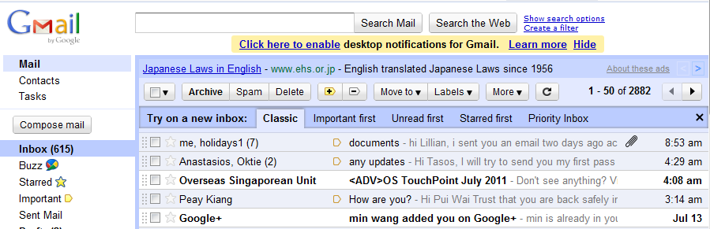
Internet Information Management
Millions of users
Lots of data (peta-bytes = 10¹⁵ bytes!)
Startups prefer cheap computers
Store data in very large clusters of cheap computers

Slide 13
Parallel DBMS Architecture
results
query
Parallel DB layer
Parallel DB layer
Catalog DB
DBMS
DBMS
DBMS
Data Fragments
Data Fragments
Network

Slide 14
Horizontal Fragmentation: Range Partition
Partition 1
sid | sname | rating | age
22 | dustin | 7 | 45
29 | brutus | 1 | 33
31 | lubber | 8 | 55
32 | andy | 4 | 23
58 | rusty | 10 | 35
64 | horatio | 7 | 35
sid | sname | rating | age
29 | brutus | 1 | 33
32 | andy | 4 | 23
Partition 2
sid | sname | rating | age
22 | dustin | 7 | 45
31 | lubber | 8 | 55
58 | rusty | 10 | 35
64 | horatio | 7 | 35
Range Partition on rating column
Partition 1: 0 <= rating < 5
Partition 2: 5 <= rating <= 10

Slide 15
Range Partition: Query Processing
Partition 1
Which partitions?
Better than non-parallel ?
sid | sname | rating | age
29 | brutus | 1 | 33
32 | andy | 4 | 23
SELECT *
FROM Sailors S
SELECT *
FROM Sailors S
WHERE rating = 2
Partition 2
sid | sname | rating | age
22 | dustin | 7 | 45
31 | lubber | 8 | 55
58 | rusty | 10 | 35
64 | horatio | 7 | 35
SELECT *
FROM Sailors S
WHERE age > 30
SELECT *
FROM Sailors S
WHERE rating < 2 and age < 30

Slide 16
Horizontal Fragmentation: Hash Partition
Partition 1
sid | sname | rating | age
22 | dustin | 7 | 45
29 | brutus | 1 | 33
31 | lubber | 8 | 55
32 | andy | 4 | 23
58 | rusty | 10 | 35
64 | horatio | 7 | 35
sid | sname | rating | age
31 | lubber | 8 | 55
32 | andy | 4 | 23
58 | rusty | 10 | 35
Partition 2
Hash partitioning using hash function
Partition = rating mod 2
sid | sname | rating | age
22 | dustin | 7 | 45
29 | brutus | 1 | 33
64 | horatio | 7 | 35

Slide 17
Hash Partition: Query Processing
Which partitions?
Better than non-parallel ?
Partition 1
sid | sname | rating | age
31 | lubber | 8 | 55
32 | andy | 4 | 23
58 | rusty | 10 | 35
SELECT *
FROM Sailors S
SELECT *
FROM Sailors S
WHERE rating = 2
Partition 2
SELECT *
FROM Sailors S
WHERE age > 30
sid | sname | rating | age
22 | dustin | 7 | 45
29 | brutus | 1 | 33
64 | horatio | 7 | 35
SELECT *
FROM Sailors S
WHERE rating < 2 and age < 30

Slide 18
Fragmentation & Replication
Node 1
Node 2
Node 3
Node 4
P1
P4
P2
P1
P3
P2
P4
P3
Network
Suppose table is fragmented into 4 partitions on 4 nodes
Replication stores another partition on each node
What happens when 1 node fails ? 2 nodes ?
What happens when a row needs to be updated ?

Slide 19
Internet Search Engines
World Wide Web
Keyword Query
Search Engine Web Server
Ranked Results
Snipplets
Web Crawler
Query
Postings
etc
Doc IDs
Web Page Repository
Inverted
Index
Indexer

Slide 20
Unstructured Text Data
Field of “Information Retrieval”
Data Model
Collection of documents
Each document is a bag of words (aka terms)
Query Model
Keyword + Boolean Combinations
Eg. DBMS and SQL and tutorial
Details:
Not all words are equal. “Stop words” (eg. “the”, “a”, “his” ...) are ignored.
Stemming : convert words to their basic form. Eg. “Surfing”, “surfed” becomes “surf”

Slide 21
Inverted Indexes
Recall: an index is a mapping of search key to data entries
What is the search key ?
What is the data entry ?
Inverted Index:
For each term store a list of postings
A posting consists of <docid,position> pairs
What is the data in an inverted index sorted on ?
lexicon
Posting lists
DBMS
doc01
10
18
20
doc02
5
38
doc01
13
SQL
doc06
1
12
doc09
4
9
doc20
12
trigger
doc01
12
15
doc09
14
21
25
doc10
11
55
...
...

Slide 22
Lookups using Inverted Indexes
lexicon
Posting lists
DBMS
doc01
10
18
20
doc02
5
38
doc01
13
SQL
doc06
1
12
doc09
4
9
doc20
12
trigger
doc01
12
15
doc09
14
21
25
doc10
11
55
...
...
Given a single keyword query “k” (eg. SQL)
Find k in the lexicon
Retrieve the posting list for k
Scan posting list for document IDs [and positions]
What if the query is “k1 and k2” ?
Retrieve document IDs for k1 and k2
Perform intersection

Slide 23
Too Many Matching Documents
Rank the results by “relevance”!
Vector-Space Model
Documents are vectors in hi-dimensional space
Each dimension in the vector represents a term
Queries are represented as vectors similarly
Vector distance (dot product) between query vector and document vector gives ranking criteria
Weights can be used to tweak relevance
PageRank (homework)
Star
Doc about movie stars
Doc about astronomy
Doc about behavior
Diet

Slide 24

Streaming Data Management
http://www.youtube.com/watch?v=trvoc6GDAqo

Slide 25

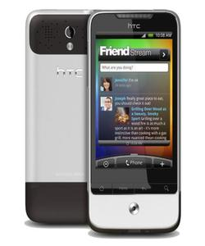


Mobile Information Management
Alerts can notify emergency services or caregiver
Wearable sensors transmit vitals to cell phone via wireless (eg. bluetooth)
Phone runs a complex event processing (CEP) engine with rules for alerts
SPO2
ECG
HR
Temp.
Acc.
...
IF Avg(Window(HR)) > 100
AND Avg(Window(Acc)) < 2
THEN SMS(doctor)

Slide 26
Discussion
What are some applications in your country where data or information management can make a difference?
http://www.youtube.com/watch?v=bedVDouyMYE

Slide 27
Research Topic #1 Optimizing Content Freshness of Relations Extracted From the Web Using Keyword Search
Mohan Yang (Shanghai Jiao Tong University),
Haixun Wang (Microsoft Research Asia),
Lipyeow Lim (UHM)
Min Wang (HP Labs China)

Slide 28
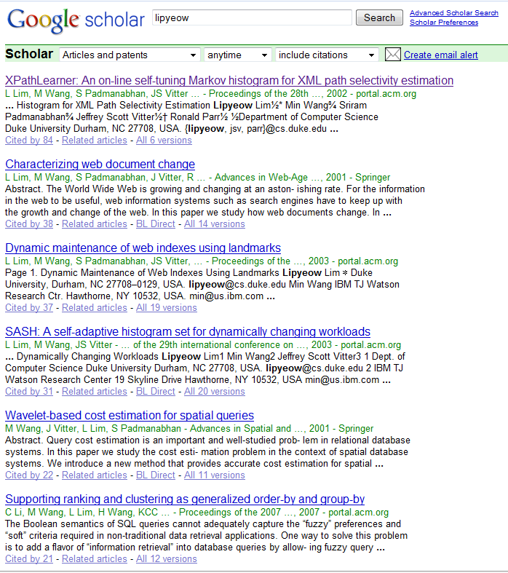
Motivating Application
Management at a prominent research institute wanted to analyze the impact of the publications of its researchers ...
Employee | Publication | Citation
Lipyeow | XPathLearner ... | 84
Lipyeow | Characterizing... | 38
Haixun | Clustering by ... | 308
Haixun | Mining concept ... | 424
... | ... | ...
Notes:
Maintain a local database of each researcher’s publications and their citation counts
Researcher’s publish papers all the time
Papers are cited by other papers all the time

Slide 29
The Simple Solution
Loop
Q = set of keyword queries
Foreach q in Q
Send q to Google Scholar
Scrape the first few pages into tuples
Update local relation using scraped tuples
Sleep for t seconds
End Loop
Query Google Scholar using researcher’s name and/or publication title to get
new publications and
updated citation counts

Slide 30
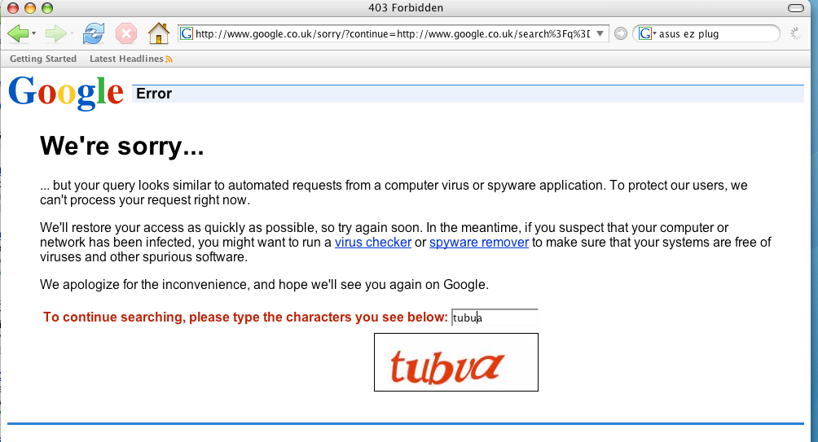
Problem with the Simple Solution
Everyone trying to use Google in the building got this screen !

Slide 31
The Elegant Solution
All this hacking (including the solution I am about to present) could be avoided if there was an API to get structured relations from Google Scholar.
Google
Scholar
Repository
Employee | Publication | Citation
Lipyeow | XPathLearner ... | 84
Lipyeow | Characterizing... | 38
Haixun | Clustering by ... | 308
Haixun | Mining concept ... | 424
... | ... | ...
API (SQL?)
Linking Open Data effort might address this issue...

Slide 32

But ...
Such API’s don’t exist (yet?)
And ...
I need those citation counts by next week!

Slide 33
Problem Statement
Local database periodically synchronizes its data subset with the data source
Data source supports keyword query API only
Extract relations from the top k results (ie first few result pages) to update local database
At each synchronization,
find a set of queries that will maximize the “content freshness” of the local database.
Only relevant keywords are used in the queries
Keywords cover the local relation
Number of queries should be minimized
Result size should be minimized
NP-Hard by reduction to Set Cover

Slide 34
Picking the Right Queries ...
Loop
Q = set of keyword queries
Foreach q in Q
Send q to Google Scholar
Scrape the first few pages into tuples
Update local relation using scraped tuples
Sleep for t seconds
End Loop
The simple algorithm is fine, we just need to pick the right queries...
Not all tuples are equal – some don’t get updated at all, some are updated all the time
Some updates are too small to be significant

Slide 35
Greedy Probes Algorithm
1. Q = empty set of queries
2. NotCovered = set L of local tuples
3. While not stopping condition do
4. K = Find all keywords associated with NotCovered
5. Pick q from PowerSet(K) using heuristic equation
6. Add q to Q
7. Remove tuples associated with q from NotCovered
8. End While
Could be based on size of Q or coverage of L
What should greedy heuristic do ?
Local coverage : a good query will get results to update as much of the local relation as possible
Server coverage : a good query should retrieve as few results from the server as possible.
A good query updates the most critical portion of the local relation to maximize “content freshness”

Slide 36
Content Freshness
Employee | Publication | Citation
Lipyeow | XPathLearner | 87
Local
Employee | Publication | Citation
Lipyeow | XPathLearner | 84
Server
Weighted tuple dissimilarity
Some tuples are more important to update
= w(local)*d(local,server)
Content Freshness
Example:
w(l) = l.citation = 84
d(l,s) = | l.citation – s.citation | = 3
Catch: local DB does not know the current value of citation on the server!

Slide 37
Content Freshness (take 2)
Estimate the server value of citation using an update model based on
Current local value of citation
Volatility of the particular citation field
Time elapsed since last sync.
F(l,t) estimates the dissimilarity between the local tuple and the server tuple at time t assuming an update model

Slide 38
Greedy Heuristic
Query efficiency
To give higher priority to “unfresh” tuples, we weight the local coverage with the freshness
Catch: local DB does not know server coverage!
Estimate server coverage using statistical methods
Estimate server coverage using another sample data source (eg. DBLP)

Slide 39
Experiments
Data sets:
Synthetic data
Paper citations (this presentation)
DVD online store
Approximate Powerset(K) with all keyword pairs
Result Extraction
Method 1: scan through all result pages
Method 2: scan only the first result page

Slide 40
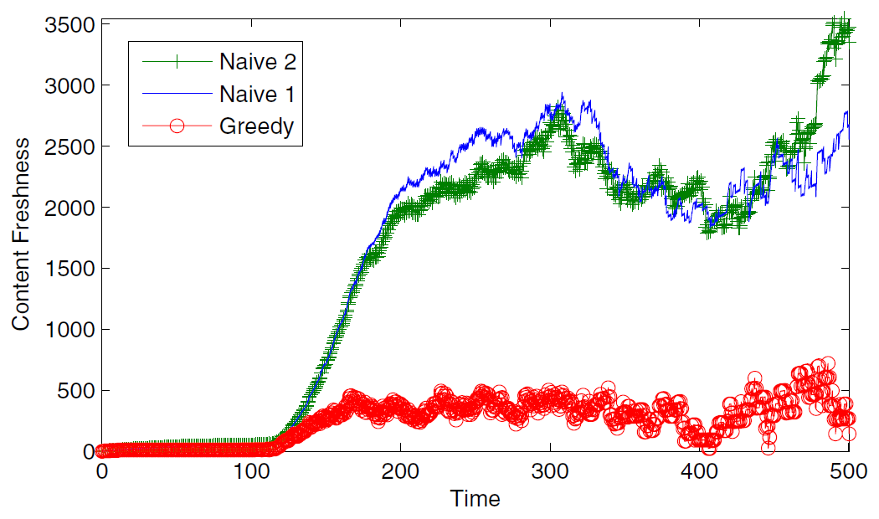
Content Freshness
Synthetic citation data based on known statistics
A Poisson-based update model used to estimate freshness
10 queries are sent at each sync
Naive 1 & 2 sends simple ID-based queries

Slide 41
Optimizations
1. Q = empty set of queries
2. NotCovered = set L of local tuples
3. While not stopping condition do
4. K = Find all keywords associated with NotCovered
5. Pick q from PowerSet(K) using heuristic equation
6. Add q to Q
7. Remove tuples associated with q from NotCovered
8. End While
K can be large
Power Set is exponential
Approximate K using most frequent k keywords
Approximate Power Set using subsets up to size m=2 or 3.

Slide 42
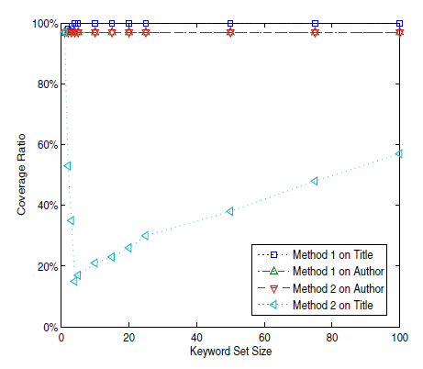
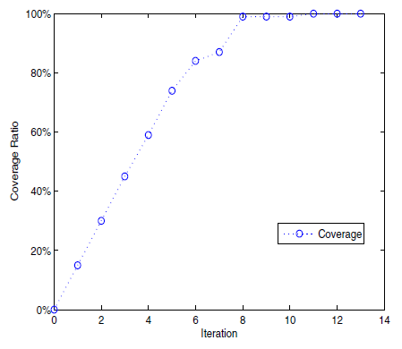
Coverage Ratio
Top 5 frequent keywords from title & Method 1
Coverage ratio is the fraction of local tuples covered by a set of queries
Result Extraction
Method 1: scan through all result pages
Method 2: scan only the first result page

Slide 43
Summary
Introduced the problem of maintaining a local relation extracted from a web source via keyword queries
Problem is NP-Hard, so design a greedy heuristic-based algorithm
Tried one heuristic, results show some potential
Still room for more work – journal paper

Slide 44
Research Topic #2 Optimizing Sensor Data Acquisition for Energy-Efficient Smartphone-based Continuous Event Processing
Lipyeow Lim
University of Hawai`i at Mānoa
Archan Misra
Singapore Management University

Slide 45
Telehealth Scenario
Alerts can notify emergency services or caregiver
Wearable sensors transmit vitals to cell phone via wireless (eg. bluetooth)
Phone runs a complex event processing (CEP) engine with rules for alerts
SPO2
ECG
HR
Temp.
Acc.
...
IF Avg(Window(HR)) > 100
AND Avg(Window(Acc)) < 2
THEN SMS(doctor)

Slide 46
Continuous/Streaming Evaluation
if Avg(S2, 5)>20 AND S1<10 AND Max(S3,10)<4 then email(doctor).
Algorithm
When t_{i} of Si arrives
Enqueue t_{i} into W_{i}
If Q is true,
Then output alert
CEP Engine
S1
3
1
w1
Eval Query
S2
9 2 5 6 9
w1
S3
0
1 0 0 1 1 2 3 1 4 3
w3
1 0 0 1 1 2 3 1 4
“Push” model

Slide 47

Energy Consumption
Wifi or Bluetooth
SPO2
ECG
HR
Temp.
Acc.
...
Sensor: transmits data
Phone:
receives data
Phone:
evaluate queries

Slide 48
Research Question
Is there a better way to perform such complex event processing that
Minimizes energy consumption at the phone, and/or
Maximizes operational lifetime of the system.

Slide 49
Key Ideas
Pull model
Evaluate a query every ω seconds
Acquire only data that is needed
Evaluation order of predicates matter!
Shortcircuiting can avoid data acquisition
Batching
Assuming fairly smart sensors capable of buffering and supporting “pull”

Slide 50
Query Model
AVG(SPO2, 5s) < 98%
AND
SPREAD(Acc, 10s) < 2g
AND
AVG(HR, 10s) < 75
Alert
OR
AVG(SPO2, 5s) < 95%
SPREAD(Acc, 10s) > 4g
AND
AND
AVG(HR, 10s) > 100
A query is a boolean combination of predicates
Predicates
Aggregation functions over a time-based window of sensor data

Slide 51
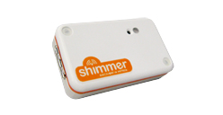
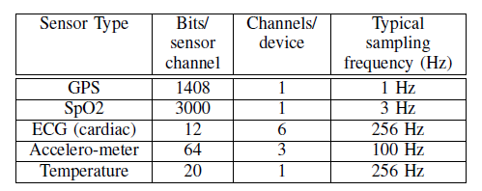
Sensor Data Acquisition
Constant sampling rate
802.11 (wifi) uses 2 power modes: active, idle
Bluetooth has 3 modes: active, idle, sleep (not relevant).
Time needed to switch modes
Energy expended to switch
3D acc.
ECG, EMG, GSR
Bluetooth
Or 802.11
Or 802.15

Slide 52
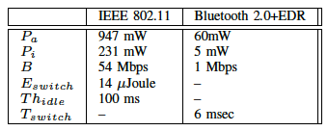
Pulling N Tuples from Sensor
Power
Idle mode consumes P_{i} mW
Active mode consumes P_{a} mW
Sensor rate is f Hz
A tuple is S bits
Bandwidth is B Mbps
Switch
P_{a}
Active
P_{i}
Idle
Time
N*S/B
N/f

Slide 53
Pull-based Evaluation
if Avg(S2, 5)>20 AND S1<10 AND Max(S3,10)<4 then email(doctor).
CEP Engine
Pull
Loop every ω seconds
For each sensor Si
Acquire data for Si
Enqueue data into W_{i}
EndFor
If Q is true,
Then output alert
End loop
S1
1
w1
Eval Query
S2
9 2 5 6 9
w2
S3
1 0 0 1 1 2 3 1 4 3
w3
Complex interaction between ω, stream rates, and predicate windows
If predicate S1<10 is false, why bother to acquire data for S2 and S3?

Slide 54
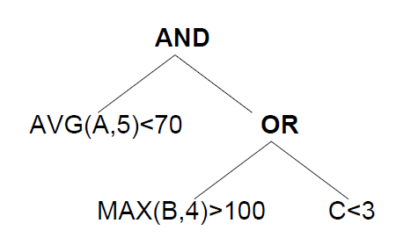
Example: ω=7
P1
Time 5: eval order is P3,P1,P2
Time 12: eval order is P1,P2,P3
Time 19: eval order is P2,P3,P1
P2
P3

Slide 55
Evaluation Order
if Avg(S2, 5)>20 AND S1<10 AND Max(S3,10)<4 then email(doctor).
Predicate | Avg(S2, 5)>20 | S1<10 | Max(S3,10)<4
Acquisition | 5 * .02 = 0.1 nJ | 0.2 nJ | 10 * .01 = 0.1 nJ
Pr(false) | 0.95 | 0.5 | 0.8
Acq./Pr(f) | 0.1/0.95 | 0.2/0.5 | 0.1/0.8
Evaluate predicates with lowest energy consumption first
Evaluate predicates with highest false probability first
Evaluate predicate with lowest normalized acquisition cost first.

Slide 56
Example: ω=3
P1
Time 5: P1,P2,P3
Time 8: acquisition cost for A becomes cheaper, because some tuples are already in buffer
P2
P3
Acquisition cost depends on state of the buffer at time t

Slide 57
Algorithm Sketch
At each ω
Calculate normalized acquisition cost (NAC) based on buffer state and P(pred=true)
Find evaluation order using NAC
Acquire sensor data and eval pred using eval order with shortcircuiting.
What happens if >2 predicates operate on the same sensor data stream?

Slide 58
Simulation Setup
Naive
data from all sensors acquired in batches
ASRS-static
Evaluation order determined once at initialization and never changes
ASRS-dynamic
Evaluation order determined at each ω time period.
Simulation results averages 5 1-hour traces with 95% confidence intervals.
P(pred=true) distributions obtained from half the data streams themselves

Slide 59
Simulation Data & Query
Data streams generated using independent Gaussian distribution
SPO2 ~ N(96,4), 3 Hz, 3000 bits
HR ~ N(80,40), 0.5 Hz, 32 bits
Accel ~ N(0,10), 256 Hz, 196 bits
AVG(SPO2, 5s) < 98%
AND
SPREAD(Acc, 10s) < 2g
AND
AVG(HR, 10s) < 75
Alert
OR
AVG(SPO2, 5s) < 95%
SPREAD(Acc, 10s) > 4g
AND
AND
AVG(HR, 10s) > 100

Slide 60
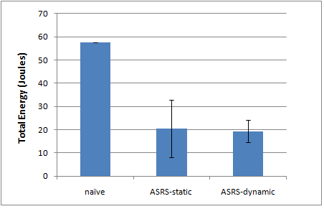
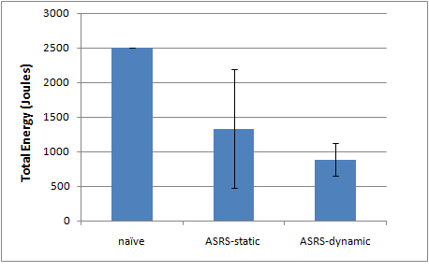
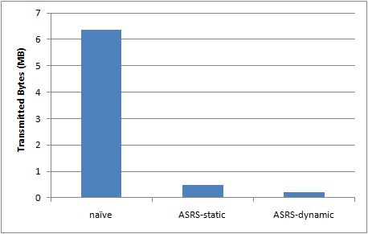
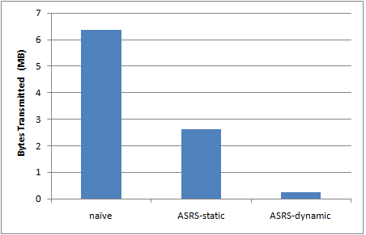
Simulation Results
Bluetooth
802.11
Energy
Bytes

Slide 61
Summary
Pull-based processing paradigm can have a significant impact on data acquisition energy consumption
Ordered evaluation of predicates can help shortcircuit the evaluation and avoid costly data acquisition
We proposed evaluation algorithms based on these two observations to minimize data acquisition cost at CEP engine
Results on synthetic traces show that savings up to 70% are possible.

Slide 62

Real-time Data Analytics for Wind Power Management
Key problem in renewable energy is the variability in supply
Demand is predictable
Accurate and continuous forecasting can help utility company balance the load
Weather forecasting algorithms in streaming mode ?

Slide 63


Scientific Data Warehouses
Massive amount of data (petabyte range)
No updates, append only
Interactive queries + long running analytical queries
Commodity clusters and/or virtualized “cloud” environment
Data-intensive vs Compute-intensive infra-structures ?
Pan-STARRS 1 Telescope
10⁹-pixel camera
30-second exposures
> 2 TB per night
5 * 10⁹ objects
5 * 10¹¹ detections

