Slide 1


Low-Latency Xpath Query Evaluation on Multi-Core Processor
Ben Karsin, Henri Casanova & Lipyeow Lim

Slide 2
Introduction
XML is fast becoming ubiquitous
Many industrial file formats are in XML (eg. FpML, ACCORD, etc.)
Many commercial DBMS include support for XML & XML query languages
XPath is the basis for most XML Query Languages
Inter-query parallelism supported by most DBMS can increase throughput of Xpath queries
Intra-query parallelism still needed to address query latency issues

Slide 3
XML Data Model
XML Document
Tags or element names
<dblp>
<inproceedings key="conf/cikm/HassanzadehKLMW09" >
<author>Oktie Hassanzadeh</author>
<author>Anastasios Kementsietsidis</author>
<author>Lipyeow Lim</author>
<author>Renée J. Miller</author>
<author>Min Wang</author>
<title>
A framework for semantic link discovery over relational data.</title>
<pages>1027-1036</pages>
<year>2009</year>
<booktitle>CIKM</booktitle>
</inproceedings>
</dblp>
dblp
Parent-child relationship
attributes
inproceedings
@key
booktitle
conf…
author
year
CIKM
Oktie…
author
pages
2009
Anast…
author
title
Lipyeow…
author
1027-..
author
Renee…
A framework…
Min…
Text values

Slide 4
Xpath Evaluation
Like file paths in filesystem
Relative vs absolute
Examples:
/dblp/inproceedings/author
//author
//inproceedings[year=2009 and booktitle=CIKM]/title
Results are sequences of nodes.
a node represents an XML fragment for the subtree rooted at that node.
dblp
inproceedings
@key
booktitle
conf…
author
year
CIKM
Oktie…
author
pages
2009
Anast…
author
title
Lipyeow…
author
1027-..
author
Renee…
A framework…
Min…

Slide 5
Problem Statement
How do we parallelize Xpath evaluation on multi-core processors to improve query response time?
➔ Previous work used static partitioning of the work at query compile time
Our parallel evaluation approach partitions the work at runtime
Assumptions:
Rely on existing Xpath processing algorithms
XML data are stored as in-memory DOM trees
Restrict to simple linear Xpaths, consider complex queries later

Slide 6
#1: Static Work Partitioning (SWP)
Sequential
Parallel
Xpath Query: /a/b/c/d/e/f/g
Context
Depth C
Sequential
Evaluate sequentially a prefix of the XPath query (“context”)
Evaluate the rest of the XPath in parallel
Determine prefix and number of parallel work partitions prior to evaluation
limited by # cores
Fixed #
Parallel
Partitions

Slide 7
#2: Work Queue (WQ)
Evaluate context sequentially
Partition the remaining work into W work units
Put work partitions on a shared work queue (spin lock)
Each thread/core will take work units off queue and perform evaluation
Evaluation is complete when queue is empty and threads are done.
Context
Depth C
Sequential
Work
Partitions
Shared Work Queue
read
read
Thread 1
Thread 2

Slide 8
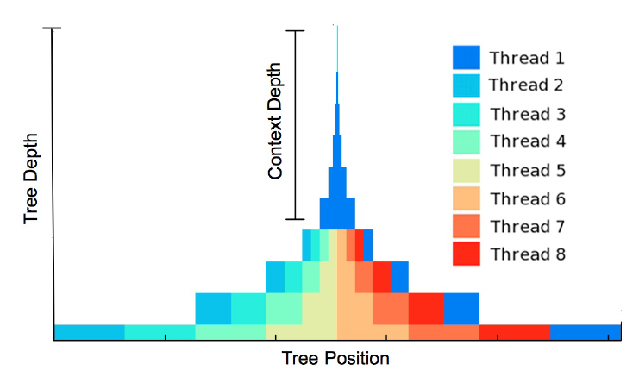
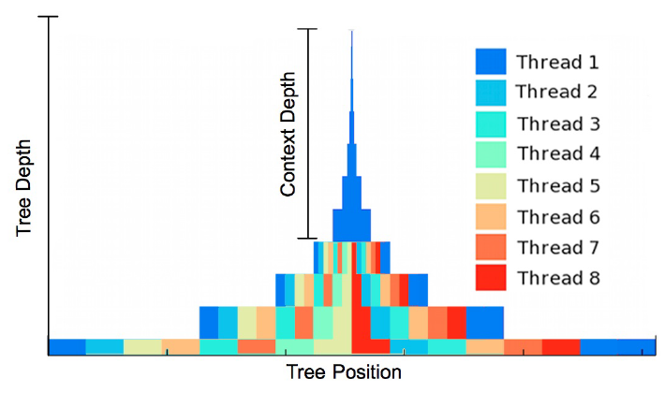
SWP vs WQ
SWP
WQ
Work distributed among 8 threads for each level of a synthetically generated1024-node XML tree using SWP and WQ

Slide 9
#3: Producer-Consumer-Hybrid (PCH)
No explicit sequential phase
Put work unit with root node on queue
Threads take work from queue, do partial evaluation, write further work units onto the queue, repeat.
3 Types of Threads
Producer
Consumer
Hybrid (producer & consumer)
Shared Work Queue
read
write
read
write
Thread 1
Thread 2

Slide 10
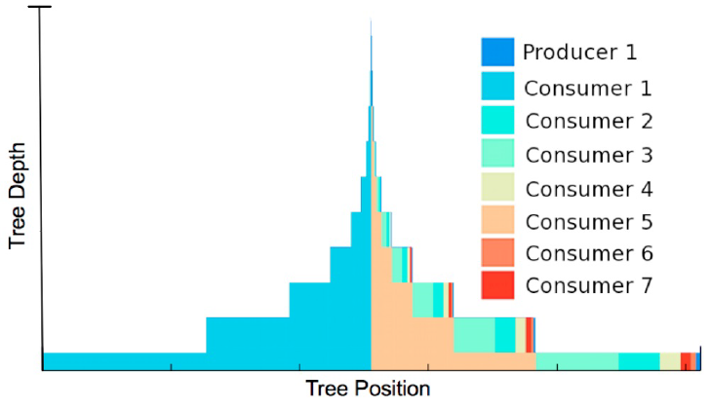
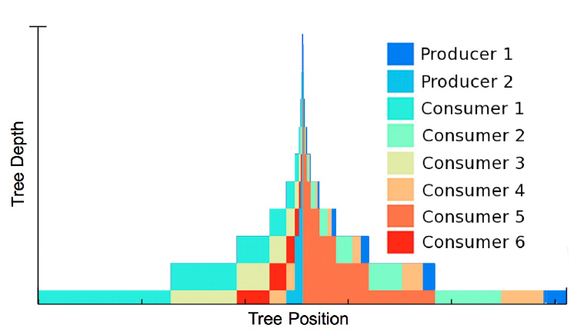
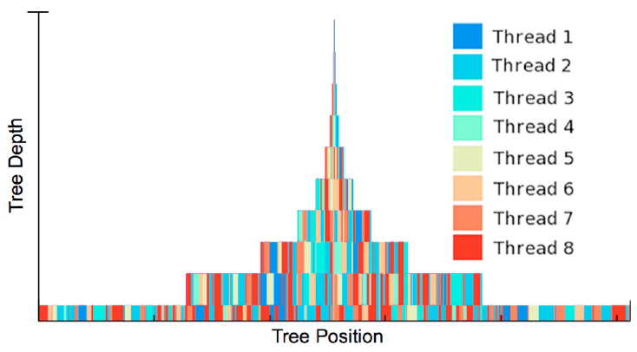
PCH Work Distribution
PCH-1/7/0
PCH-2/6/0
PCH-0/0/8

Slide 11
Experimental Setup
Compute Servers:
Greenwolf: 4-core Intel i7 2.67 GHz
DiRT: 8-core Intel Xeon 2.40 GHz
Hyper-threading disabled
Data Sets
Synthetic XML trees
Real DBLP XML data (900MB)
Xmark Benchmark data
Implementation: C using xerces-c & pthreads

Slide 12
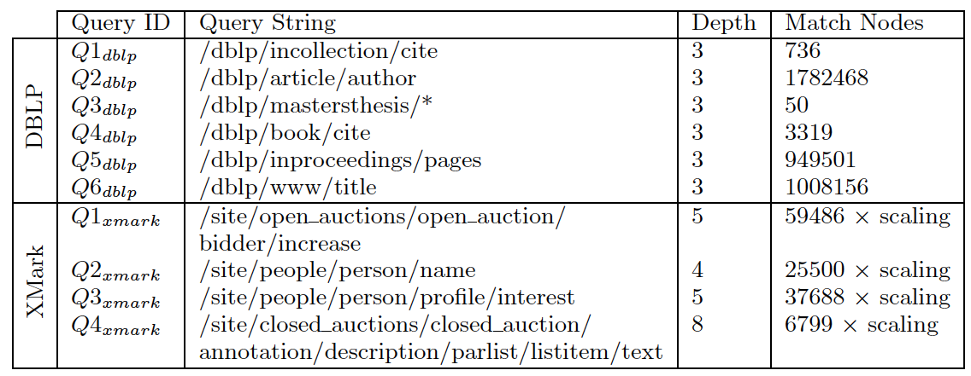
Xpath Queries Used

Slide 13
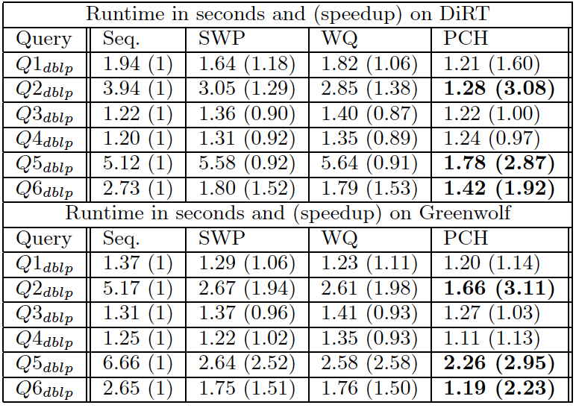
Runtime for DBLP Data
Notes:
Average runtimes of six queries over the DBLP data set on the DiRT and Greenwolf platforms. On three of the
queries, speedup is signicant (shown in boldface), though
on the others there is very little speedup or even slowdown.

Slide 14
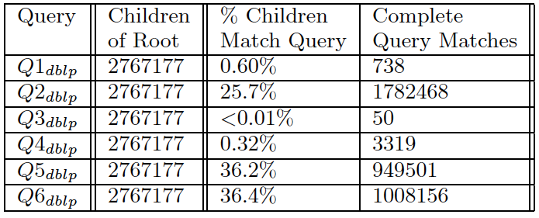
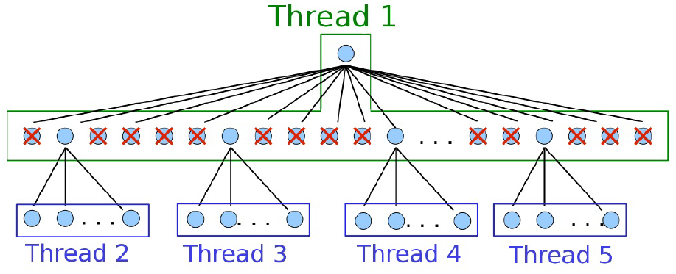
Reason for Speedup
Notes:
Details about the DBLP dataset and queries. The root node has an enormous number of children (over 2.7
million). The three queries that lead to poor parallel performance (Q1dblp, Q3dblp, and Q4dblp) have a very small
number of sub-match nodes. The high initial branch factor and the low number of sub-matches contribute to load
imbalance.

Slide 15
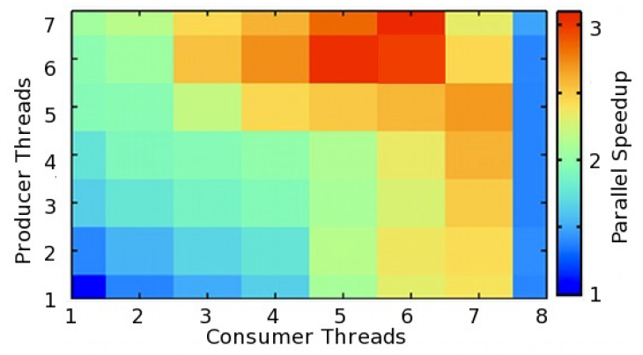
PCH on DBLP Data
Notes:
Parallel speedup achieved by PCH when running Q2dblp on the DBLP dataset using varying p/c/h combinations, on DiRT. The pattern indicates that, as with previous
experiments, the best combination is for PCH-2/1/5, with a maximum speedup of 3.08
.

Slide 16
Conclusion
We propose the PCH approach to parallelize Xpath queries over in-memory XML data
We evaluated the performance of PCH with the SWP and WQ methods.
Hybrid Producer-Consumer threads are beneficial to query latency in combination with pure producer & pure consumer threads.
Exact optimal configuration of PCH requires benchmarking on specific hardware, XML data and query types.

