Slide 1
Podcast Supplement
Asst. Prof. Lipyeow Lim
Information & Computer Science Department
University of Hawaii at Manoa

Slide 2
Approaches to A.I.
Human-oriented
Rationalist
Thinking Humanly
Thinking Rationally
Thinking
Acting Humanly
Acting Rationally
Acting

Slide 3
Acting Humanly: Turing Test (1950)
Human
?
Human
Interrogator
A.I.
Operational test of intelligence
Anticipated all major arguments against AI in following 50 years
Suggested major components of AI: knowledge, reasoning, language understanding, learning

Slide 4
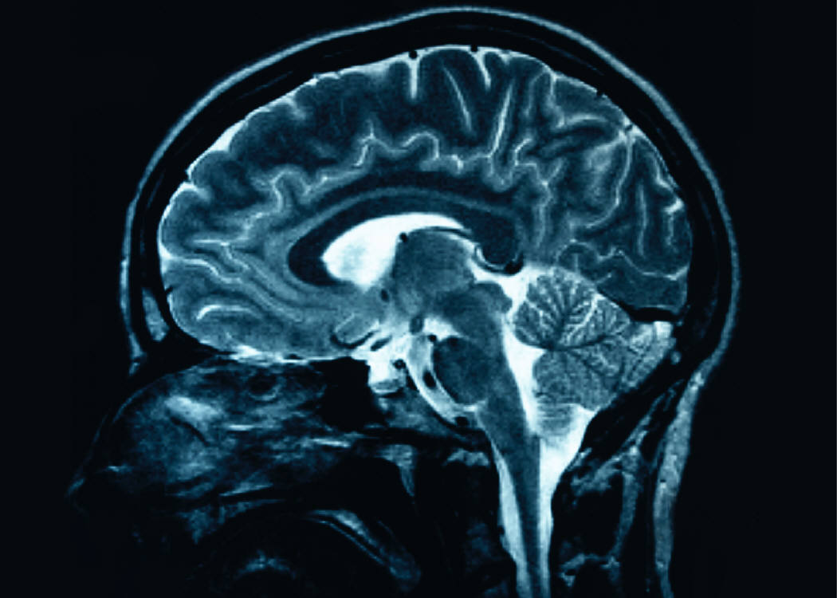
Thinking Humanly : Cognitive Science
AI thinks like humans do
How do humans think ?
How can we find out ?
Introspection
Psychological experiments
Brain imaging
The goal is to formulate computer programs that mimic how humans think and hence achieve AI!

Slide 5
Thinking Rationally
Aristotle: what are correct arguments/thought processes?
Syllogism:
Socrates is a man;
All men are mortal
Therefore Socrates is mortal
Field of logic
AI programs represent knowledge using formal logic and solves problems using logical inference/reasoning.

Slide 6
Acting Rationally
Acting rationally == doing the right thing
What is the “right thing” ?
Logical / rational
maximize goal achievement, given the available information
This approach is the focus of many AI efforts!
AI programs are rational agents : programs that act so as to achieve the best outcome or best expected outcome

Slide 7
Intelligent Agents
Agent
Sensors
Percepts
Environment
Agent Program
Actuators
Actions
Perceives its environment through sensors
Acts upon the environment through actuators
Percepts – perceptual input at any given instant
Agent program implements how to map a sequence of percepts to an action to achieve some goal

Slide 8
Example: Vacuum Robot (“Agent”)
Agent
Percepts
A
B
Sensors
Environment
Agent Program
*********
*********
Actuators
Actions
Goal/outcome: keep two rooms A & B clean.
Percepts: which room it is in and whether the carpet in that room is dirty.
Actions: go Right, go Left, or Suck.

Slide 9
Example: Vacuum Robot Agent Program
Agent
Percepts
A
B
Sensors
Environment
Agent Program
*********
*********
Actuators
Actions
Percept Sequence | Action
[A,Clean] | Go Right
[A, Dirty] | Suck
[B, Clean] | Go Left
[B, Dirty] | Suck
[A, Clean], [A, Clean] | Go Right

Slide 10
Example: Tic-Tac-Toe Agent
0
 | X
Human
Agent
Goal/outcome: Play by the rules and win
Percepts: the tic-tac-toe board and the human’s move on the board.
Actions: put a “0” on any of the empty cell on the board

Slide 11

Example: Car Driving Agent
Agent
Percepts
Sensors
Environment
Agent Program
Actuators
Actions
Goal/outcome: Navigate and drive to destination safely obeying traffic rules
Percepts: its own location, speed, direction, and location, speed, direction of nearby objects
Actions: accelerate, decelerate, hardstop, turn x degrees left, turn x degrees right, maintain speed

Slide 12
Representation & Search
Newell & Simon argue that intelligent activity (human or machine) is achieved by:
Representing significant aspects of a problem using symbol patterns
Generating potential solutions by applying operations on the representation
Selecting a solution by searching among these possibilities

Slide 13
Example: Vacuum Robot
A
B
A
B
A
B
*****
*****
Suck
*****
Right
*****
Suck
State representation:
Cleanliness status of each room
Location of robot
State Transitions (generating possibilities)
Triggered by actions of robot (L, R, S)
Goal states (selecting solutions)
Any state where both rooms are clean
A
B

Slide 14
Example: Vacuum Robot State Space
A
B
R
S
R
A
B
A
B
*****
*****
*****
*****
S
L
L
L
S
L
R
R
A
B
A
B
A
B
*****
S
*****
*****
L
L
R
L
R
S
R
R
S
A
B
S
A
B
*****
L

Slide 15
Example: Tic-Tac-Toe
State representation:
Tic-tac-toe board
Location of X’s and 0’s
State Transitions (generating possibilities)
Triggered by players putting X/0 on empty cells
Goal states (selecting solutions)
Any state where symbols form a line
 | X
Player A
0
 | X
0 |  | X
 | X
Player B
Player A
0 |  | X
0 | X
0 |  | X
0 | X
X
Player B
Player A
Player A Wins !

Slide 16
Example: State Space for Tic-Tac-Toe
x
 | x
 |  | x
x
 | x
 |  | x
...
...
...
...
...
0 |  | x
 | 0 | x
 |  | x
0
 |  | x
 | 0
 |  | x
 |  | 0
 |  | x
 |  | 0
...

Slide 17
Summary
Four different approaches to AI
Acting vs Thinking
Human-oriented vs Rationalist
Intelligent Agents
Sensors
Actuators
Agent Program
Representation and Search
Representing the state of the problem
Generating the state space
Searching the state space for goal states

