Slide 1
ICS 101 Fall 2011 Introduction to Artificial Intelligence
Asst. Prof. Lipyeow Lim
Information & Computer Science Department
University of Hawaii at Manoa

Slide 2
What is Artificial Intelligence ?

Slide 3
What is human intelligence ?

Slide 4
What are signs (activities, abilities etc) of human intelligence ?
Exercise 1: Write down four examples in your worksheet

Slide 5
Approaches to A.I.
Human-oriented
Rationalist
Thinking Humanly
Thinking Rationally
Thinking
Acting Humanly
Acting Rationally
Acting

Slide 6
Definitions of AI (a)
“The exciting new effort to make computer think ... machines with minds, in the full and literal sense.” (Haugeland, 1985)
“[The automation of] activities that associate with human thinking, activities such as decision-making, problem solving, learning ...” (Bellman, 1978)
“The art of creating machines that perform functions that require intelligence when performed by people.” (Kurzweil, 1990)
“The study of how to make computers do things, at the moment, people are better.” (Rich and Knight, 1991)

Slide 7
Definitions of AI (b)
“The study of mental faculties through the use of computational models.” (Charniak and McDermott, 1985)
“The study of the computations that make it possible to perceive, reason, and act.” (Winston, 1992)
“Computational Intelligence is the study of the design of intelligent agents.”(Poole et al., 1998)
“AI ... is concerned with intelligent behavior in artifacts.” (Nilsson, 1998)

Slide 8
Acting Humanly: Turing Test (1950)
Human
?
Human
Interrogator
A.I.
Operational test of intelligence
Anticipated all major arguments against AI in following 50 years
Suggested major components of AI: knowledge, reasoning, language understanding, learning

Slide 9
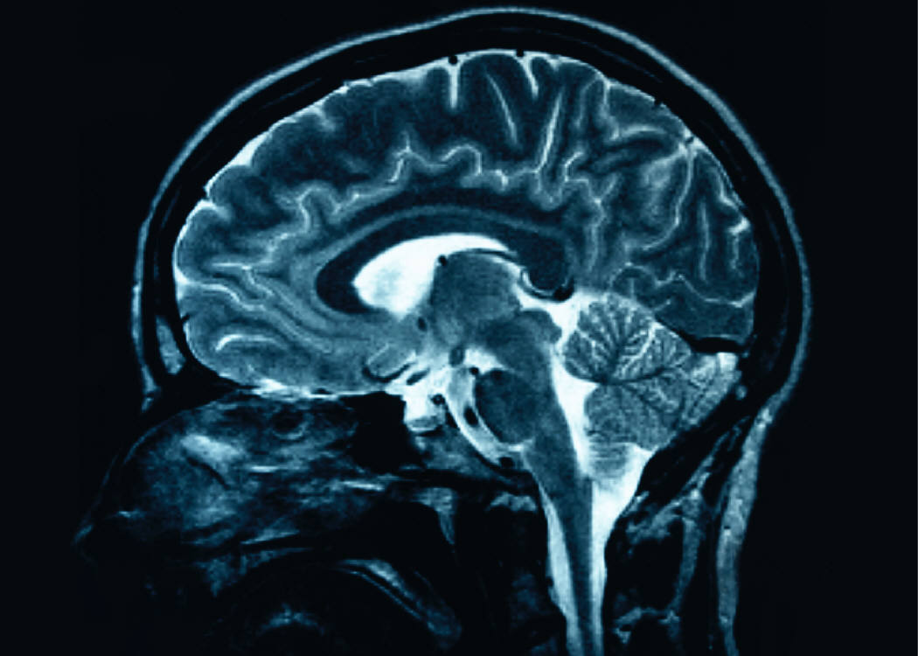
Thinking Humanly : Cognitive Science
AI thinks like humans do
How do humans think ?
How can we find out ?
Introspection
Psychological experiments
Brain imaging
The goal is to formulate computer programs that mimic how humans think and hence achieve AI!

Slide 10
Thinking Rationally
Aristotle: what are correct arguments/thought processes?
Syllogism:
Socrates is a man;
All men are mortal
Therefore Socrates is mortal
Field of logic
AI programs represent knowledge using formal logic and solves problems using logical inference/reasoning.

Slide 11
Acting Rationally
Acting rationally == doing the right thing
What is the “right thing” ?
Logical / rational
maximize goal achievement, given the available information
This approach is the focus of many AI efforts!
AI programs are rational agents : programs that act so as to achieve the best outcome or best expected outcome

Slide 12
AI Today
Robotic Vehicles: Google Self-Drive Car
Speech Recognition: Call routing, Call center
Autonomous planning: Mars Rover
Game Playing: Deep Blue, Watson
Spam Fighting
Logistic Planning: Dynamic Analysis & Replanning Tool (DART)
Robotics : Roomba
Machine Translation

Slide 13
Intelligent Agents
Agent
Percepts
Sensors
Environment
Agent Program
Actuators
Actions
Perceives its environment through sensors
Acts upon the environment through actuators
Percepts – perceptual input at any given instant
Agent program implements how to map a sequence of percepts to an action

Slide 14
Example: Vacuum Robot
A
B
************
************
Vacuum Robot (“agent”) needs to keep two rooms A & B clean. It can sense which room it is in and whether the carpet in that room is dirty. It can either go Right, go Left, or Suck.

Slide 15
Example: Vacuum Robot Agent Program
Agent
Percepts
A
B
Sensors
Environment
Agent Program
*********
*********
Actuators
Actions
Percept Sequence | Action
[A,Clean] | Go Right
[A, Dirty] | Suck
[B, Clean] | Go Left
[B, Dirty] | Suck
[A, Clean], [A, Clean] | Go Right

Slide 16
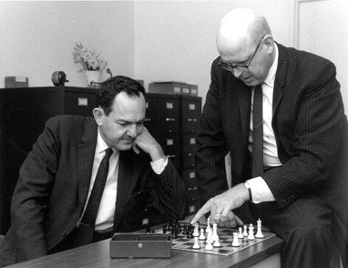
Representation & Search
Newell & Simon argue that intelligent activity (human or machine) is achieved by:
Representing significant aspects of a problem using symbol patterns
Generating potential solutions by applying operations on the representation
Selecting a solution by searching among these possibilities

Slide 17
Example: Tic-Tac-Toe
2 Player Game: Each gets a symbol 0 or X
Each player tries to get 3 of his/her symbol in a row/column/diagonal in a 3 by 3 grid.
 | X
0
 | X
0 |  | X
 | X
0 |  | X
0 | X
Player A
Player B
Player A
Player B
0 |  | X
0 | X
X
Player A Wins !
Player A

Slide 18
Example: State Space for Tic-Tac-Toe
x
 | x
 |  | x
x
 | x
 |  | x
...
...
...
...
...
0 |  | x
 | 0 | x
 |  | x
0
 |  | x
 | 0
 |  | x
 |  | 0
 |  | x
 |  | 0
...

Slide 19
Exercise
Draw the state space for the vacuum robot starting from the following initial state for the next two state transitions.
A
B
************
************

