Slide 1
ICS 101 Fall 2013 Introduction to Data Management
Asst. Prof. Lipyeow Lim
Information & Computer Science Department
University of Hawaii at Manoa

Slide 2

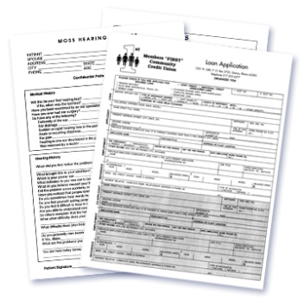


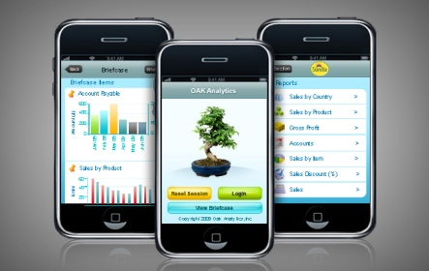
The Data Management Problem
Where is the photo I took last Christmas ?
User
Where did I read about “Turing Machines” ?
Queries
Where is the invoice for this computer ?
?
Which product is the most profitable ?
Data

Slide 3
What is a DBMS ?
A database management system (DBMS) is a collection of programs that enables users to
Create new DBs and specify the structure using data definition language (DDL)
Query data using a query language or data manipulation language (DML)
Store very large amounts of data
Support durability in the face of failures, errors, misuse
Control concurrent access to data from many users

Slide 4
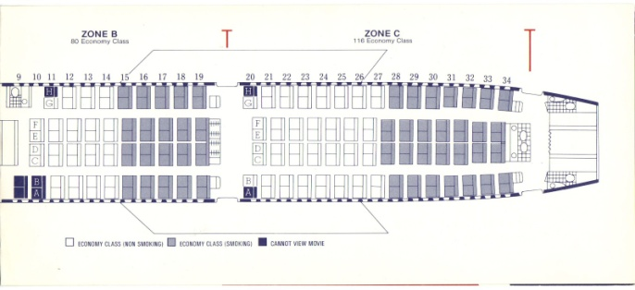
Transactions
A transaction is the DBMS’s abstract view of a user’s sequence of action.
A DBMS supports multiple users, hence
Multiple transactions may be running concurrently.
Eg. User 1 views available seats and reserves seat 22A.
Eg. User 2 views available seats and reserves seat 22A.
Eg. User 3 views available seats and reserves seat 23D.
Airline Reservation
Database

Slide 5
ACID Properties of Transactions
Atomicity : all-or-nothing execution of transactions
Consistency: constraints on data elements are preserved
Isolation: each transaction executes as if no other transaction is executing concurrently
Durability: effect of an executed transaction must never be lost

Slide 6
Atomicity
A transaction might
commit after completing all its actions, or
abort (or be aborted by the DBMS) after executing some actions.
DBMS guarantees that all transactions are atomic
A user can think of a Xact as always executing all its actions in one step, or not executing any actions at all.
Key technique for ensuring atomicity is logging
DBMS logs all actions so that it can undo the actions of aborted transactions.

Slide 7
Example (Atomicity)
T1: BEGIN
A=A+100
B=B-100
END
T2: BEGIN
A=1.06*A
B=1.06*B
END
The first transaction is transferring $100 from B’s account to A’s account.
The second is crediting both accounts with a 6% interest payment
There is no guarantee that T1 will execute before T2 or vice-versa, if both are submitted together. However, the net effect must be equivalent to these two transactions running serially in some order.

Slide 8
Serial Executions
A = 100, B = 200
T1 | T2
A=A+100
B=B-100
 | A=1.06*A
 | B=1.06*B
A = 200, B = 200
A = 200, B = 100
A = 212, B = 100
A = 212, B = 106
T1 | T2
 | A=1.06*A
 | B=1.06*B
A=A+100
B=B-100
A = 100, B = 200
A = 106, B = 200
A = 106, B = 212
A = 206, B = 212
A = 206, B = 112

Slide 9
Example (Serializability)
A = 100, B = 200
T1 | T2
A=A+100
 | A=1.06*A
B=B-100
 | B=1.06*B
A = 100, B = 200
T1 | T2
A=A+100
 | A=1.06*A
 | B=1.06*B
B=B-100
A = 200, B = 200
A = 200, B = 200
A = 212,
B = 200
A = 212, B = 200
A = 212, B = 100
A = 212,
B = 212
equivalent
A = 212, B = 106
A = 212, B = 112
T1 | T2
A=A+100
B=B-100
 | A=1.06*A
 | B=1.06*B

Slide 10
Scheduling Transactions
Serial schedule: Schedule that does not interleave the actions of different transactions.
Equivalent schedules: For any database state, the effect (on the set of objects in the database) of executing the first schedule is identical to the effect of executing the second schedule.
Serializable schedule: A schedule that is equivalent to some serial execution of the transactions.
(Note: If each transaction preserves consistency, every serializable schedule preserves consistency.)

Slide 11
Consistency
A transaction must leave the database in a consistent state.
Criteria for consistency is application dependent. Examples include
Date of birth must be in YYYYMMDD format
Name fields can only contain alphanumeric characters
Bank account balances cannot be negative

Slide 12
Ensuring Isolation
Scheduling concurrent transactions
DBMS ensures that execution of {T1, ... , Tn} is equivalent to some serial execution T1’ ... Tn’.
Idea: use locks to serialize access to shared objects
Strict 2 Phase locking protocol:
Before reading/writing an object, a transaction requests a lock on the object, and waits till the DBMS gives it the lock.
All locks are released at the end of the transaction.
What if Tj already has a lock on Y and Ti later requests a lock on Y? (Deadlock!) Ti or Tj is aborted and restarted!

Slide 13
Durability
Effects of completed transactions persists even if system crashes before all changes are written out to disk
Use a Write Ahead Log to record:
T writes an object: the old value and the new value.
Log record must go to disk before the DB is changed! (Write Ahead Log property)
T commits/aborts: a log record indicating this action.
Log records are chained together by Xact id, so it’s easy to undo a specific Xact.
Log is often duplexed (i.e. replicated on a second disk) and archived on stable storage.

