Slide 1
ICS 101 Fall 2013 Networking and the Internet
Asst. Prof. Lipyeow Lim
Information & Computer Science Department
University of Hawaii at Manoa

Slide 2
Problem
Ancient cities G and R have a made a pact that each will come to the (military) aid of the other if one is in trouble.
Ancient
City G
Ancient
City R
150 miles
G & R are 150 miles apart.
How can they send a message for help quickly ?

Slide 3
LOTR: Beacon of Gondor
Gondor
150 miles
Rohan
Video: http://www.youtube.com/watch?v=i6LGJ7evrAg
Transmission medium: air- line of sight
Data encoding: 1 bit – fire or no fire
All receivers have to be listening
Agreed upon interpretation of the signal at the endpoints
Intermediate beacon wardens are always looking for a signal and relaying the signal
One way communication

Slide 4
Modern Computer Networks
Host
computer
Host computer
Router
Router
Router
Host computer
Ethernet or WiFi
Fibre optic cables
Local area network
Signaling technology can transmit complex sequences of bits - packets
Each host or router obeys a set of rules for how to handle incoming/outgoing messages – communication protocols
Communications can be multi-way
Bandwidth: the number of bits that can be transferred per second (bps)
Latency: the time it takes for a message to reach the destination after leaving the source

Slide 5
Quiz 1
What is the bandwidth between two communicating nodes A & B?
How long it takes for 1 bit to travel from A to B
How much data can travel from A to B in one unit time
How far apart A and B are
How long it takes a beam of light to travel from A to B

Slide 6
Quiz 2
What is the latency between two communicating nodes A & B ?
How long it takes for 1 bit to travel from A to B
How much data can travel from A to B in one unit time
How far apart A and B are
How long it takes a beam of light to travel from A to B

Slide 7

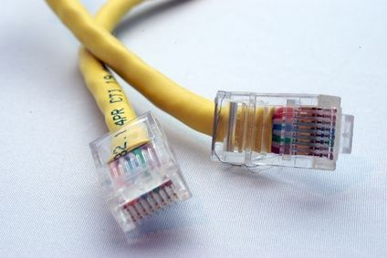
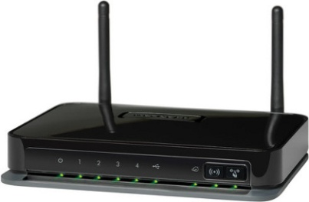
Local Area Networks
Wired (UTP Cat5) or Wireless 802.11
Connects hosts within a limited spatial region together to form a network
All hosts within the network can “talk” to each other
The network is often a shared medium: only one host can talk at one time and the rest listens.

Slide 8
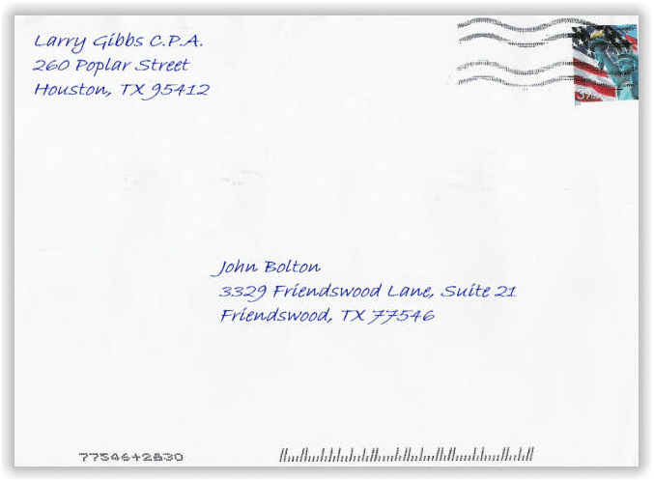
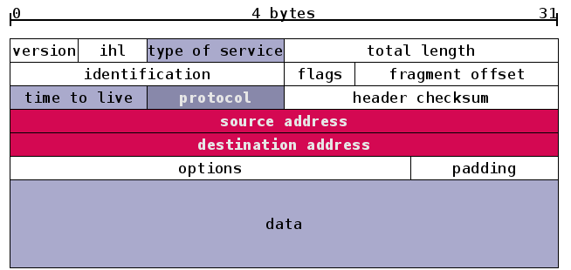
Data Packet
How messages are packaged for delivery on the network – like postal mail.
Source and destination addresses

Slide 9
Network Abstractions
Network communications are conceived as layers of abstractions.
Each layer plays a specific role and is relatively independent of other layers
Each layer has its own packet format
Packets from higher layers are embedded in packets of lower layers – “encapsulation”
Network
Application
Transport
Internet
Link
Application
Transport
Internet
Link
Application
Transport
Internet
Link
Physical Network

Slide 10
TCP/IP Four Layer Model
Process to process: communicates data to other processes/applications on the same host or on other hosts
Eg. SMTP, FTP, SSH, HTTP
Application
Transport
Internet
Link
Host to host: communicates data to other host on the same network on on other networks
Hides the topology of the network
Flow control, error correction, connection control
Eg. TCP, UDP
Inter-network: communicates data to other networks
Deals with addressing and routing of datagrams to next network
Eg. IPv4, IPv6
Transmit data to other network interfaces on the local network
Eg. Ethernet, WiFi 802.11

Slide 11
Link Layer
Eg. Ethernet, WiFi 802.11
A host can have multiple network interface cards (eg. Laptops typically have an ethernet interface and a WiFi interface)
Each interface has a 48-bit physical address that is hardwired to the hardware
Application
Transport
Internet
Link
Application
Transport
Internet
Link
Physical Network
Data packet arrives from upper layer (Internet layer)
If packet is too big, break packet into smaller fragments (`frames’)
Embed data packet in a link layer packet with link layer header, sequence number, error correction code etc.
Link layer packets gets transmitted on physical link
Link layer protocol governs how transmission over physical link is done. Eg. Carrier sense multiple access
Bottom-up process is similar on the receiving host

Slide 12
Internet Layer
Eg. IPv4
Connects multiple networks together.
Each network interface of a host is associated with an 32-bit IPv4 address
IP address is not hardwired, but assigned in the software
Application
Transport
Internet
Link
Application
Transport
Internet
Link
Physical Network
Data packet arrives from Transport layer
Embed data packet in an IPv4 packet with IP header etc.
Pass packet to Link layer
Data packet arrives from Link layer
Check IP header if packet destination is for this host. If yes, strip header and pass to Transport layer
Otherwise forward packet (routing)

Slide 13
IPv4 Addresses & Domain Name Service
Network Address
Host Address
128 | 171 | 10 | 13
0
16
31
IP addresses are 32 bit numbers often written in 4 octets: 128.171.10.13
Each address is also split into two parts
Prefix is the network address
Suffix is the host address within that network
Domain Name Servers provide a service that translates more meaningful names to IP addresses
Uhunix.hawaii.edu = 128.171.24.197
www2.hawaii.edu = 128.171.224.150

Slide 14
IPv4 & Inter-network Routing
host
host
Application
Transport
Internet
Link
Application
Transport
Internet
Link
Router
Router
Internet
Link
Internet
Link
Ethernet Network
Fibre Network
Ethernet Network
For routers
Examine destination IP address
Look up routing tables to determine outgoing network
Pass packet to link layer of that outgoing network
Best effort delivery – no guarantees!

Slide 15
Transport Layer
Eg. TCP (connection-oriented), UDP
End-to-end message transfer between hosts applications
Each application on a host is associated with a port number
IP address + port number will identify an application end-point
Application
Transport
Internet
Link
Application
Transport
Internet
Link
Physical Network
TCP provides a reliable communication channel between two host applications by addressing several issues
Data packets arriving out of order
Data packets are corrupted
Same packets arriving more than once
Some packets are lost/discarded
Traffic congestion control

Slide 16
Applications: Email
Mail Client
Mail Server
Mail Server
Mail Client
POP/IMAP/SMTP
Transport: TCP
Internet: IPv4
Link
POP/IMAP/SMTP
Transport: TCP
Internet: IPv4
Link
POP/IMAP/SMTP
Transport: TCP
Internet: IPv4
Link
POP/IMAP/SMTP
Transport: TCP
Internet: IPv4
Link
Network
Internet
Network
Your email client program downloads incoming emails from mail server (imap.gmail.com pop.gmail.com)
Outgoing emails are sent to mail server (smtp.gmail.com)
Mail servers handle the routing of emails using SMTP protocol which operates on port 25 or 587
Lookup IP address of destination hostname in the email address using DNS
Relaying email as packets to that IP address

Slide 17
Sample Email Header
Delivered-To: strev@guhrelay.hawaii.edu
Received: by 10.58.145.6 with SMTP id sq6csp687725veb; Mon, 3 Sep 2012
20:39:01 -0700 (PDT)
Received: by 10.68.129.38 with SMTP id nt6mr43102232pbb.76.1346729940698; Mon,
03 Sep 2012 20:39:00 -0700 (PDT)
Return-Path: <postmaster@laulima.hawaii.edu>
Received: from mta11.its.hawaii.edu (mta11.its.hawaii.edu. [128.171.224.147])
by mx.google.com with ESMTPS id px6si25354378pbc.214.2012.09.03.20.38.53
(version=TLSv1/SSLv3 cipher=RC4-MD5); Mon, 03 Sep 2012 20:39:00 -0700 (PDT)
Received-SPF: pass (google.com: domain of postmaster@laulima.hawaii.edu
designates 128.171.224.58 as permitted sender) client-ip=128.171.224.58;
Authentication-Results: mx.google.com; spf=pass (google.com: domain of
postmaster@laulima.hawaii.edu designates 128.171.224.58 as permitted sender)
smtp.mail=postmaster@laulima.hawaii.edu
MIME-version: 1.0
Content-type: multipart/mixed; boundary="Boundary_(ID_3RY8N2VbJHb4tH5siR1eww)"
Received: from pmx11.its.hawaii.edu (pmx11.its.hawaii.edu [128.171.224.58]) by
mta11.its.hawaii.edu (Sun Java(tm) System Messaging Server 6.3-11.01 (built
Feb 12 2010; 32bit)) with ESMTP id <0M9T0071I3GJ4F40@mta11.its.hawaii.edu>;
Mon, 03 Sep 2012 17:38:45 -1000 (HST)
Received: from kuhi.its.hawaii.edu (kuhi.its.hawaii.edu [128.171.25.223]) by
pmx11.its.hawaii.edu (Postfix) with ESMTP id E587118C023; Mon, 03 Sep 2012
17:38:42 -1000 (HST)
Received: from sak24.its.hawaii.edu (sak24.its.hawaii.edu [128.171.225.199])
by kuhi.its.hawaii.edu (8.12.10/8.12.6) with ESMTP id q843ccvH023430; Mon, 03
Sep 2012 17:38:38 -1000 (HST)
Date: Mon, 03 Sep 2012 17:38:33 -1000 (HST)
From: Dennis Streveler <strev@hawaii.edu>
Cc: "strev@hawaii.edu" <strev@hawaii.edu>
Message-id: <112987554.2310.1346729913602.JavaMail.sakai@sak24.its.hawaii.edu>
Subject: ICS 101 Help: Tuesday lecture -- Everything you THOUGHT you knew
about NETWORKS and then some
X-Mailer: sakai-mailsender

Slide 18
Applications: HTTP
HTTP Client
HTTP Server
Hyper-Text Transfer Protocol (port 80)
Request-response protocol
When http://www2.hawaii.edu/~lipyeow/index.html is entered into a web browser (http client)
HTTP
Transport: TCP
Internet: IPv4
Link
HTTP
Transport: TCP
Internet: IPv4
Link
Internet
GET /~lipyeow/index.html HTTP/1.1
host: www2.hawaii.edu
HTTP/1.1 200 OK
Date: Sun, 02 Sep 2012 00:35:40 GMT
Server: Apache
Last-Modified: Tue, 21 Aug 2012 01:27:18 GMT
ETag: "7d3e8-2950-4c7bc86e86980"
Accept-Ranges: bytes
Content-Length: 10576
Content-Type: text/html
<!DOCTYPE HTML PUBLIC "-//W3C//DTD HTML 4.0 Transitional//EN"> <HTML> ...

Slide 19
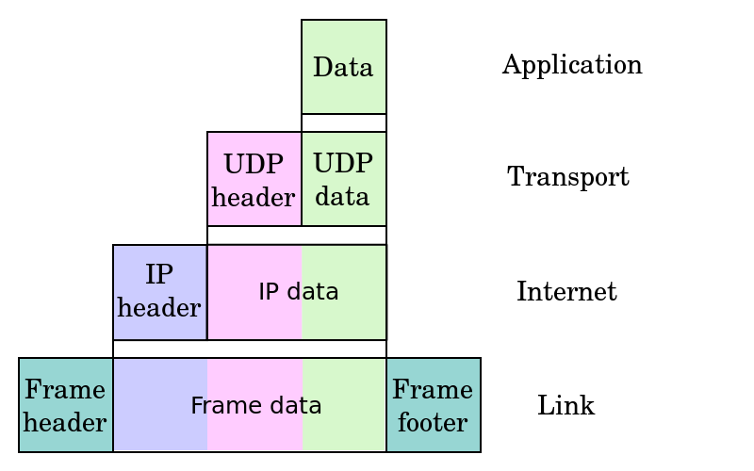
Internet Security
All data transmitted on the network using the protocols described thus far are in plaintext
Anyone with access to the physical network link can snoop on the bit sequences and decode according to the protocol stack!
Anyone can read your emails if he/she has access to a link on which your email packets are transmitted
Use encrypted connections eg. SSL/TLS

Slide 20
Secure HTTP -- HTTPS
Certificate Authority
HTTPS Client
verify certificate
verify certificate
HTTP SSL/TLS
Transport: TCP
Internet: IPv4
Link
certificate
HTTP SSL/TLS
Transport: TCP
Internet: IPv4
Link
certificate
session key
HTTP messages
HTTPS Server
Use HTTP over a SSL/TLS layer (port 443)
Negotiate a stateful encrypted connection to carry the HTTP messages.
Use a trusted 3rd party (CA) to verify identity
Use public key handshake to establish a session key
Encrypt subsequent messages using session key

Slide 21
Worksheet Questions
Packets are the unit of transfer between two communicating nodes. Name two fields in a packet format.
Recall the TCP/IP 4-layer model. Name one possible protocol/technology at the link layer.

